Slide 1
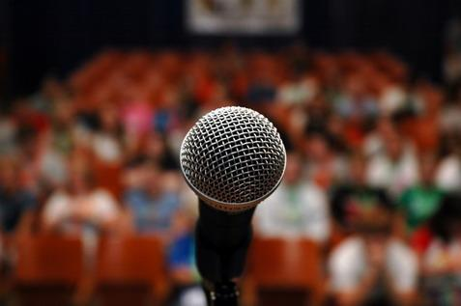
Public Speaking/ How to Lead a Dialogue
Claire & Geo

Slide 2
Know your material
Know your material.
*Pick a topic you are interested in.
*Use
-humor
-stories
-conversational language

Slide 3
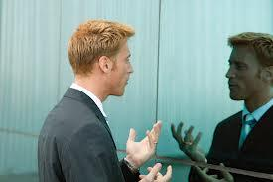
Practice
2. Practice. Practice. Practice!
*Rehearse out loud
*Work to control filler words
*Practice with a timer

Slide 4
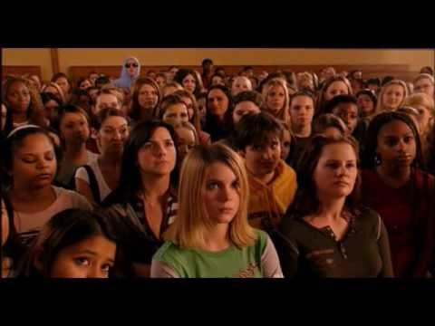
Know the audience
*Greet some of the audience members as they arrive.
*It’s easier to speak to a group of friends than to strangers.

Slide 5
Know the room
4. Know the room.
*Arrive early
*Walk around the speaking area and practice using the microphone and any visual aids.

Slide 6
Relax
*Begin by addressing the audience.
*Pause, smile and count to three before saying anything.

Slide 7
Visualize yourself giving your speech
6. Visualize yourself giving your speech.
*Imagine yourself speaking, your voice loud, clear and confident. *Visualize the audience clapping – it will boost your confidence.

Slide 8
People want you to succeed
7. Realize that people want you to succeed.
*Audiences want you to be interesting, stimulating, informative and entertaining.
*They’re rooting for you!! :)

Slide 9
Don’t apologize
8. Don’t apologize for any nervousness or problem – the audience probably never noticed it.

Slide 10
Concentrate on the message
9. Concentrate on the message – not the medium.
*Focus your attention away from your own anxieties and concentrate on your message and your audience.

Slide 11
Gain experience
10. Gain experience.
*Your speech should represent you — as an authority and as a person.
*Experience builds confidence, which is the key to effective speaking.

Slide 12
Group Activity
Divide your group into pairs.
Each person interviews the other in turn. The information gained forms the basis of a brief introduction speech they'll give when the interviewing process is complete.
Ask them to find out their partner's name, where they live/work, what hobbies they have, what their favorite book, film, song...is, what they're most proud of (an achievement perhaps), what they hope for from the class, something funny that happened in their childhood, where they go for holidays, what they think about the latest local issue ...
When the group comes back together the introductions begin: "This is Mary from Taupo. When she's not working for the Social Welfare Department she's collecting stamps. Her favorites are ..."
- See more at: http://www.write-out-loud.com/public-speaking-activities.html#sthash.K3Xos4Vs.dpuf

Slide 13
Sources
http://www.write-out-loud.com/public-speaking-activities.html
http://www.toastmasters.org/tips.asp

