Slide 1


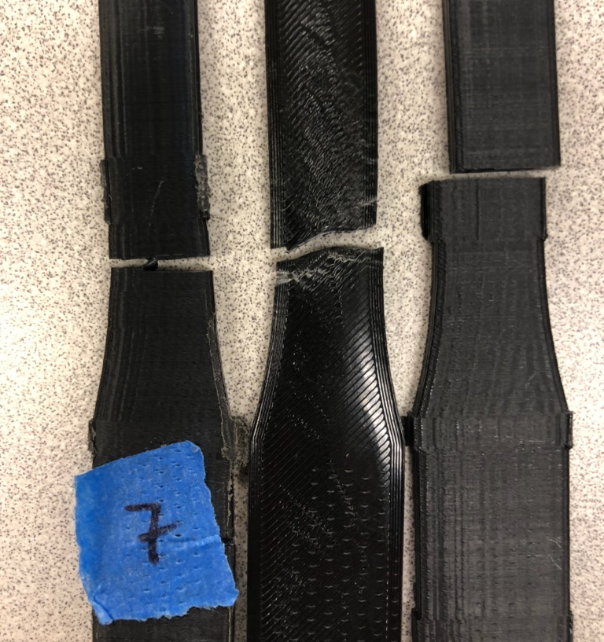
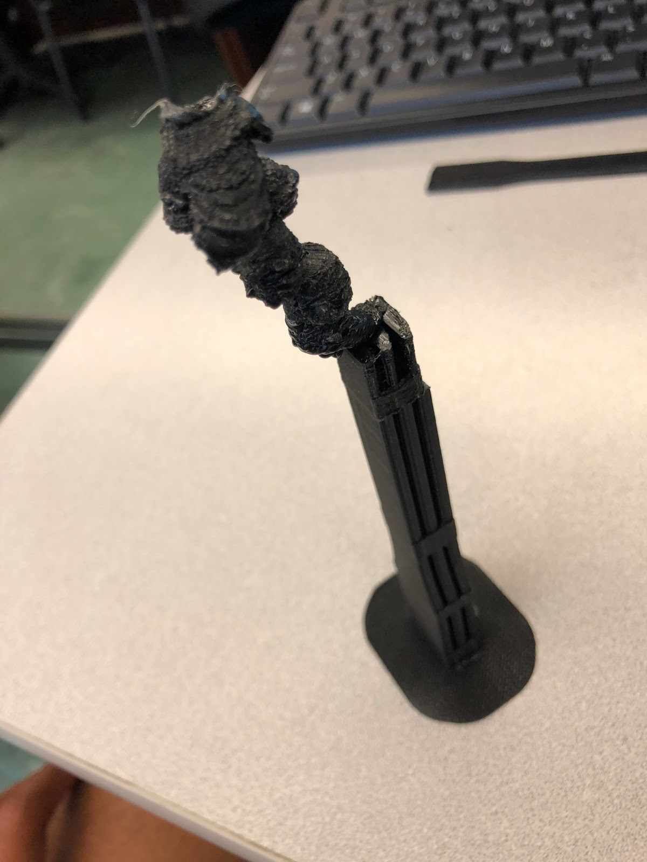
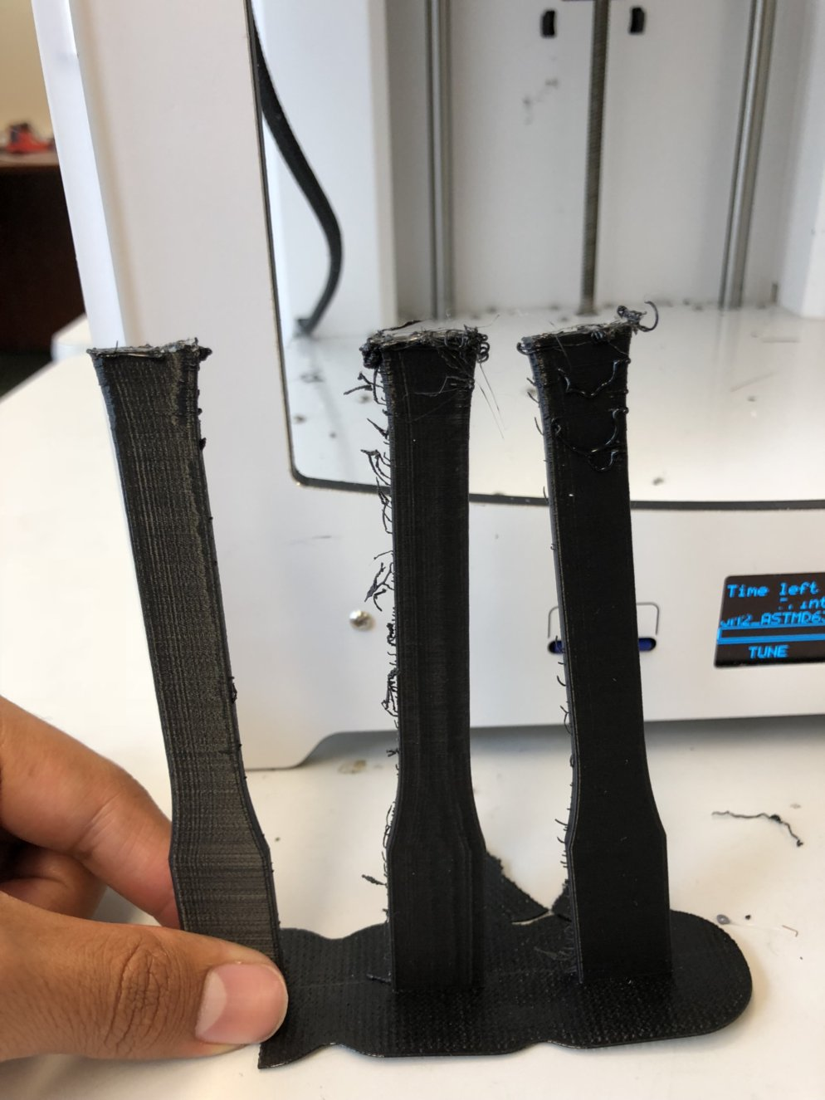
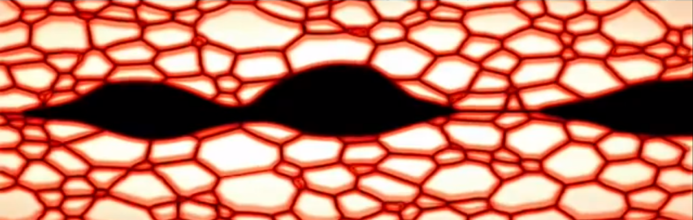
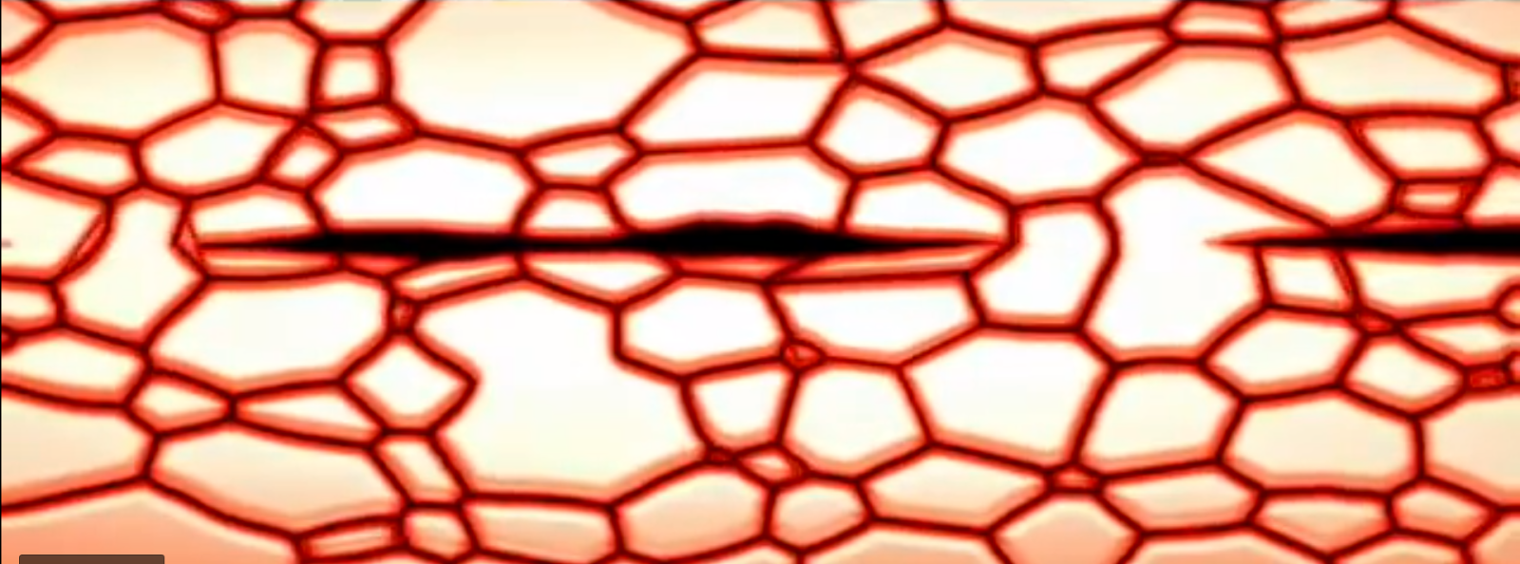
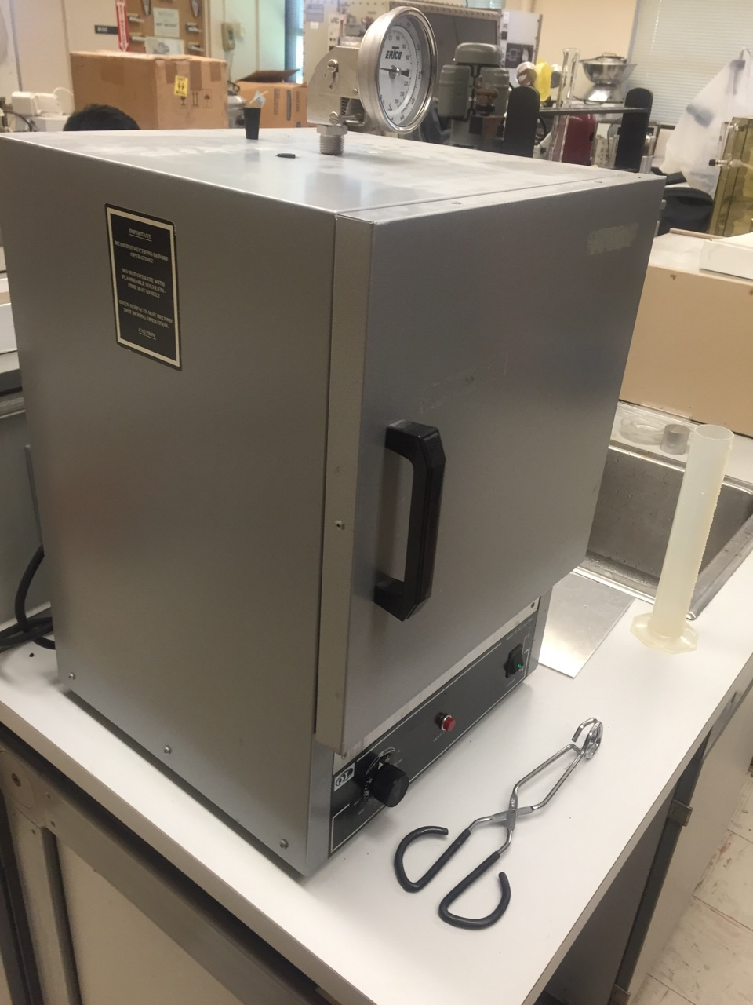
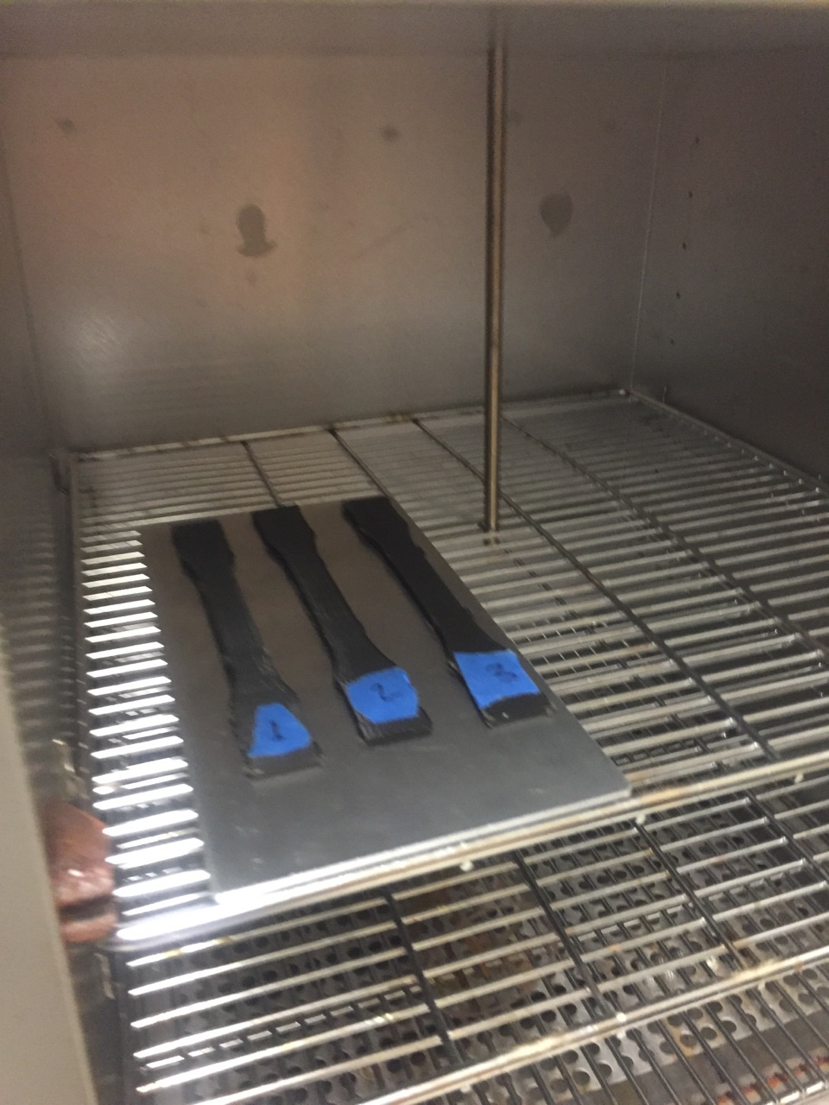
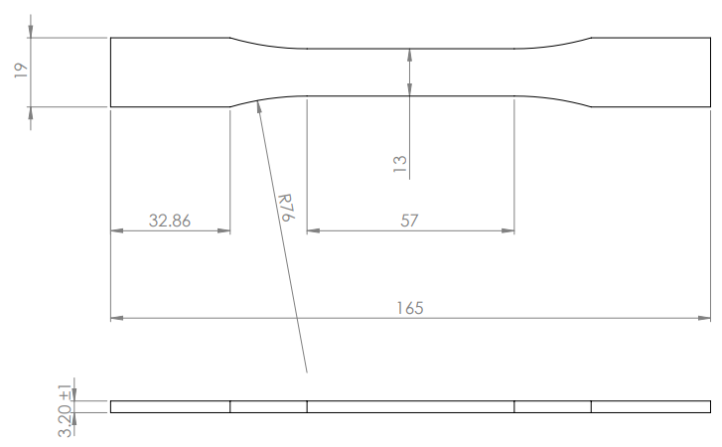
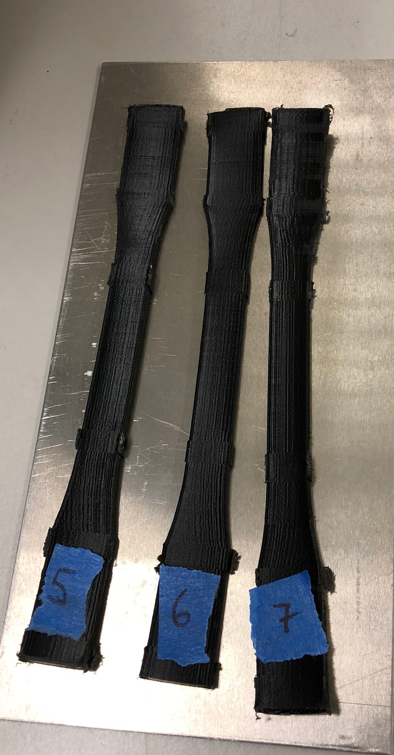
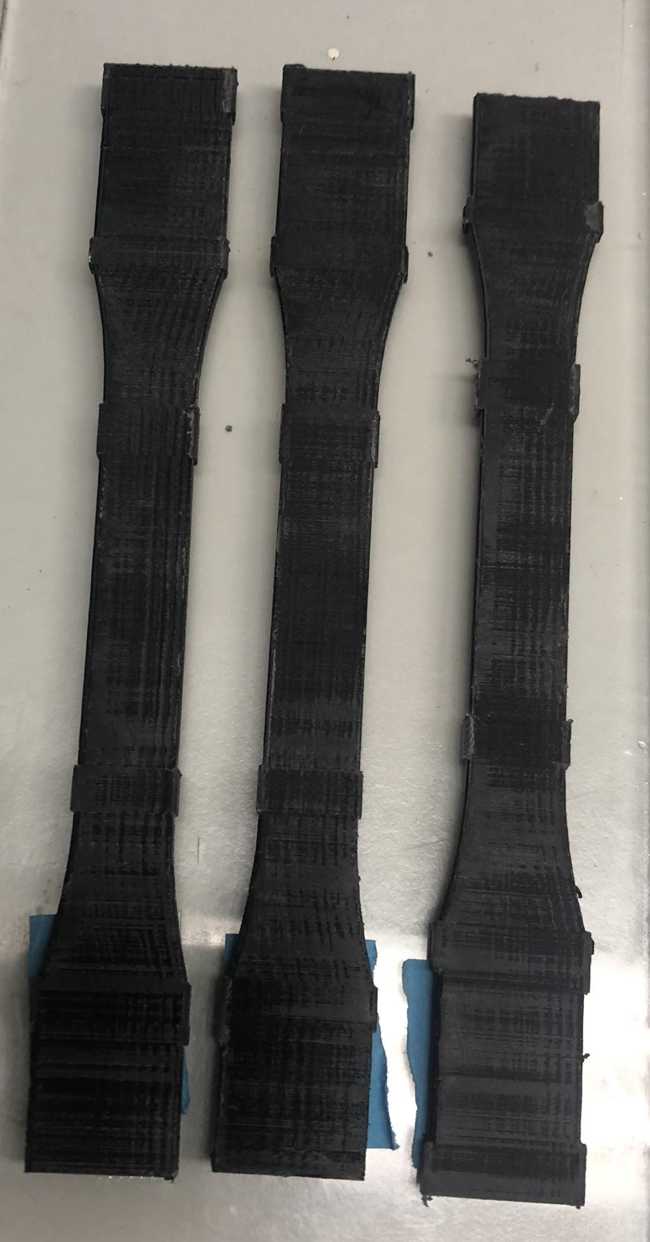
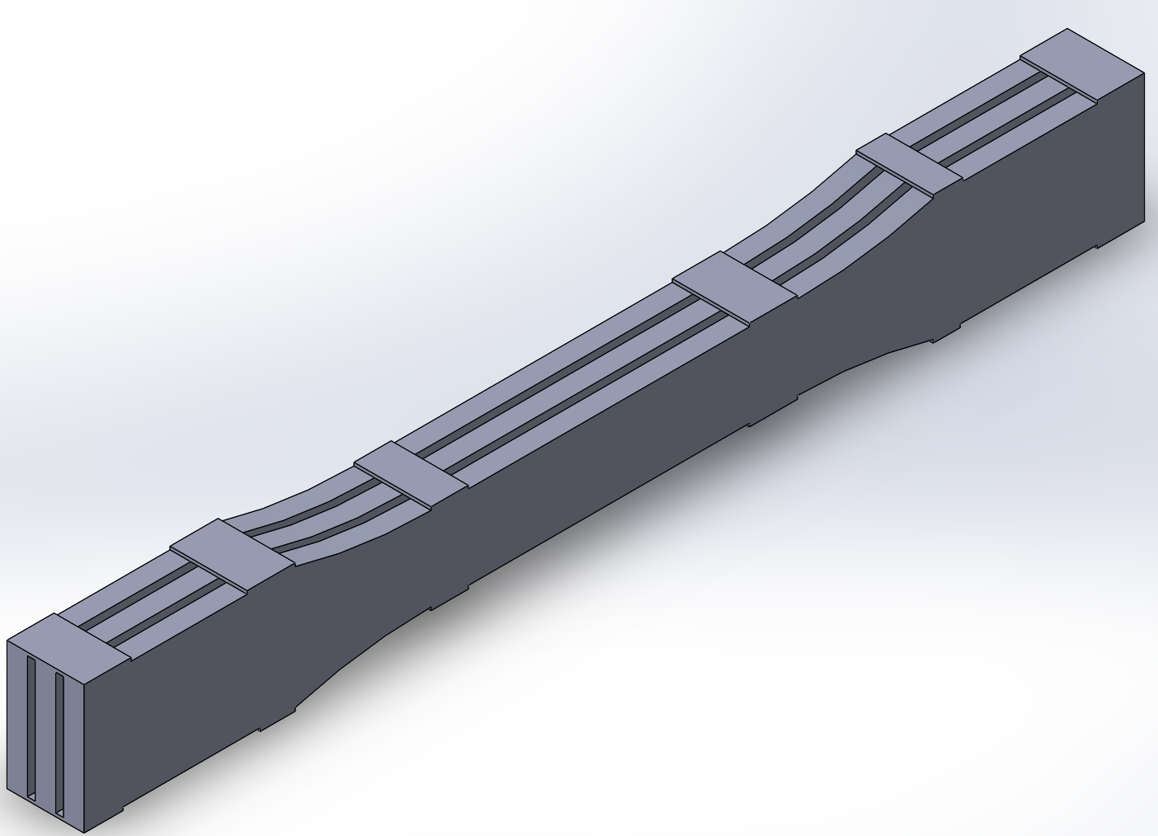
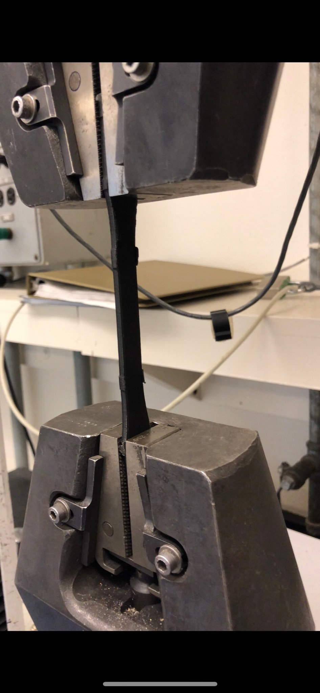
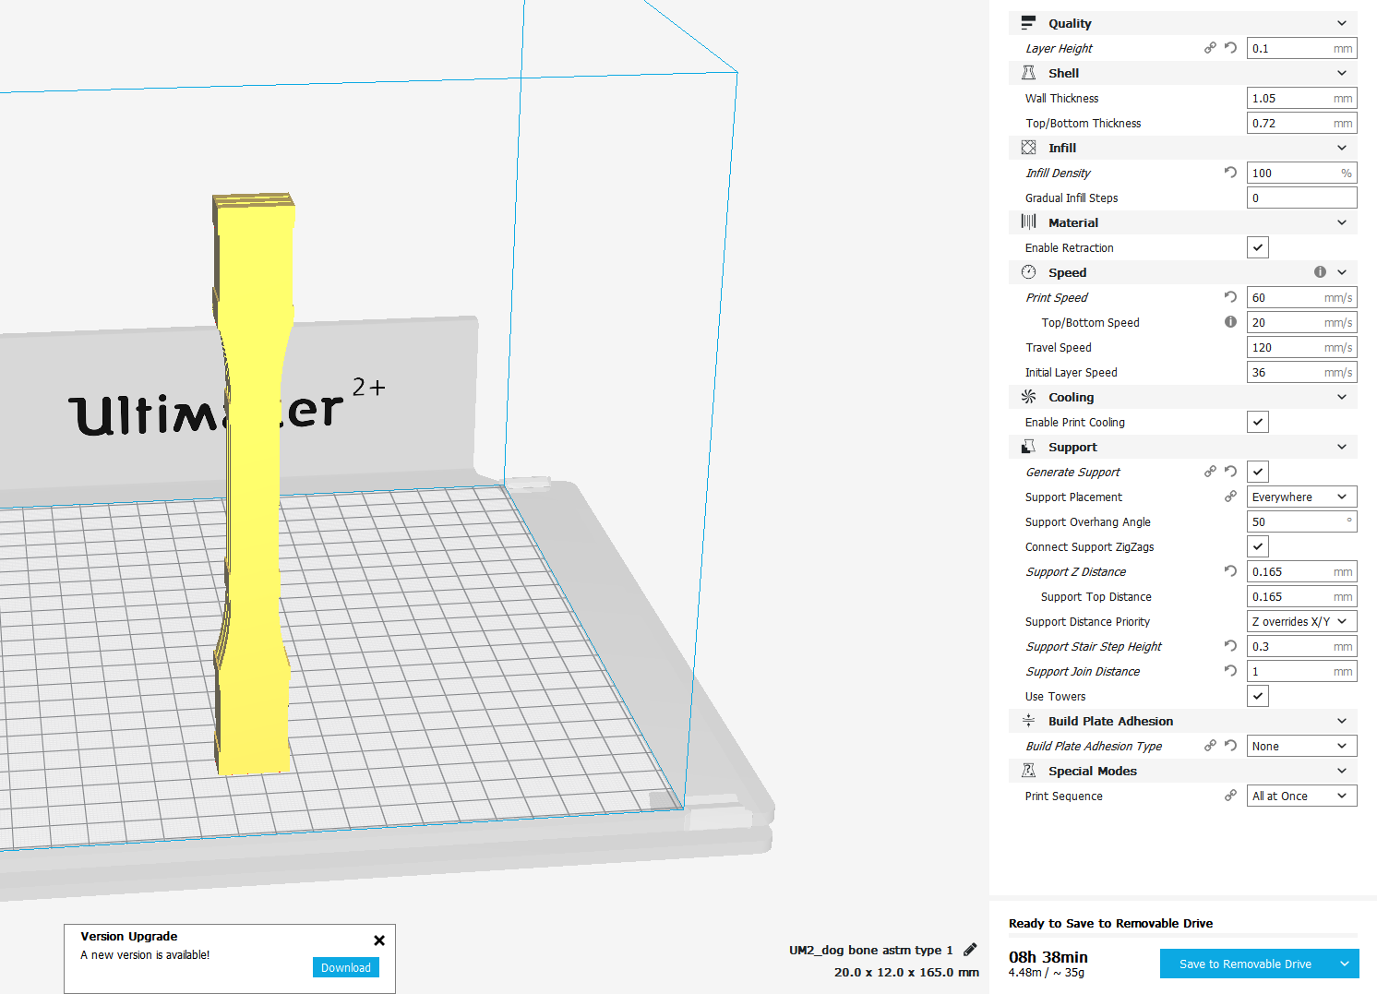
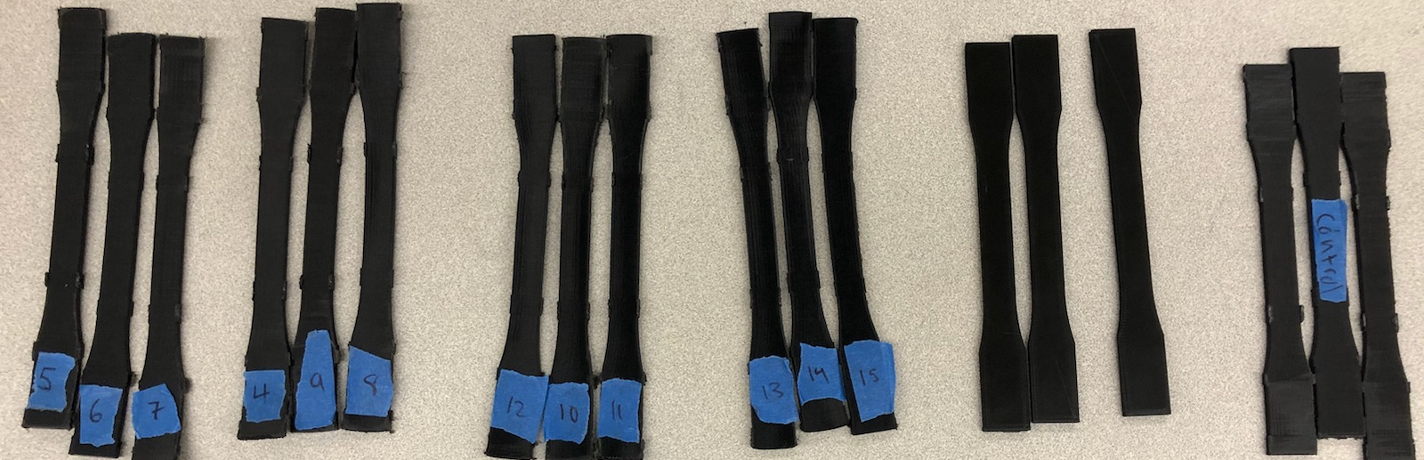
The effects of Annealing the Mechanical Properties on Additive Manufactured Thermoplastics
Juan Lopez, Travis Welch, Philip Velbis, Jose Reyna
Background and Objective: 3D printed objects when printed have weak layer bonds. The reason that the bonds might be weak is due to little air gaps in between the plastic. The goal is to heat the object to release the air gaps to lessen the internal stress to increase the strength.
Printing:
We printed our parts going upwards rather than laying flat on the print bed. The layers on the flat print go lengthwise rather than side to side. We want to test the layer bond not the plastic itself
Results:
We were looking for a few things from the tests
The raw data
How the specimen broke
The Graphs
Data Calculations
Process:
This image shows what we hope to accomplish with treating our material with heat from the surface, where the air gaps are going away allowing recrystallization
Before:
After:
14 hours per print
5 different printing designs
1/3 failed
There are different types of breaking, and there is also necking
Annealing:
We had a total of 9 batches consisting of 3 specimen each
We annealed at 4 different temperatures and at 4 different times
We used a Quincy Labs Model GC oven
Most of our samples looked brittle when they broke, but a few seemed more ductile after annealing
When something is being printed using Fused Deposition Modeling (FDM) there will always be a little bit of space somewhere in between them due to material being stacked on each other.
Approach:
We started with placing the specimen on metal plates but they seemed to warp consistently so we switched to a glass plate where there was less warping
Batch | Time(min) | Temperature(°C) | Avg Toungness (J/m^3) | Avg E(N/m^2)
1 | None | None | 4.22465 | 9.0256
2 | 60 min | 60 | 12.4207 | 5.87675
3 | 60 min | 75 | 4.142167 | 7.164167
4 | 60 min | 90 | 3.375067 | 15.546
5 | 60 min | 80 | 4.005467 | 7.611133
6 | 60 min | None | 116.8257 | 6.664733
7 | 90 min | 60 | 4.549633 | 8.9444
8 | 120 min | 60 | 4.3722 | 8.822967
9 | 30 min | 60 | 12.94667 | 6.460667
For our testing we chose the ASTM d638 type 1(American Society for Testing and Materials), which is the best type for tensile testing plastics
From the graphs we were able to find the Toughness, Elastic Modulus, Yield Strength, Ultimate Strength, Fracture Strength, and Resilience.
From there we had to create the specimen in Solidworks where we had to design something wouldn’t fall over
Tensile Testing:
We ran the specimen at .05mm/s for the first batch
We ran .01mm/s for the rest of the batches
Conclusion:
Annealing a 3D printed object can help the mechanical properties including toughness, Elastic modulus, Yield Strength, Ultimate Strength, Fracture Strength, and Resilience
Annealing PLA at a lower temperature helps the toughness rather than high heat
Specimen were less brittle and more ductile
We used Cura to be able to able to go from Solidworks to a 3D printer. Within Cura we had a slot of settings to configure for the best print
Acknowledgments:
This project is supported by the US Department of Education through the through the Minority Science and Engineering Improvement Program (MSEIP, Award No. P120A150014); and through the Hispanic-Serving Institution Science, Technology, Engineering, and Mathematics (HSI STEM) Program, Award No. P031C110159.

