Slide 1


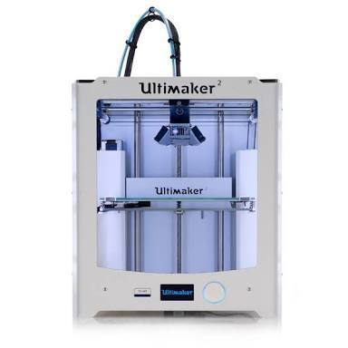
Effects of the Mechanical Properties for Annealed Additive Manufactured Thermoplastics
Advisor: Dr. Teh Mentor: Alex Furlanic Lead: Juan Lopez
Part Time: Travis Welch, Philip Velbis, Jose Reyna

Slide 2

Overview:
Problem Statement
Solution
Research
Design
Printing
Annealing Process
Tensile Testing
Results
Analysis/Conclusions
Summary
References
Questions

Slide 3
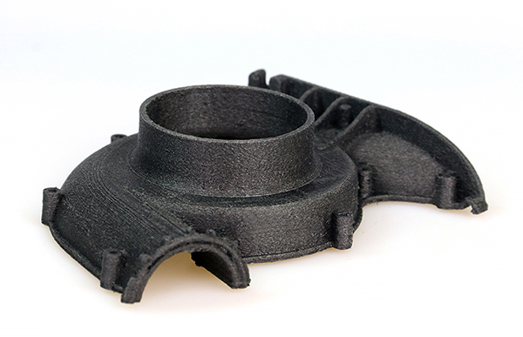
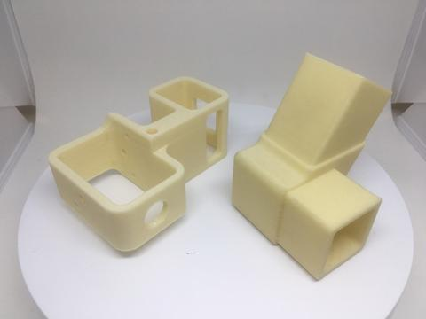
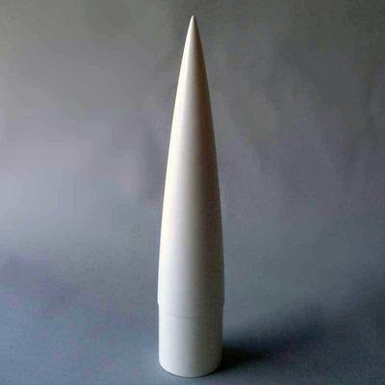
Problem Statement
3d printers can print objects very fast but if you’re using Polylactic Acid (PLA) the object may not be very strong.
Carbon Fiber
Kevlar
Fiber Glass

Slide 4
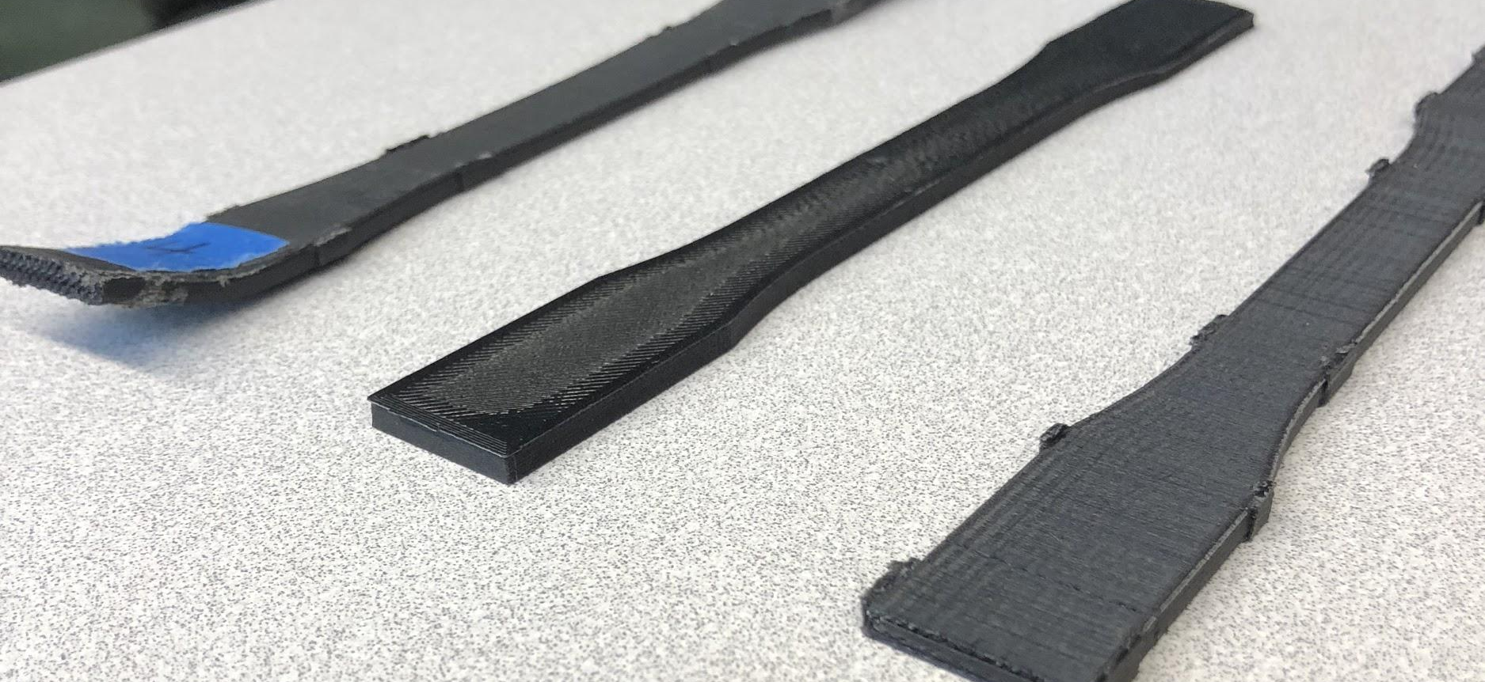
Proposed Solution
Annealing the printed object will release the air gaps making the 3D printed object tougher by releasing air gaps allowing the layers to get closer to each other.

Slide 5

Our Research
Effects on annealing printed objects for a period of time
Thermodynamics / material science overview
New technologies including Rapid Liquid printing
Previous research papers related to annealing 3D printed objects

Slide 6
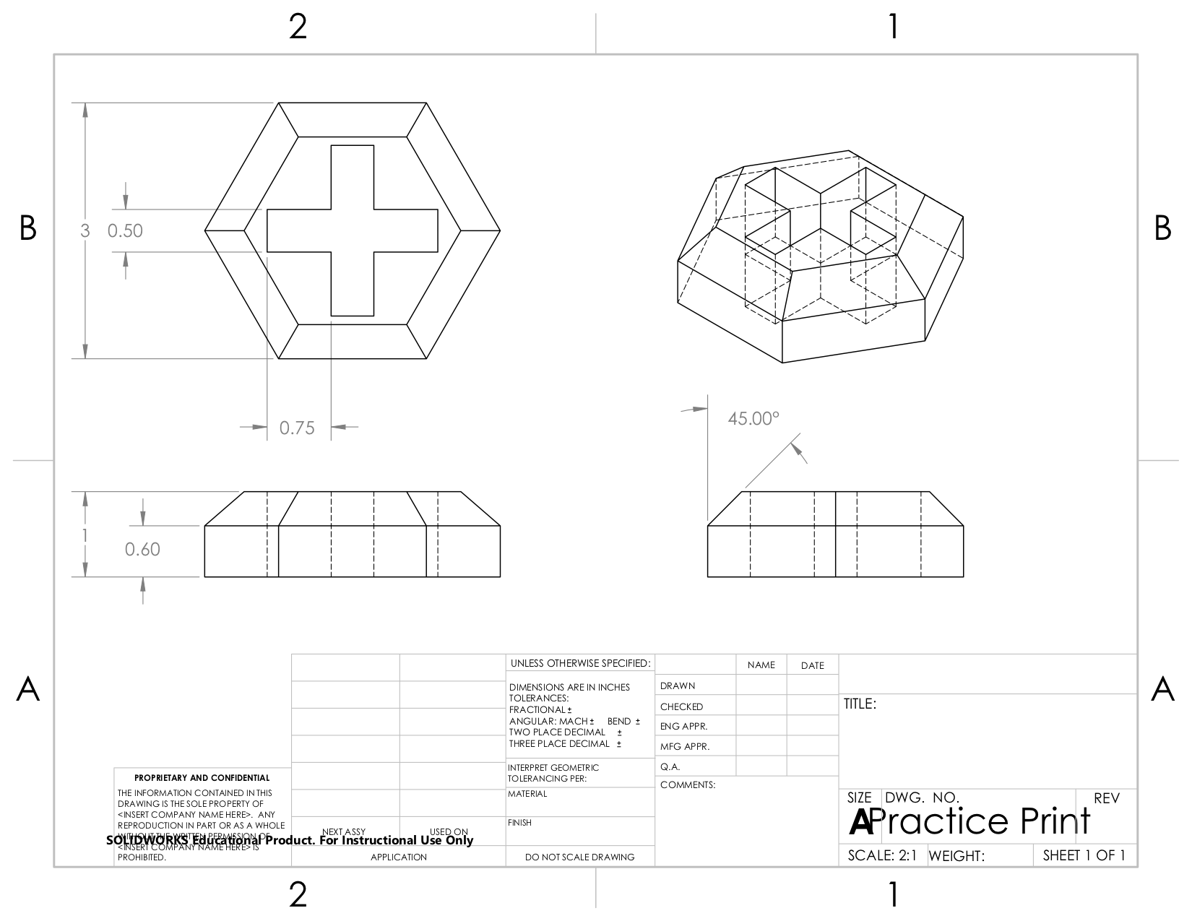
Solidworks Overview
The most common for 3D design
Take an idea to a finished product
Design a good sample
Make prototyping faster and easier

Slide 7
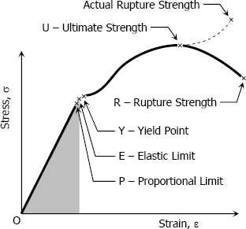
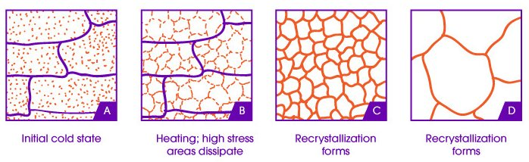
Thermodynamics/Material science Overview
Annealing polymers
Can lead to the following changes:
Elastic Modulus
Yield Strength
Toughness
Fracture Strength

Slide 8
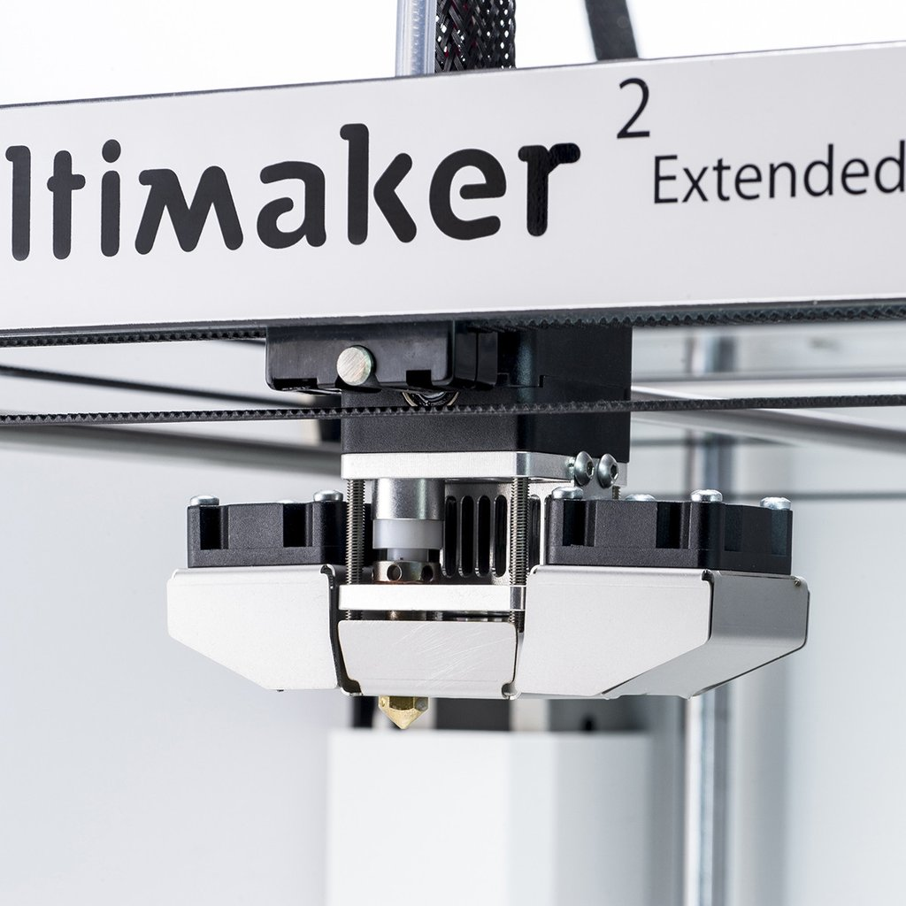
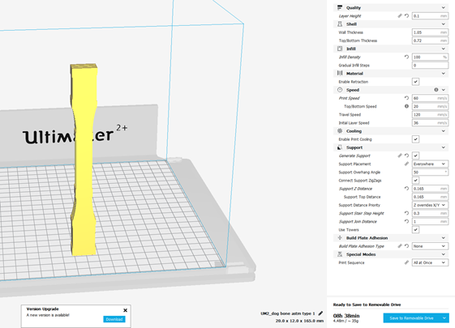
Learning to Use Ultimaker
Material Load
Calibrate Build plate
Change and accommodate different material
Change different nozzles
Use 3d printing Cura software
Printer Nozzle
Dual Fans

Slide 9
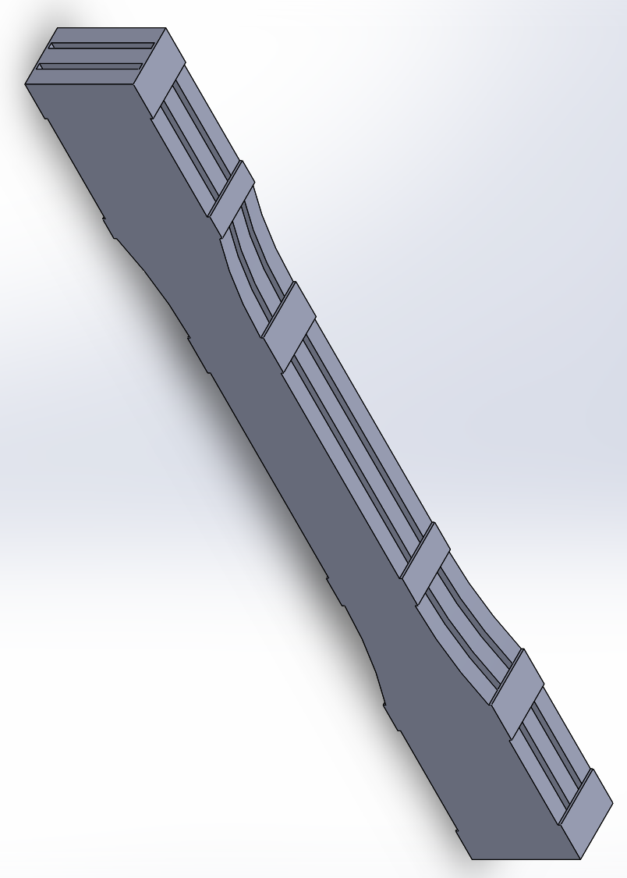
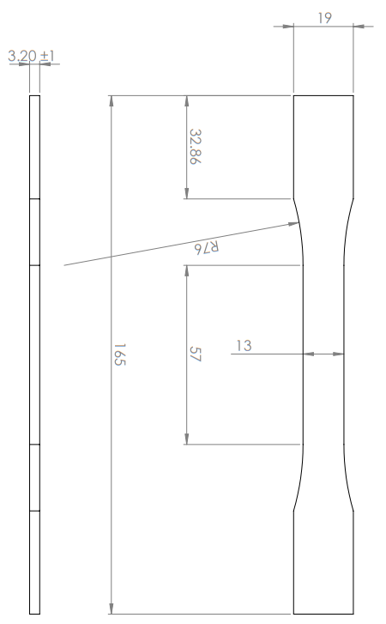
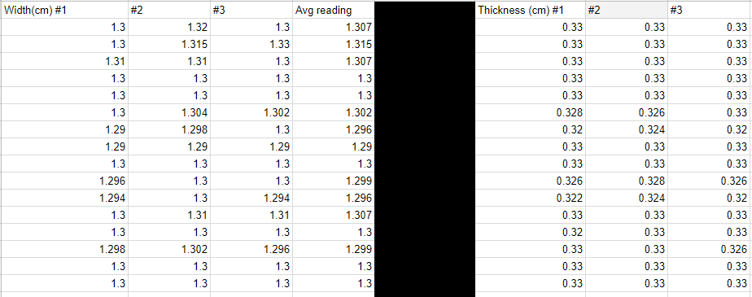
Sample Design
Dog Bone design is from American Society for Testing and Materials (d638 Type 1)
Design is optimal for tensile testing plastics
6-14 hrs per print
Print upward direction, in the way the printer bonds each layer

Slide 10
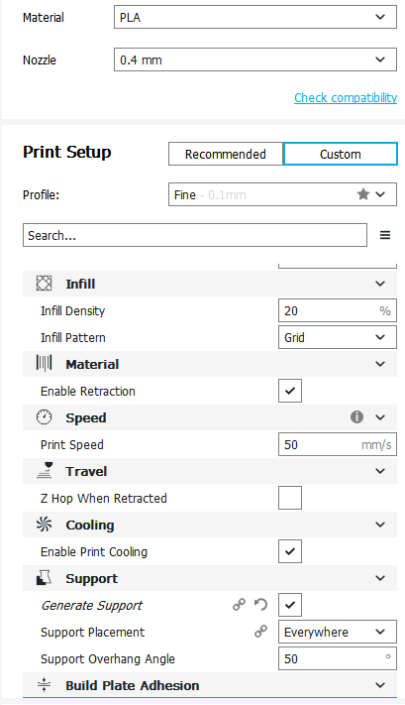
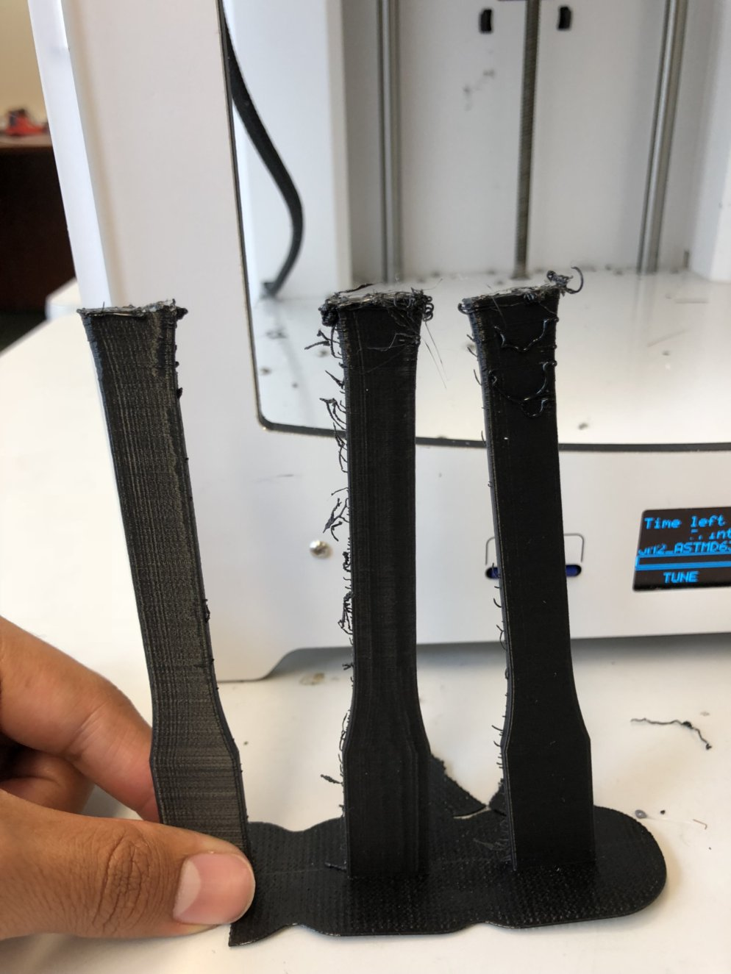
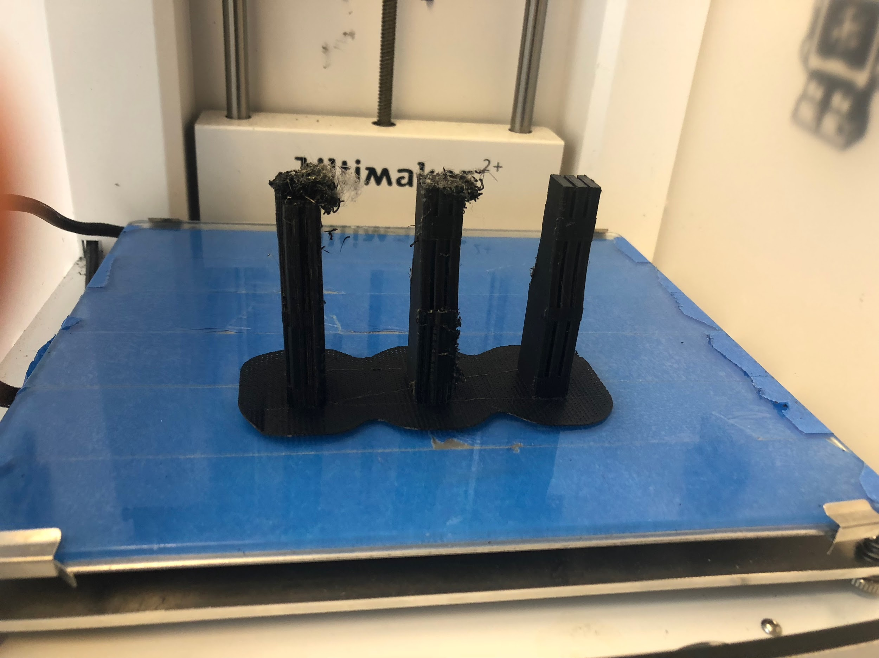
Trial and Error of 3D Printing
Hard trial and error process
Adjusting temperature in accordance to material and print layout

Slide 11
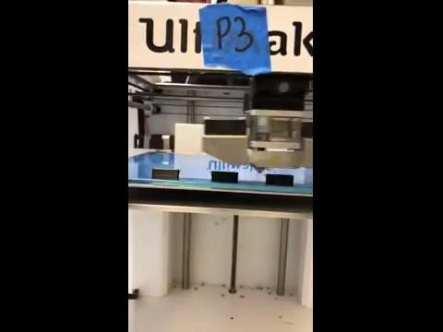

Slide 12
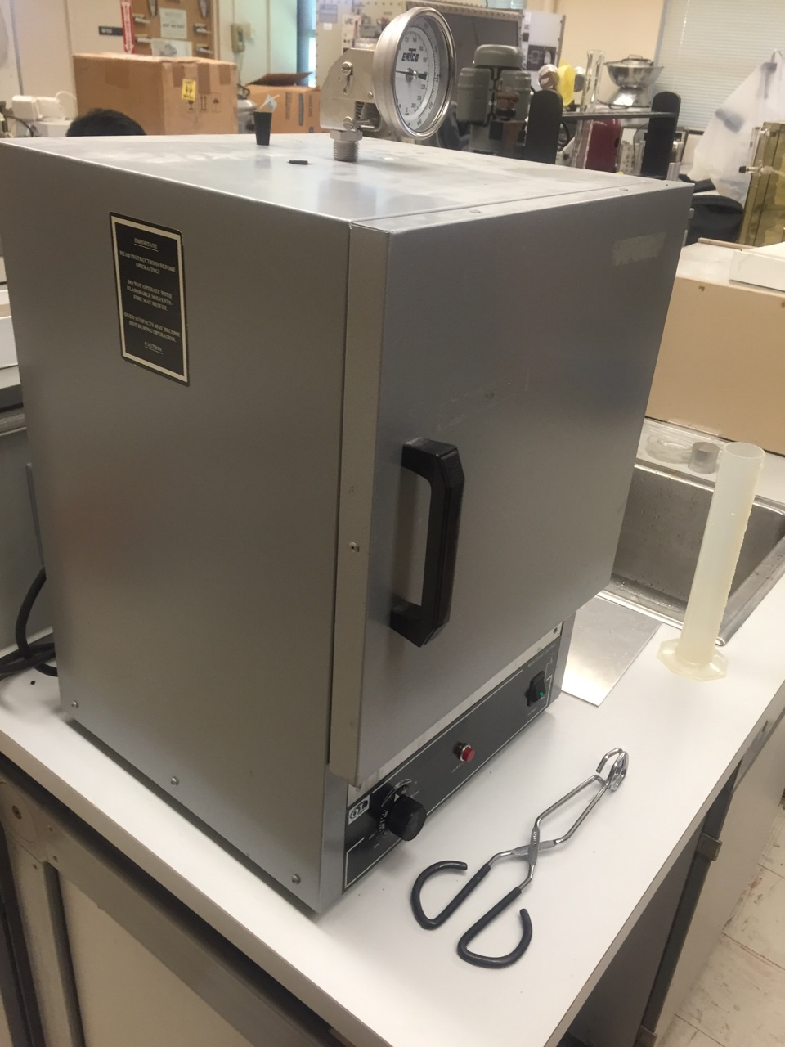
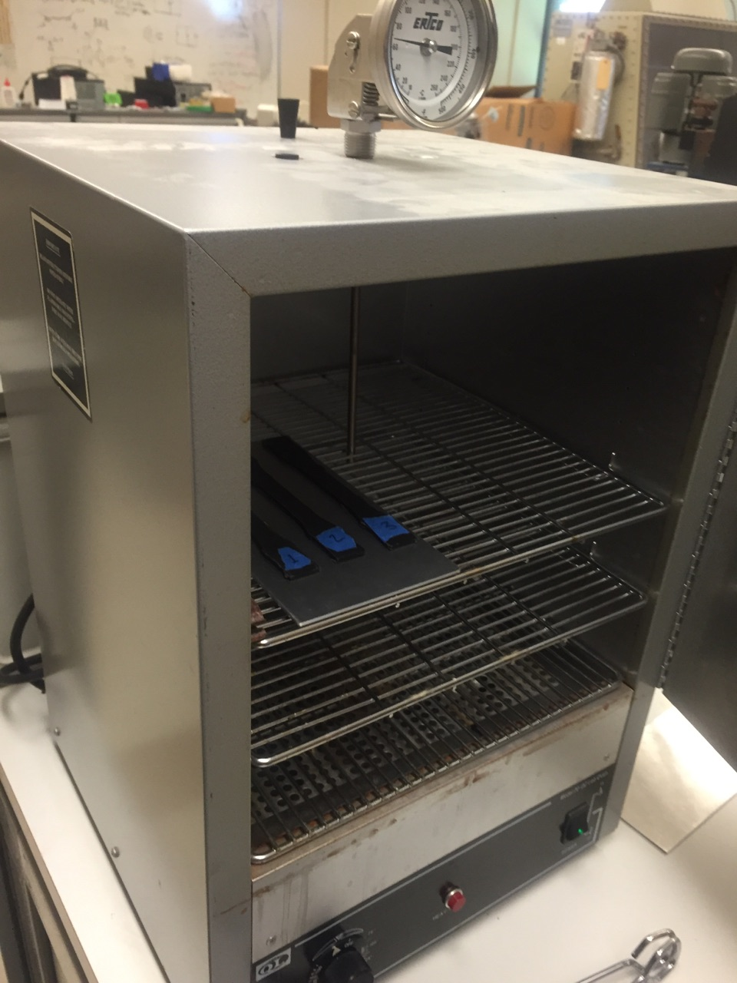
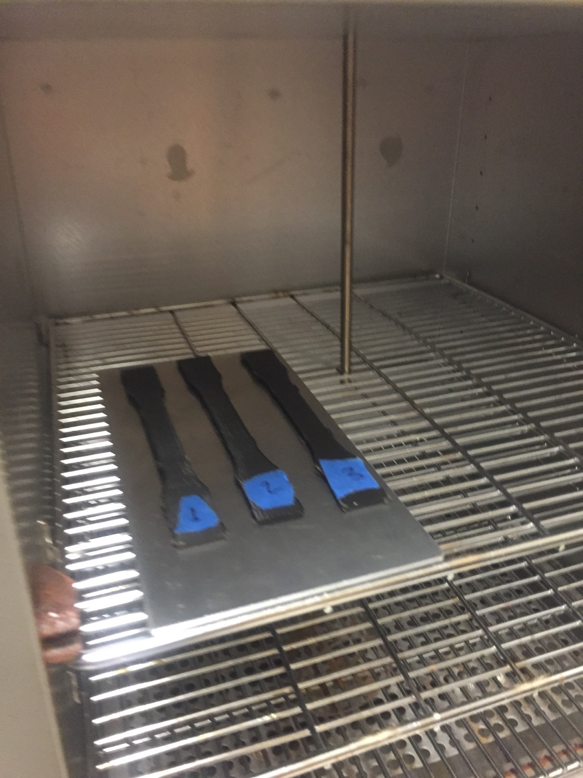
Annealing Process
Use ⅓ -½ of the materials melting temperature
Melting temperature for PLA is 180-200
For Annealing Trial #1- The temperature varies, the time is constant
Fro Annealing Trail #2- The Time varies, the temperature is constant
Useful way to make improvements between the trials

Slide 13
Table of Trials
Annealing Trail #1 (Temp Variable, Metal Plate)
3 control samples with vertical print design
3 samples for 60C for 60 minutes
3 samples for 75C for 60 minutes
3 samples for 90C for 60 minutes
3 control samples with horizontal print design
Annealing Trial #2 (Time Variable, Glass Plate )
3 samples for 60C for 30 minutes
3 samples for 60C for 90 minutes
3 samples for 60C for 120 minutes
For Testing Purposes :
3 samples at 80C for 60 minutes (Glass Plate)

Slide 14
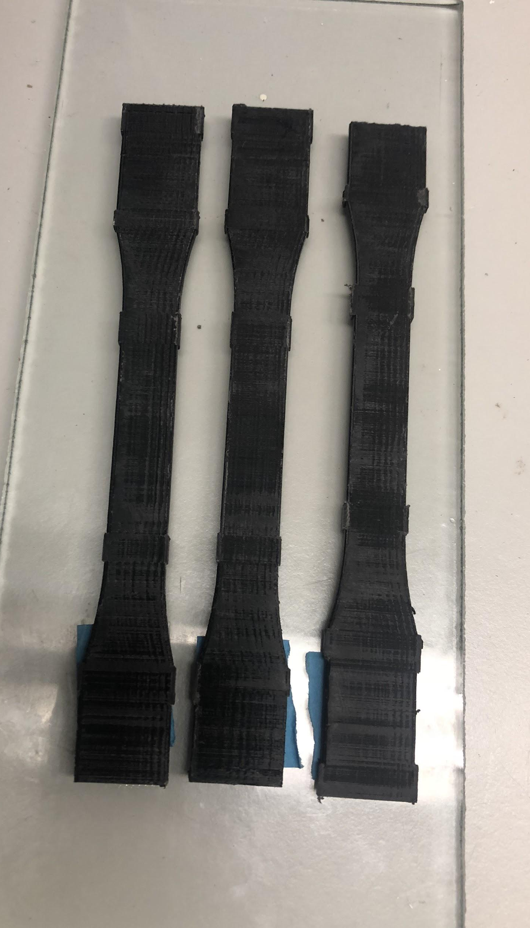
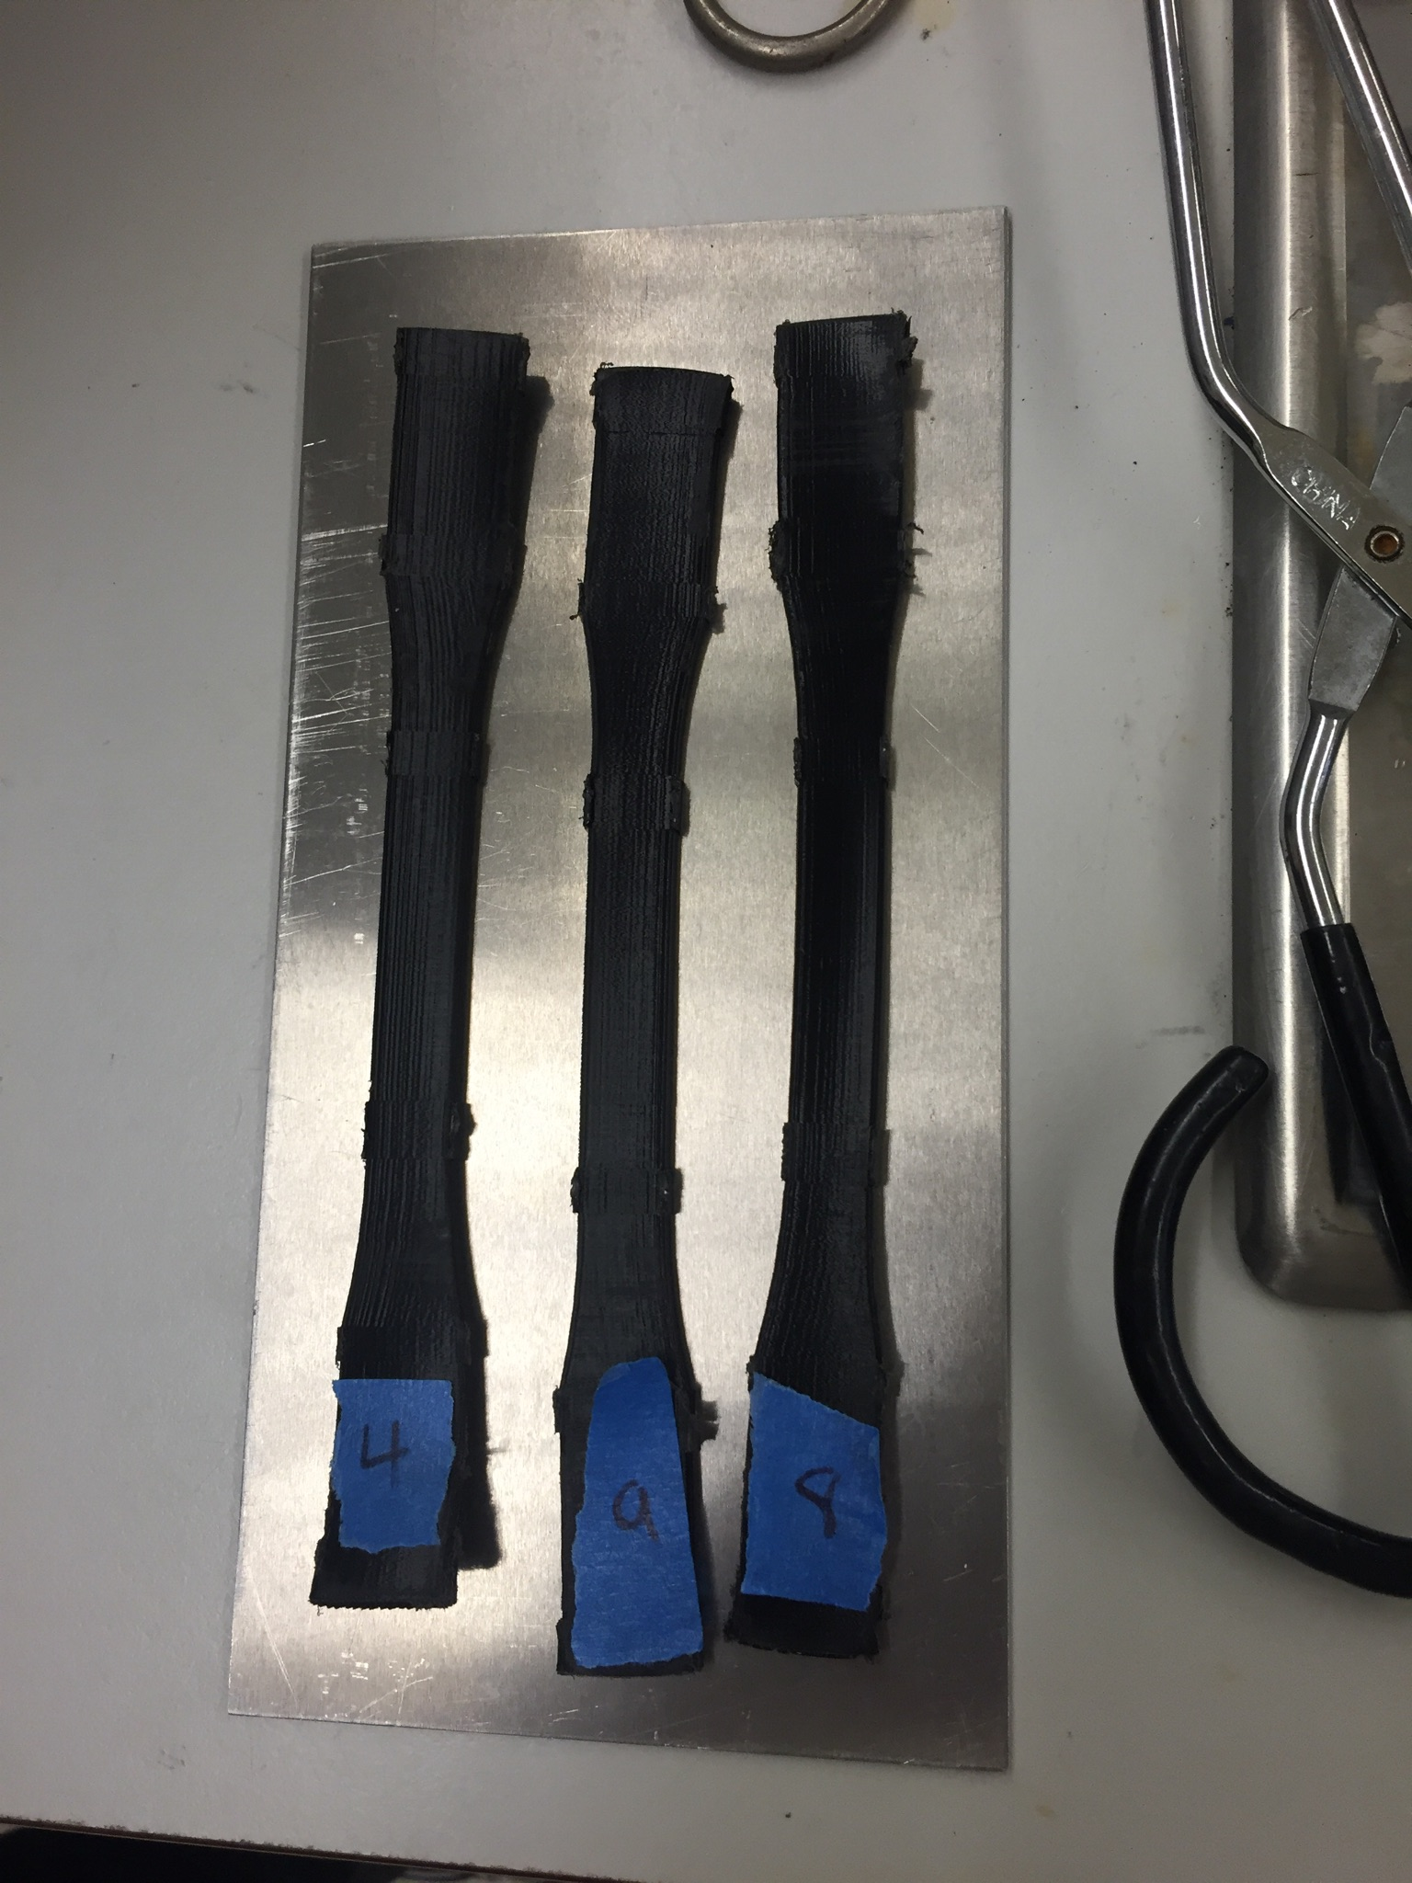
Annealing Trial and Error Process
Samples tend to warp during the process
Metal plate vs Glass Plate
Adjusting our oven to be stable at low temp
OFF…..75C…..90C…..
Use of Thermometer
Keeping our experiment consistent throughout

Slide 15
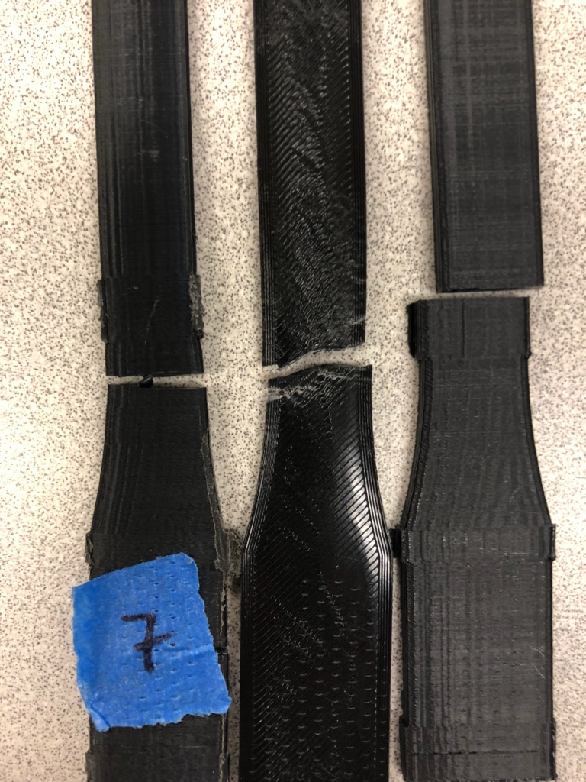
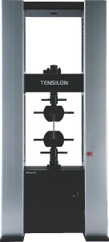
Tensile Testing
Conducted testing on the first annealing trial
Made conclusions and improvements
60C
Glass plate to reduce warping
Conducted testing on the second annealing trial
Used results to compare to the first annealing trial and control samples
Keeping all the variables the same

Slide 16
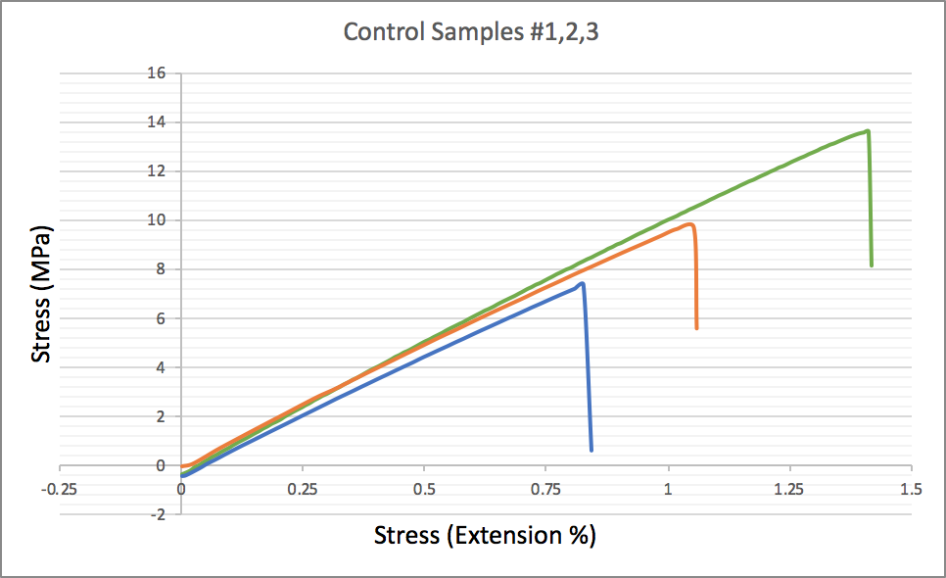
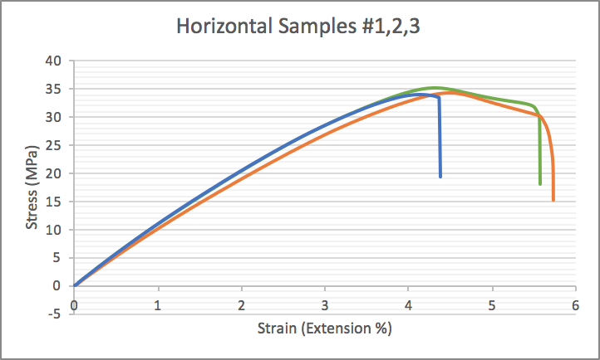
Results
Control Samples- Printed in in upward direction, no annealing done
Horizontal Samples- Printed flat on build plate, no annealing done
Key:
Sample #1
Sample #2
Sample #3
Average Toughness(Area Under Graph): 6.14107 (J/m^3)
Average Toughness(Area Under Graph): 116.8255405 (J/m^3)

Slide 17
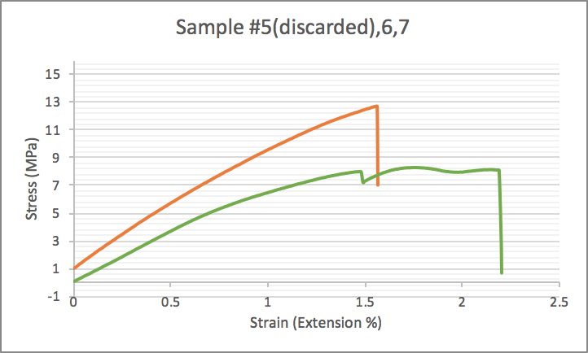
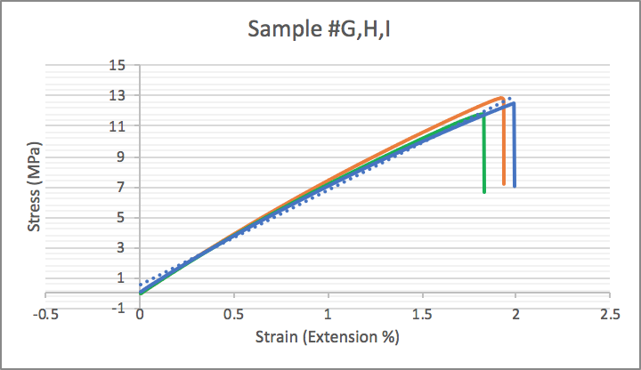
Results
Sample 5,6,7- From Annealing Trial #1, done at 60C for 60mins
Sample G,H,I- From Annealing Trial #2, done at 60C for 30mins
Key:
Sample #G
Sample #6,H
Sample #7,I
Average Toughness(Area Under Graph): 12.42069 (J/m^3)
Average Toughness(Area Under Graph): 12.9466667 (J/m^3)

Slide 18
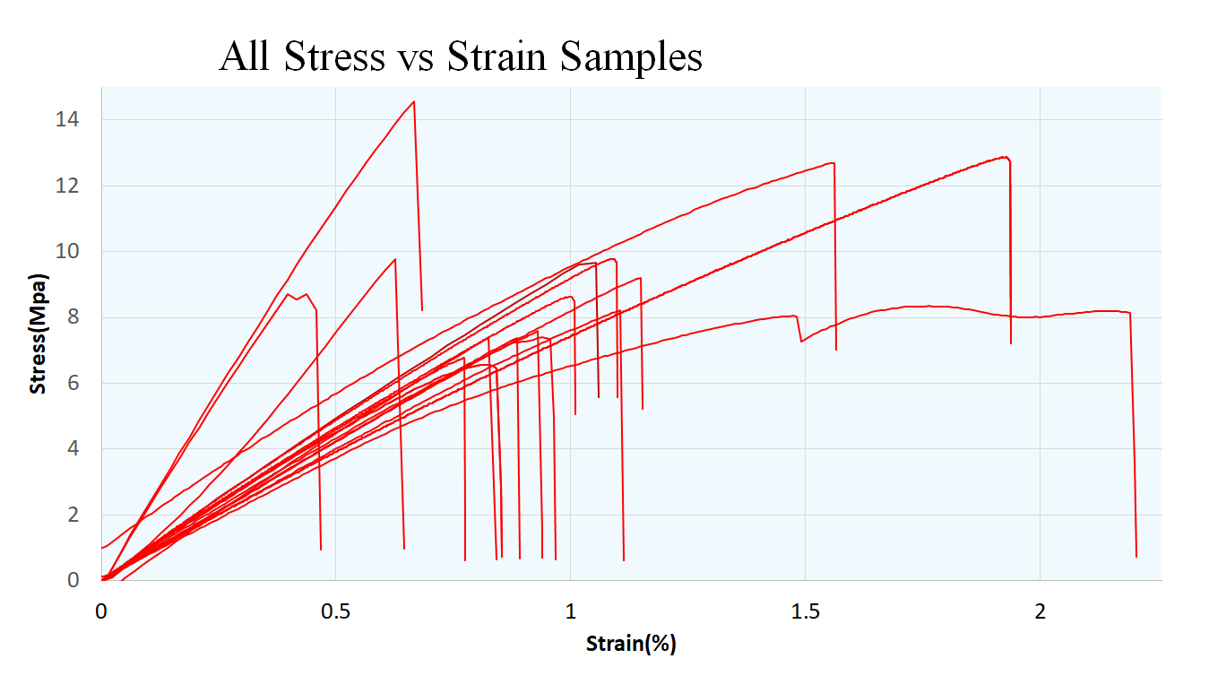

Slide 19
Analysis
Batch | Time | Temperature(°C) | Avg Toungness (J/m^3) | Avg E(N/m^2)
1 | None | None | 4.22465 | 9.0256
2 | 60 min | 60 | 12.4207 | 5.87675
3 | 60 min | 75 | 4.142167 | 7.164167
4 | 60 min | 90 | 3.375067 | 15.546
5 | 60 min | 80 | 4.005467 | 7.611133
6 | 60 min | None | 116.8257 | 6.664733
7 | 90 min | 60 | 4.549633 | 8.9444
8 | 120 min | 60 | 4.3722 | 8.822967
9 | 30 min | 60 | 12.94667 | 6.460667
Using the Riemann Sum to calculate and compare toughness

Slide 20
Conclusions
Annealing a 3D printed object can help the mechanical properties including toughness, Elastic modulus
Annealing PLA at a lower temperature helps the toughness rather than high heat
Specimen were less brittle and more ductile

Slide 21
Summary
Problem Statement
Proposed Solution
Approach/Methodology
Printing and Annealing trial and error process
Results/Analysis
Tensile Testing
Best Stress vs Strain
Analysis
References

Slide 22
References
https://conservancy.umn.edu/bitstream/handle/11299/169793/RosplockM.pdf?sequence=1
https://community.ultimaker.com/topic/15440-annealing-printed-parts-directly-in-the-ultimaker/
https://onlinelibrary.wiley.com/doi/full/10.1002/app.27261

Slide 23
Questions
?

