Slide 1


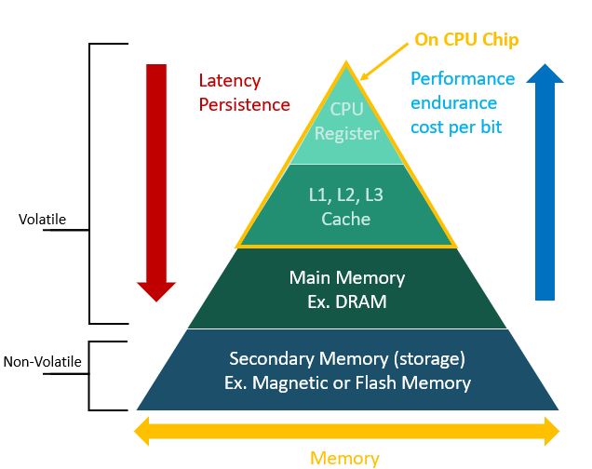
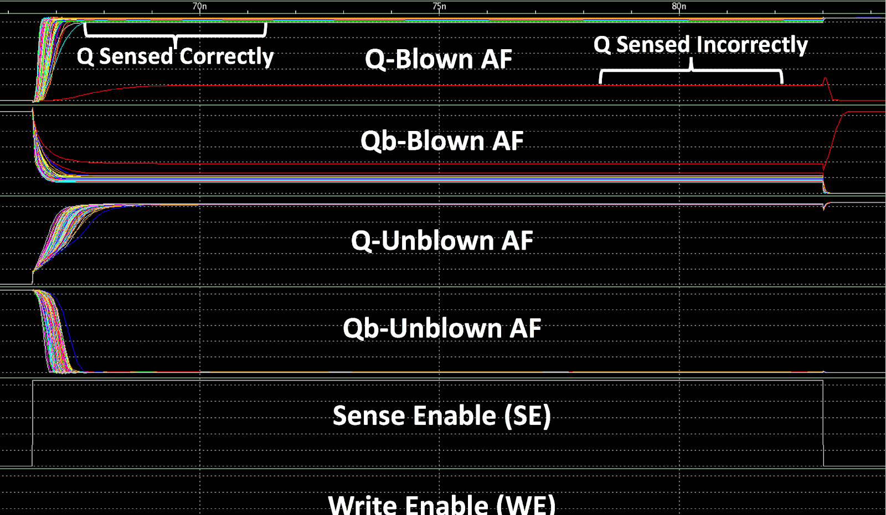
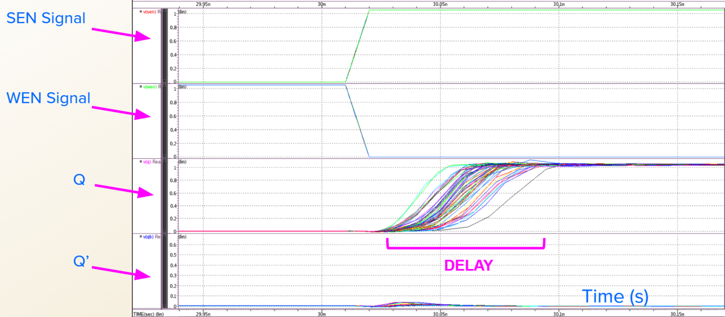
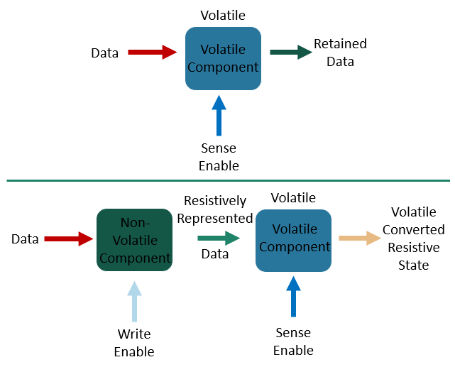
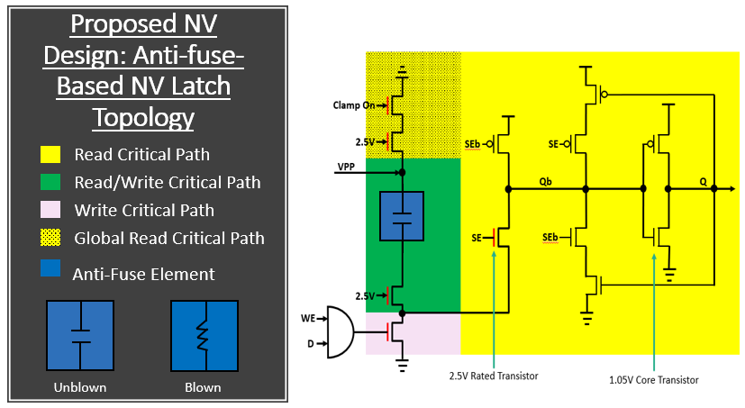
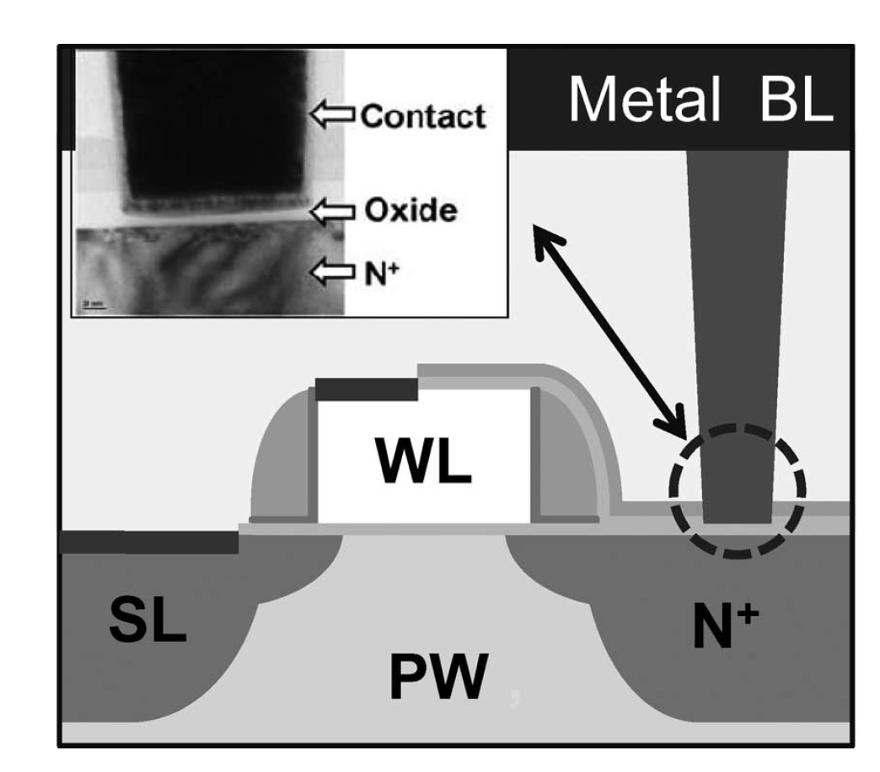
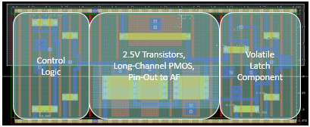
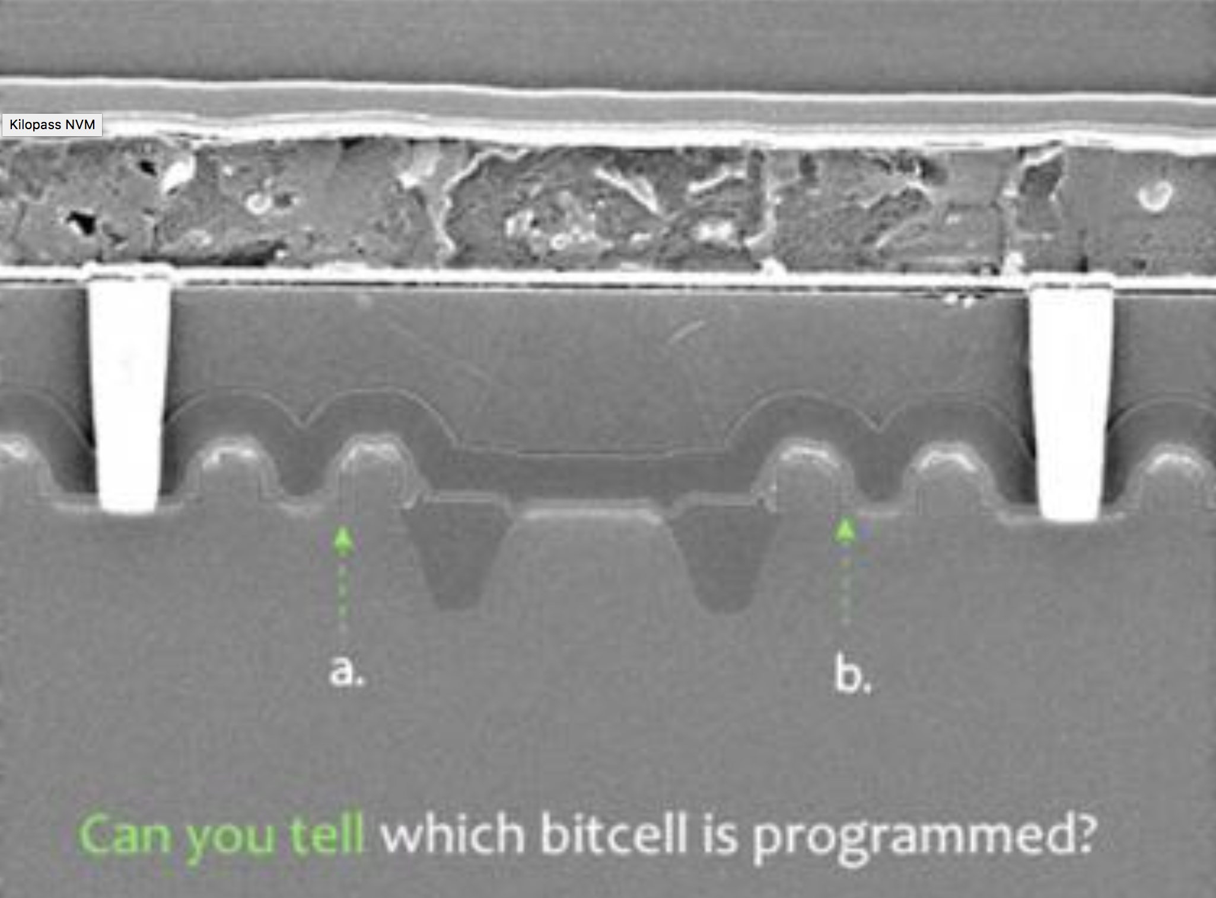
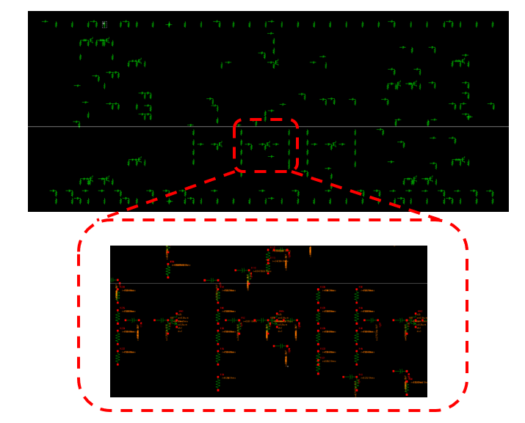
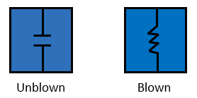
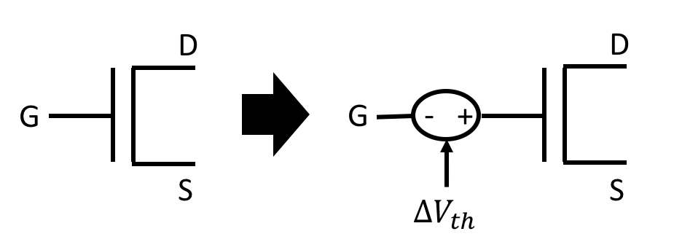
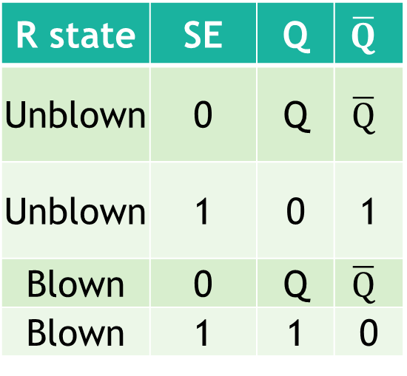
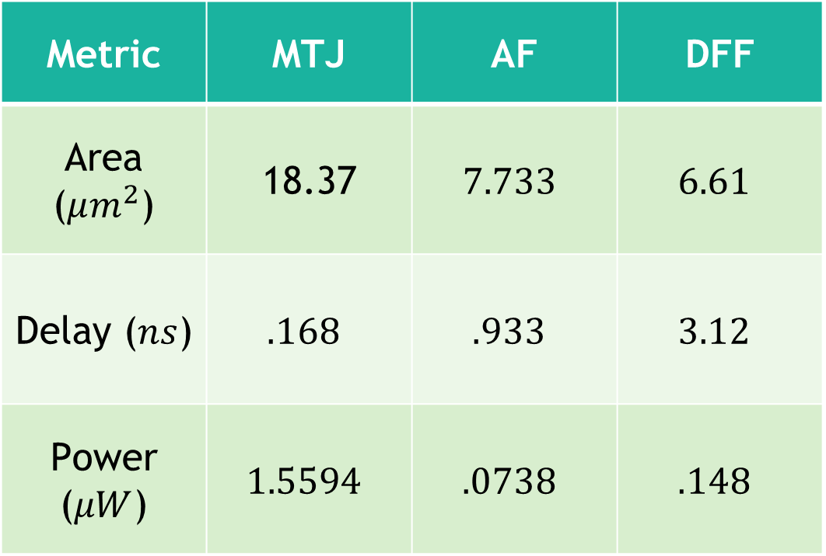
Design and Optimization of Non-Volatile Antifuse Latch using Resistive Memory Technology
Alex Hercules¹, Anthony Lal¹, Michael Gee¹
Graduate Mentor: Tyler Sheaves², Advisor: Hamid Mahmoodi²
¹Cañada College 4200 Farm Hill Blvd. Redwood City, CA 94061
²San Francisco State University: Dept. of Engineering 1600 Holloway Ave. San Francisco, CA 94132
1. Introduction
Logic
Optimization of write (6 Transistors)
6. Results
Conventional method of storing data for typical electronic devices use electrically charged node to store binary information.
If power is lost data is permanently lost.
This charged node that stores data is known as volatile memory.
Depending on the voltage potential across the Anti-Fuse during write operation determines if it will blow.
When reading, we expect the cell output Q to match the user input D from write.
We ran multivariable simulations with six variables to see how the transistor values are affected and to find read and write failures
Metric | MTJ | AF | DFF
Area ($μm^{2}$) | 18.37 | $$7.733$$ | $$6.61$$
Delay ($ns$) | $$.168$$ | $$.933$$ | $$3.12$$
Power ($μW$) | $$1.5594$$ | $$.0738$$ | $$.148$$
D | WE | R state
0 | 0 | R state
0 | 1 | R state
1 | 0 | R state
1 | 1 | Blown
R state | SE | Q | $$\overline{Q}$$
Unblown | 0 | Q | $$\overline{Q}$$
Unblown | 1 | 0 | 1
Blown | 0 | Q | $$\overline{Q}$$
Blown | 1 | 1 | 0
The anti-fuse is favorable if a smaller area overhead is desired and one time programmability is sufficient
MTJ provides programmability at a higher cost in area and power (both static and switching) but offers a lower sensing (read) delay
Compared to DFF, Anti-fuse has minimal overhead of (117%) and MTJ is much higher due to large write drivers
Optimization of read (12 Transistors)
Optimization of the read cycle was performed by using HSpice and a netlist that allowed delay and area to be used as weighted goals.
We propose a technology called non-volatile embedded memory that use resistive based memory as a long term solution.
If this technology proves viable, computers can be created without secondary storage in mind
Write Truth Table
The netlist contained a parameter which allowed an area goal to be set so that HSpice would determine the best possible transistor size.
Read Truth Table
2. Non-Volatile embedded Memory
Write Operations
When writing, if WE and D are both on, the Anti-Fuse will become blown. Else, the previous resistive state is kept
It is important to note that while D = 0 and WE = 1, will achieve an unblown state, we can not assume the initial condition and cannot guarantee that the Anti-Fuse is unblown. We can however guarantee the previous R state is retained
Read Operations
During read, Q only updates when SE is also on, otherwise the previous saved state is retained
Issues with the Anti-fuse may have too large of a low resistance to evaluate to a proper high output. To mitigate this we create larger resistance on PMOS-type transistor with an input of SEb.
Resistive memory technology to replace traditional charge-based memory
Information storage by use of resistive material, data is then read out as resistance value.
By embedding non-volatile memory inside the CPU chip, data frequently used by the CPU will not be lost upon power down, and the benefits of NV storage without the drawbacks of intra- component data transfers can be achieved.
Monte Carlo Simulations
A Monte Carlo failure rate netlist program was used to test each set of values recorded in the optimization process.
Each set of our values was run at 1000 iterations to ensure reliability of the circuit to within 0.1% accuracy.
We looked for values that passed simulations with 0% failure rate, which meant a minimum of 99.9% reliability.
The optimization for 100 run Monte Carlo yielded best values that had higher delay, lower reliability, and lower area.
7. Conclusion
Magnetic Tunnel Junction (MTJ) | Anti-Fuse (AF)
Reprogrammable | One time programmable
Low Resistive Ratio | High Resistive Ratio
Large area overhead | Small area overhead
High static power consumption | Low static power consumption
Large switching (programming) delay | Small switching (programming) delay
Low sensing (read) delay | Relatively high sensing (read) delay compared to MTJ
Requires new on-chip magnetic layer | Requires typical Anti-fuse / standard cells
3. Anti-fuse
Layout
AF is one time programmable and functions inversely of a eFuse.
A cell whose insulating element breaks down under high electric field, made of transistor-dielectric or metallic materials.
A high resistance device whose resistance can be permanently altered to a low resistance value by placing a sufficient electric field across it.
Once programmed, resistance cannot be reversed.
On the microscopic level, it is nearly impossible for hackers to identify the state of the anti-fuse
We compared proposed solutions’ power, delay, and area overhead metrics which showed the tradeoff between programmability and cost.
8. References
[1] H. Mahmoodi, A. Attaran, T. Sheaves, “Design of a Non-Volatile Latch using Resistive Memory Technology”
[2] H. Mahmoodi, S. Srinivasan Lakshmipuramᐩ, M. Aora, Y. Asgarieh, H. Homayoun, B. Lin and D. M. Tullsen “Resisitive Computation: A Critique.” IEEE COMPUTER ARCHITECTURE LETTERS, VOL. 13 NO.2, JULY-DECEMBER 2014
[3] W. Zhao, E. Belhaire and C. Chappert “Spin-MTJ based Non-Volatile Flip-Flop.”
Proceedings of the 7th IEEE International Conference on Nanotechnology August 2-5
2007, Hong Kong
[4]Wicht, Bernhard, Thomas Nirschl, and Doris Schmitt-Landsiedel. "Yield and Speed Optimization of a Latch-Type Voltage Sense Amplifier." IEEE JOURNAL OF SOLID-STATE CIRCUITS , VOL.39 NO.07, JULY 2004
[5]Welser, Jeffrey, S.A. Wolf, and Phaedon Avouris. " 282 CHAPTER 8 APPLICATIONS: NANOELECTRONICS AND NANOMAGNETICS ." Nanotechnology Research Directions for Societal Needs in 2020. London: Springer Dordrecht, 2011.
5. Methodology
The goal of the layout was to minimize the area the circuit would take up while still being able to perform as desired.
The first test we ran once our layout was constructed was the Design Rules Checking (DRC), which checks to make sure our design follows the current rules and conventions used in manufacturing.
Design Methods: Optimization Algorithms
Select transistors which impact device reliability.
Size transistors minimally such that no failures are detected after 10,000 random variations.
Complete Layout of properly sized schematic.
Retest Reliability and Resize if necessary.
Extracted parasitics from Layout
Parasitics come in form of RC circuits
Each RC replaces a component of the layout
Design is revalidated for reliability for the following performance metrics:
    Design Area
    Design Static Power
    Design Sensing Delay
4. Design and Parameters
9. Acknowledgements
Thank you to Dr. Hamid Mahmoodi and Tyler Sheaves for mentoring us in this project with supportive guidance. Thank you to Synopsys for providing EDA licenses to NECRL and to DARPA for continued funding for this research. Finally, we are truly grateful for this opportunity brought to us led by Dr. Amelito Enriquez through the ASPIRES program.
Anti-fuse consists of two states: Unblown and blown
  Unblown behaves like a resistor and circuit is open
  Blown behaves like a capacitor and connects the circuit

