Slide 1


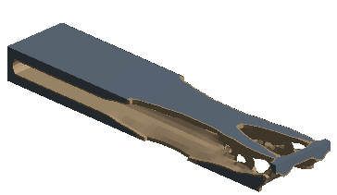
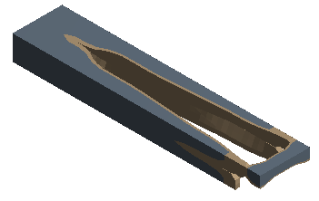
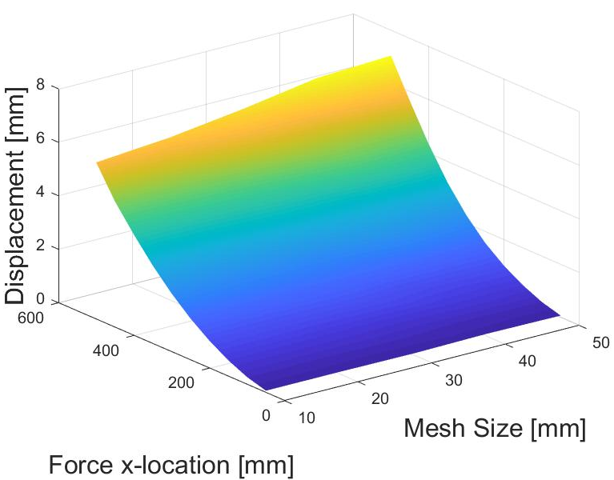
Automated Platform for Static Structural Analyses and Topology Optimization
Y. Ordonez¹, A. Bituin¹, K. Kyain¹, A. Maxwell², Z. Jiang²
¹Cañada College / ²San Francisco State University
ABSTRACT
AUTOMATED PLATFORM
Topology Optimization solution w/ 10mm Mesh Size, 50% volume retained
Topology Optimization solution w / 20mm Mesh Size, 50% volume retained
High rise structures are an ideal solution to crowded urban environments. Development in engineering and construction methods have allowed for structures to achieve greater heights. Taller structures are exposed to higher demands, due to higher wind speeds. Depending on the geographical location of a structure it may be subjected to other environmental loads (earthquake, hurricane, tornado, etc). Topology optimization has become a popular research area because optimized designs use the least amount of material but maintain high performance. Current drawbacks to topology optimization is that it can be time consuming to consider optimized designs for multiple load cases, or varying model parameters. Automation of the optimization process allows the designer to truly create the best design for many different scenarios.
AutoCAD/AutoLISP
AutoCAD is used to create initial geometry.
AutoLISP the programming language for AutoCAD
Use AutoCAD commands to compile scripts and functions which automate initial geometry creation and variation of initial geometry based on previous optimized results.
Geometry is exported as an .IGES file.
ANSYS/ADPL
ANSYS software uses finite element analysis to analyze and optimize geometries.
ANSYS uses its own native scripting language called ADPL, allowing automation of processing and analyses.
MATLAB
Calls ANSYS and AutoCAD and invokes respective scripts.
Collect and analyze results to drive optimization process.
OBJECTIVES
CASE STUDY
FUTURE PLANS
Use main MATLAB script to call all necessary programs in automated platform.
Automate modeling process using AutoCAD/AutoLISP.
Bypass ANSYS graphical user interface (GUI) and automate preprocessing and optimization process.
Use MATLAB function to compile and analyze optimization results and drive optimization process.
To validate the automated platform a simple case study was investigated.
Cantilever beam dimensioned 100 mm X 50 mm X 500 mm.
As of now, our platform will automatically import .IGES Geometry, apply and iterate several load cases, perform topology optimization, and output nodal displacement results interpreted by MATLAB.
The platform may be easily edited and expanded to perform the following, but not limited to:
  Use results to drive automated model modification towards optimization.
  Analyze more complex models, such as high-rise structures.
  Output further results, including nodal stresses and densities for topology optimization.
Mesh size varied by from 10 mm to 50 mm by 10 mm increments.
For each mesh size, point load location was changed by 50 mm increments.
Topology optimization performed.
25,000 N
X = 0
SEQUENCE FLOWCHART:
500 mm
Displacement results for each iteration are compiled so MATLAB script can analyze results.
MATLAB Script
CASE STUDY RESULTS
Mesh size, force location, and displacement compared.
Large mesh sizes overestimate the beam’s displacement.
As mesh size is reduced displacement results converge to an equal displacement.
Simulated results were compared to theoretical results of a completely solid rectangular beam.
Simulated results fell within acceptable of theoretical results, which indicated that our results are fairly accurate.
ACKNOWLEDGEMENTS
AutoCAD/AutoLISP
ANSYS APDL
MATLAB
This project is supported by the US Department of Education through the Minority Science and Engineering Improvement Program (MSEIP, Award No. P120A150014); and through the Hispanic-Serving Institution Science, Technology, Engineering, and Mathematics (HSI STEM) Program, Award No. P031C110159.
We would like to express our appreciation to several individuals that have made this program a success and a wonderful experience. We want to thank Dr. Amelito Enriquez from Cañada College for the opportunity to participate in this internship. Also, we want to thank our faculty advisor Dr. Zhaoshuo Jiang from San Francisco State University and our graduate mentor Alec Maxwell from San Francisco State University. We also want to thank San Francisco State University graduate student Wen Li Tang, for participating to help us further understand the software behind our research.
Creating and modifying Geometry
Optimization
Performance Evaluation
Results Extraction
Next Candidate
¹Yardley Ordonez, Lead Intern
²Adrian Bituin, Part-Time Intern
³Krystal Kyain, Part-Time Intern
⁴Alec Maxwell, Graduate Student Mentor
⁵Dr. Zhaoshuo Jiang, Faculty Advisor

