Slide 1


Topology Optimization through Computer Aided Software
2018 ASPIRES Summer Internship Program
Final Program Presentation
Yardley Ordonez
Adrian Bituin
Krystal Kyain
Alec Maxwell; Wen Li Tang; Prof. Zhaoshuo Jiang

Slide 2

Outline
Background & Motivation
Proposed Solution
Results
Future Plans
Conclusion
2
Notes:
We will start off with the outline of our presentation.
We will give some background knowledge on High-rise structures, the loads they go through, what is topology optimization, some of the challenges we encountered and ofcourse solutions.
We will also talk about project flow and what is next

Slide 3
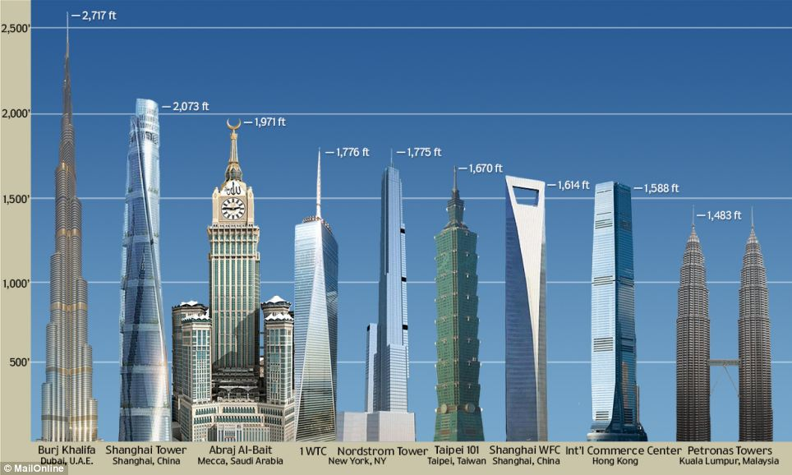
Background – High-rise Structures
3
Notes:
In the last decade we can see the world's tallest building is built which has a different design than the other tallest buildings.

Slide 4
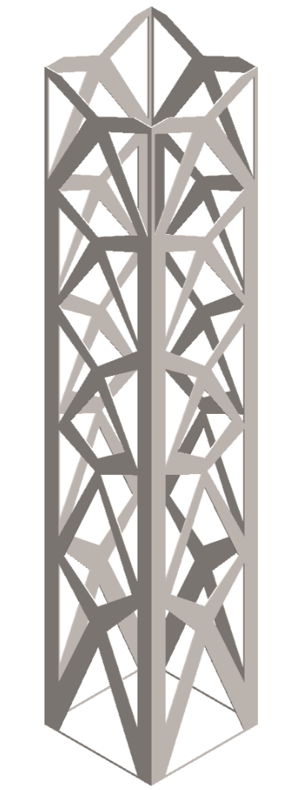
Background – High-rise Structures cont.
Solution for overpopulation
Efficient static structures
Iconic structures
Economical Design
4

Slide 5
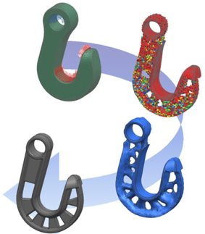
Background – Topology Optimization
Optimize a given design with a set of constraints
Create a cost effective design with increased performance
  Maintain highest stiffness with least amount of material
5
Notes:
Optimize a design to achieve the same performance (if not, better), but with using less materials
CONSTRAINTS: member sizes, forces, volume & mass percentage, geometric features, etc.

Slide 6
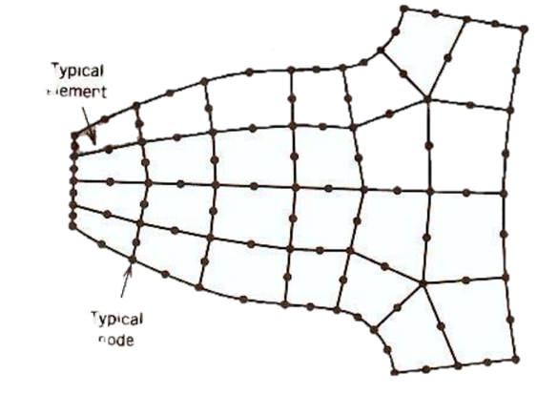
Background – Finite Element Method
Break down design into finite number of smaller elements
Each element connected by nodes
Purpose of a mesh
Apply loads at certain nodes
Element
Node
6

Slide 7
Background – Challenges
Load cases are run separately and engineers need to run each loading condition one by one
Cases where various meshes are run
An automatic platform is proposed as a solution to design efficient structures in a more effective method
7

Slide 8
Why Automate?
Geometry
Optimization Engine
Graphical User Interface
Structural Solver
Analyses performed through GUI is extremely tedious and labor-intensive
Results
8
Notes:
Okay for only when one load case, but automate is quicker analyses between several geometries and loads
Load cases are run separately and engineers need to run each loading condition one by one
An automatic platform is proposed as a solution to design efficient structures in a more effective method

Slide 9
Sequence Flowchart
MATLAB Script
1.
2.
3.
AutoCAD/AutoLISP
ANSYS APDL
MATLAB
Geometry & Loading
Creation
Optimization &
Performance Evaluation
Results Extraction
Next Candidate
4.
MATLAB will be used to guide the automation
9
Notes:
With APDL code we will be able create a geometry in AutoCAD, run the geometry through simulations in ANSYS and have MATLAB extract the results. We will automate this process so we can repeat it and have a very efficient design at the end.

Slide 10
Sequence Flowchart
MATLAB Script
AutoCAD/AutoLISP
ANSYS APDL
MATLAB
Geometry & Loading
Creation
Optimization &
Performance Evaluation
Results Extraction
Next Candidate
MATLAB will be used to guide the automation
10
Notes:
With APDL code we will be able create a geometry in AutoCAD, run the geometry through simulations in ANSYS and have MATLAB extract the results. We will automate this process so we can repeat it and have a very efficient design at the end.

Slide 11
Platform Sequence – AutoLISP
AutoCAD’s programming language
  Create custom command to complete desired task
Be able to alter parameters easily
Automate the process of creating model and exporting .IGES file
11
Notes:
AutoCAD’s version of APDL??

Slide 12
Sequence Flowchart
MATLAB Script
AutoCAD/AutoLISP
ANSYS APDL
MATLAB
Geometry & Loading
Creation
Optimization &
Performance Evaluation
Results Extraction
Next Candidate
MATLAB will be used to guide the automation
12
Notes:
With APDL code we will be able create a geometry in AutoCAD, run the geometry through simulations in ANSYS and have MATLAB extract the results. We will automate this process so we can repeat it and have a very efficient design at the end.

Slide 13
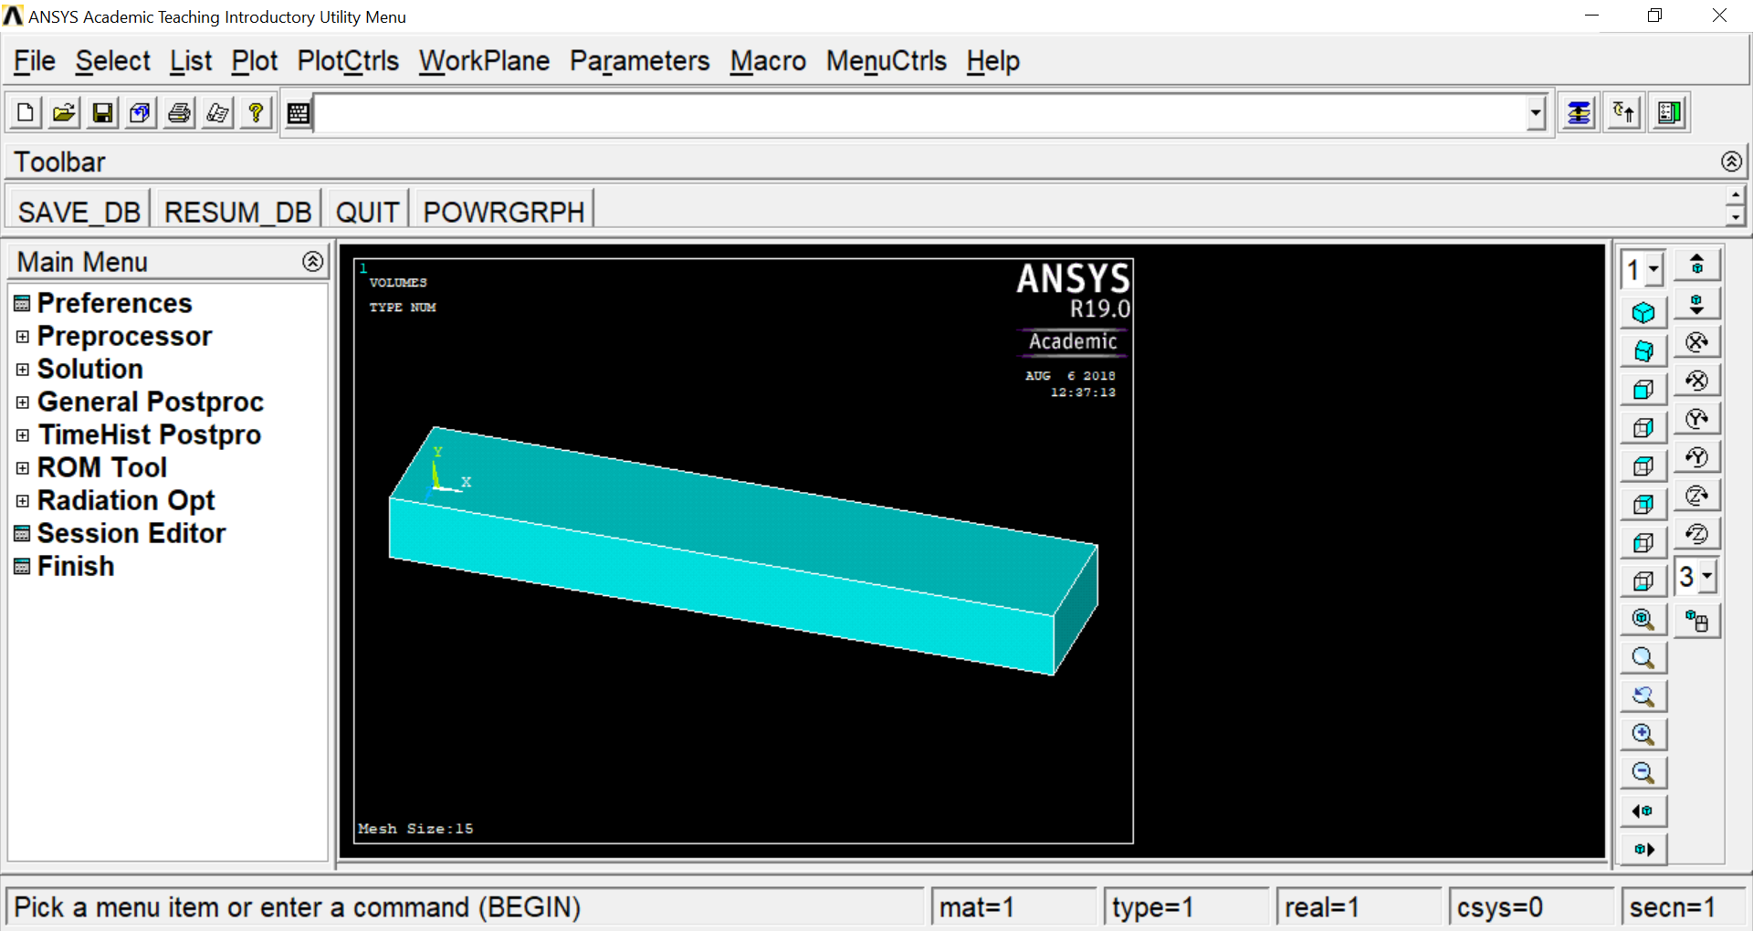
Platform Sequence – APDL Scripting
Ansys Parametric Design Language: ANSYS Scripting Language
Write script to import model, apply a mesh, define load cases, perform topology optimization, and output results.
Ability to edit parameters quickly and easily.
Input APDL Code
13
Notes:
AutoCAD’s version of APDL??

Slide 14
Platform Sequence – Sequence Flowchart
MATLAB Script
AutoCAD/AutoLISP
ANSYS APDL
MATLAB
Geometry & Loading
Creation
Optimization &
Performance Evaluation
Results Extraction
Next Candidate
MATLAB will be used to guide the automation
14
Notes:
With APDL code we will be able create a geometry in AutoCAD, run the geometry through simulations in ANSYS and have MATLAB extract the results. We will automate this process so we can repeat it and have a very efficient design at the end.

Slide 15
Platform Sequence – MATLAB
MATLAB code will:
  Run AutoLISP file through AutoCAD and export into .IGES
  Run APDL script file through ANSYS in the background.
  Interpret and graph results.
15

Slide 16
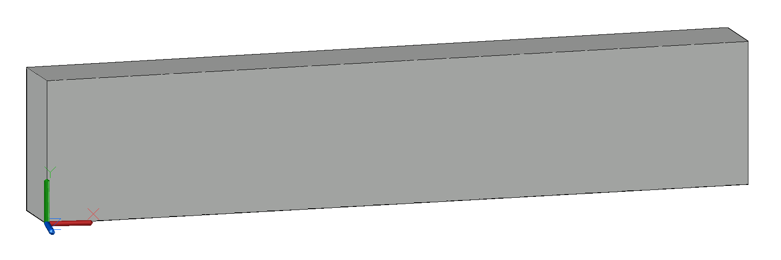
Platform Execution– Geometry
Simple cantilever beam designed with AutoLISP
Dimensions: 500x50x100 mm
  Imported as .IGES file into ANSYS APDL
100 mm
50 mm
500 mm
16
Notes:
Support along the back face

Slide 17
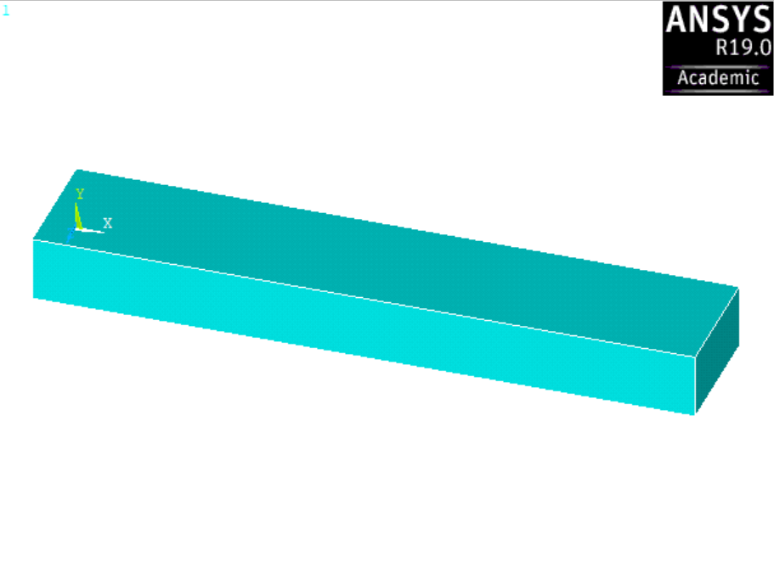
Platform Execution – APDL Scripting
APDL script will generate a mesh for the beam and will loop to vary the beam's mesh size four more times.
With each mesh iteration, the program will loop ten times, applying a point-load force at ten equally spaced x-locations along the top face of the beam.
Fixed Support
X = 0mm
X = 500mm
17

Slide 18
Platform Execution – APDL Scripting
APDL script will generate a mesh for the beam and will loop to vary the beam's mesh size four more times.
With each mesh iteration, the program will loop ten times, applying a point-load force at ten equally spaced x-locations along the top face of the beam.
Fixed Support
X = 0mm
X = 500mm
18

Slide 19
Platform Execution– APDL Scripting
X = 500mm
X = 450mm
(Continue incrementing by -50mm)
. . . . .
X = 50mm
When force iterations are completed from 500mm to 10mm, begin again with new mesh size
19

Slide 20
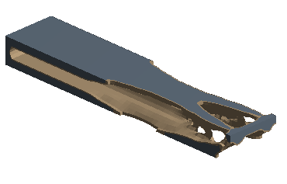
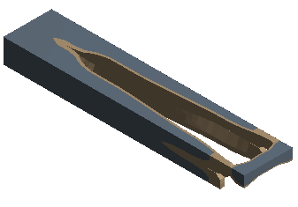
Platform Execution– APDL Scripting
The platform will then run a topology optimization analysis.
10mm Mesh Size, 50% volume retained
20mm Mesh Size, 50% volume retained
20

Slide 21
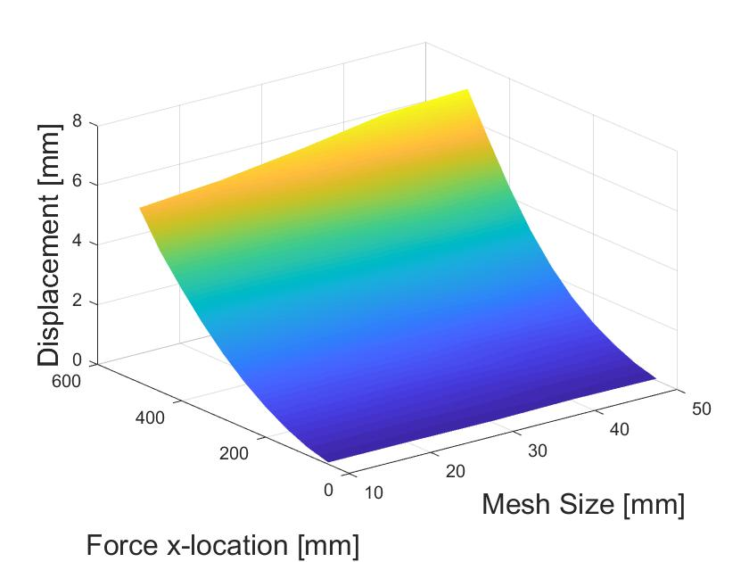
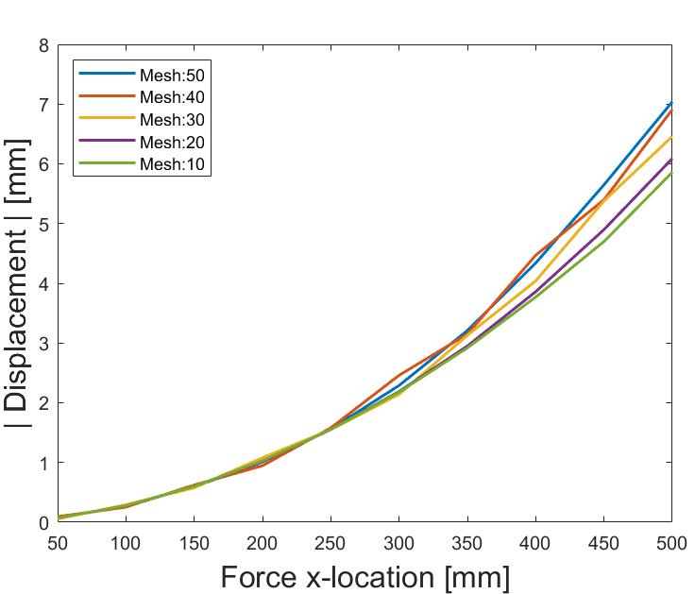
Platform Execution– MATLAB
Read and compare force location, mesh size, and beam displacement results.
Large mesh sizes overestimate the beam's displacement, and converge to an equal value as it gets smaller
21

Slide 22
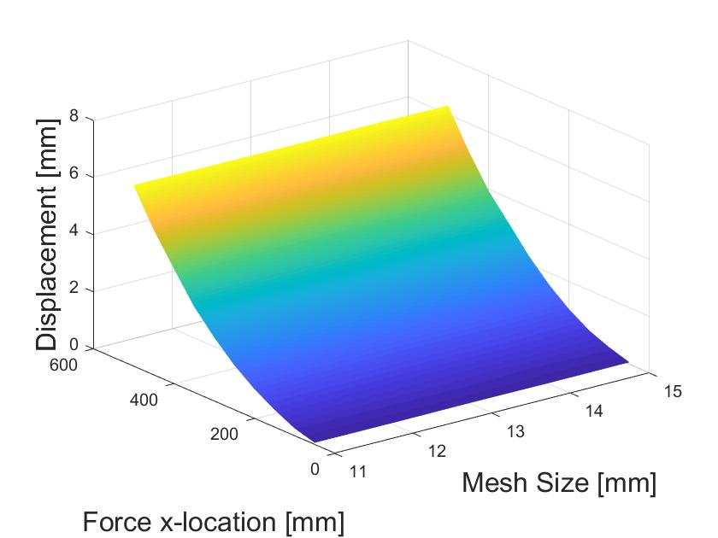
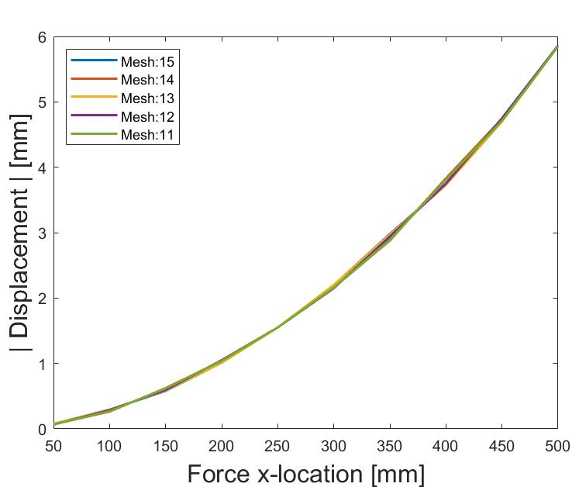
Platform Execution – MATLAB
Effect of mesh size on displacement not visually observable between small increments of size.
22

Slide 23
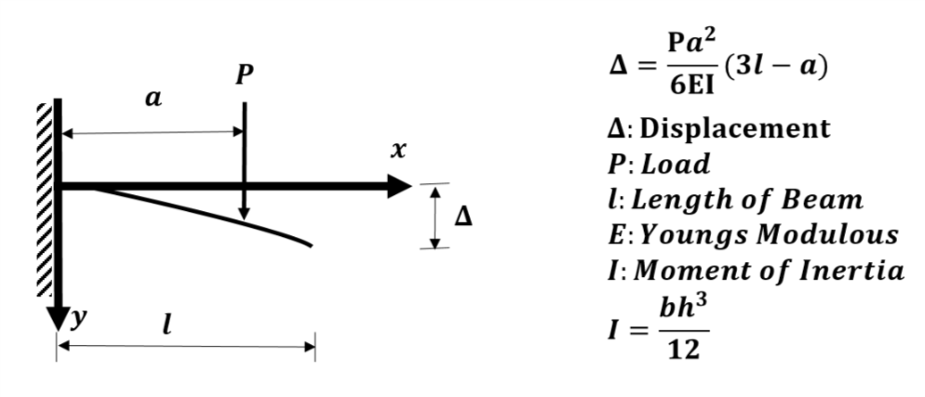
Point Load on Cantilever Beam
Displacement equation: compare experimental results vs. theoretical values.
23
Notes:
High rise structure designs are usually chosen by the architect, skipping the optimized process. The question is how efficient are these structures?
Here is Krystal to give more Background knowledge of our research.

Slide 24
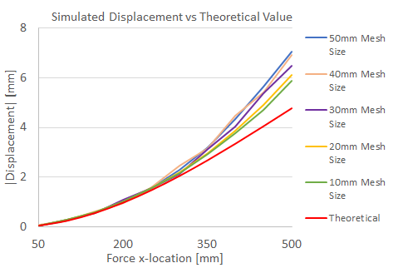
Results Comparison to Theoretical Value
As illustrated, solution is more accurate with a smaller mesh size.
24

Slide 25
Future Plans
Current platform: Automated routine of performing analyses on a simple cantilever beam and outputting displacement results.
Prospective modifications with platform:
    Shape optimization.
    Analyze complex models.
    Export different quantitative results.
25

Slide 26
Conclusion
New programming methods
Topology optimization
Teamwork
Time management
26

Slide 27

Questions?
27

Slide 28
Resources
Some of the figures were accessed from the internet. The copyrights of the figures belong to the original authors.
28

Slide 29
