Slide 1


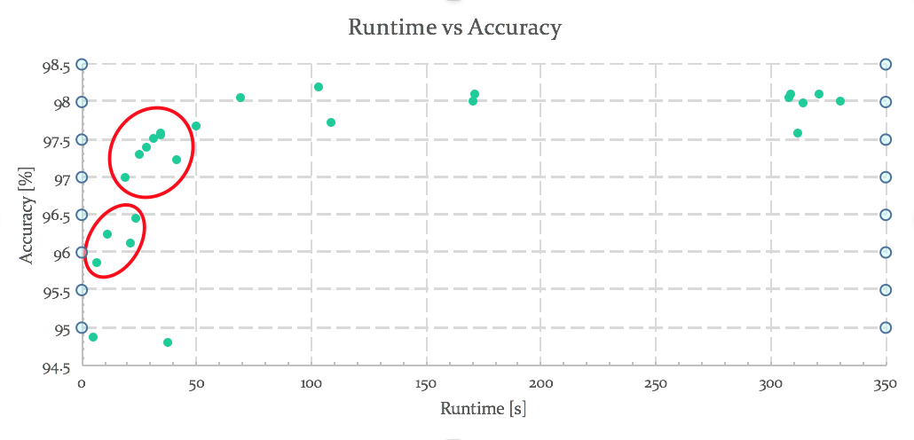
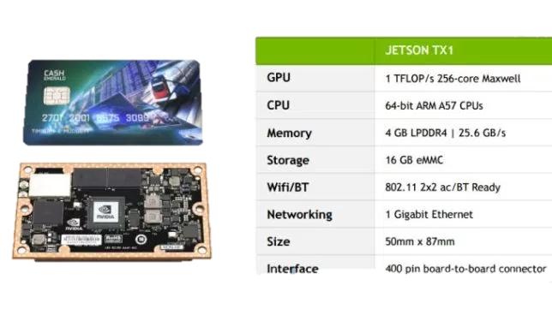
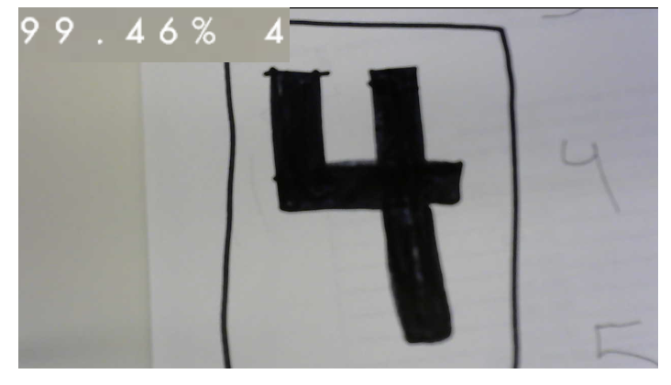
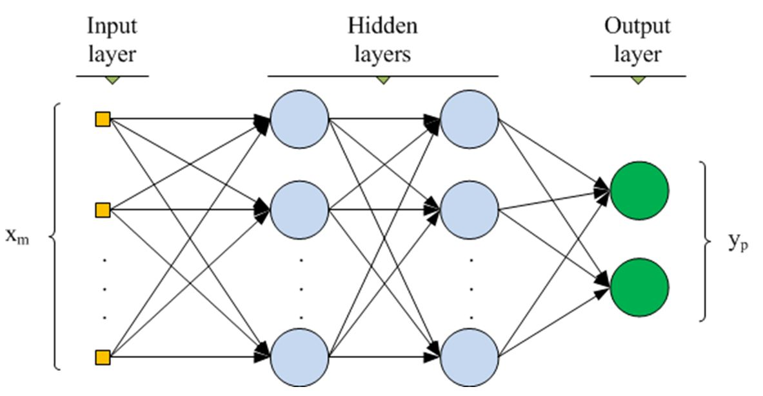
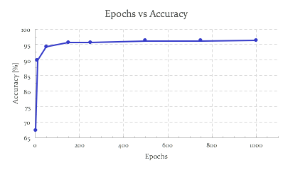

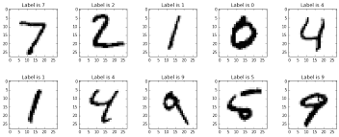
Jetson Ready Neural Network
Alex Choi, Ayesha Iqbal, Jayson Mercurio, Jose L. Guzman
Advisors: Dr. Hao Jiang, Student Mentor: Kevin Yamada
School of Engineering, San Francisco State University, San Francisco, CA 94132, USA
MOTIVATION
JETSON
Learn about the newest technology
NVIDIA Jetson TX1 can bring neural networks to the mobile world
Implement deep learning concepts
NVIDIA’s Jetson is the ideal solution for compute-intensive embedded applications (deploying deep Inference)
Jetson TX1 is used for drones, robots, and other autonomous devices that can use deep learning to identify objects
The Jetson offers high-performance parallel processing power from onboard GPU, while consuming less than 10 watts of power
OBJECTIVE
Build a classification model for the MNIST dataset
Deploy and optimize the neural network on the Jetson using TensorRT
Validate and analyze the predictive model on the Jetson with various environmental factors
 | JETSON TX1
GPU | 1 TFLOP/s 256-core Maxwell
CPU | 64-bit ARM A57 CPUs
Memory | 4 GB LPDDR4 | 25.6 GB/s
Storage | 16 GB eMMC
WIFI/BT | 802.11 2x2 ac/BT Ready
Networking | 1 Gigabit Ethernet
Size | 50mm x 87mm
Interface | 400 pin board-to-board connector
Fig 6. Fast deployable model with limited accuracy loss
Batch Size | 1024
Epochs | < 100
Learning Rate | 0.01
Activation Function | ReLU
Hidden Units | 800
Optimizer | Adam
Layers | 1
ARCHITECTURE OF FAST DEPLOYABLE MODEL
Real-time Digit recognition using Deep Learning.
Multi Layer perceptron (MLP) is a feedforward neural network with one or more layers between input and output layer
RESULTS
MODEL VALIDATION
  Default parameter values chosen from conventional/common values found through published literature
  Further trained and analyzed constructed models from combining ideal parameters by using epoch - cost and runtime – accuracy analysis
FUTURE WORK
Single Parameter Tuning
Use more complex Dataset such as affNIST
Work with convolutional network
Hidden Units vs Accuracy
(MNIST) data set is a collection of handwritten digits from 0-9
Grey scale (black and white)
Resized (28x28)
ACKNOWLEDGEMENTS
This project is supported by the US Department of Education through the Minority Science and Engineering Improvement Program (MSEIP, Award No. P120A150014); and through the Hispanic-Serving Institution Science, Technology, Engineering, and Mathematics (HSI STEM) Program, Award No. P031C110159. ​
Fig 4. Displays ideal number of epochs
Fig 5. Displays ideal number of Hidden units
Notes:
This project is supported by the US Department of Education through the Minority Science and Engineering Improvement Program (MSEIP, Award No. P120A150014); and through the Hispanic-Serving Institution Science, Technology, Engineering, and Mathematics (HSI STEM) Program, Award No. P031C110159. ​

