Slide 1


Efficient Logic Design Using Spin Transfer Torque Memory Technology & Lookup Tables
Advisor: Hamid Mahmoodi
Group Mentor: Ali Attaran
Members: Brandon Leung, Yu Ting Huang, Fernando Lorenzo, Sergio Rodriguez, Janine Young
School of Engineering
San Francisco State University San Francisco, CA
August 2016
Notes:
Brandon
Our title slide. Everyone agree? :) “banana do your work” leung…. So keep font consistent….
“Hello everyone my name is…….. We’d like to thank you for attending our presentation on ‘title’.”

Slide 2
Overview
Spin Transfer Torque (STT) Memory
STT Based Look Up Tables
Research Goals: Optimal Hybridization of Custom CMOS and STT-LUT
Adder Case Study
Individual Gate Mapping
Multiple Gate Mapping
Conclusion
Notes:
Brandon
In this presentation we will go over…...

Slide 3
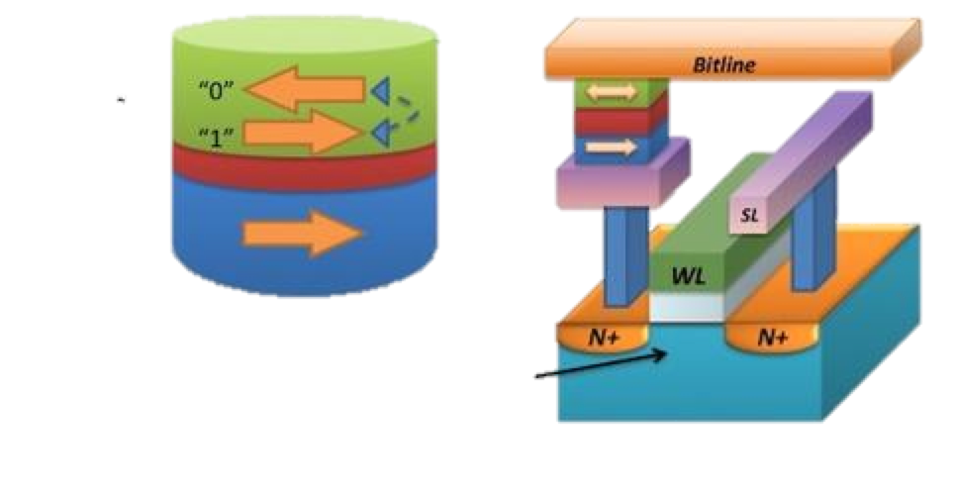
Spin Transfer Torque Random Access Memory (STTRAM)
Reconfigurable information storage technology
Information is stored as magnetic orientation in a Magnetic Tunnel Junction (MTJ) Device
MTJ is compatible with standard IC process (CMOS) and manufactured transistors
Notes:
Sergio
STT offers advantages when compared to current memory storage technology such as flash, SRAM and DRAM. STT is a reconfigurable technology which means that the IC design can be changed once already manufactured. This means that IC design would be more secure and Intellectual Property(IP) would be harder to pirate. STT uses MTJ as a storage device

Slide 4

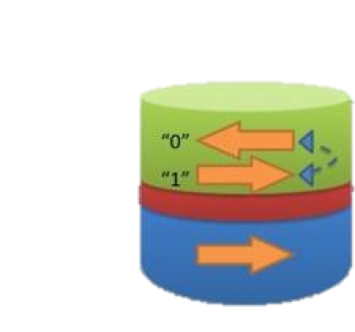
Magnetic Tunnel Junction (MTJ)
Composition
  Two ferromagnetic layers
    Free layer - magnetic field orientation can be changed
    Fixed layer - magnetic field orientation cannot be changed
  Oxide barrier
Used to store information
  Information is sense as resistances (high and low)
Notes:
Sergio
MTJ are logic memory storage devices made with two ferromagnetic layers and an oxide barrier between the layers. There is one fixed layer whose magnetic orientation cannot be changed. There is also a free layers whose magnetic orientation can be changed. MTJ can have two states: parallel and antiparallel. The parallel state holds logic state 0(low resistance); the antiparallel state holds logic state 1(high resistance).

Slide 5
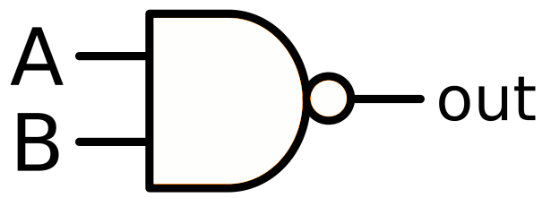
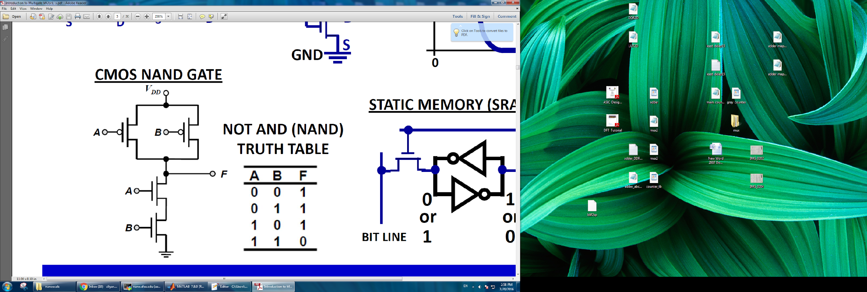
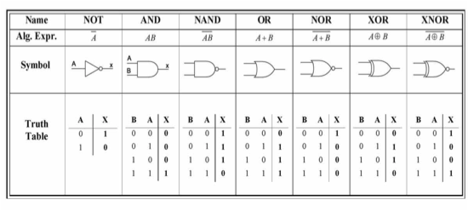
Logic Gates in Custom CMOS
Logic gates designed using custom-made transistors
Configuration is fixed and
non-programmable after manufactured
Notes:
Andrea

Slide 6
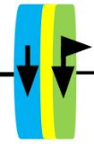
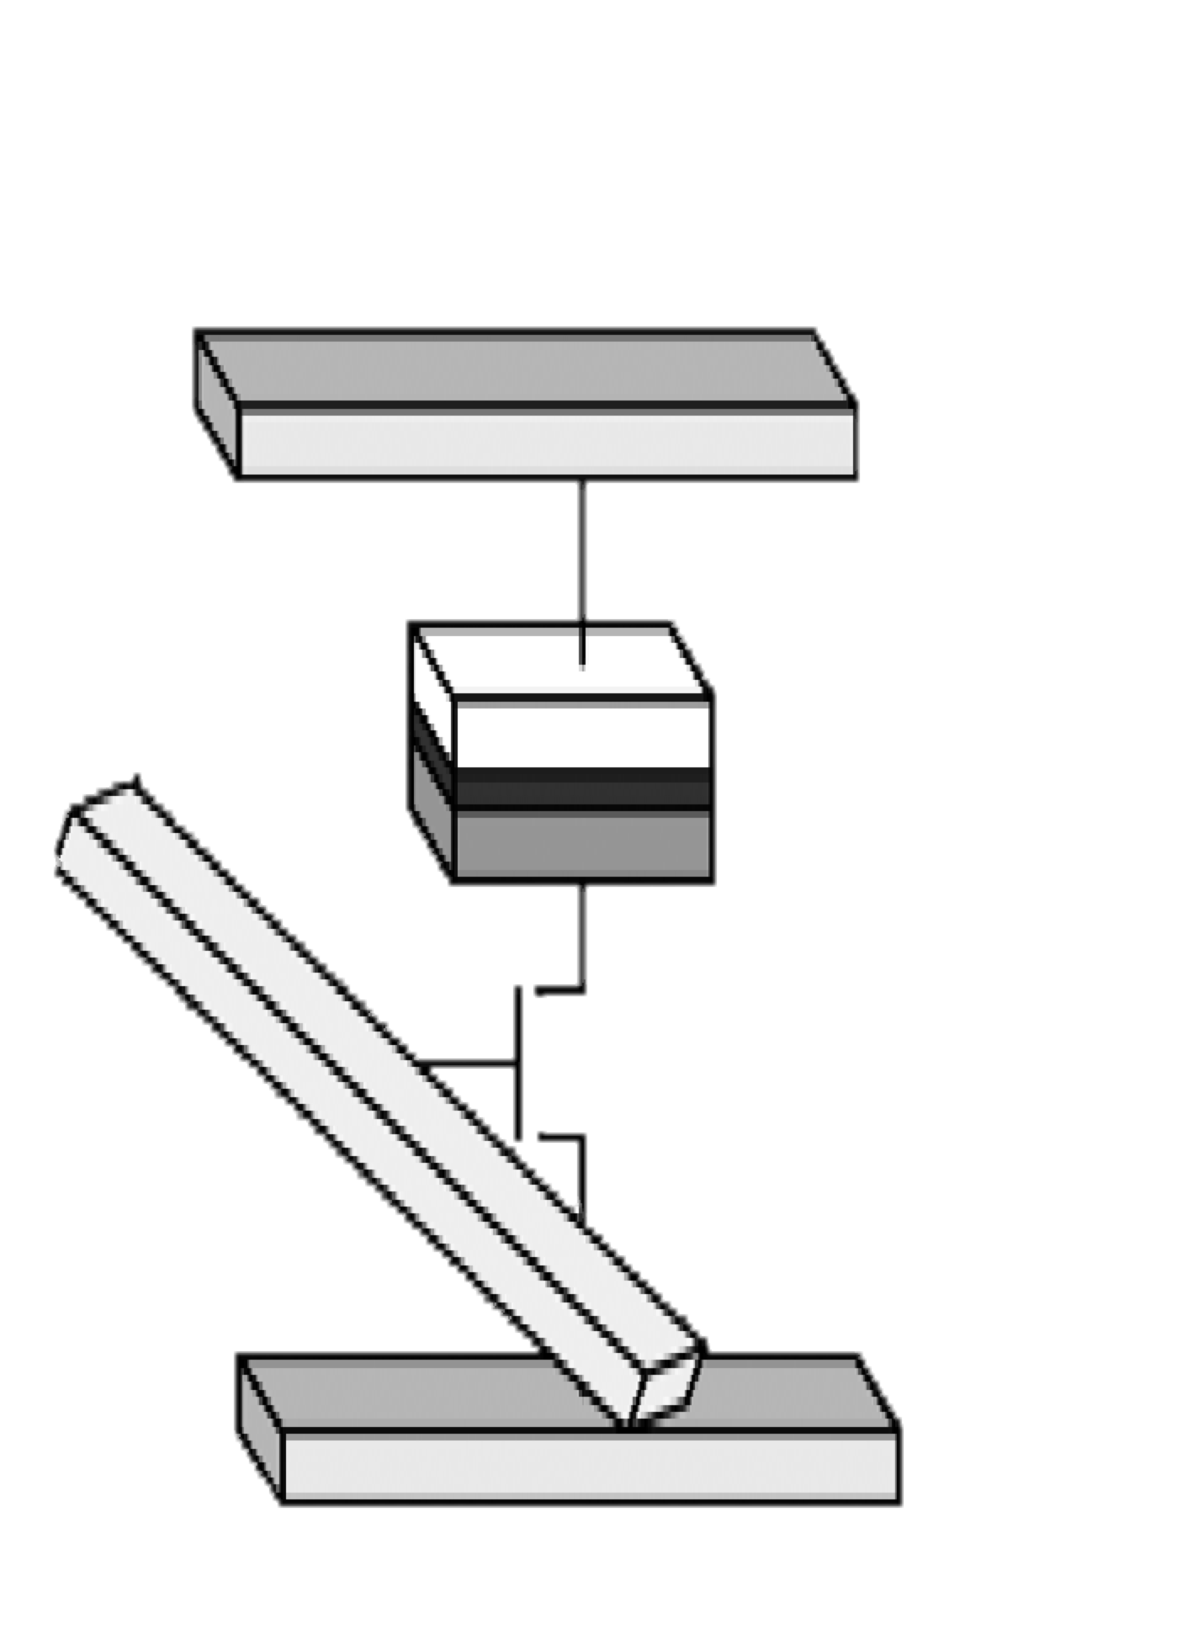
STT Based Look Up Table (STT-LUT)
STTRAM cell
bit line
word
line
source line
Each STT-LUT consists of a number of multiplexers and STTRAM
Mux
Mux
Output signal
Mux
Each MUX consists of a number of logic subcircuits
n selector inputs
Notes:
Andrea

Slide 7
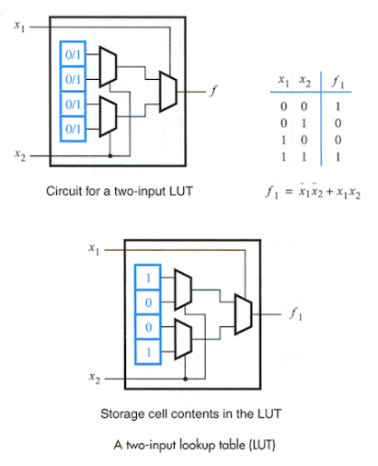
Logic Mapping Using LUT
By programming the MTJs, we can map any arbitrary logic function
LUT fan-in sets a limit on number of input variables
LUT is single output
XNOR gate
Notes:
Andrea

Slide 8
Advantages and Disadvantages of using STT-LUT
Advantages:
More difficult to reverse engineer
Non-volatility
CMOS compatibility
Disadvantages:
Power Consumption
Delay Overhead
Area increment
Notes:
Andrea

Slide 9
Research Goals
Create hybrid design of logic circuits using a mix of custom CMOS and STT-LUTs
Experiment this optimization on adder test circuit
Optimal hybridizations pathways that utilizes efficiency of custom CMOS and programmability of LUTs
Notes:
Fernando

Slide 10
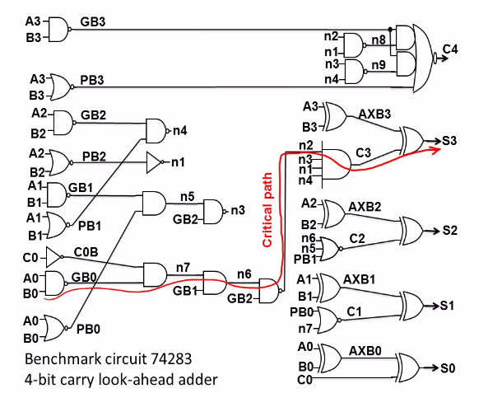
Case Study: 4-bit Adder
Individually map gates and then proceed to multiple gate mapping
STT-LUT mapping of gates will increase performance penalties
Notes:
Fernando
An adder is basically a circuit that adds bit numbers. The 4-bit adder, created using a Hardware Description Language called Verilog, adds 2 4-bit numbers to create two outputs, a 4-bit sum and a carry. A3 would be added with B3, A2 with B2, and so on.
Our goal is to map as many gates with STT-LUTs into this adder to create a hybrid circuit that consists a mix of STT-LUTs and Custom CMOS gates
Unfortunately using STT-LUTs consequently increases penalties in performance areas like power consumption and delay, so we need to carefully analyze how each gates can affect the 4-bit adder performance.

Slide 11
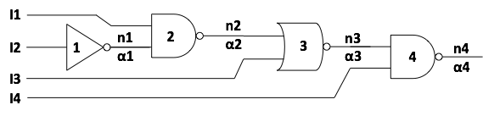
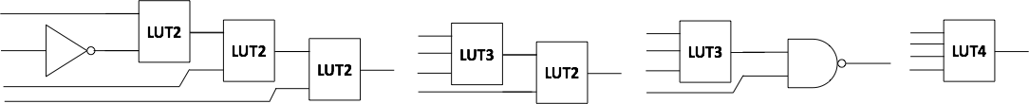
Individual Gate Mapping
Each logic gate can be replaced by Lookup Table programmed with the truth table of the logic gate
Simulate and analyze delay, power, and area from each mapped gate
I2
I3
I4
Notes:
Fernando
To find out how each gate affects the overall performance of the circuit, we replaced each individual gate with its respective LUT and then simulated it.
Since there are 30 gates that make up the adder, we ran 30 simulations and analyzed 30 unique sets of data. Here is a visual representation of individual gate mapping. The 3-input NOR gate is replaced with an LUT3. It’s called LUT3 because it accepts 3 inputs.

Slide 12
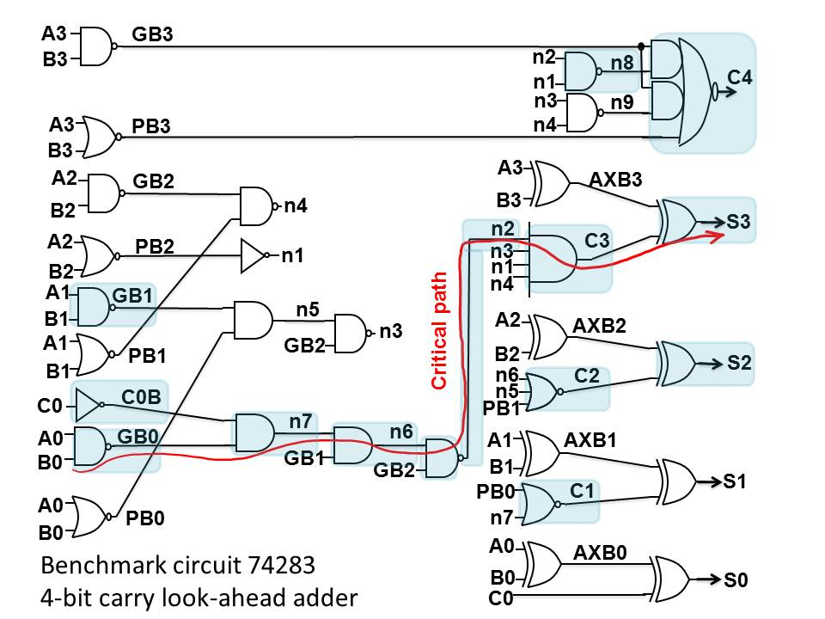
Logic Gates with Delay Overhead
LUT replacement of all the gates on the critical path causes delay overhead
LUT replacement of some non-critical gates results in delay overhead and change of the critical path
Notes:
Sergio
We also have our observation of the critical output, which tells us where the critical path (the path from input to output with most delay) ends and if the critical path changed at all.
The highlighted gates in this figure are the ones that produce delay overhead, meaning when that gate is replaced with an LUT the adder experienced more delay than without implementation. As expected, LUT replacement of all the gates on the critical path, which in this case is the path with the most gates, causes delay overhead. There are also some gates
From our results, we observed that the most of the gates with LUT implementation did not have a change in critical path, except gates S2 and C4. We think that due to C4 having 5 inputs and S2 having an input from C2, which also has delay overhead, the critical path has changed.
The highlighted gates in this figure are the ones that produce delay overhead. As expected
The highlighted gates produced delay overhead. GB1: 27 C0B: 28 N8: 27 C4: 43
Explain more about delay overhead and how critical output would change accordingly

Slide 13
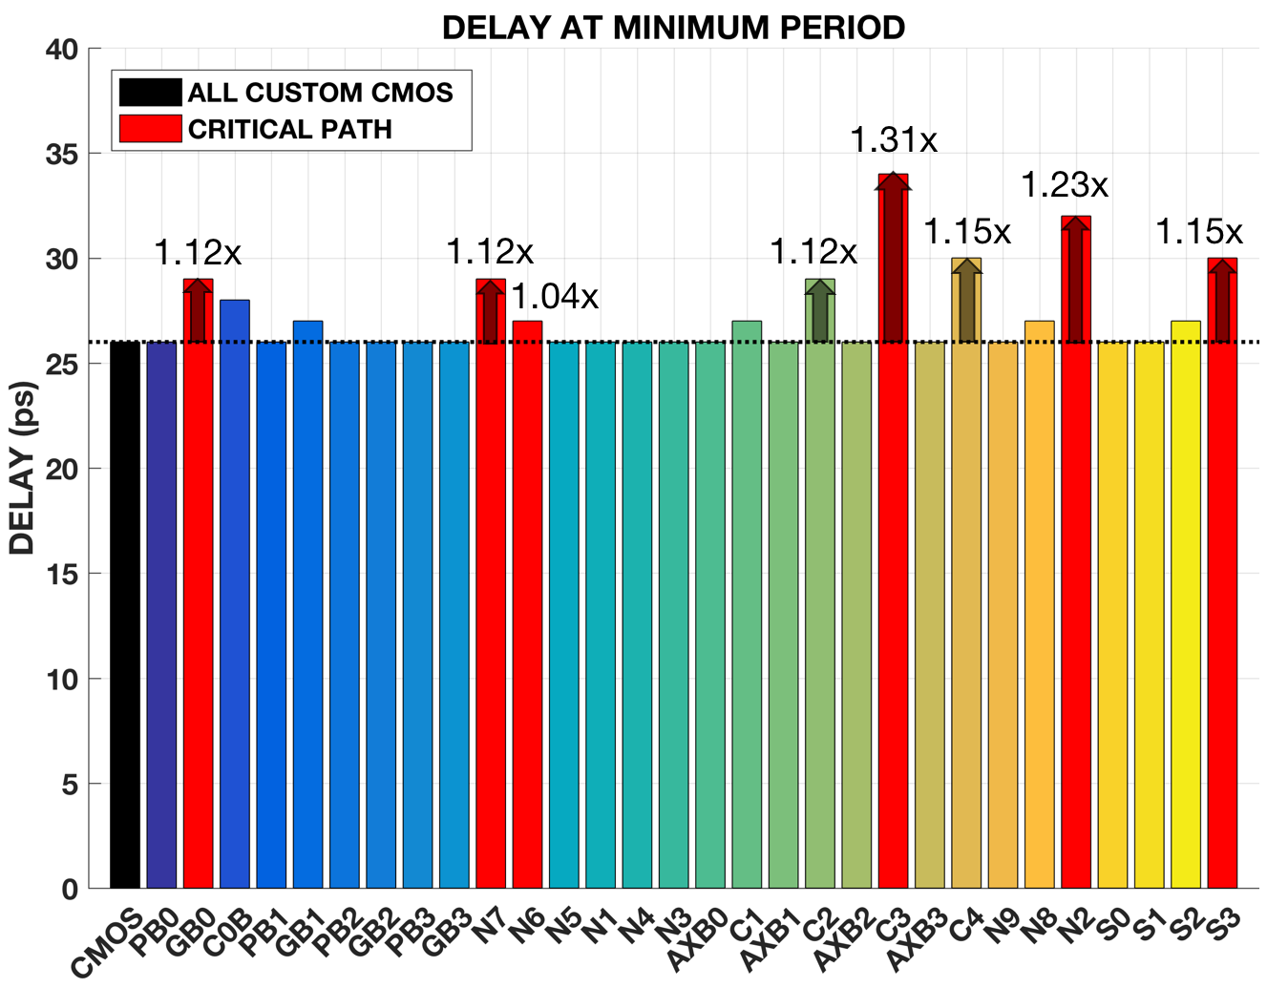
LUT replacement of a gate may result in delay overhead
Notes:
Sergio
What is %? How much increase/decrease?
Lut replacement of a gate may result in delay overhead.

Slide 14
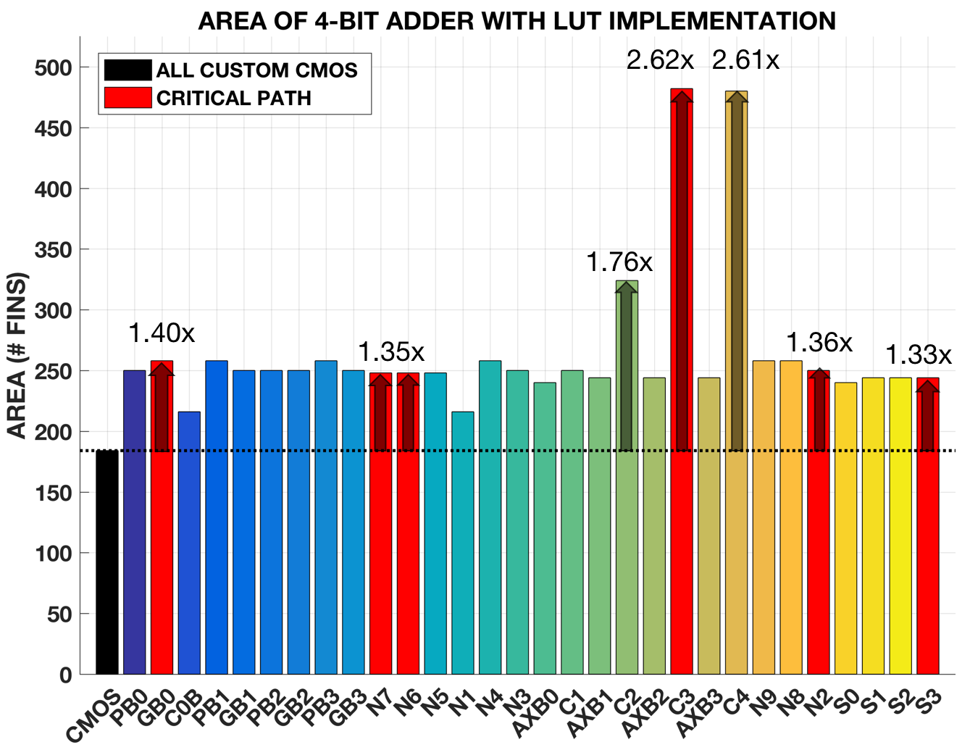
Area is determined by number of transistors
LUT replacement of any gate results in area increase
Notes:
Sergio
Results in area increase.

Slide 15
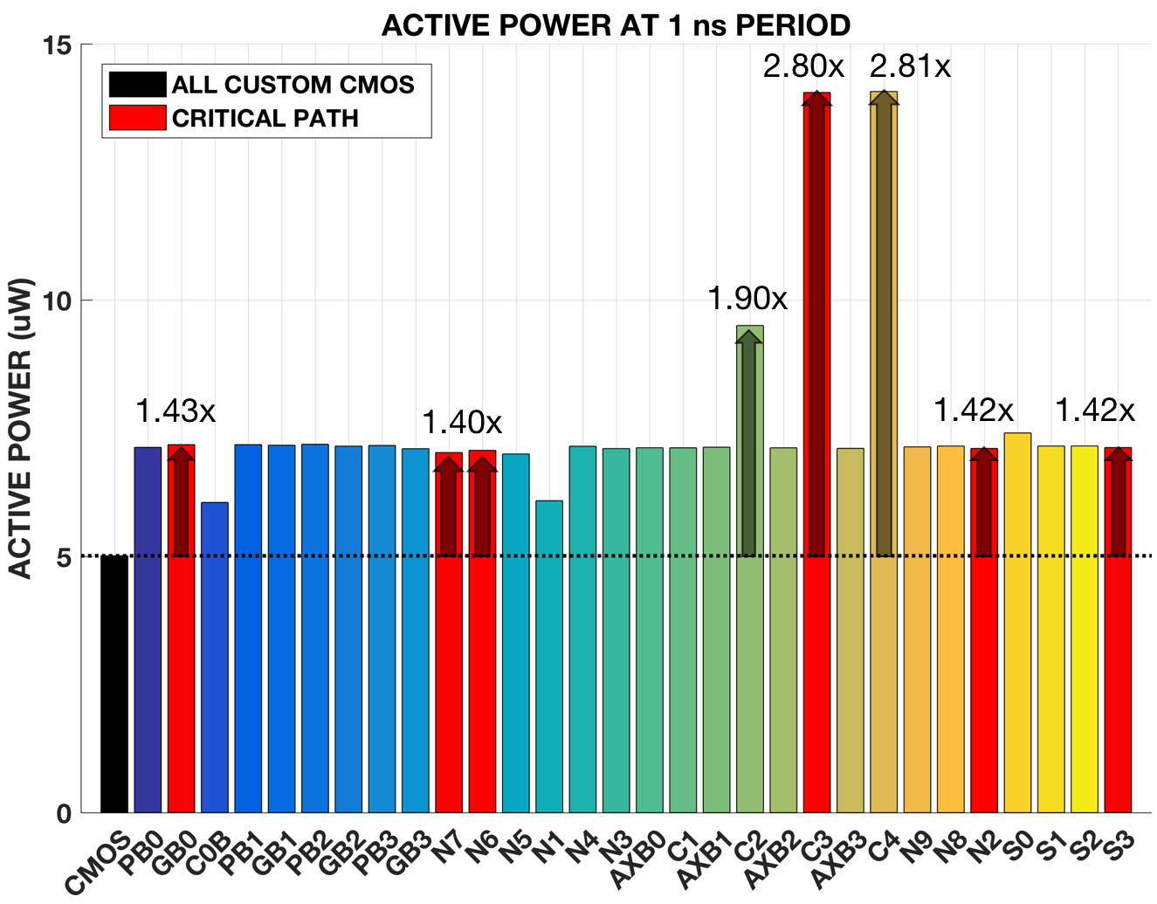
LUT replacement of any gate results in power overhead
Notes:
Sergio
Just 1 ns period.
LUT replacement of any gate results in power overhead.
Labeled our current troublesome gates
Add arrows to and label how much more the gate’s power consumption is in relation to all cmos

Slide 16
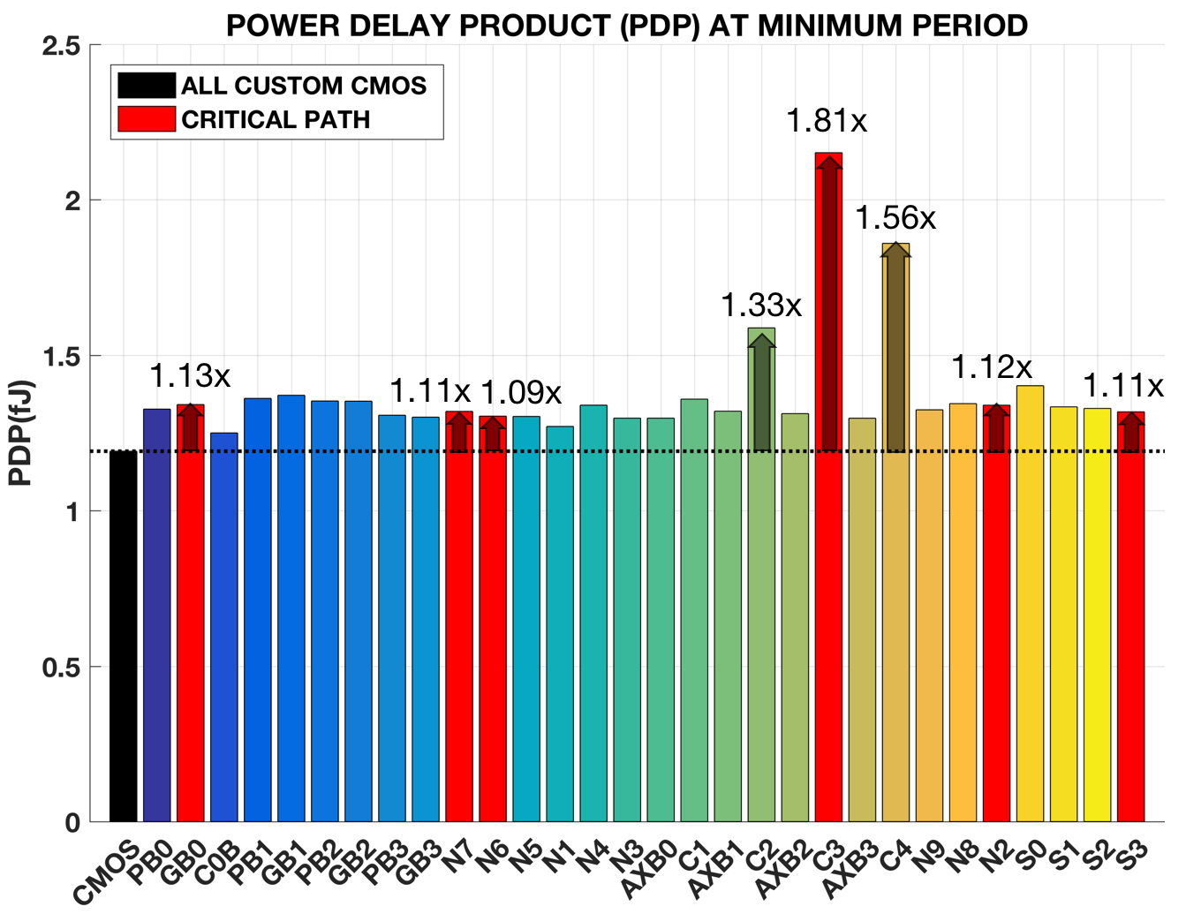
LUT replacement of any gate results in PDP increase
Notes:
Sergio
Add bullets points for result.
Pdp is a measure of energy consumed per addition. LUT replacement of any gate results in PDP increase.

Slide 17
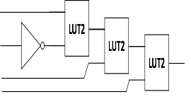
Multiple Gate Mapping
Map multiple gates simultaneously and extract data
Optimization algorithms
  Independent Selection
  Dependent Selection
  Parametric-Aware Dependent Selection
Notes:
Brandon
After retrieving data on how each gate affects the circuit, we moved on to multiple gate implementation, which is mapping multiple gates at once and then running a simulation. Because there were too many combinations, we used three optimization algorithms to determine which gates should be replaced with LUTs. These algorithms are Independent Selection, Dependent Selection, and Parametric-aware Dependent Selection. These were obtained from a previous study.

Slide 18
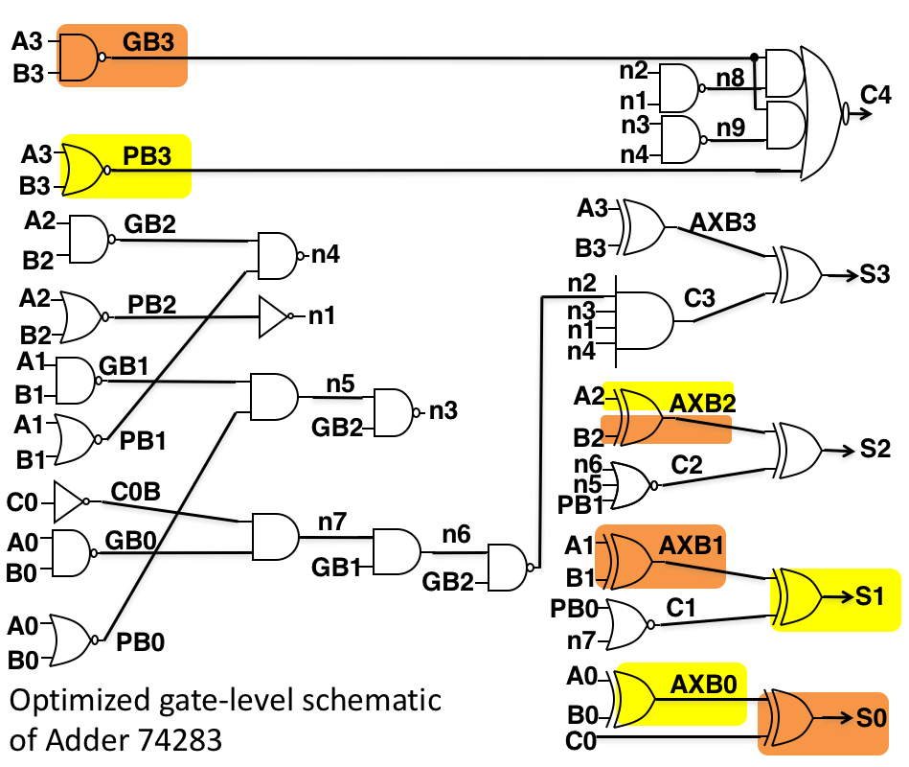
Independent Selection
Select gates that are not along the same path
Notes:
Brandon
For independent selection, the gates that are selected to be mapped are independent of each other, in other words they do not share the same pathway. In this image, there are two cases of independent selection. In the first case, GB3, AXB2, AXB1, S0 are mapped simultaneously and the data is extracted. For the second case, PB3, AXB2, AXB0, S1 are mapped.

Slide 19
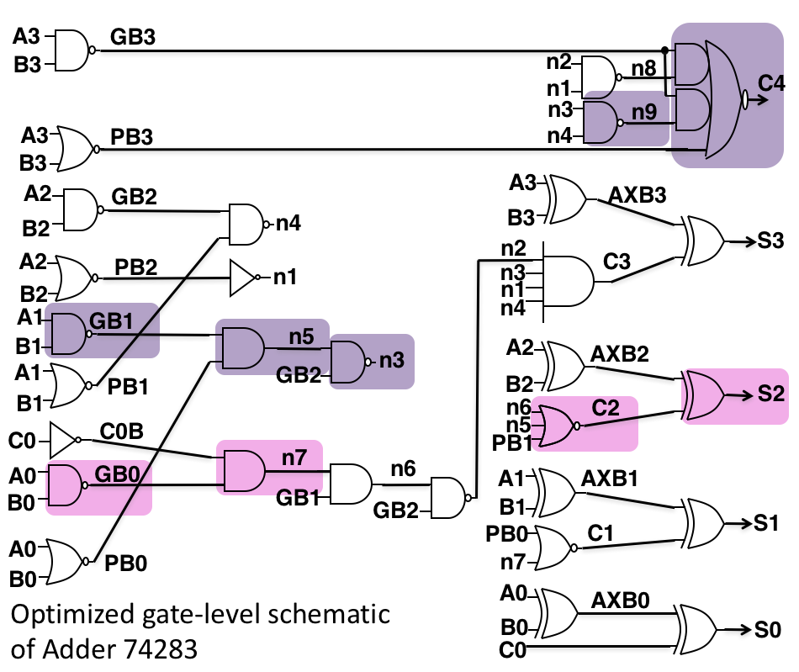
Dependent Selection
Select gates that are along the same path or subsequent to each other
Notes:
Brandon
For Dependent selection, the gates that are selected are along the same pathways, directly or indirectly. An example of direct connection would be at GB1. All gates along the pathway starting with GB1 are replaced with LUTs. The second case is an indirect connection due because there is a break in the pathway at n6.

Slide 20
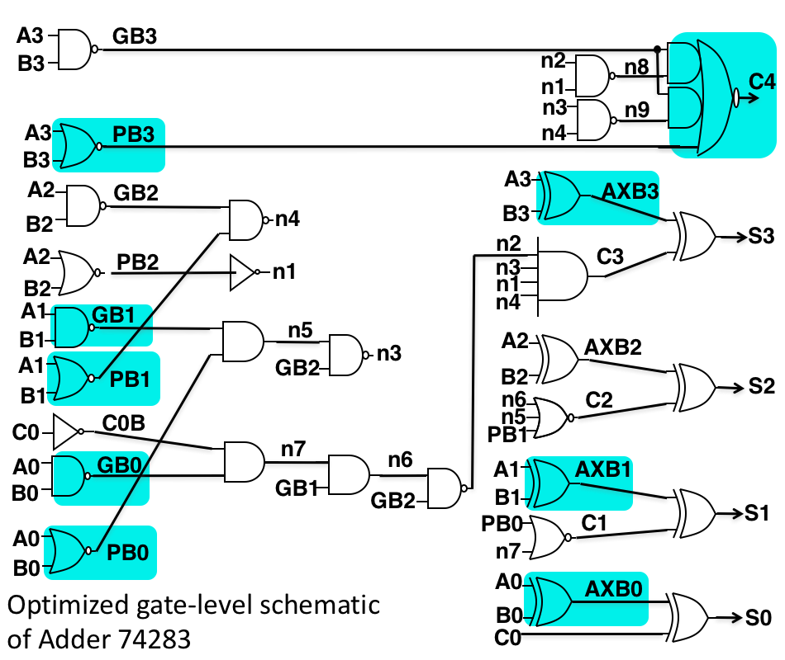
Parametric-Aware Dependent
Select gates that do not severely impact the delay, regardless of dependency
Notes:
Brandon
For Parametric-aware, gates are selected by how large of an impact it has on the delay. The dependency of the gates do not matter as long as the implementations do not severely affect the time delay. All gates here do not produce any delay overhead when mapped with the exception of C4. We chose to map C4 because of the complexity of the gate. Leaving a gate like C4 unmapped would be detrimental to the circuit’s security.

Slide 21
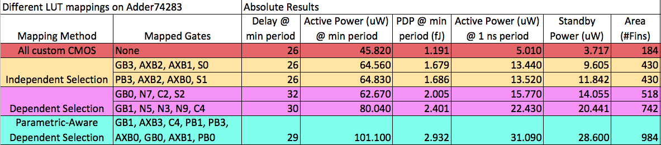
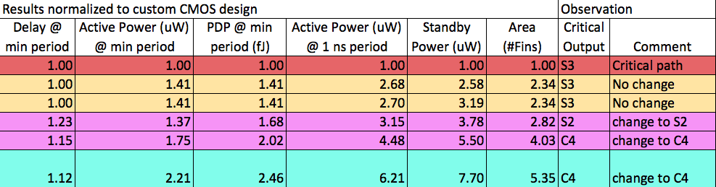
Multiple Gate Mapping Results
Notes:
Janine
Now that we have our mapping selection method and our individual gate results, we can do a multiple gate mapping where we also measure the delay, active power at the minimum period and 1 ns period, the PDP, standby power and area. We also have our normalized results, which is our absolute results over the all custom CMOS results, in which the adder has no LUT implementation. And we have our observation of the critical output, which tells us if the critical path has changed.
The red row represents the all custom CMOS. The yellow row represents the independent selection, these are just two sets of the 12 possible combinations. The pink row is the 2 dependent selections and the blue row is the parametric aware dependent selection.

Slide 22
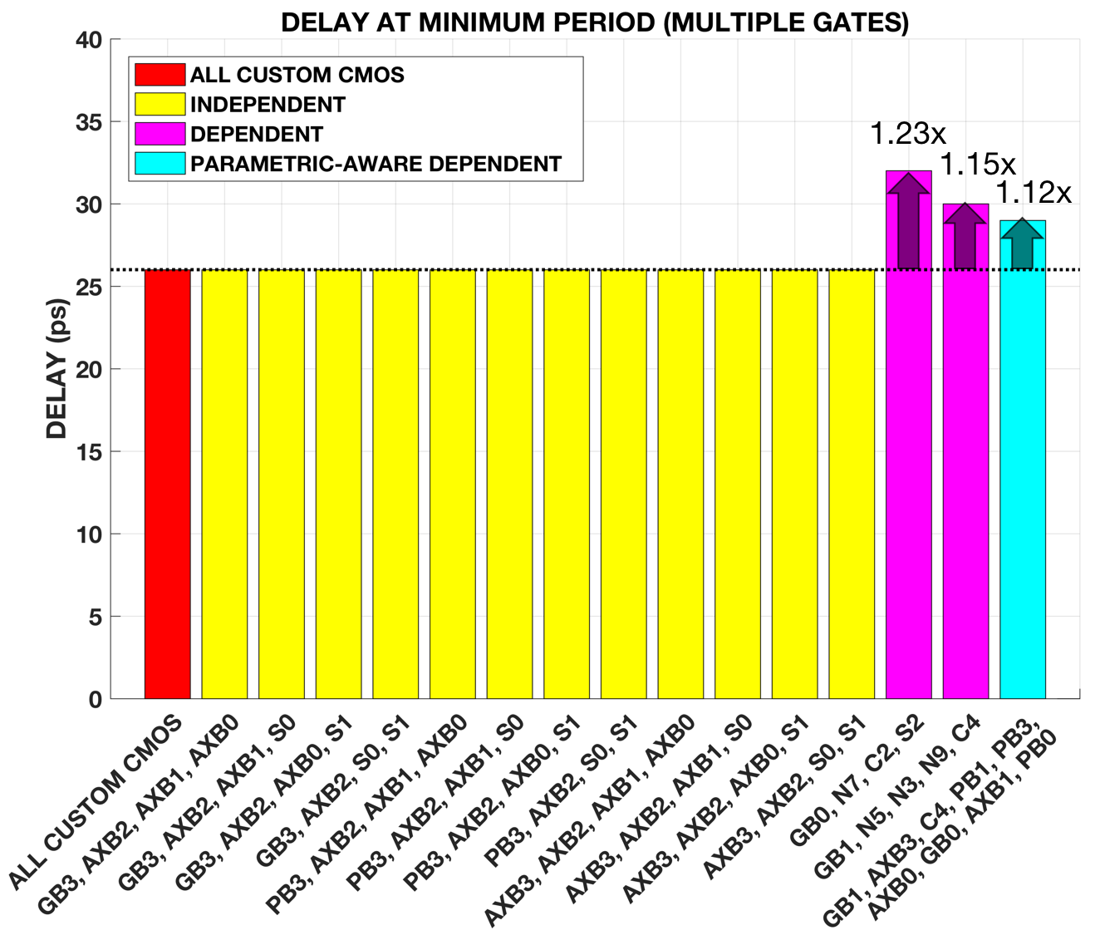
Independent selection has no delay overhead
Dependent and parametric-aware dependent selection produce delay overhead
Notes:
Janine
This bar graph represents the delay at minimum period in all three selection methods and the all custom CMOS case. As you can see, LUT replacement of multiple gates produces no delay overhead for the independent selections. And this is because the individual gates chosen also do not produce delay.
There is delay overhead for both dependent and parametric-aware dependent selections. The first case of dependent selection results in the most overhead, a delay 1.23 times greater than the all custom CMOS. And this is because all of the individual gates chosen for mapping have delay. The second dependent selection has a lesser overhead, because only two of the gates chosen have delay. The parametric-aware dependent selection has even lesser overhead, even though its mapping many more gates, and this is because the chosen gates are not all in the same pathway, unlike the dependent selection, and the overhead is also caused by some gates with delay.
(There is more overhead in the dependent selection, despite having lesser gates implemented than the parametric-aware dependent. When gates in the same pathway are replaced with LUTs, the input of one gate is dependent on the other, so it is possible for more delay to carry over.)

Slide 23
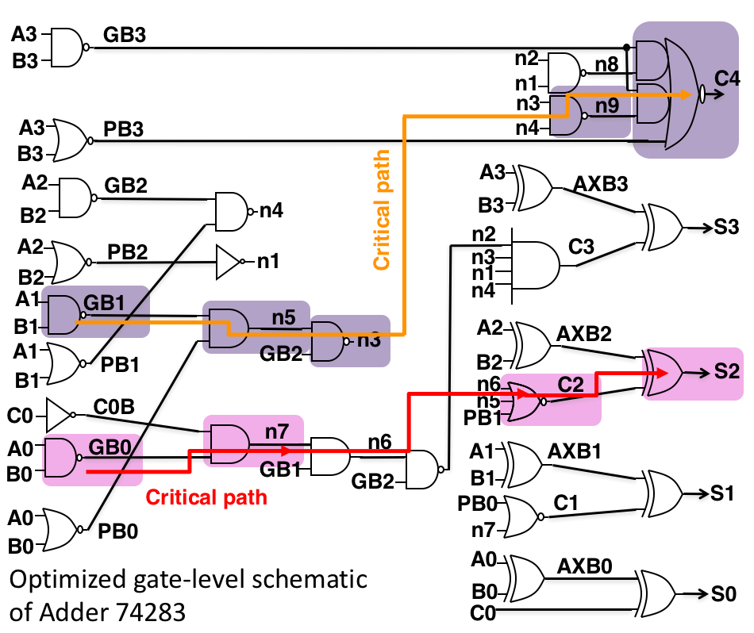
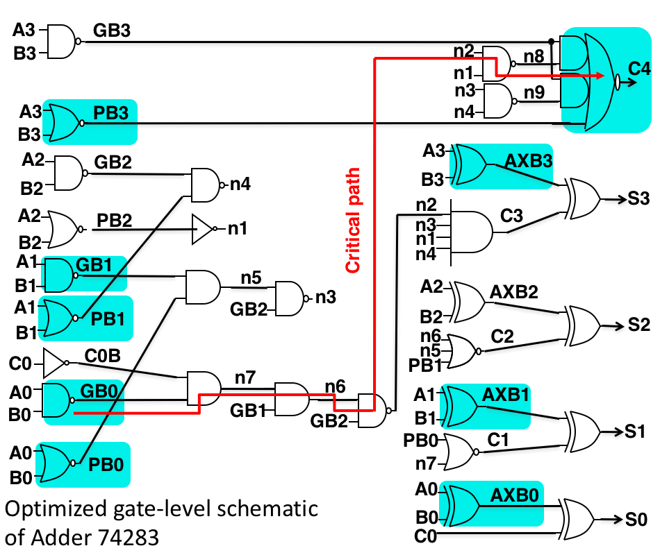
Critical path does not change when mapping independent selections
Critical path changes when mapping dependent and parametric-aware dependent selections

Slide 24
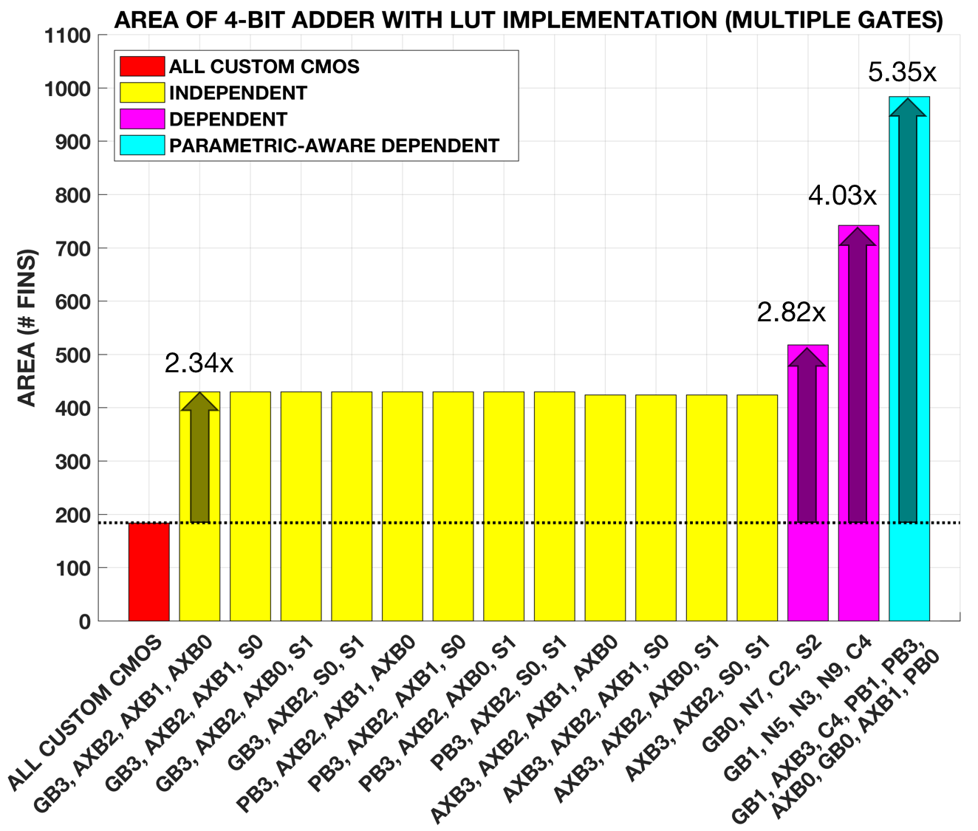
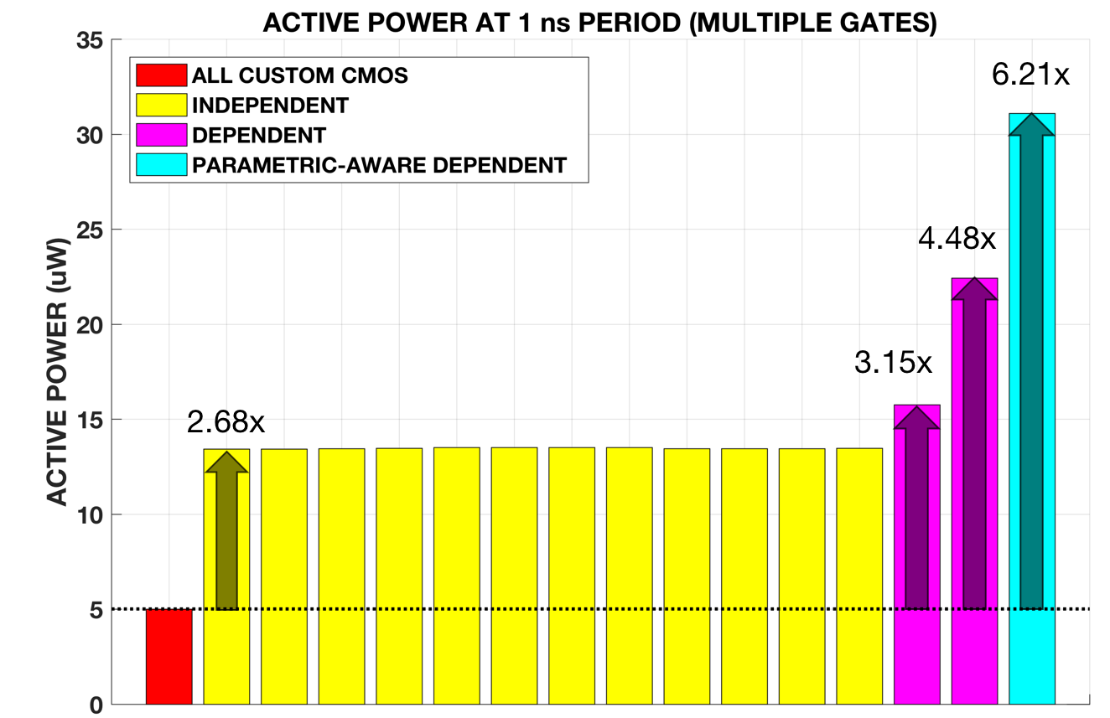
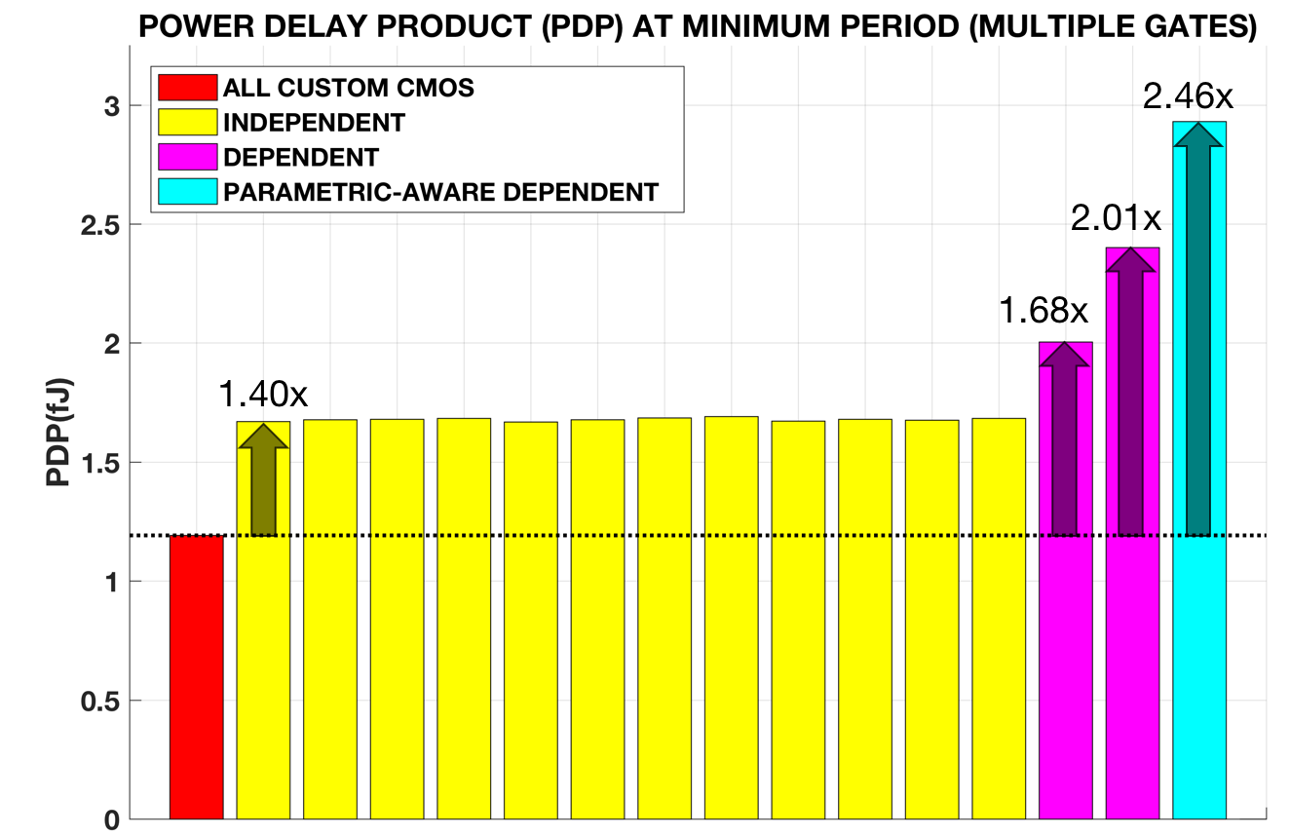
LUT replacement of multiple gates result in area, power, and PDP overhead
Independent selections result in the least area, thus requires the least power and PDP
Parametric-aware dependent selection results in the most area, thus require the most power and PDP

Slide 25
Conclusion
Independent selection causes no delay overhead and uses the least power to operate but is the easiest to reverse-engineer
Dependent selection is more difficult to reverse-engineer but shows the longest delay overhead
Parametric-aware dependent selection is more difficult to reverse-engineer than independent and less delay than dependent but requires more power
Notes:
Fernando

Slide 26
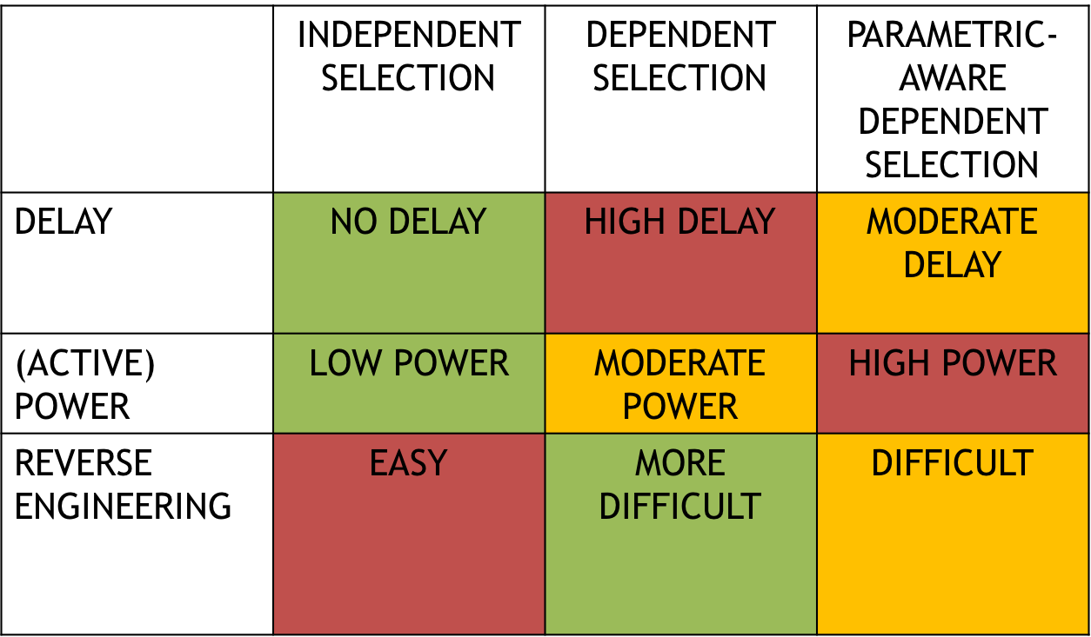
Conclusion

Slide 27
Acknowledgements
Advisor: Dr. Hamid Mahmoodi
Mentor: Ali Attaran
Dr. Amelito Enriquez

Slide 28
References
Almasi, D., Enhancing Hardware Security Using Spin Transfer Torque Logic, in Engineering of Embedded Electrical and Computer Systems. 2015, San Francisco State University: San Francisco.
Winograd, T., et al. Preventing Design Reverse Engineering with Reconfigurable Spin Transfer Torque LUT Gates, in 2016 17th International Symposium on Quality Electronic Design. (ISQED). 2016.
Mano, M. Morris and Kime. Charles R. Logic and Computer Design Fundamentals. New Jersey: Pearson Education, 2008. Book.

