Slide 1


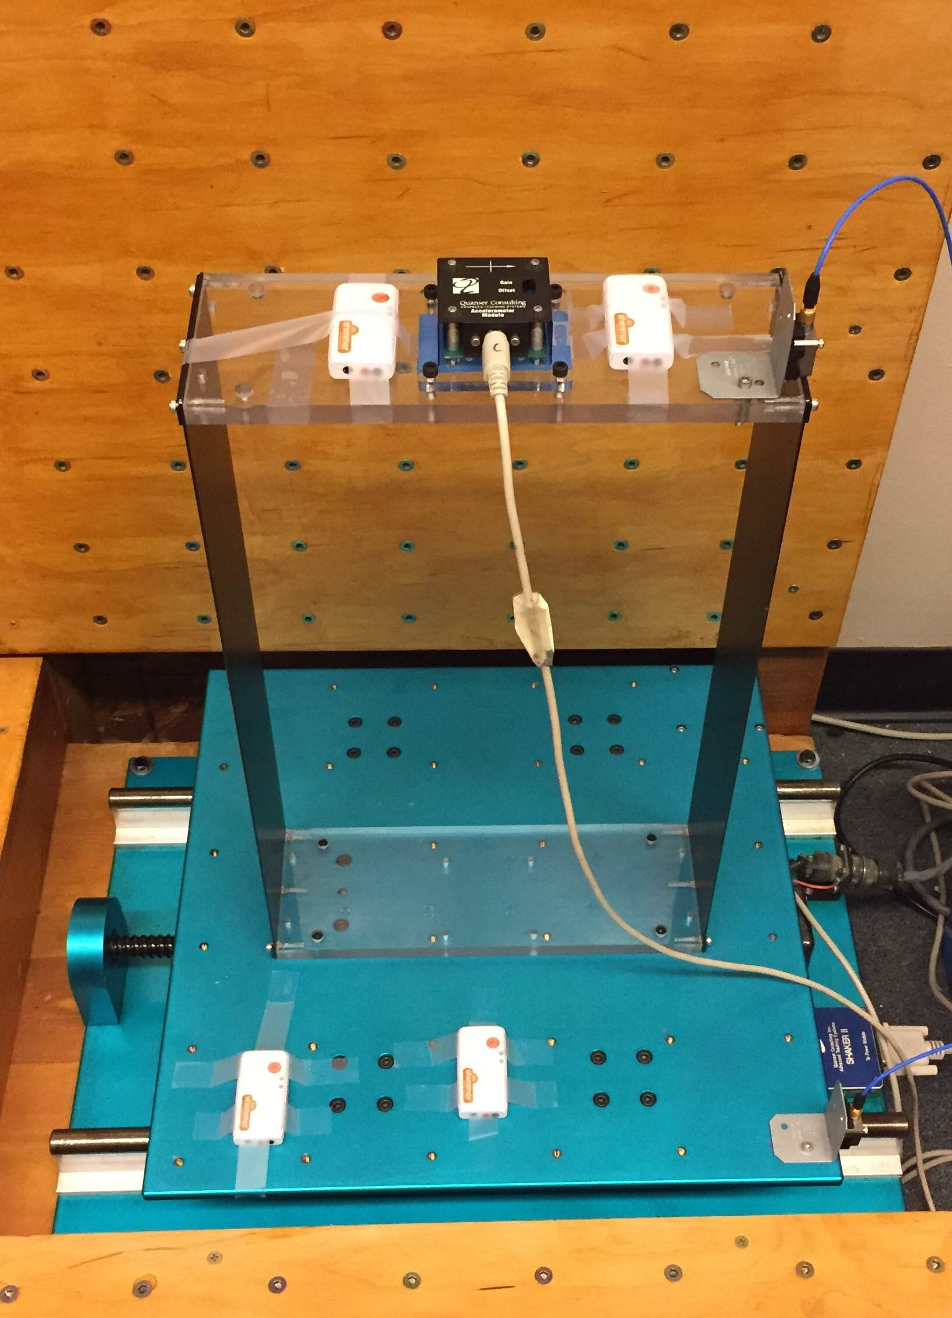
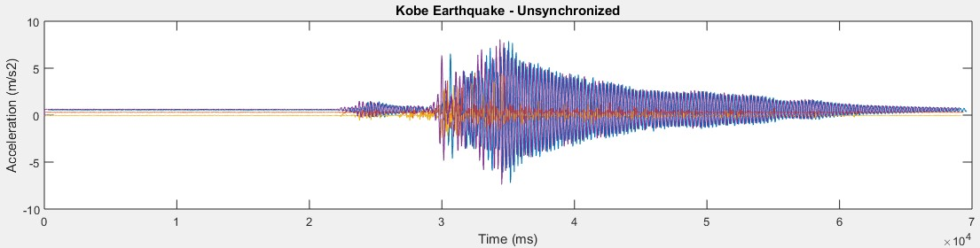
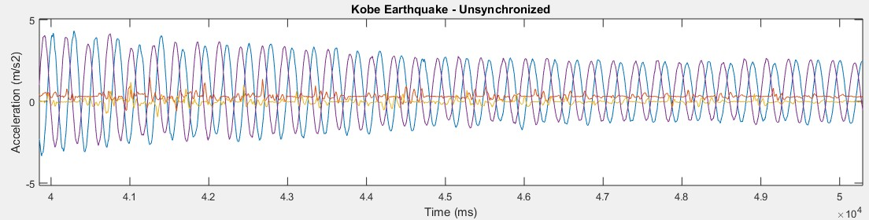
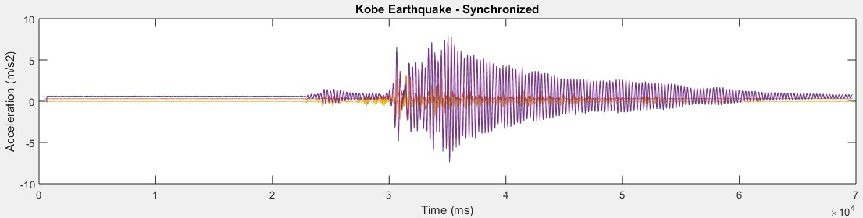
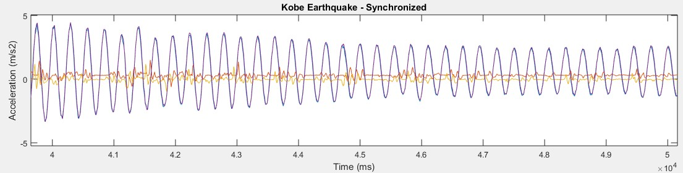
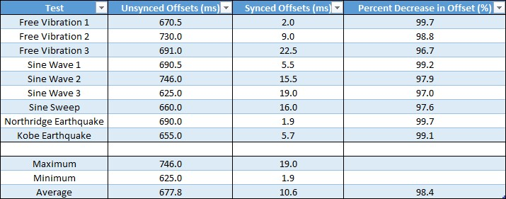
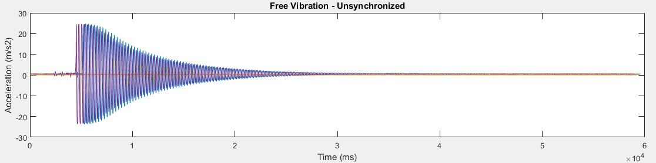
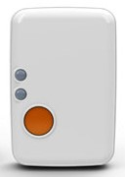
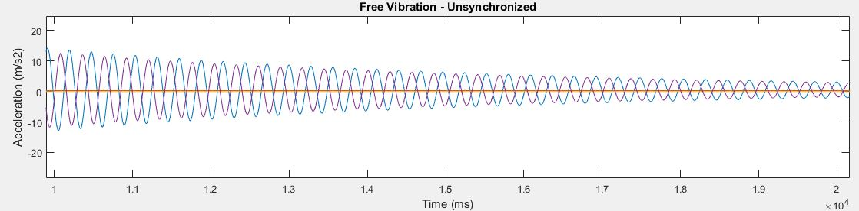
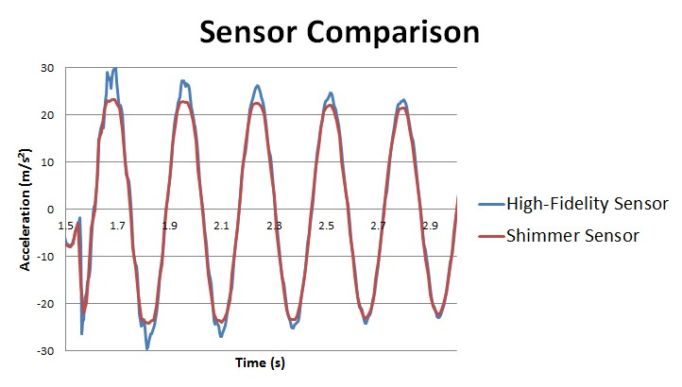

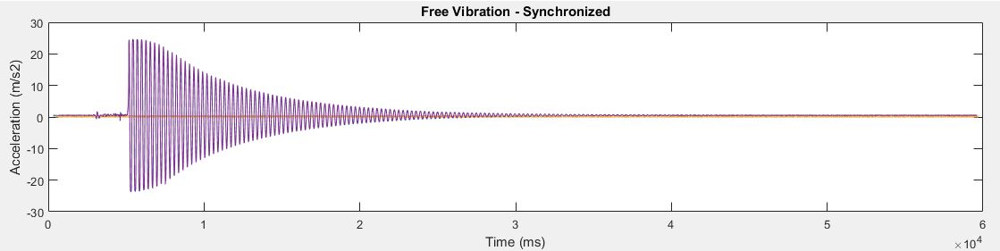
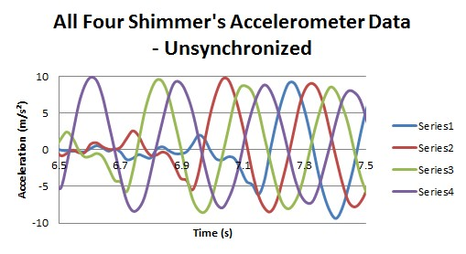
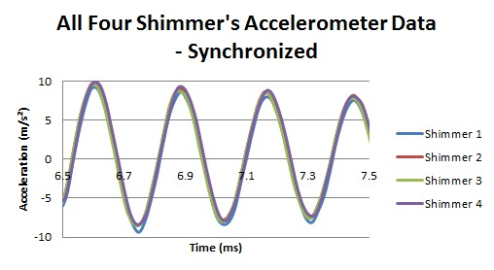
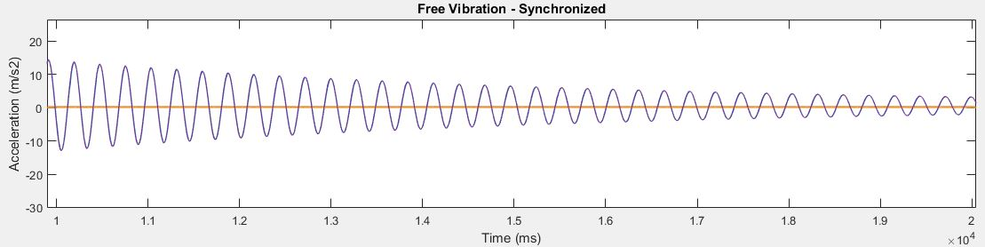
Time Synchronization of Smart Wearable Devices For Recording Seismic Activity
Alex Furlanic¹, Panfilo Armas¹, Rene Parra¹, Philip Thomas¹,
Dr. Amelito Enriquez¹, Dr. Zhaoshuo Jiang², Jackie Lok²
¹Cañada College / ²School of Engineering
Abstract
Testing
Analysis
Efforts are being made to advance our ability to understand earthquakes and minimize casualties. Large amounts of earthquake records are needed, and there are currently very limited sources for obtaining such data. Smart wearable devices, with recent advancements of sensor technologies and access to the internet, are becoming popular, giving them the potential to detect, measure, and record seismic data. Time synchronization is a critical factor to ensure accurate measurements. This research focuses on developing an appropriate time synchronization procedure suited for smart wearable devices. Data is collected and synchronized using this procedure. The research also tests the reliability and accuracy of wearable device sensors compared to traditional high-fidelity sensors. This is done with a variety of excitation tests and test durations. This research is the first step towards developing a system for detecting earthquakes using smart wearable devices.
PCB high fidelity sensor
When comparing the graphs, it can be seen that the waves are aligned in the synchronized versions compared with the unsynchronized versions
Before synchronization, the time offsets between each Shimmer are on average 677.8 ms with a minimum offset of 625 ms
After synchronization, the average time offset is 10.6 ms with a minimum offset of 1.9 ms
The data gathered by the Shimmer sensors and high-fidelity sensors match with a percent difference error ranging from 10-20%
Quanser
Single degree of Freedom Structure
Objectives
Shimmer
Conclusion
Develop an appropriate time synchronization procedure suited for smart wearable devices
Test the effectiveness of that procedure
Test the reliability and accuracy of the sensors in wearable devices by comparing them to high-fidelity sensors
Developed a time synchronization procedure for wireless sensors
The procedure has potential for smart wearable devices
The procedure that was developed has proven to be an effective method both visually and numerically
Proved that sensors in smart wearable devices are accurate and reliable
Shake table
Equipment
Future Work
SDOF Structure on Shake Table
  Full access to lab, able to simulate a wide variety of tests
Shimmer
  Four devices, each with multiple sensors
Quanser
  Accelerometer
PCB sensor
  High-fidelity accelerometer
MATLAB
  Controls Shimmer devices and processes data
Shimmers
  Two on structure, two on shake table
High Fidelity Sensors
  One on structure, one on Shake table
Four Types of Tests
      Free Vibration
      Sine Wave
      Sine Sweep
    Earthquake
The table below includes:
All nine test runs
Estimated offset for each test, both before and after synchronization
Maximum, minimum, and average offsets
Percent in decrease of the offsets
Use this time synchronization procedure for smartwatches
Test using a smartwatch on a shake table
Modify MATLAB time synchronization procedure for more accurate offset estimation by calculating offset for each individual sample
Use the collected data to recognize earthquakes and filter out noise
Transmit this data to a database where it can be analyzed as a whole
Procedure
References
Code
  Use MATLAB to control the Shimmers and collect data
Connection
  All four Shimmers connect to a single PC wirelessly via Bluetooth
Data Collection
  The PC collects and saves data from the Shimmer’s sensors for a specified length of time
Synchronization
  Reads the saved data files
  Calculates the time offset between the first Shimmer and the other three Shimmers using the Shimmers’ local timestamps and the Unix timestamps
  Adds the offset to each Shimmer’s local timestamp
  Saves the synchronized data
Graph Comparison
  Displays two graphs: one with the unsynchronized data and one with the synchronized data
Results
1. Ali, Shaukat. "Sensors and Mobile Phones: Evolution and State-of-the-Art."Pakistan Journal of Science (2014): n. pag. ResearchGate. Web. 5 July 2016.
2. Feng, M., Fukuda, Y., Mizuta, M., & Ozer, E. (2015). Citizen Sensors for SHM: Use of Accelerometer Data from Smartphones. Sensors, 15(2), 2980-2998. doi:10.3390/s150202980
3. Roche, Michael. "Time Synchronization in Wireless Networks." Time Synchronization in Wireless Networks. Washington University in St. Louis, n.d. Web. 03 Aug. 2016. <http://www.cs.wustl.edu/~jain/cse574-06/ftp/time_sync/index.html>.
4. Sundararaman, Bharath, Ugo Buy, and Ajay D. Kshemkalyani. "Clock Synchronization for Wireless Sensor Networks: A Survey." Ad Hoc Networks 3.3 (2005): 281-323. Web.
Below are graphs depicting accelerometer data for the free vibration and the Kobe Earthquake tests before and after synchronization. The blue and purple lines refer to the Shimmers on top of the structure and the orange and green lines refer to the Shimmers on the shake table.
Below is a comparison between the accelerometer data collected from a Shimmer device and from a high-fidelity sensor during a free vibration test. The purpose of this is to test the accuracy of sensors in wireless devices.
Acknowledgements
Advisors Dr. Amelito Enriquez and Dr. Zhaoshuo Jiang, and student mentors Jackie Lok and Alec Maxwell.
This project was partly supported by the US Department of Education through Minority Science and Engineering Improvement Program (MSEIP, Award No. P120A15014), and the Hispanic-Serving Institution Science, Technology, Engineering, and Mathematics (HSI STEM) Program, Award No. P031C110159.

