Slide 1
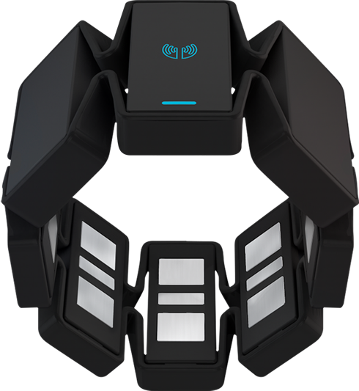
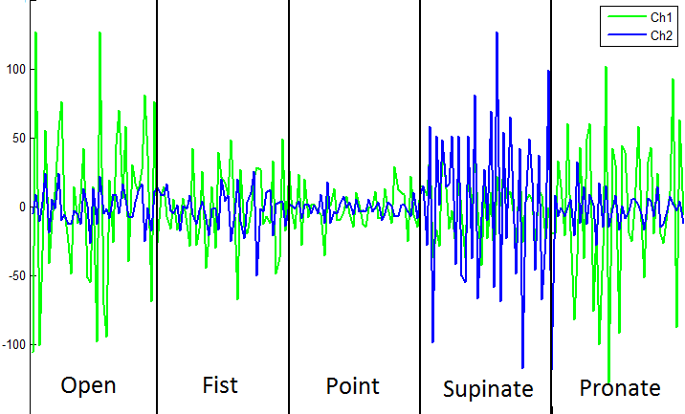
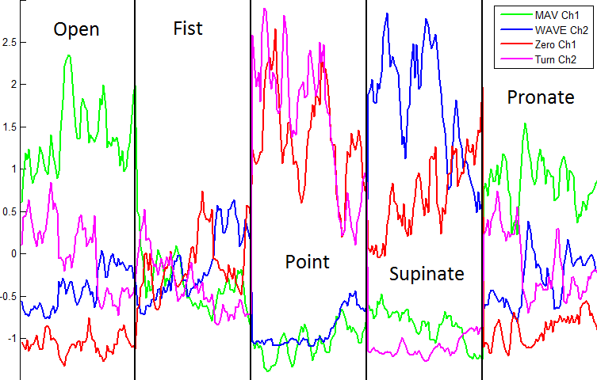
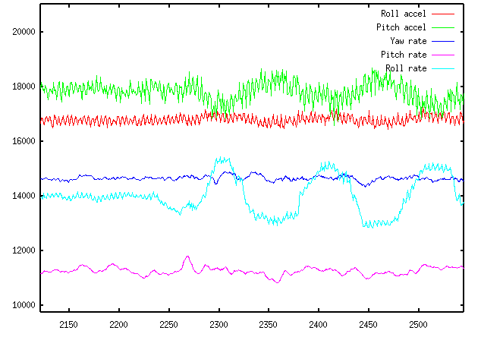
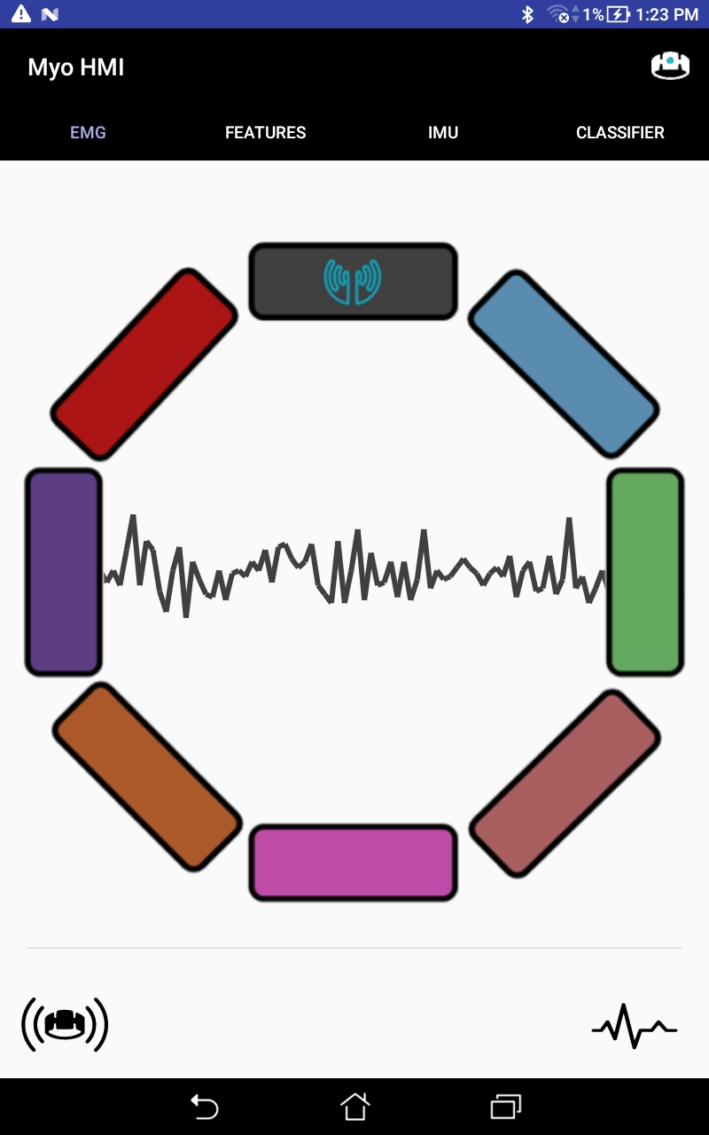
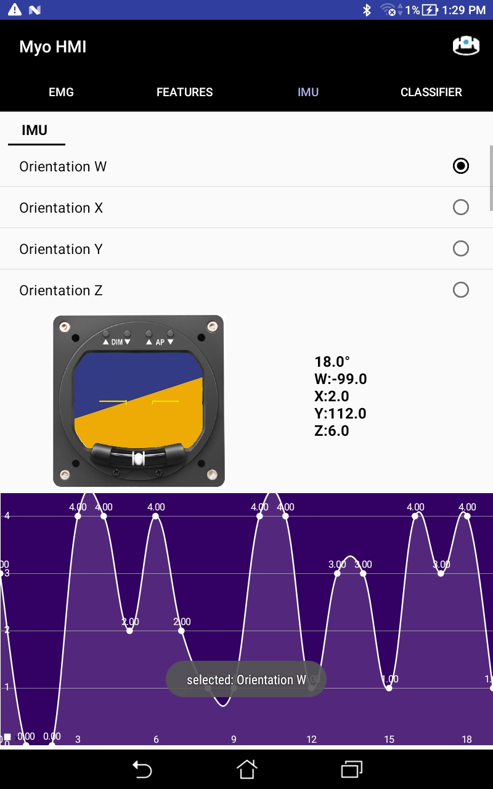
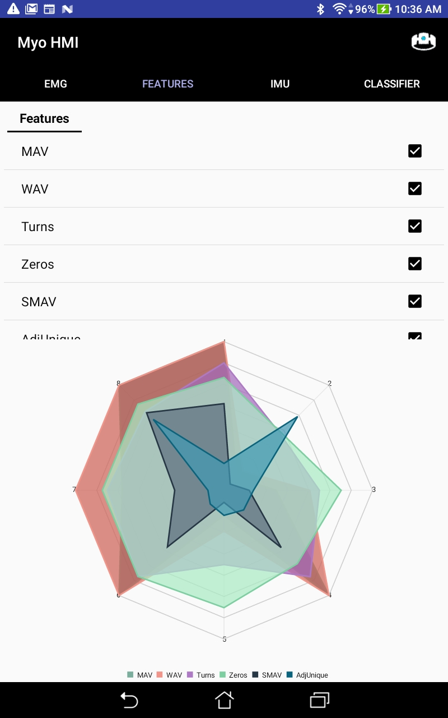
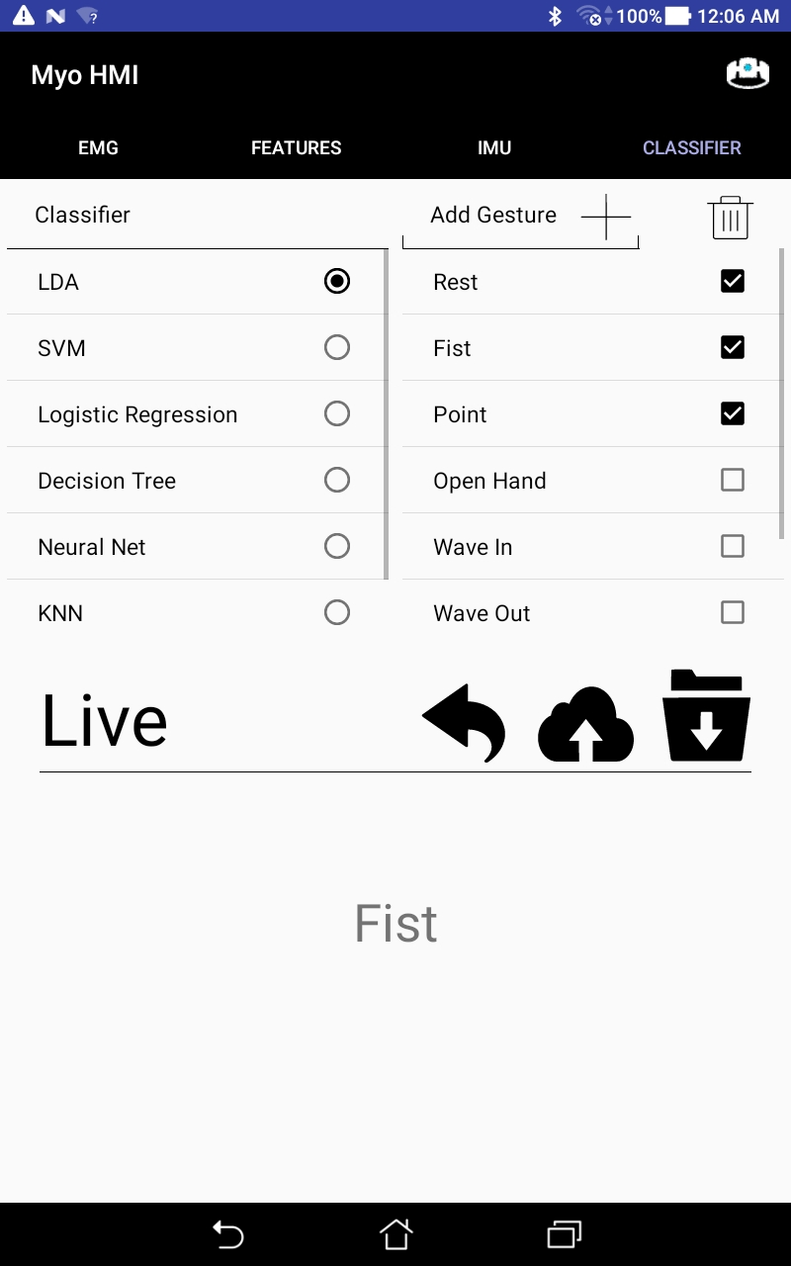
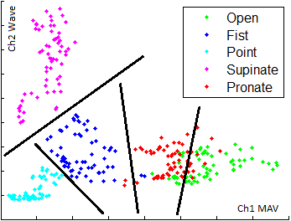
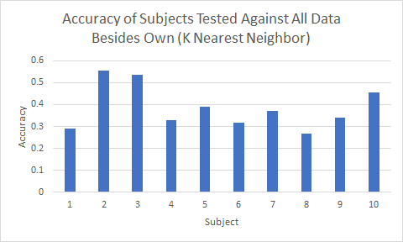
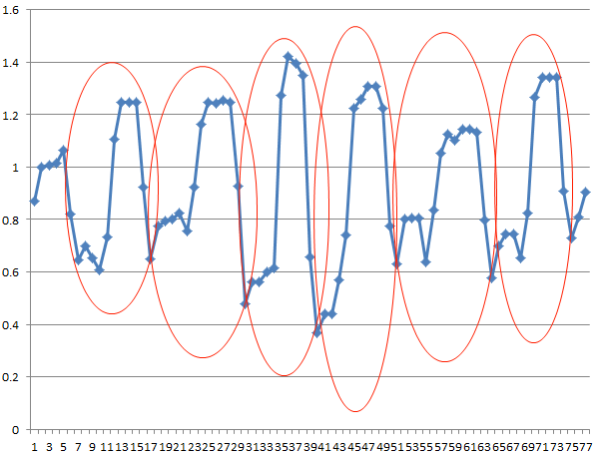
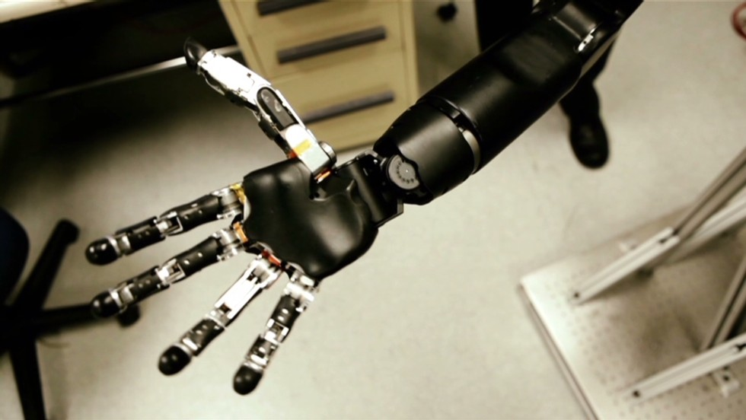
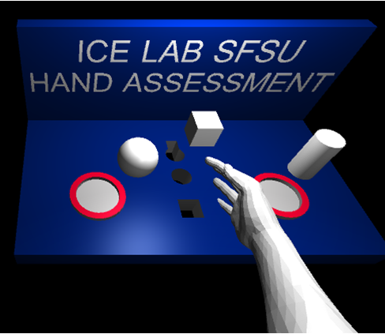
Integrating Mobile and Cloud Computing for Electromyography (EMG) and Inertial Measurement Unit (IMU)-Based Neural-Machine Interface
Victor Delaplaine¹, Ricardo Colin¹, Danny Ceron¹, Paul Leung¹
Advisors: Dr. Xiaorong Zhang², Dr. Amelito Enriquez¹, Mentor: Alexander David²
¹Cañada College, ²San Francisco State University
Background
MyoHMI Architecture
Question Topic | Responsiveness | Accuracy | Ease of Use | Aesthetic
Average Rating | 4.25 | 4.125 | 4.125 | 4.0
Motivation: There is an estimated number of 6.7 million amputees around the world. Developing an inexpensive inutive, and reliable platform would help toward those limbless patients.
Goal: Anticipate the human motion intention in real time from wearable sensors and by using basic Machine Learning algorithms.
EMG: The application was created through visual studios receives raw EMG from the myo armband through the use of bluetooth low energy (BLE)
Myo Armband
Raw EMG and IMU Data
Feature Extraction EMG
Table 1. Average Rating of Mobile Application from 10 users
Test subjects filled a survey to rate app performance and aesthetic from 1 to 5 perform 1 trial of 8 gestures
8 EMG sensors streaming at 200Hz
A 9-axis IMU that streaming around 50Hz
Communicates via Bluetooth Low Energy
Conclusion
The User Independent PR module in the application has an estimated value of 50 % accuracy with 10 different subjects when testing a gesture fist.
The most effective way to store data is using a structured query language database.
Created a website that provides instructions and is open source
Implemented an IMU tab with a virtual horizon that reads changes from the armband
Objectives
Amazon Web Services
Raw EMG
Raw IMU
Features
Develop an open, low-cost, portable and flexible research platform for developing EMG PR-based NMI by integrating edge and cloud computing techniques
Take advantage of Amazon Web Services storage and find a good method to store data so it is very accessible for user independent pattern recognition.
To Integrate the IMU data in MyoHMI so that the gesture predicted can be more precise.
Conclusion
Future Work
Fully implement IMU for gesture recognition
Gather additional trained data for User Independent Pattern Recognition
Improve accuracy of gesture recognition
Improve website instructions
Classification
Cloud Pattern Recognition
Supervised Machine Learning
Results
Acknowledgements
ASPIRES (Accelerated STEM Pathways through Internship, Research, Engagement, and Support) program Grant No. P120A150014. Special acknowledgements to Dr. Amelito Enriquez from Canada College for the opportunity and for guiding us through the whole program. Also, spcieal appreciation to Dr. Xiaorong Zhang and Alexander David from San Francisco State University for all their guidance and advices throughout the whole internship.
Gestures
Prosthetics
10 test subjects perform 1 trial of 8 gestures
Following the training phase records data for all gestures to be stored in a mySQL database hosted on AWS.
Virtual Reality
References
Zhang, X., Chen, X., Li, Y., Wang, Kongqiao., and Yang, J. “A Framework for Hand Gesture Recognition Based on Accelerometer and EMG Sensors.” IEEE Transactions on Systems, Man, and Cybernetics. 41.6 (2011).
Aspires paper 2017
Decision tree. Wikipedia. https://en.wikipedia.org/wiki/Decision_tree
Notes:
Feature Calculator:
data windowing: uses overlapping sliding window, it allow the application to obtain a denser data set, meaning the receiving device allows input of many sets of data and perform analysis before waiting for an acknowledgment or the current window to finish
Feature extraction:
Classifications and cross validations:

