Slide 1

Student Services Service Area Outcome Assessments
Preparation for the next program review cycle
Karen Engel, Dean of PRIE
Lindsey Irizarry, Instructional Technologist, ASLT

Slide 2
SAO Assessment Cycle
Every 3 years
Revise, update, or inactivate existing SAOs in Nuventive
Add new SAOs (if needed)
Every year or term
Assess SAOs
Record results of assessments in Nuventive, including reflections or actions needed
Every 3 years
Reflect on 3 years worth of SAO assessments in your Comprehensive Program Review
If resources are needed, submit an Annual Update
3 SAO’s are plenty

Slide 3
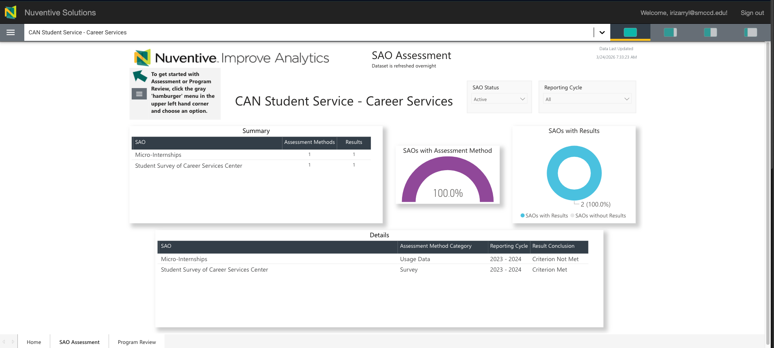
Every program has an “SAO dashboard” on their Nuventive landing pages

Slide 4
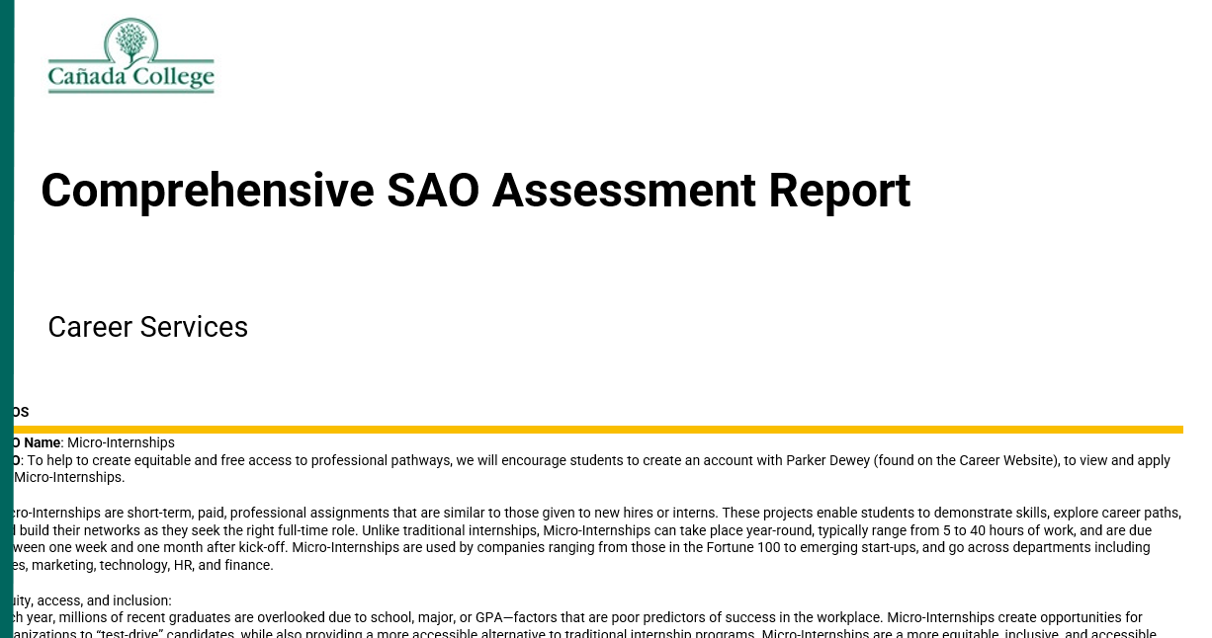
Every program has a Comprehensive SAO Assessment Report
Instructions on how to generate the SAO Assessment Report

Slide 5
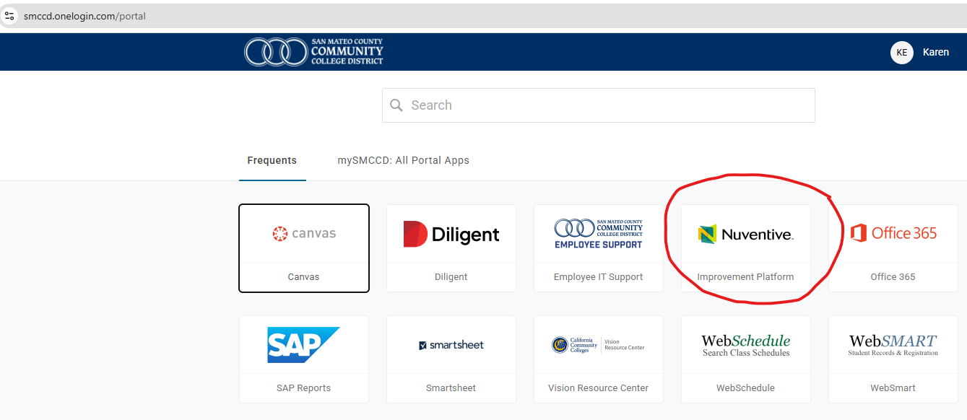
Logging in to Nuventive
If you cannot access the Nuventive interface, please email Lindsey (irizarryl@smccd.edu) to set up your account

Slide 6
Quantitative Institutional & Tracking Data
Student Success Metrics: Analyze the correlation between service usage and key indicators like GPA improvements, retention rates, and course completion rates.
Process Efficiency Measures: Track operational benchmarks such as turnaround time for transcript processing, accuracy of financial reports, and volume of students served.
Early Alert Participation: Measure the percentage of faculty who submit early alerts and the percentage of case referrals closed by student services staff.

Slide 7

Qualitative Methods for Assessing Program Outcomes
Facilitated Focus Groups: Organize sessions with students from diverse backgrounds to discuss their experiences, allowing for shared perspectives and detailed elaboration.
One-on-One Interviews: Conduct personal interviews to explore unique student perspectives and the specific reasoning behind their engagement or lack thereof.
Reflective Journals & Portfolios: Have students use learning logs, e-portfolios, or reflective posts to document their personal growth and skill development resulting from program participation.

Slide 8
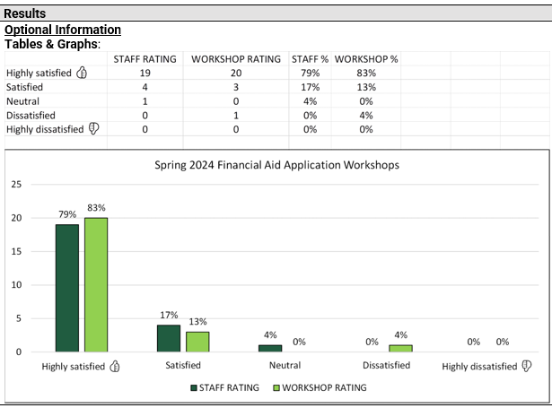
Direct Performance & Learning Assessments
Curriculum Mapping: Map student service outcomes (like financial literacy or career planning) to specific workshops or touchpoints to identify where performance is actually being evaluated.
Quizzes & Hands-on Activities: Use low-stakes quizzes or simulations during workshops to provide real-time feedback on whether students have mastered specific concepts.
Authentic Tasks: Evaluate effectiveness by requiring students to complete a related task, such as submitting a resume to the career center or creating an academic plan.

