Slide 1
Program Review Timeline
2026
Dr. Wissem Bennani
Dr. DeVon Scott

Slide 2
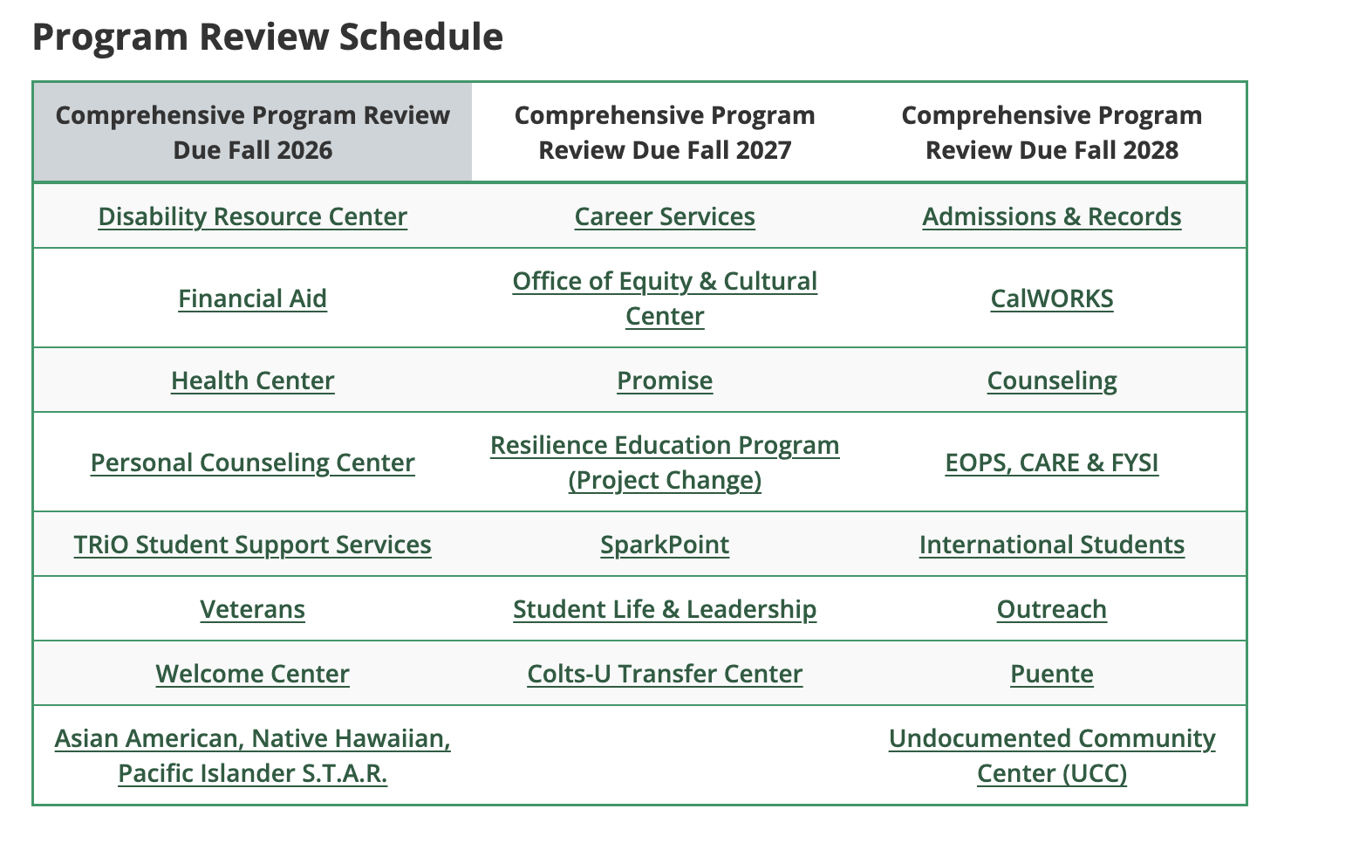

Slide 3
June 12, 2026 | Nuventive/Improve and Data Dashboards open; PRIE available to provide custom data. PRIE data dashboards are updated.
August Flex Day | Program Review Training open to all
September & October Divisions/Department Meetings | Divisions or departments discuss program reviews at monthly meetings
October 16, 2026 | All Comprehensive Program Reviews, Annual Updates, Goals and Resource Requests DUE in Nuventive
October 30, 2026 | Supervisors (Deans and VPs) complete their feedback on submitted program reviews in Nuventive
November 6, 2026 | All responses to supervisor feedback are due and final submittals of all program reviews and materials are DUE in Nuventive
November 18, 2026 | Administrative Peer Review session
November 18, 2026 | PBC Hosts Position Proposal Presentations
November 20 or December 4 | IPC Peer Review session
Early December | Senates Prioritize New Position Requests and Recommend to President
December 9, 2026 | SSPC Peer Review: fully submitted to the programs
February and March Division/Department Meetings | Divisions/departments and VP Offices meet to prioritize non-personnel resource requests
February 10, 2027 | SSPC Program Review Presentations
March 17, 2027 | PBC Certifies Prioritization Process & Collects Division Summaries
March 19, 2027 | IPC Instructional Program Review Presentations

