Slide 1
EMP 3.8: (1) increase University pathways (2) increase by 35% the number of Cañada College transfer-seeking students who achieve transfer readiness and the number of students who apply to a 4-year University between 2022 and 2027 (3) reduce the transfer equity gap for low-income, first-generation, working adults and Black, Indigenous and People of Color (BIPOC) students.

Slide 2
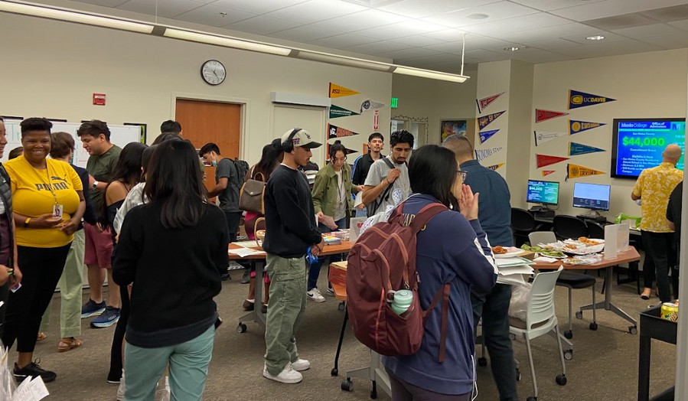
Updated Accomplishments:
Building a Transfer Culture Colts-U Transfer Center (1)
space, staff and opportunities Student engagement data (2) Serving Disproportionately Impacted and BIPOC students (3)
Outreach and Communication
Fall: October is Transfer Month campaign Spring: Transfer recognition campaign Continued use of social media,
Canvas, newsletter

Slide 3
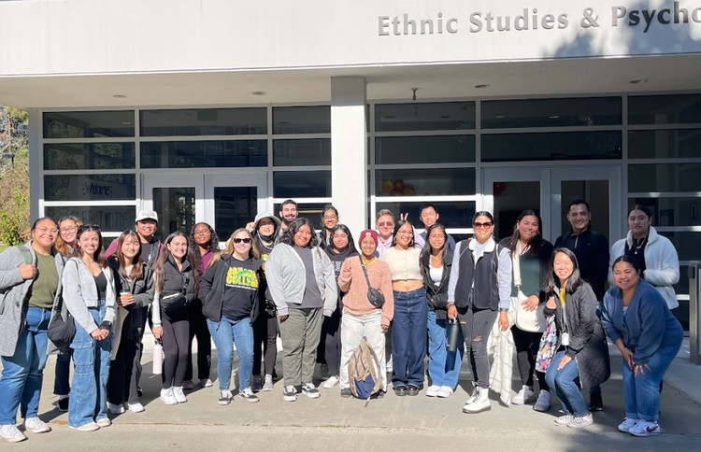
In progress & discussion:
2025-2028 College Transfer Plan
Re-engage College Transfer Advisory Board Data
streamline data collection disaggregate data by race/ethnicity
understand how specific populations of students are engaging with the Colts-U Transfer Center (DI, racially minoritized etc.)
Build Transfer Alumni Connections (Community Connections: EMP 3.12)

Slide 4
Questions?

