Slide 1
Position Proposal: Digital Communications Coordinator

Slide 2
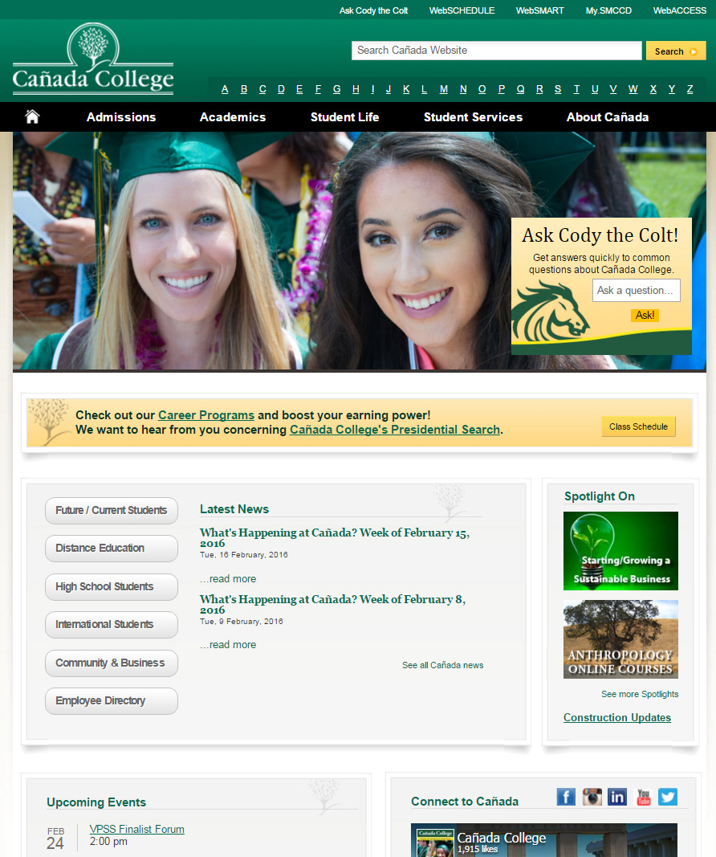
Why do we need a Digital Communications Coordinator?
MCPR and VCC are cross-functioning between 4 positions
VCC core job is course Schedule and Catalog
Maintaining a website is a full-time job that requires “pro-active” daily maintenance
Current Web work is currently “re-active”

Slide 3
Current Staffing and Roles
CSM:
Director of MCPR
Visual Communications Coordinator
Web Programmer and Analyst
Web Content Coordinator
College Recruiter
Cañada:
Director of MCPR
Visual Communications Coordinator
College Recruiter
Skyline:
Director of MCPR
Visual Communications Coordinator
Web Analyst
Promotions and Web Content Coordinator
Office Assistant
Not Sustainable!

Slide 4
What We Do:
Print Advertising: Pole Banners; Bus Ads; Magazine Ads; Mailers; Brochures; Posters
Booklets, Handbooks, Bookmarks, and MANY, MANY MORE!
Catalog/Schedules
Videos/Commercials/Campus Photography
Olive Hill Press
Social Media Campaigns
Board of Trustees Report
Department Branding and Logos
What’s Happening at Cañada
College Presentations
Content Creation and Layout
Event Planning
Department Needs and Web Updates
Community and Media Relations

Slide 5
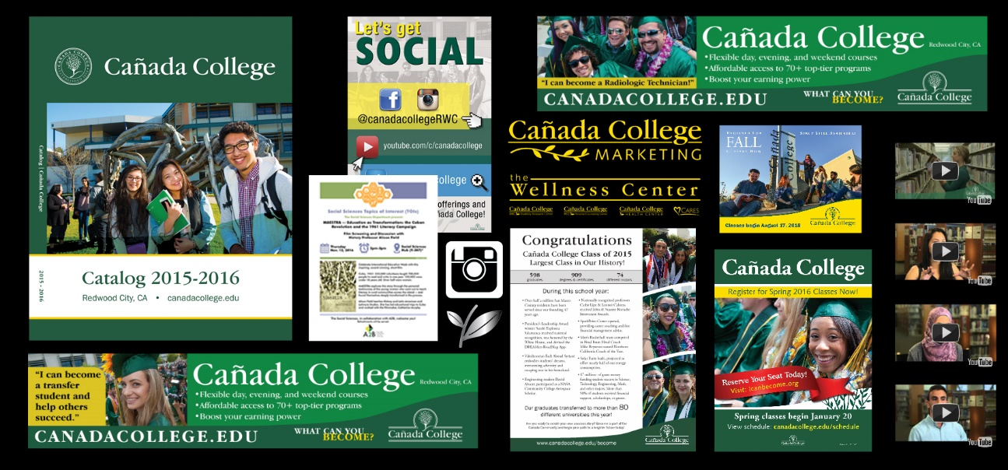
Examples of What We Do

Slide 6
The Need for a Digital Communications Coordinator
Peak schedule/catalog/material production season: February through May
Peak months: March and May
6 Schedules (3-print and 3-web)
1 Catalog
All Corresponding Web Pages
Commencement
Student Scholarship/Recognition Booklet
Commencement Program
Commencement Web Pages
*Average requests: 3-5 Web and 3-5 Design requests per week

Slide 7
How the DCC Supports Our College Goals & Mission
Works with faculty, staff, and students to develop, implement and grow impactful, cost-effective web and digital communication strategies and campaigns to enhance public awareness of the educational and enrichment opportunities at the College.
This is accomplished through:
Creative use of web, social media, internal and external college communications through engaging web design and effective content.
Ensuring user accessibility and 508 compliance among all mobile, handheld, and desktop devices. Having a current, user-friendly website is critical for our students to find classes, services and events on campus.

Slide 8
Scope of Work for Digital Communications Coordinator
Web Design & Content
Content Development
Implements plans, designs and new software
Hands-On Training & Assistance
Web Data Analysis
Codes in HTML
Consults & Research
Campus Committees
Prepares documentation of web
systems and applications

Slide 9
Growth in Social Media
28 percent Facebook increase in last 12 months
Monitor and respond to students question and feedback
React to urgent safety and security matters on campus
Use a tool to leverage awareness of programs and services offered

Slide 10
Social Media Advertising
10,000 Posts Reach!
73 Likes!

Slide 11
Social Media Advertising
44,208 People
Reached!

Slide 12
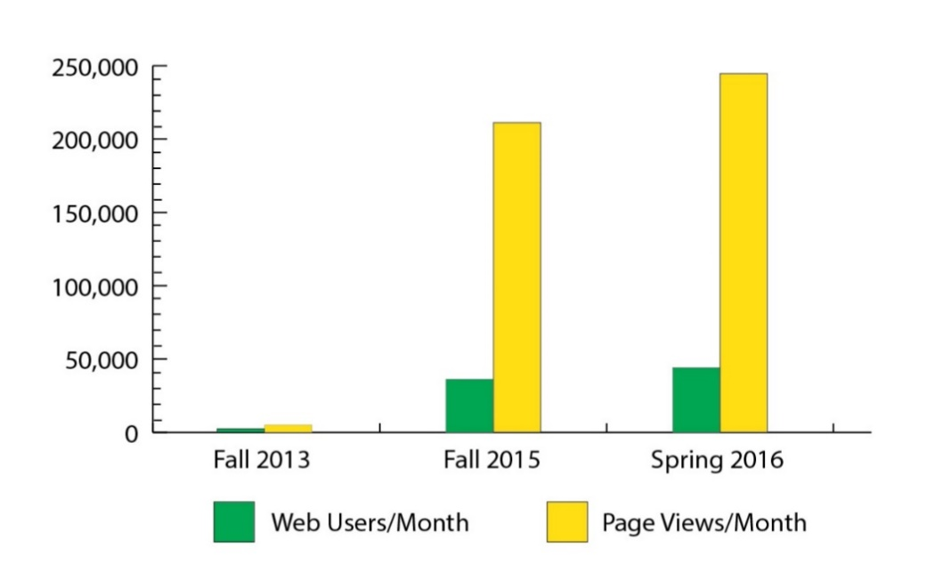
How Will This Benefit Me/My Department?
Alleviate VCC work load
Enable future pro-active projects
Website changes will be accomplished quicker
Devote proper attention to electronic media
Bulk of our target audience uses new media
Website is our #1 Marketing Tool
Web-Content needs to be consistently monitored
2-Person Team Web growth chart from 2013-2016:

Slide 13
Questions?
THANK YOU!

