Slide 1
Accessibility Specialist
Classified; Spring 2016

Slide 2
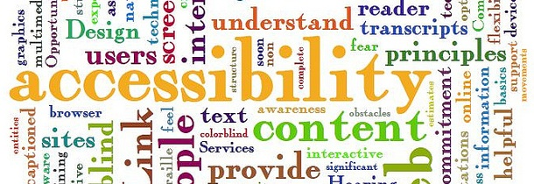
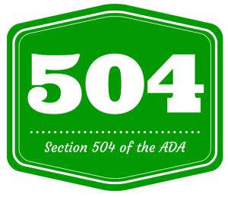
What will the Accessibility Specialist do?
Under the Office of Instruction; same office as the Instructional Designer and (proposed) Instructional Technologist
Consult with faculty on accessibility issues
Support for all course materials:
Videos and captioning
Readable PDFs and documents
Canvas/WebAccess support re: accessibility (quizzes, assignments, etc.)
General questions on accessibility
Hold workshops with faculty to improve accessibility on distance education courses

Slide 3
Why is an Accessibility Specialist so important?
Currently work being done (somewhat) by Instructional Designer and Alt Media Specialist—when they have the time
Faculty need help year-round, but especially as they set up their classes for the following term.
Materials need to be prepared, videos need to be found…this takes skill and time!
When materials are not 508 compliant, this can lead to a long list of issues:
Students are not able to fully participate in the class. (You don’t always know who needs the help!)
Students can file a grievance against the instructor/college for not making materials accessible.
Audits can lead to sanctions, especially for online education
Need a specialist!

Slide 4
It’s about equity!
OEI Rubric includes a section on Accessibility
Canvas is more compliant (and easier to navigate) with 504 and 508 regulations
BUT…faculty need help in this…from an expert!

Slide 5
The nuts and bolts
Position to be shared equally amongst the 3 colleges in the district
Cañada only would be responsible for 1/3 of the position’s salary
Salary would be set in collaboration with the other colleges, but an approximate budget of Grade 30, $60,000 annually in total ($20,000 annually paid by Cañada)
Ties in with multiple areas of the mission, strategic goals (1, 2, and 3)
Reaches out to all aspects of the community
Assists students in attaining their goals
Work done would lead to increasing student success, retention, and (potentially) persistence rates

