Slide 1

Planning & Budgeting Council
Orientation
PBC Co-Chairs: Diana Tedone-Goldstone and Maria Huning
September 2, 2026

Slide 2
Agenda
Part 1: Who are we? What is Participatory Governance?
Part 2: Participatory Governance Roles and Responsibilities
Part 3: The College Planning and Budgeting Cycle

Slide 3

Participatory Governance is 4 constituency groups working together for student success!
College constituency groups…
…represented by:
Students
Faculty
Staff
Administrators
Associated Students of Canada College (ASCC) –
aka, Student Senate
Academic Senate
Classified Senate
College Cabinet

Slide 4
Part 2: Roles and Responsibilities
  Participatory Governance Bodies at Cañada College
  Roles and Responsibilities of Academic, Classified, and Student Senates
  Roles and Responsibilities of Council Members
  Roles and Responsibilities of College Committee Members

Slide 5
Participatory Governance Manual
https://canadacollege.edu/pgm/

Slide 6
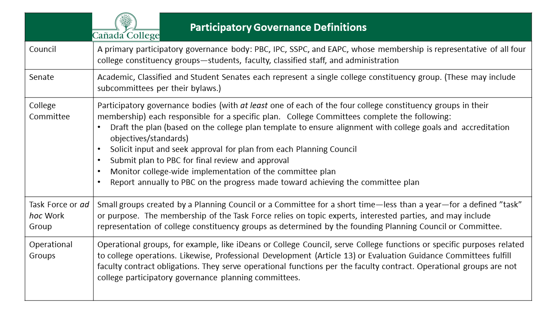

Slide 7

Participatory Governance Structure
As of May 15, 2024
SMCCD Board of Trustees
Chancellor
President
College Committees
Distance Ed. Advisory (DEAC)
Honors Transfer Prog.
Professional Development Planning
Safety (District Plan)
Technology
EAPC
Staff
Faculty
Students
Admini-strators
PBC
Staff
Faculty
Students
Admini-strators
ASCC
(students)
Academic Senate (faculty)
ClassifiedSenate (staff)
Cabinet
Subcommittees of the Academic Senate:
Black Students Matter
Curriculum Committee
Textbook Affordability
Faculty
Staff
Students
Admini-strators
Faculty
Staff
Students
Admini-strators
IPC
SSPC
Key:
= recommendations
= decisions
Programs
Program Review, Assessment, Resource and Staffing Requests
Deans
College Mission

Slide 8
Norm Setting
VALUE OUR COMMUNITY: Maintain a collegial and constructive environment focused on solutions and future planning
USE “I” STATEMENTS: Everyone speaks from their own experiences
ONE MIC, ONE VOICE: Respect means one colleague speaks at a time
MAKE SPACE, TAKE SPACE: Colleagues should be aware of how much they are speaking. If they feel they are speaking a lot, they should let others speak, and if they find themselves not talking, they should try to contribute some comments, ideas or suggestions
ASSUME THE BEST: Assume your colleagues are speaking with the best intentions and do not mean to offend anyone
CORRECT GENTLY, BUT DO CORRECT: If colleagues say something that hurts you or you’re unpacking, politely address what was said. Letting comments slip by only makes the space less safe and increases the difficulty of building successful partnerships
LEAN INTO DISCOMFORT: Be willing to experience some discomfort in discussions, and learn from it as a team
UPHOLD COMMITMENTS: The key to a safe and successful team is honoring your commitments and communicating if challenges come up
Notes:
Manuel

Slide 9
Supporting Student Participation at Cañada
Use acronyms mindfully
  Spell out an acronym on first use in order to avoid distancing people from a conversation/information item
Facilitate student participation during governance meetings. Consider multiple approaches, such as:
  Check-ins with student representatives during meetings
  Follow-ups after a meeting to see if there are confusions
  Buddy system: identify a fellow committee member who can provide more immediate answers, feedback, and encouragement
Practice critical pedagogies when students participate, ensuring students have equal voice (minding potential infantilizing)
  Every perspective deserves to be understood

Slide 10
PBC Responsibilities
The purpose of the Planning & Budgeting Council is to advise and make recommendations to the President on matters pertaining to:
Institutional priorities
Policies and procedures
Accreditation
Program Review processes
How to prioritize expenditures to advance the College goals
Budget development
College-wide planning
Governance issues
Issues regarding college facilities, maintenance, and operations
Issues regarding campus climate
Any other issue affecting the well-being of the College at large
PBC Bylaws

Slide 11
PBC Responsibilities:
oversees and facilitates Cañada’s planning processes, including the Annual Strategic Plan, the Educational Master Plan
ensures that the Instructional Planning Council (IPC) and Student Services Planning Council (SSPC) implement annual cycles of Program Review as well as Student Learning Outcomes and Service Area Outcome assessments that allow for continuous improvement.
ensures that College Committees fulfill their responsibilities for shaping and implementing college plans related to their area of expertise (e.g., distance education, technology, etc).
establishes ad hoc work groups and subcommittees to address college planning needs and priorities.
serves as the College’s Accreditation Oversight Committee with particular focus on ensuring that the College meets all of the requirements and standards set by the Accrediting Commission for Community and Junior Colleges (ACCJC).
hosts regular presentations and discussions of the College budget.
reviews feedback on current budgeting processes and makes recommendations for improvement, such as the processes for requesting personnel and non-personnel items.
ensures the Office of Planning, Research, and Institutional Effectiveness (PRIE) conducts an annual evaluation of college participatory governance processes and makes recommendations for any areas identified for improvement.
PBC Bylaws

Slide 12
Roles & Responsibilities of all PBC members
Communicating
Representing your constituency while keeping your “college-wide” hat on → wearing multiple hats!
Honoring your responsibility for the overall well-being of the College as a whole
Ultimately: recommendations to President
PBC Bylaws

Slide 13
PBC Members: expectations of service
Members will commit to attend and prepare for Planning & Budget Council (PBC) meetings
Members will notify co-chairs if unable to attend scheduled meetings
Meetings will start on time
Members will provide information to and solicit feedback from constituent groups.
Members may be removed or asked to resign by consensus of the other members, after three (3) absences in one semester.
PBC Bylaws

Slide 14
Roles & responsibilities of all College Committee members
Ensure balanced participation by all four campus constituencies
Ensure participation of some issue-area experts from across the College and/or the District (as needed)
Create (or update) Bylaws per PBC approved template
Understand the changes approved by PBC regarding the role and responsibilities of all college-wide committees
Review the Education Master Plan and Strategic Enrollment Management Plan to identify those aspects of each Plan for which the Committee should take responsibility
Update or revise the Committee’s Plan and vet those changes with each Planning Council before coming to PBC for approval
Monitor college-wide implementation of the Plan and report to PBC if progress is or is not being made (at least annually)
Cañada’s Participatory Governance Manual: https://canadacollege.edu/pgm/process.php

Slide 15
Part 3: The College Planning & Budgeting Cycle
  Integrated Planning and Budgeting Cycle
  Program Review, Priority Setting and Resource Allocation
  Basing decisions based on data

Slide 16
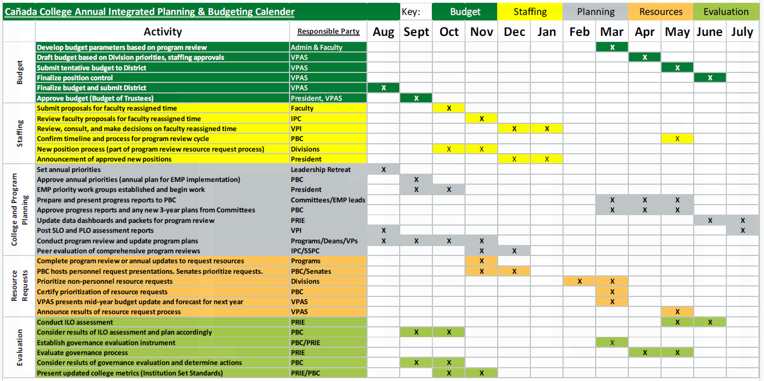
Annual Integrated Planning, Budgeting & Evaluation Cycle

Slide 17
Cañada College Strategic Planning Calendar | 2022-23 | 2023-24 | 2024-25 | 2025-26 | 2026-27 | 2027-2028
Educational Master Plan 2022-27 | Year 1 | Year 2 | Year 3 | Year 4 | Year 5 | EMP Planning Year
Committee Plans:
Distance Education Plan |  |  | Year 1 | Year 2 | Year 3
Facilities Master Plan (District) | Year 1 | Year 2 | Year 3 | Plan Amendment (2025-30)
Professional Development Plan |  |  | Year 1 | Year 2 | Year 3
Strategic Enrollment Management Plan |  | Year 1 | Year 2 | Year 3 | completed | completed
Student Equity & Achievement Plan | Year 1 | Year 2 | Year 3 | Year 1 | Year 2 | Year 3
Technology Plan |  |  | Year 1 | Year 2 | Year 3
Transfer Plan* |  |  |  | Year 1 | Year 2 | Year 3
Committee plans operationalize and help monitor the implementation of the goals and strategic initiatives established in the Education Master Plan by topic *Plan developed and monitored by the Cañada Transfer Advisory Board (not a committee)

Slide 18
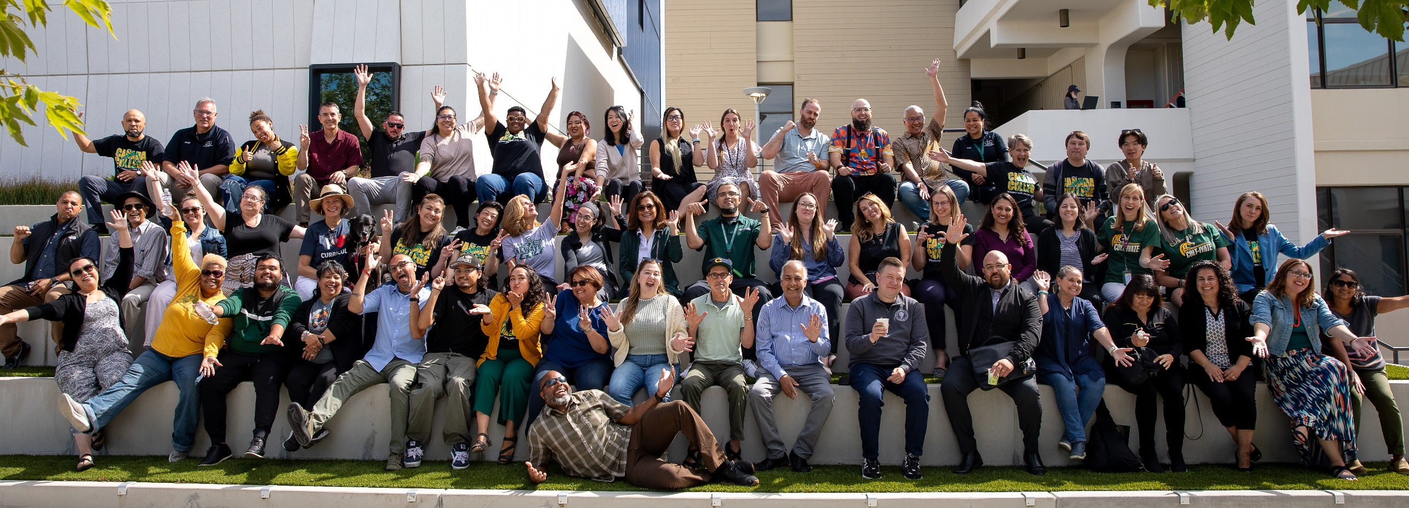
Working on College Plans Together
Each year our collaborative work on our strategic priorities starts at our Summer Leadership Retreat and continues all year in our college Councils, Committees, and ad hoc work groups.
Information on how to get involved is posted on our Cañada Collaborates website

Slide 19
Program Review
PURPOSE: Program review is the process through which constituencies on a campus take stock of their successes and shortcomings and seek to identify ways in which they can meet their goals more effectively.
A candid self-evaluation supported by evidence
Guides internal decision making
Provides external accountability (accreditation)
Connects program review with the college mission, planning, and budgeting
Faculty and Student Service Programs describes and documents what they do and why they do it
Instructional Program Review is faculty led: at Cañada the Academic Senate delegates process of peer review of program reviews to IPC
SSPC facilitates the peer review of student services program reviews
The President’s Office facilitates the peer review of administrative program reviews
College Program Review website: https://canadacollege.edu/programreview/index.php

Slide 20
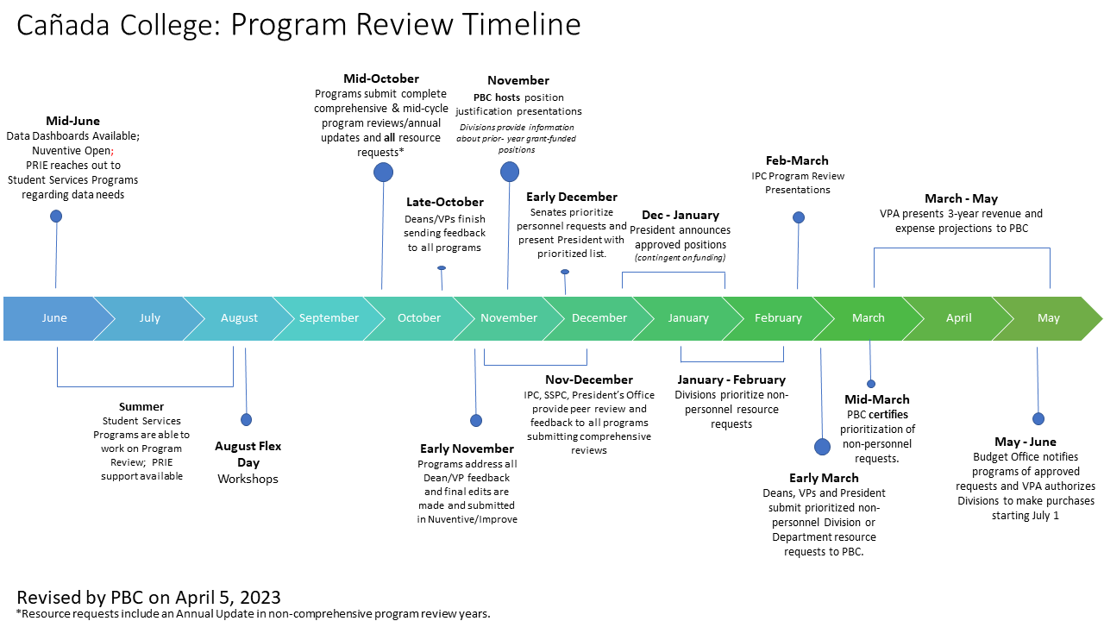

Slide 21
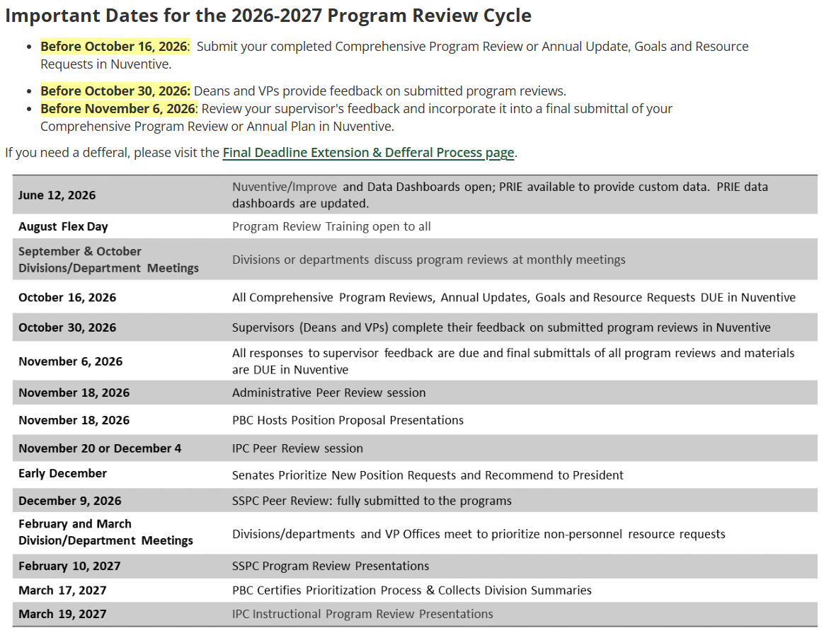
Program Review website

Slide 22
PBC Role in Resource Prioritization
The College uses Program Review as evidence for justifying new and replacement positions.
For New Personnel Requests, three distinct processes exist:
Process for New (non-temporary) Positions
Process for Vacancy Replacements
Process for Externally-funded and other Temporary Positions
For new position requests, PBC hosts an all-governance group meeting where programs can make presentations about new positions needed. Host a college-wide discussion of strengths and weaknesses for the position proposals. All members of the college community are invited to participate in the discussion.
For Non-personnel Requests:
After Divisions complete the process of prioritizing resource requests, PBC must certify that the prioritization process has been followed. PBC will collect a brief summary of the process used by each Division from a Dean and a Program Review Author (representative) from each Division. The summary includes answers to the following questions:
  Do all prioritized resource requests align with and support the College’s Mission, Vision and Values? If No, please explain.
  Please provide a brief summary of how your Division went about the resource request prioritization process during this cycle. Include any rubrics, tools, or other information you considered during your process.
Once PBC certifies the process, forward the non-personnel requests in priority order to the President.

Slide 23
Questions & Answers

