Slide 1

Participating in College
Decision-Making
Hosted by
PBC Co-Chairs: Diana Tedone-Goldstone and Allison Hughes, Academic Senate Co-Presidents
Dean of Planning, Research, Innovation, and Effectiveness (PRIE), Karen Engel
August 14, 2026

Slide 2

Sign in sheet

Slide 3
Agenda
Part 1: Who are we? What is Participatory Governance?
Part 2: Participatory Governance Roles and Responsibilities
Part 3: The College Planning and Budgeting Cycle

Slide 4
Part 1: Who are we?
What is participatory governance?
  People, Programs, Service Area
  Mission, Vision, and Values of the College
  College Organizational Chart
  What is Participatory Governance?
  The Law

Slide 5

Cañada College: Fall 2026
Students | 6,705
Classified Staff | 130
Full-time Faculty | 65
Part-time Faculty | 148
Administrators | 13
Offering 121 degree and certificate programs
Serving San Mateo County Residents, particularly residents of:
Atherton Belle Haven East Palo Alto Emerald Lake Hills Kensington Square La Honda Ladera Menlo Oaks Menlo Park North Fair Oaks North Skyline | Pescadero Portola Valley Redwood City Rural Mid Coast San Carlos San Gregorio Sequoia Tract South Skyline Stanford Lands Weekend Acres Woodside

Slide 6
Mission
Vision
Cañada College engages and empowers students in transforming their lives and communities through quality education.
Cañada College provides equitable education such that students from diverse backgrounds are able to achieve their educational goals and benefit the world.
https://canadacollege.edu/about/mission.php

Slide 7
Values
Transforming Lives
Community Partnerships
Academic Excellence
Sustainability
Transparency and Authenticity
Student Centered
Cultural Empathy
Social Justice and Racial Equity
Antiracism
Equity
Inclusion
Diversity
Access
Liberation
https://canadacollege.edu/about/mission.php

Slide 8
College Goals: 2022-27
Student Access, Success and Completion
Cañada College ensures student access to relevant and transformative student services and instructional programs that are inclusive, diverse, equitable, and antiracist. As an institution, Cañada contributes to the financial stability of students to empower them to pursue personal, academic, professional, and civic goals. Cañada College continuously assesses processes and removes barriers to student access, success, and completion.
Community Connections
Cañada College establishes equity-minded partnerships with other educational institutions, employers, governments, and community-based organizations that result in seamless pathways for high school students transitioning to college, college students transitioning to university, and all community members pursuing career, and lifelong educational opportunities.
Equity-Minded and Antiracist College Culture
Cañada College transforms its culture to be equity-minded and antiracist. Our teaching, learning, and services create a sense of belonging among all community members so they are able to recognize that their unique selves are valued, express themselves fully, and thrive. Our educational practices reflect the fundamental importance of individualized learning experiences, the shared building of knowledge, and promoting social justice at Cañada College.
Accessible Infrastructure and Innovation
College financial resources are well managed in support of the College’s values and to provide accessible physical and virtual spaces that promote continuous innovation and excellence in teaching and learning. Cañada’s investments in physical, technological and transportation infrastructure create sustainable, equitable access to the College and support equitable educational outcomes across the diverse members of the community we serve.
https://canadacollege.edu/emp/goals.php

Slide 9
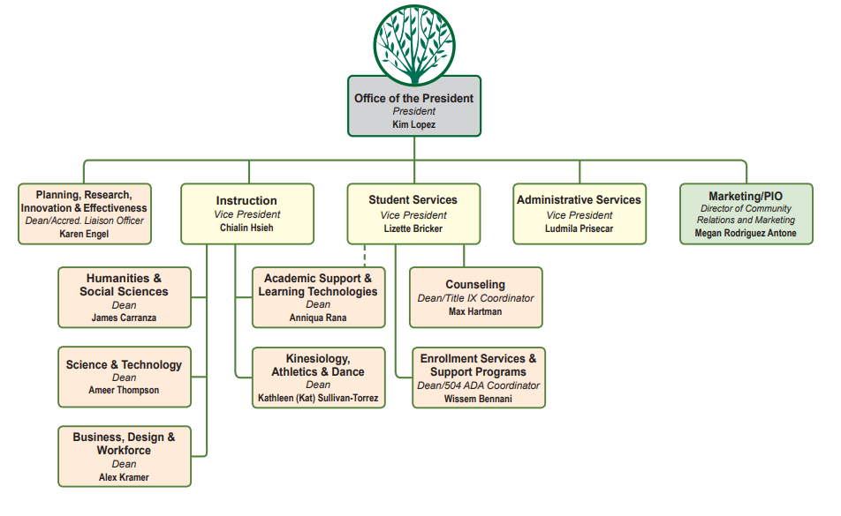
David Eck
Full college organization chart: https://canadacollege.edu/about/org-chart.php
Updates are still in progress

Slide 10

Participatory Governance is 4 constituency groups working together for student success!
College constituency groups…
…represented by:
Students
Faculty
Staff
Administrators
Associated Students of Canada College (ASCC) –
aka, Student Senate
Academic Senate
Classified Senate
College Cabinet

Slide 11
Participatory Governance
“ … not a simple process to implement“
“ … goodwill, thoughtful people, a willingness to take risks and the ability to admit problems exist – can go far toward establishing a positive environment…"
“The central objective should be creation of a climate where energy is devoted to solving crucial educational tasks and not to turf battles over governance.”
California Community College Trustees (CCCT) and the
Chief Executive Officers of the California Community Colleges (CEOCCC)
Policy Paper, December 1989

Slide 12
Participatory Governance: the law
The California Community College Board of Governors shall establish "minimum standards" and local governing boards shall "establish procedures not inconsistent" with those standards to ensure:
Faculty, staff and students have the right to participate effectively in district and college governance and
The right of academic senates to assume primary responsibility for making recommendations in the areas of curriculum and academic standards.
Education Code Sections 70901 and 70902

Slide 13
Cañada College’s Decision-Making Philosophy
The following philosophy applies to participatory governance, planning, program review, and budgeting:
To base decisions on data.
To make decisions with equity in student outcomes at the forefront as reflected in the College mission, vision, values and goals.
To effectively integrate program review, planning, and budget.
To encourage widespread institutional dialog and reinforce the college vlaue of transparency.
To base the participatory decision-making process on cooperation, trust, and shared values rather than confrontation.
To focus on issues that are institutional in nature and which affect the College as a whole.
To reach solutions that are made better through the expertise of the participants and made more acceptable through the participatory process.
To foster a climate of mutual trust, creative conflict resolution, and positive communication skills.
To communicate regularly and clearly with those stakeholders directly affected by decisions.
To effectively use time and resources by streamlining the processes to avoid duplication of effort.
To identify purpose, function, membership, and reporting relationships for each committee or work group.
To maintain reasonable balance and continuity of representation within each participatory governance group.
To expect representatives on committees to be familiar with committee functions, to be responsible for attendance, and to regularly consult and communicate with constituents.
The participatory governance process will be reviewed regularly by the PBC.
Cañada’s Participatory Governance Manual: https://canadacollege.edu/pgm/process.php

Slide 14
Proposed Community Agreements for all Councils and Committees
VALUE OUR COMMUNITY: Maintain a collegial and constructive environment focused on solutions and future planning
USE “I” STATEMENTS: Everyone speaks from their own experiences
ONE MIC, ONE VOICE: Respect means one colleague speaks at a time
MAKE SPACE, TAKE SPACE: Colleagues should be aware of how much they are speaking. If they feel they are speaking a lot, they should let others speak, and if they find themselves not talking, they should try to contribute some comments, ideas or suggestions
ASSUME THE BEST: Assume your colleagues are speaking with the best intentions and do not mean to offend anyone
CORRECT GENTLY, BUT DO CORRECT: If colleagues say something that hurts you or you’re unpacking, politely address what was said. Letting comments slip by only makes the space less safe and increases the difficulty of building successful partnerships
LEAN INTO DISCOMFORT: Be willing to experience some discomfort in discussions, and learn from it as a team
UPHOLD COMMITMENTS: The key to a safe and successful team is honoring your commitments and communicating if challenges come up
Notes:
Proposed by the Director of Equity September 12, 2024. Setting community agreements can create a safer and braver space for dialogue. In this context, colleague refers to all students, faculty, staff, and administrators.

Slide 15
Part 2: Roles and Responsibilities
  Participatory Governance Bodies at Cañada College
  Roles and Responsibilities of Academic, Classified, and Student Senates
  Roles and Responsibilities of Council Members
  Roles and Responsibilities of College Committee Members

Slide 16
Participatory Governance Manual
https://canadacollege.edu/pgm/

Slide 17
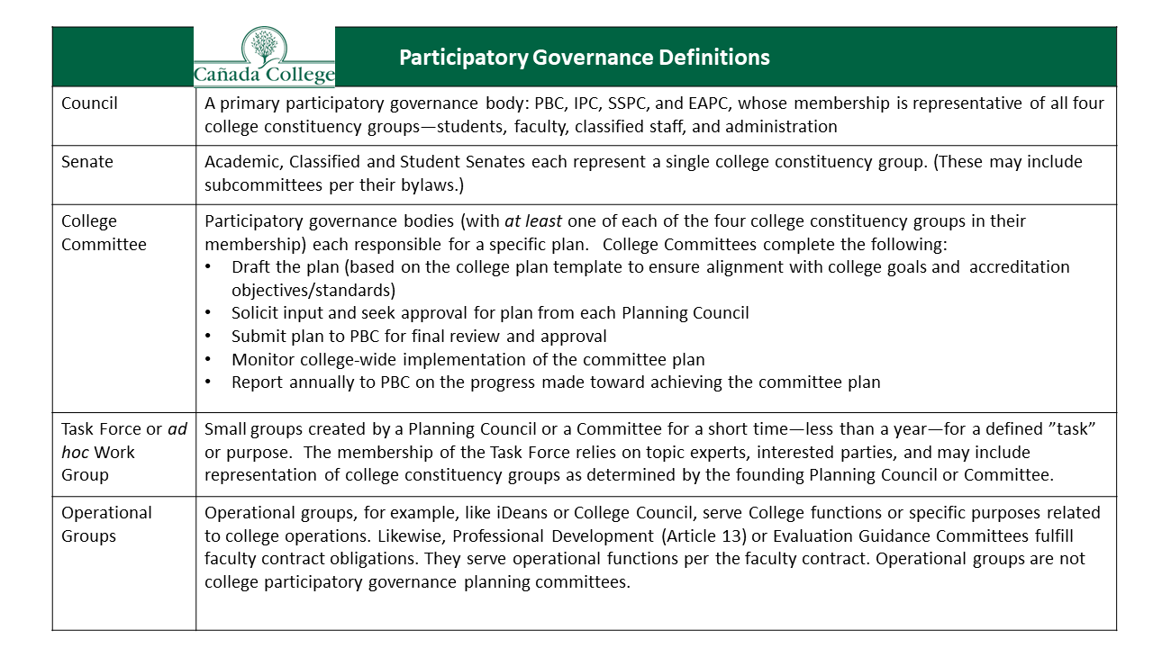

Slide 18
Documentation of Dialogue
Publicizing agendas and minutes
Agendas of all participatory governance groups are posted on websites and emailed to the entire college community. Those governance groups that are subject to the Open Meetings Act finalize their agendas and post them to the campus community within 72 hours of the meeting. Note takers at these meetings strive to capture the substance and spirit of conversations with as much detail as possible, using the note-taking guidelines from PBC. These minutes, once approved, are posted on the respective governance group's website.
Documenting dialogue
In cases where dialogue concerning a particular significant issue is spread out over a period of months and/or occurs between multiple governance bodies, the college creates a dedicated web page documenting and tracking the conversation in chronological order with links to relevant documents including processes, timelines, meeting minutes and college-wide communications.
Meeting Minute Template
On October 01, 2025, the Planning & Budgeting Council adopted this template and recommends it to all Councils and Committees at Cañada to use to document dialogue and actions taken by their participatory governance group.
Participatory Governance Manual

Slide 19

Participatory Governance Structure
As of May 15, 2024
SMCCD Board of Trustees
Chancellor
President
College Committees
Distance Ed. Advisory (DEAC)
Honors Transfer Prog.
Professional Development Planning
Safety (District Plan)
Technology
EAPC
Staff
Faculty
Students
Admini-strators
PBC
Staff
Faculty
Students
Admini-strators
ASCC
(students)
Academic Senate (faculty)
ClassifiedSenate (staff)
Cabinet
Subcommittees of the Academic Senate:
Black Students Matter
Curriculum Committee
Textbook Affordability
Faculty
Staff
Students
Admini-strators
Faculty
Staff
Students
Admini-strators
IPC
SSPC
Key:
= recommendations
= decisions
Programs
Program Review, Assessment, Resource and Staffing Requests
Deans
College Mission

Slide 20
Participatory Governance Structure
As of May 15, 2024
SMCCD Board of Trustees
Senates
Chancellor
President
College Committees
Distance Ed. Advisory (DEAC)
Honors Transfer Prog.
Professional Development Planning
Safety (District Plan)
Technology
EAPC
Staff
Faculty
Students
Admini-strators
PBC
Staff
Faculty
Students
Admini-strators
ASCC
(students)
Academic Senate (faculty)
ClassifiedSenate (staff)
Cabinet
Subcommittees of the Academic Senate:
Black Students Matter
Curriculum Committee
Textbook Affordability
Faculty
Staff
Students
Admini-strators
Faculty
Staff
Students
Admini-strators
IPC
SSPC
Key:
= recommendations
= decisions
Programs
Program Review, Assessment, Resource and Staffing Requests
Deans
College Mission

Slide 21
Participatory Governance: Academic Senate
CA Ed Code: Title 5 §53203
The governing board shall adopt policies for appropriate delegation of authority and responsibility to its academic senate.
...providing at a minimum the governing board or its designees consult collegially with the academic senate when adopting policies and procedures on academic and professional matters.
The “10+1”
Academic and professional matters means the Academic Senate is primarily responsible for the following policy development and implementation matters:
  Degree and certificate requirements
  Curriculum, including establishing prerequisites and placing courses within disciplines
  Grading policies
  Educational program development
  Standards or policies regarding student preparation and success
  District and college governance structures, as related to faculty roles
  Faculty roles and involvement in accreditation processes, including self study and annual reports
  Policies for faculty professional development activities
  Processes for program review
  Processes for institutional planning and budget development, and
  Other academic and professional matters as mutually agreed upon between the governing board and the academic senate

Slide 22
Participatory Governance: Classified Senate
The primary governing body for all classified professionals at Cañada College in conjunction with CSEA is the Classified Senate.
Members are from various areas, full-time or part-time permanent employment, and actively participate in all college-wide discussions, excluding collective bargaining matters.
Classified Senate represents:
non-represented (non-union) classified employees, including supervisors and management
CALIFORNIA SCHOOL EMPLOYEES ASSOCIATION, Chapter 33 (CSEA)
LOCAL 829, COUNCIL 57 AMERICAN FEDERATION OF STATE, COUNTY AND MUNICIPAL EMPLOYEES (AFSCME), AFL-CIO
B.P 2.08: The SMCCCD Board recognizes CSEA as the official body representing classified staff and considers classified staff to be full participants in participatory governance on all items pertaining to their interests (Education Code §70901.2). The selection of classified representatives to serve on District and/or College committees, task forces, or other governance groups shall be made by CSEA with the expectation that all classified staff will be considered in the process of selecting representatives (Title 5 §51023.5).
Classified Senate constitution, by-laws, and statement of ethics help them to fairly represent all their constituents.

Slide 23
Staff Roles in College Governance
Governing boards adopt policies and procedures that provide staff opportunity to participate effectively in district and college governance.
  formulation and development of policies and procedures, and
  processes for jointly developing recommendations that have or will have a significant effect on staff.
Board shall not take action on matters significantly affecting staff until the recommendations and opinions of staff are given every reasonable consideration.
California Education Code: Title 5 § 51023.5

Slide 24
Associated Students of Cañada College (ASCC)
The ASCC is the official student government organization of Cañada.
The ASCC leaders are elected and appointed student representatives who organize and promote campus wide programs, protect student rights, and represent the student voice on campus committees.
Governing boards adopt policies and procedures that provide students opportunity to participate effectively in district and college governance on formulation and development of policies and procedures and processes for jointly developing recommendations that have or will have a significant effect on students.
Board shall not take action on a matter having a significant effect on students until recommendations and positions by students are given every reasonable consideration.
California Education Code: § Title 5 §51023.7

Slide 25
Policies and procedures that have a “significant effect on students” include:
Grading policies;
Codes of student conduct;
Academic disciplinary policies;
Curriculum development;
Courses or programs which should be initiated or discontinued;
Processes for institutional planning and budget development;
Standards and policies regarding student preparation and success;
Student services planning and development;
Student fees within the authority of the district to adopt;
Any other district and college policy, procedure or related matter that the district governing board determines will have a significant effect on students; and
Policies and procedures pertaining to the hiring and evaluation of faculty, administration, and staff.
California Education Code: Title 5 § 51023.7

Slide 26
Supporting Student Participation at Cañada
Use acronyms mindfully
  Spell out an acronym on first use in order to avoid distancing people from a conversation/information item
Facilitate student participation during governance meetings. Consider multiple approaches, such as:
  Check-ins with student representatives during meetings
  Follow-ups after a meeting to see if there are confusions
  Buddy system: identify a fellow committee member who can provide more immediate answers, feedback, and encouragement
Practice critical pedagogies when students participate, ensuring students have equal voice (minding potential infantilizing)
  Every perspective deserves to be understood

Slide 27
Participatory Governance Structure
As of May 15, 2024
SMCCD Board of Trustees
Chancellor
Councils
President
College Committees
Distance Ed. Advisory (DEAC)
Honors Transfer Prog.
Professional Development Planning
Safety (District Plan)
Technology
EAPC
Staff
Faculty
Students
Admini-strators
PBC
Staff
Faculty
Students
Admini-strators
ASCC
(students)
Academic Senate (faculty)
ClassifiedSenate (staff)
Cabinet
Subcommittees of the Academic Senate:
Black Students Matter
Curriculum Committee
Textbook Affordability
Faculty
Staff
Students
Admini-strators
Faculty
Staff
Students
Admini-strators
IPC
SSPC
Key:
= recommendations
= decisions
Programs
Program Review, Assessment, Resource and Staffing Requests
Deans
College Mission

Slide 28
PBC Responsibilities
The purpose of the Planning & Budgeting Council is to advise and make recommendations to the President on matters pertaining to:
Institutional priorities
Policies and procedures
Accreditation
Program Review processes
How to prioritize expenditures to advance the College goals
Budget development
College-wide planning
Governance issues
Issues regarding college facilities, maintenance, and operations
Issues regarding campus climate
Any other issue affecting the well-being of the College at large
PBC Bylaws

Slide 29
PBC Responsibilities:
oversees and facilitates Cañada’s planning processes, including the Annual Strategic Plan, the Educational Master Plan
ensures that the Instructional Planning Council (IPC) and Student Services Planning Council (SSPC) implement annual cycles of Program Review as well as Student Learning Outcomes and Service Area Outcome assessments that allow for continuous improvement.
ensures that College Committees fulfill their responsibilities for shaping and implementing college plans related to their area of expertise (e.g., distance education, technology, etc).
establishes ad hoc work groups and subcommittees to address college planning needs and priorities.
serves as the College’s Accreditation Oversight Committee with particular focus on ensuring that the College meets all of the requirements and standards set by the Accrediting Commission for Community and Junior Colleges (ACCJC).
hosts regular presentations and discussions of the College budget.
reviews feedback on current budgeting processes and makes recommendations for improvement, such as the processes for requesting personnel and non-personnel items.
ensures the Office of Planning, Research, and Institutional Effectiveness (PRIE) conducts an annual evaluation of college participatory governance processes and makes recommendations for any areas identified for improvement.
PBC Bylaws

Slide 30
Roles & Responsibilities of all PBC members
Communicating
Representing your constituency while keeping your “college-wide” hat on → wearing multiple hats!
Honoring your responsibility for the overall well-being of the College as a whole
Ultimately: recommendations to President
PBC Bylaws

Slide 31
PBC Members: expectations of service
Members will commit to attend and prepare for Planning & Budget Council (PBC) meetings
Members will notify co-chairs if unable to attend scheduled meetings
Meetings will start on time
Members will provide information to and solicit feedback from constituent groups.
Members may be removed or asked to resign by consensus of the other members, after three (3) absences in one semester.
PBC Bylaws

Slide 32
Instructional Planning Council (IPC) responsibilities:
The Instructional Planning Council (IPC) is advisory to the Planning & Budgeting Council on a range of issues related to instruction:
Develop and oversee the annual process of instructional program review (on behalf of Academic Senate)
Provide feedback on instructional program review narratives in accordance with the Academic Senate guidelines.
Evaluate the instructional program review process yearly.
Host Instructional Program Review presentations (this could include a collaboration with SSPC).
Coordinate the annual program review college-wide process (including the timeline, communication, due dates) in collaboration with all councils and appropriate work groups
Recommend and review policies and procedures as they relate to instruction.
Provide support and feedback on the development of new instructional programs and instructional program discontinuance.
Regularly monitor through the agenda process how the campus is meeting relevant parts of ACCJC Standard II.
Completion of a yearly review of the purpose and the role of the Instructional Planning Council.
Discuss and identify innovative instructional methods and opportunities to enhance teaching and learning.
Review and provide feedback on reassigned time applications.
IPC Bylaws

Slide 33
Student Services Planning Council (SSPC) responsibilities:
The Student Services Planning Council is advisory to the Planning and Budgeting Council on a range of issues pertaining to student services. Its duties include:
Develop, implement, and evaluate a Student Services planning cycle (including staffing, equipment, facilities and budgetary needs.)
Integrate Student Services Division plans.
Make recommendations about policies and procedures related to Student Services.
Make recommendations to College Planning and Budgeting Council regarding prioritization of resources advancing the Strategic Goals regarding Student Services.
Meet at least once a year with the Instructional Planning Council (IPC) through the PBC hiring process.
Evaluates proposals for adding, modifying, and discontinuing Student Services programs.
Develop ongoing communication strategy with IPC by designating a SSPC member representative(s) to report to IPC on SSPC matters and to report back to SSPC on IPC matters.
Form subcommittees, work groups and task forces as needed.
SSPC Bylaws

Slide 34
Equity and Antiracism Planning Council (EAPC) responsibilities:
Mission: The mission of the Equity and Antiracism Planning Council is to disrupt and dismantle systemic racism and White supremacy for our college community in pursuit of equity, antiracism, justice and liberation.
In an effort to achieve the Council mission/purpose, the EAPC will:
  Goal #1: Collaborate with other bodies to review and revise college policies and practices.
  Goal # 2: Facilitate training for students, faculty, staff, and administration.
  Goal #3: Develop and implement college-wide programming related to equity and antiracism.
Responsibilities include: Strategic Planning (oversight of the SEAP Plan), Priority Setting, Participatory Governance (partner with PBC), Program Development & Support, Address Systemic Barriers, Innovation & Inquiry, Campus Climate, Professional Development.
Reporting EAPC makes recommendations directly to the College President.
EAPC Bylaws

Slide 35
Participatory Governance Structure
As of May 15, 2024
SMCCD Board of Trustees
Committees
Chancellor
President
College Committees
Distance Ed. Advisory (DEAC)
Honors Transfer Prog.
Professional Development Planning
Safety (District Plan)
Technology
EAPC
Staff
Faculty
Students
Admini-strators
PBC
Staff
Faculty
Students
Admini-strators
ASCC
(students)
Academic Senate (faculty)
ClassifiedSenate (staff)
Cabinet
Subcommittees of the Academic Senate:
Black Students Matter
Curriculum Committee
Textbook Affordability
Faculty
Staff
Students
Admini-strators
Faculty
Staff
Students
Admini-strators
IPC
SSPC
Key:
= recommendations
= decisions
Programs
Program Review, Assessment, Resource and Staffing Requests
Deans
College Mission

Slide 36
Roles & responsibilities of all College Committee members
Ensure balanced participation by all four campus constituencies
Ensure participation of some issue-area experts from across the College and/or the District (as needed)
Create (or update) Bylaws per PBC approved template
Understand the changes approved by PBC regarding the role and responsibilities of all college-wide committees
Review the Education Master Plan and Strategic Enrollment Management Plan to identify those aspects of each Plan for which the Committee should take responsibility
Update or revise the Committee’s Plan and vet those changes with each Planning Council before coming to PBC for approval
Monitor college-wide implementation of the Plan and report to PBC if progress is or is not being made (at least annually)
Cañada’s Participatory Governance Manual: https://canadacollege.edu/pgm/process.php

Slide 37
Part 3: The College Planning & Budgeting Cycle
  Integrated Planning and Budgeting Cycle
  Program Review, Priority Setting and Resource Allocation
  Basing decisions based on data

Slide 38
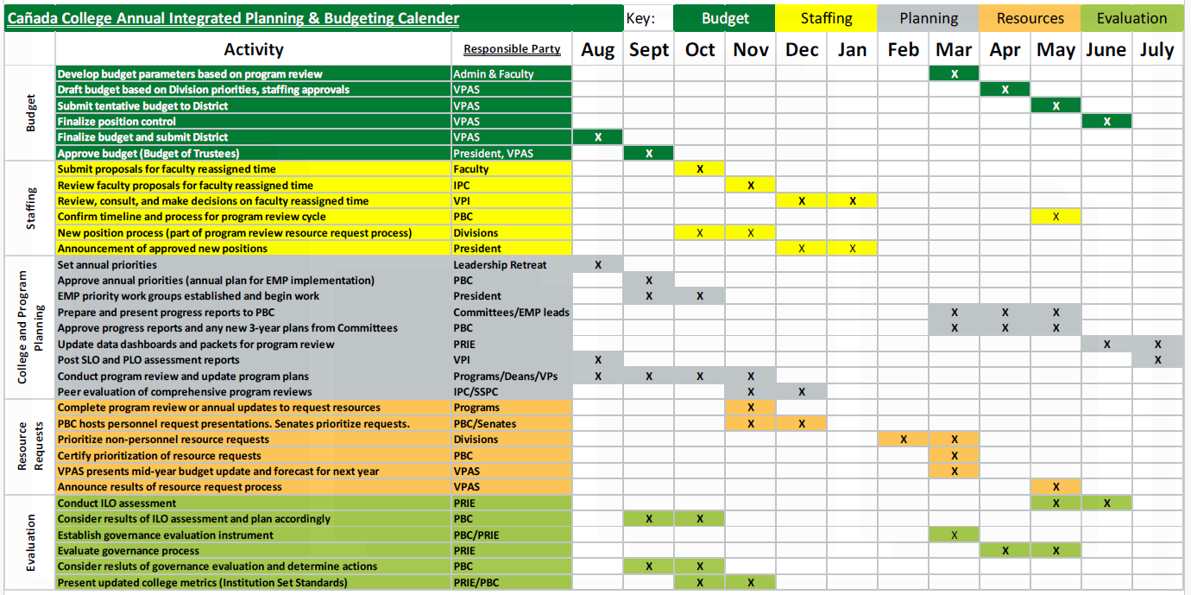
Annual Integrated Planning, Budgeting & Evaluation Cycle

Slide 39
Cañada College Strategic Planning Calendar | 2022-23 | 2023-24 | 2024-25 | 2025-26 | 2026-27 | 2027-2028
Educational Master Plan 2022-27 | Year 1 | Year 2 | Year 3 | Year 4 | Year 5 | EMP Planning Year
Committee Plans:
Distance Education Plan |  |  | Year 1 | Year 2 | Year 3
Facilities Master Plan (District) | Year 1 | Year 2 | Year 3 | Plan Amendment (2025-30)
Professional Development Plan |  |  | Year 1 | Year 2 | Year 3
Strategic Enrollment Management Plan |  | Year 1 | Year 2 | Year 3 | completed | completed
Student Equity & Achievement Plan | Year 1 | Year 2 | Year 3 | Year 1 | Year 2 | Year 3
Technology Plan |  |  | Year 1 | Year 2 | Year 3
Transfer Plan* |  |  |  | Year 1 | Year 2 | Year 3
Committee plans operationalize and help monitor the implementation of the goals and strategic initiatives established in the Education Master Plan by topic *Plan developed and monitored by the Cañada Transfer Advisory Board (not a committee)

Slide 40
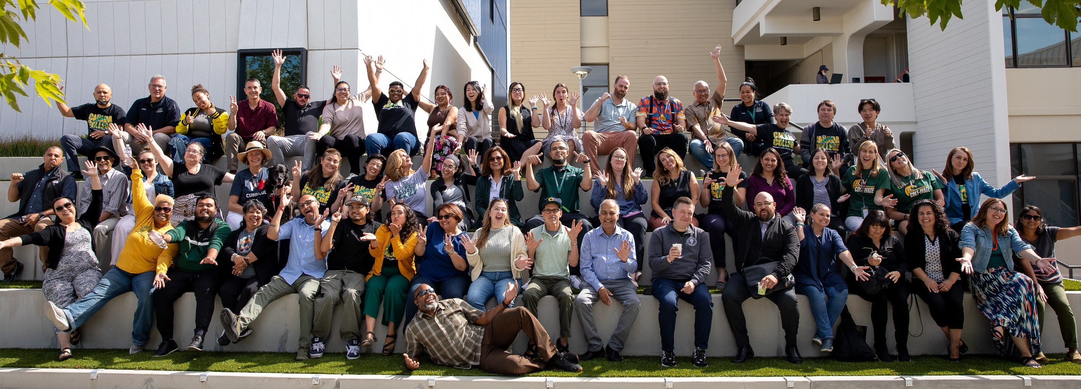
Working on College Plans Together
Each year our collaborative work on our strategic priorities starts at our Summer Leadership Retreat and continues all year in our college Councils, Committees, and ad hoc work groups.
Information on how to get involved is posted on our Cañada Collaborates website

Slide 41
Program Review
PURPOSE: Program review is the process through which constituencies on a campus take stock of their successes and shortcomings and seek to identify ways in which they can meet their goals more effectively.
A candid self-evaluation supported by evidence
Guides internal decision making
Provides external accountability (accreditation)
Connects program review with the college mission, planning, and budgeting
Faculty and Student Service Programs describes and documents what they do and why they do it
Instructional Program Review is faculty led: at Cañada the Academic Senate delegates process of peer review of program reviews to IPC
SSPC facilitates the peer review of student services program reviews
The President’s Office facilitates the peer review of administrative program reviews
College Program Review website: https://canadacollege.edu/programreview/index.php

Slide 42
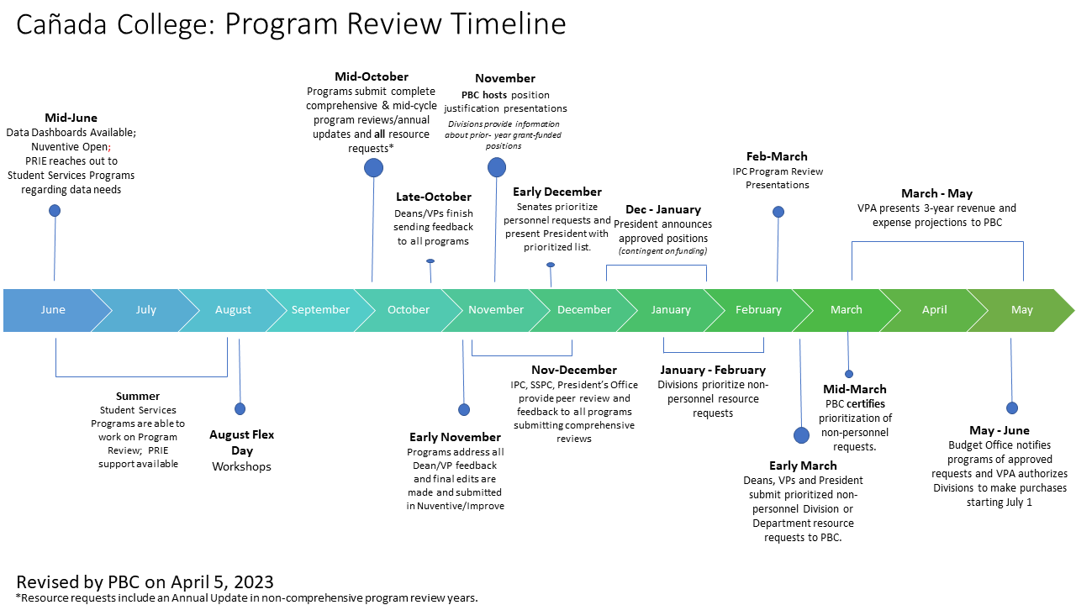

Slide 43
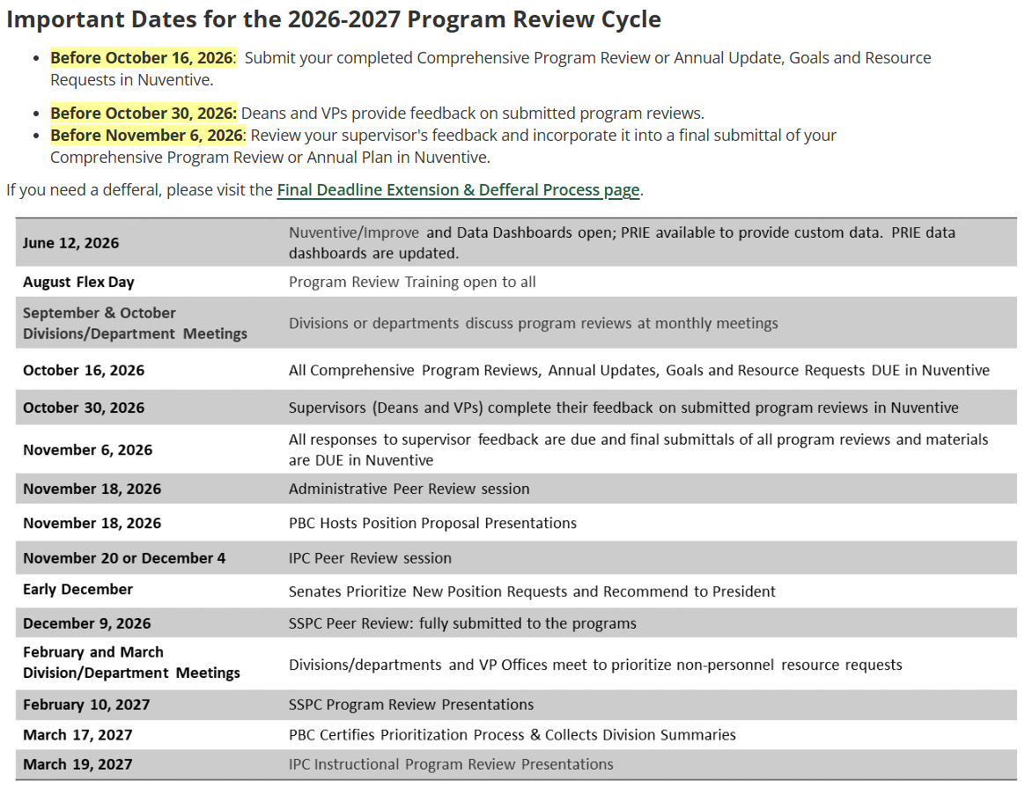
Program Review website

Slide 44
Program Development & Viability
The College uses the Program Review process to regularly monitor the growth and success of all existing instructional and student services programs.
The Academic Senate is currently updating the process for proposing new academic programs.
In recent years, the Academic Senate created and refined its program improvement and viability processes.

Slide 45
PBC Role in Resource Prioritization
The College uses Program Review as evidence for justifying new and replacement positions.
For New Personnel Requests, three distinct processes exist:
Process for New (non-temporary) Positions
Process for Vacancy Replacements
Process for Externally-funded and other Temporary Positions
For new position requests, PBC hosts an all-governance group meeting where programs can make presentations about new positions needed. Host a college-wide discussion of strengths and weaknesses for the position proposals. All members of the college community are invited to participate in the discussion.
For Non-personnel Requests:
After Divisions complete the process of prioritizing resource requests, PBC must certify that the prioritization process has been followed. PBC will collect a brief summary of the process used by each Division from a Dean and a Program Review Author (representative) from each Division. The summary includes answers to the following questions:
  Do all prioritized resource requests align with and support the College’s Mission, Vision and Values? If No, please explain.
  Please provide a brief summary of how your Division went about the resource request prioritization process during this cycle. Include any rubrics, tools, or other information you considered during your process.
Once PBC certifies the process, forward the non-personnel requests in priority order to the President.

Slide 46

Base decisions on data
PBC monitors the college’s outcome metrics via an annual review of Canada’s Institution-Set Standards and Goals
Programs utilize institutional data provided by PRIE to conduct their comprehensive program reviews
PRIE maintains data dashboards on student outcomes and enrollment management for public use
PRIE provides data related to equitable student outcomes in dashboards, in the college’s Student Equity Plan, and in program review data packets
PRIE regularly conducts surveys and posts the results its website
PRIE also conducts bespoke program evaluations as needed

Slide 47
Questions & Answers

Slide 48

Flex session evaluation form:

Slide 49
Thank you for coming!

