Slide 1
Planning and Budgeting Council EMP Update: 1.15
Ron Andrade & Mayra Arellano
February 4, 2026

Slide 2
Educational Master Plan 1.15
Create and scale the First Year Experience program for all incoming students, including default course schedules for some first-time cohorts.

Slide 3
Completed Actions
Take inventory of current activities
Outline desired FYE elements
Identify gaps and opportunities to further FYE outcomes
Complete Gap analysis and develop FYE expansion plans

Slide 4
Regular and Recurring Activities
Super Registration events recruitment into programs
First semester Counseling and SEP
Pre-semester orientations, classes, and workshops
Welcome Week

Slide 5
Pre-semester orientations, classes, and workshops
Project Change/Foster Youth/ Next Up - Case manager collaboration, intake meeting, share resource information, individual introductions, Welcome Day
NextUp CRER 401 summer before first semester, Welcome/Open House
Promise – Multi-day orientation (Fall and Spring), Kickoff in Spring for continuing students,
Dual - On-board, college connection form, orientation, CRER 137 pre-semester course
Middle College - Parent Orientation, Multi-day orientation for new students
TRIO – Re-Orientation
EOPS – Orientation where students see counselor, service form, meet EOPS staff, school supplies & SWAG, pre-advisement evaluation, Welcome/Open House
International - Orientation, counselor meeting, verify following SEVIS guidelines
Athletics – Orientation/Eligibility meetings, COLTs
Counseling - Connections and introductions to programs and services, CRER 137 and 401
Interest Areas - early outreach and appointments, welcome messaging, Welcome Week, class visits
Concurrent - Needs h.s. Counselor clearance, online orientation (services, access, social connection and that they are college students), include parents in Orientation

Slide 6
Identified Gaps
Opportunities for collaboration and growth, be strategic about resource requests
Summer Bridge and/or other collaborations to support developing community of learners
Reaching students earlier about technology information & resources that can be accessed through bookstore
Broader summer offerings for new students
Introduce support teams before semester begins
Update digital/print materials to direct students to information when they need it

Slide 7
Plans for AY 25-26
Promise Program offering CRER 401 in summer that wraps up with a day of resource information
Explore additional communication channels i.e. texting through SSL, to connect students with information and resources
First year milestone print/digital material
Establish standard process for updating and maintaining current Program Maps

Slide 8
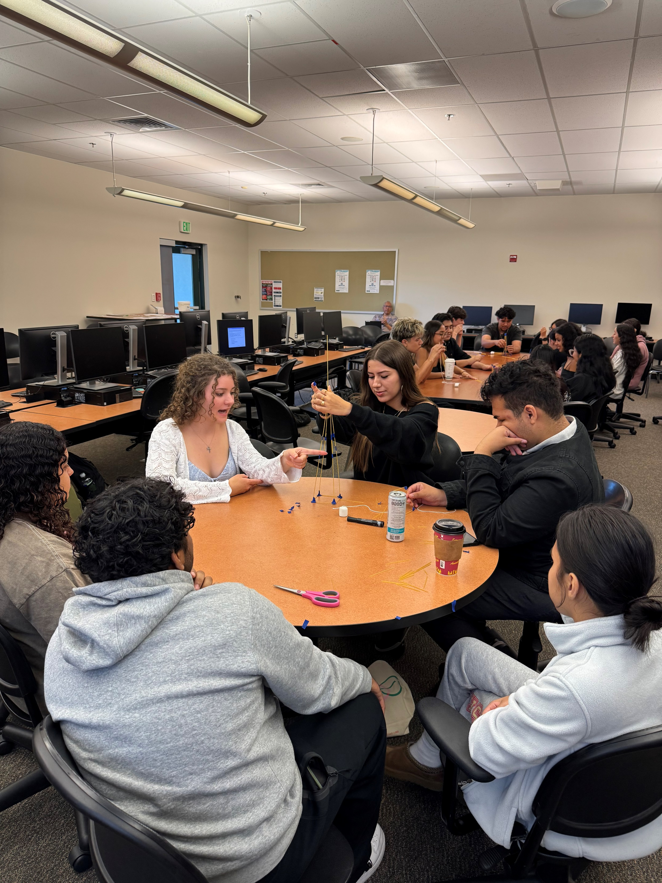
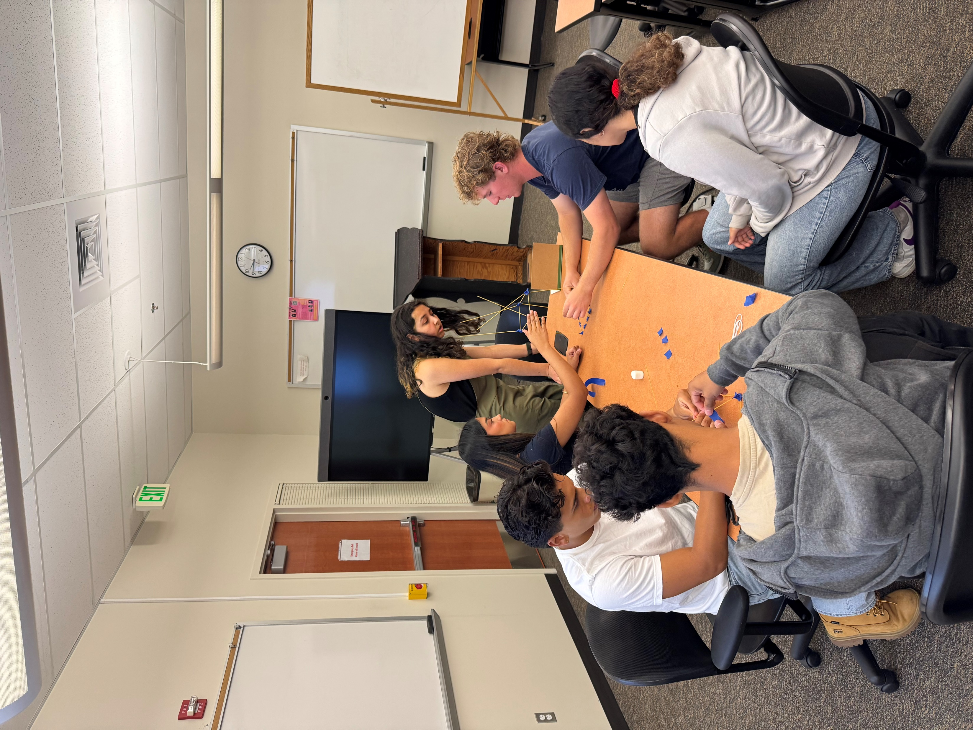
Promise Scholars Summer Bridge Programing
For New, First-Time College Students enrolled in Promise.
Emphasis on 1st Year Programming In Promise
Classroom Visits- English
Retention Specialist Support
Peer Mentors
Looking at Math and English Data Completion
University and Career Industry Visits
Podcast- Student Voices
Workshops- Topics related for 1st year students
Summer 2026: CRER 401 Taught by our Promise Counselors happening August 3rd to August 7th 2026
Focus on:
Community Building
Navigational Capital
Math and English Readiness- Faculty Presentations
College Matriculation

Slide 9
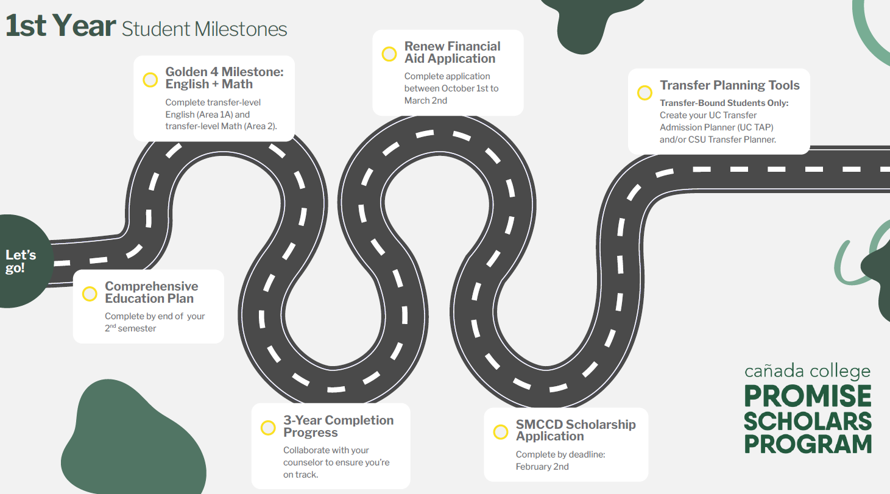

Slide 10

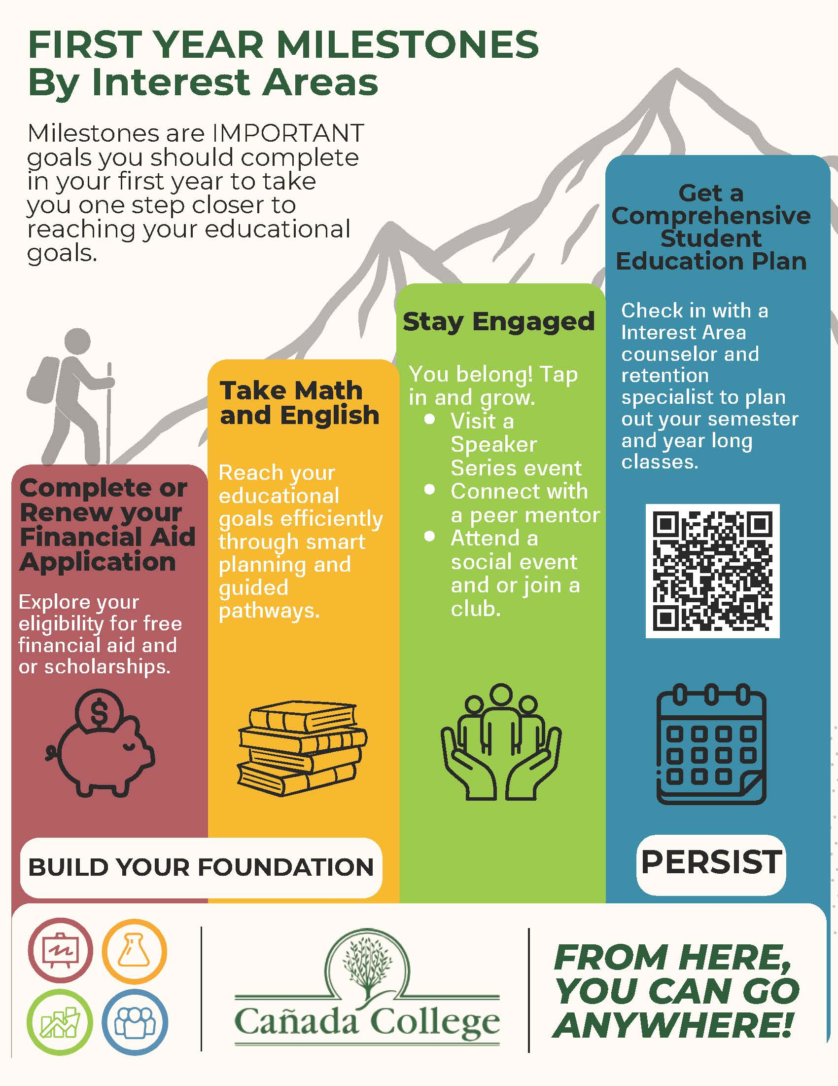

Slide 11
Goals: Positive Impacts on Student Outcomes
Stronger sense of belonging
Higher retention & persistence
Improved academic confidence & momentum
Clearer career & transfer pathways
Greater equity in access & success

Slide 12

Questions Comments Thoughts

