Slide 1



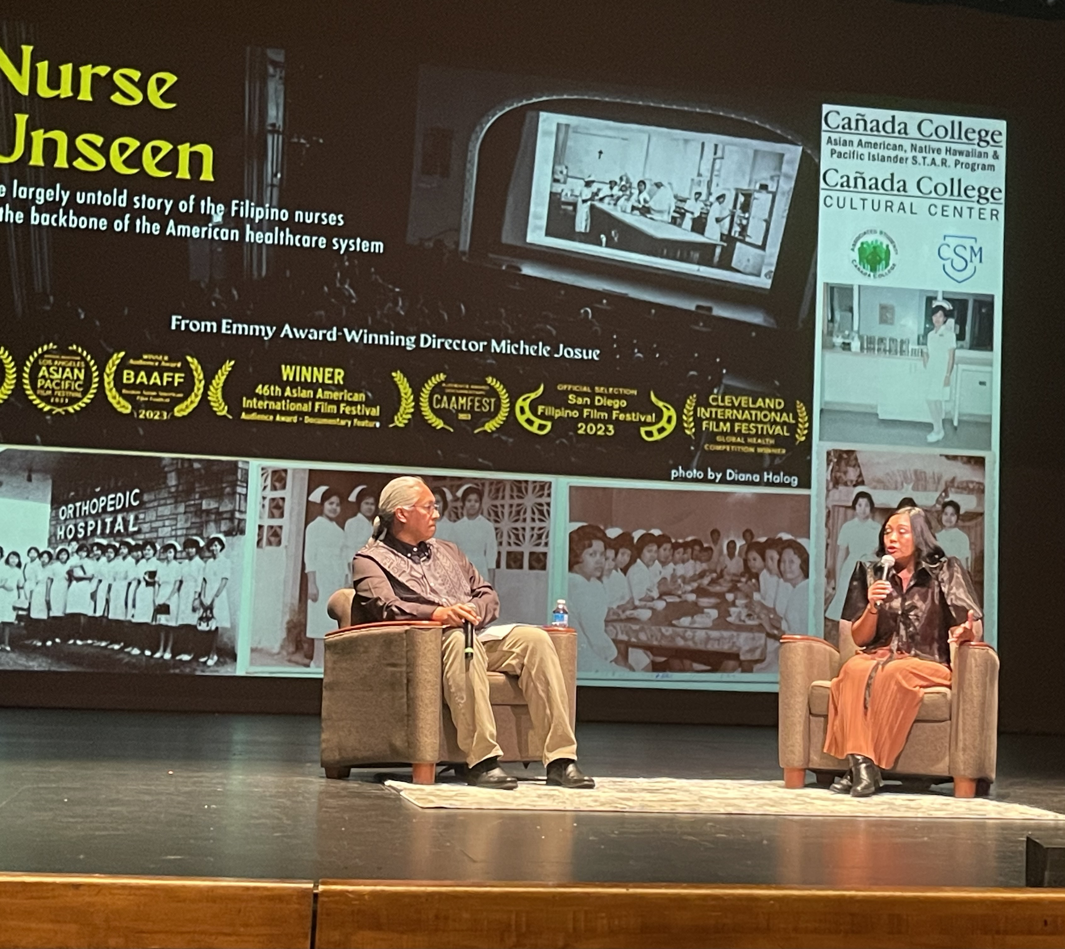
Positions Proposal
Program Service Coordinator (60% Classified)
Counseling Coordinator (100 % Faculty)
Requested by: Mary Ho

Slide 2
Cañada College
2024-2025: 22% identify as Asian, Filipinx or Pacific Islander
Asian American and Native American Pacific Islander Serving Institution (AANAPISI)
Racial/Ethnic Categories | Ethnic subgroups | %
Asian (East Asian, Southeast Asian and South Asian) | Chinese, Japanese, Korean, Vietnamese, Cambodian, Laotian, Indians & Burmese | 15%
Filipinx |  | 6%
Pacific Islander | Samoan, Native Hawaiian, Guamanian/Chamorro | 1%
PRIE Data Dashboard

Slide 3

Some Key Accomplishments:
Cañada College is an Asian American, Native Hawaiian, Pacific Islander Serving Institution
AANHPI S.T.A.R. Program is the inaugural AANAPISI program
Program Launched in Fall 2023
In 2.5 years:
Fall ‘23: STAR (formerly ARC) transfer pathway program launched
Fall ‘24: Inaugural Filipinx American History Month celebrations
Spring ‘24: Inaugural AANHPI Heritage Month celebrations launched
Spring ‘24: Inaugural AANHPI Graduation Celebration launched
May 2025: Received Proclamation from Mayor of Redwood City
Fall ‘25: STAR Learning Community launched
Center AANHPI Data Disaggregation
AANHPI STAR Website

Slide 4
Snapshot of Program Data:
2023-2024 | 2024-2025 | Fall 2025 (Aug-Oct)
329 unique students in (STAR event attendance & STAR Transfer Pathway enrollment) | 375 unique students (STAR event attendance & STAR Program enrollment) | 189 unique students (STAR events & STAR Program enrollment)
22 enrolled in STAR Transfer Pathway | - 58 enrolled in STAR Transfer Pathway - 15 unique enrolled in Learning Community (pilot launch Spring 2025) English 100: 6 students History 245: 13 students | - 65 enrolled in STAR Transfer Pathway - 20 enrolled in Learning Community (official launch) English C1000: 16 students History 245: 15 students
For breakdown of demographic information please see STAR Annual Report 2023-2024 and STAR Annual Report 2024-2025

Slide 5
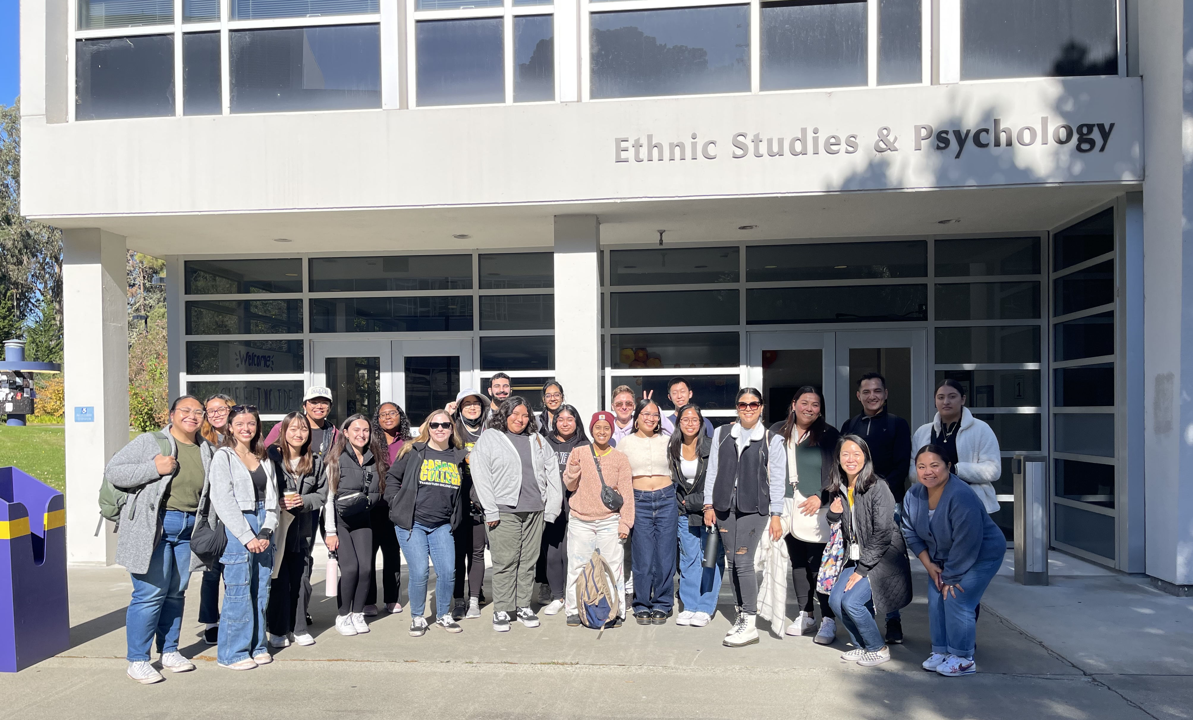
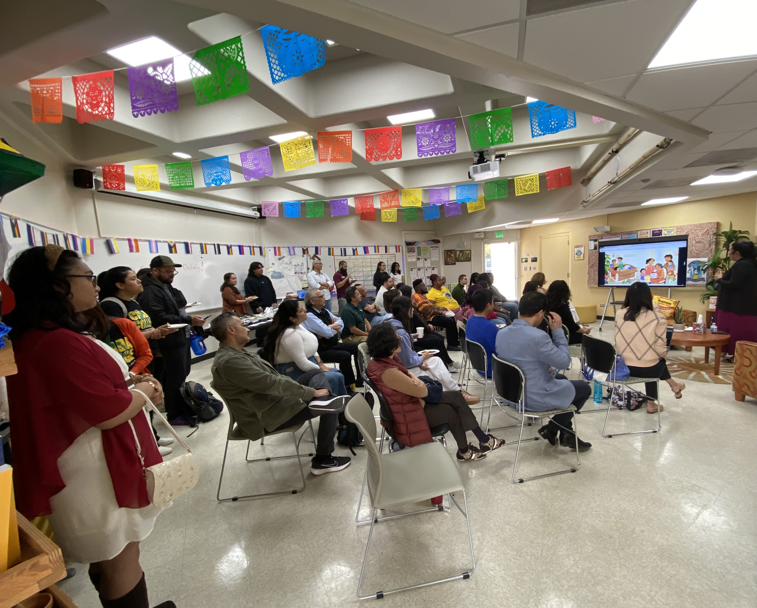
Program Services Coordinator:
Asian American, Native Hawaiian, Pacific Islander S.T.A.R (Success, Transfer, Access and Relevance) Program
60% FTE
Responsibilities: Develop and implement culturally responsive activities to support the academic, emotional and social needs of AAPI students (first-year to completion) Support the recruitment and enrollment of students in the STAR Learning Community. Hire and Supervise STAR Peer Mentors Develop and implement culturally responsive events (i.e. speakers, discussions, panels etc.) to help build institutional capacity Oversee the marketing and outreach for the AANHPI S.T.A.R. Program. Assist with data tracking

Slide 6
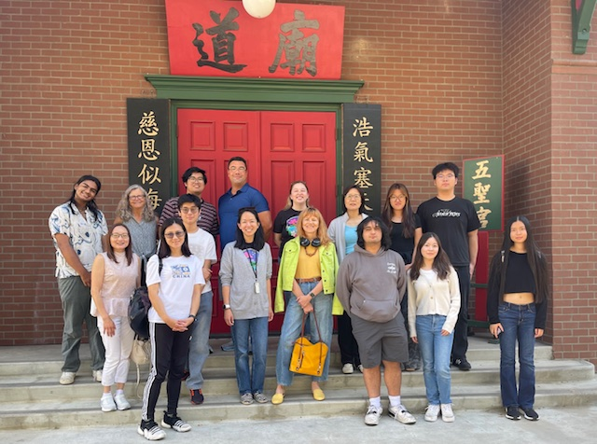
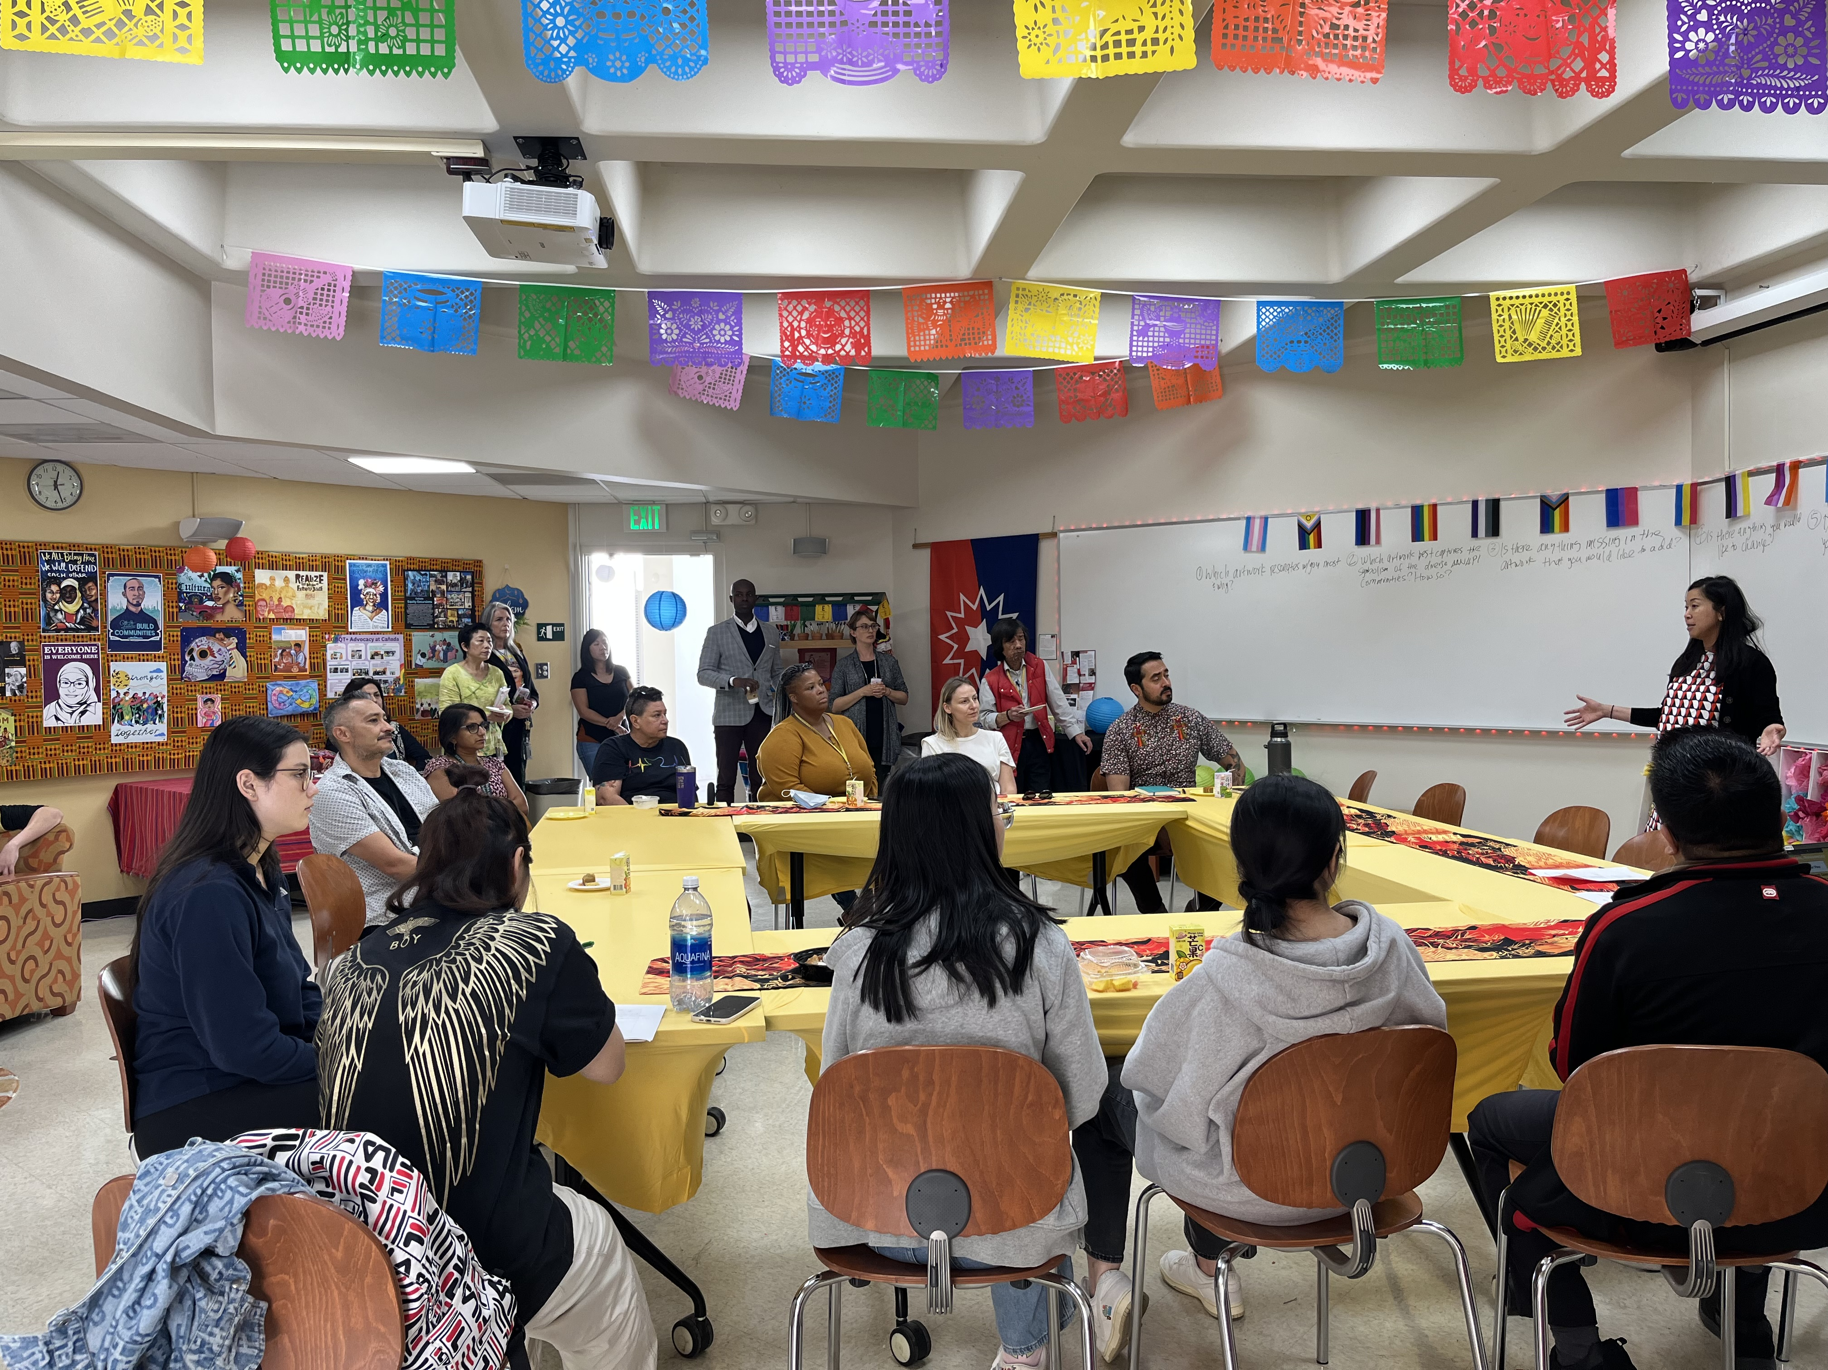
Counseling Coordinator (faculty):
Asian American, Native Hawaiian, Pacific Islander S.T.A.R (Success, Transfer, Access and Relevance) Program
100% FTE
Responsibilities: Oversee the direction of the STAR Program. Provide oversight of budget Work with campus partners to connect, promote and collaborate on behalf of the STAR Program. Supervise Program Services Coordinator Oversee data collection and reporting to College and State Serve the lead coordinator with the AANHPI SAP State Chancellor’s Office. Provide counseling to students enrolled in the STAR program (transfer pathway and Learning Community)

Slide 7
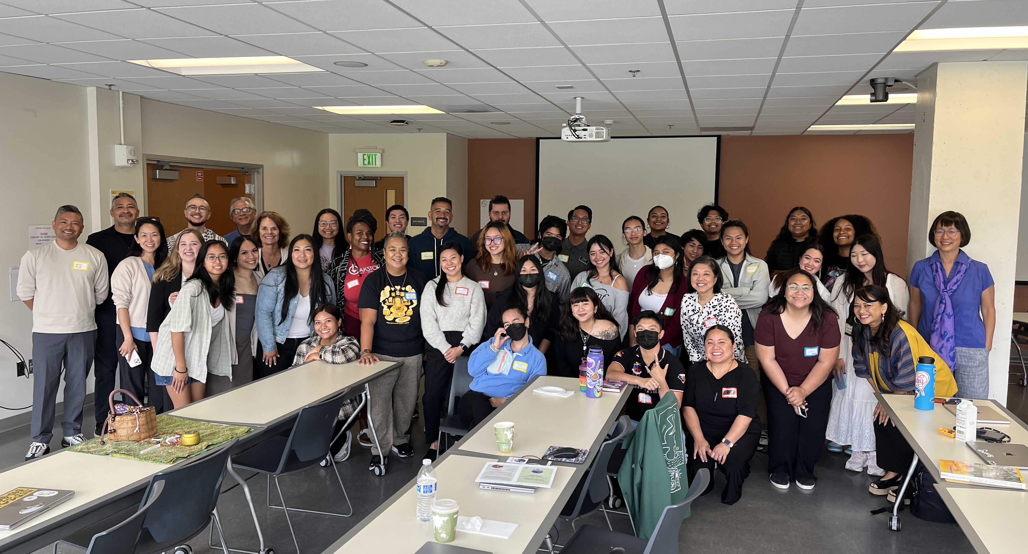
Positions Justification
Program Services Coordinator position currently exist - federal funds discontinued in Sept 2025.
Adjunct counselor currently exist - federal funds discontinued in Sept 2025.
Director of Postsecondary Success position ends in June 30, 2026 (provides leadership and advocacy for STAR Program)
Without personnel support, we will not have a STAR Program.
We are AANAPISI!
Supports the State’s AANHPI Student Achievement Program Education (Ed Code: 7.9510)
Support District Strategic Goal #1: Develop and Strength Educational Offerings & Interventions, and Support Programs that Increase Student Access, Success and Completion.

Slide 8
Cañada College Plans
EMP 2022-2027
STAR Program aligns with 1.14, 1.16, 2.2, 3.1, 3.2, 3.3, 3.8 and 4.4
This year’s priorities: EMP Strategic Initiative # 1.15: Create and scale First Year Experience Program (STAR Learning Community)
SEAP 2025-2028: Disproportionately Impacted Populations -
Metric 1: Successful Enrollment - Asians
Metric 2: Completed Both Transfer-Level Math & English – Asian Female
Metric 3: Persistence First Primary Term to Secondary Term - Asian Male, Filipino
College Transfer Plan (2025-2028) – the College’s AANAPISI designation and the STAR Program are embedded in 4 transfer focused strategies.

Slide 9
Question?

