Slide 1

Program Review Position Request
Position: Instructional Aide-II
Requested by: Dr. Ritu Malhotra
Faculty and Program Coordinator-Medical Assisting Program

Slide 2
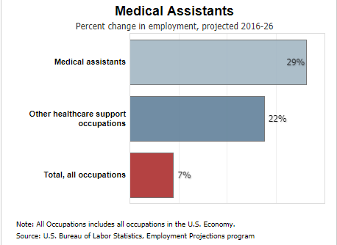
Soaring Demand of Medical Assistants
19% projected job growth (2022–2032, U.S. Bureau of Labor Statistics)
119,800 new jobs expected nationwide over the decade
47% of medical practices say MAs are the hardest role to fill (MGMA Survey, 2023)

Slide 3
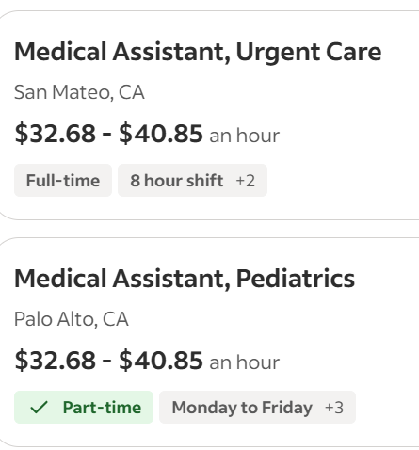
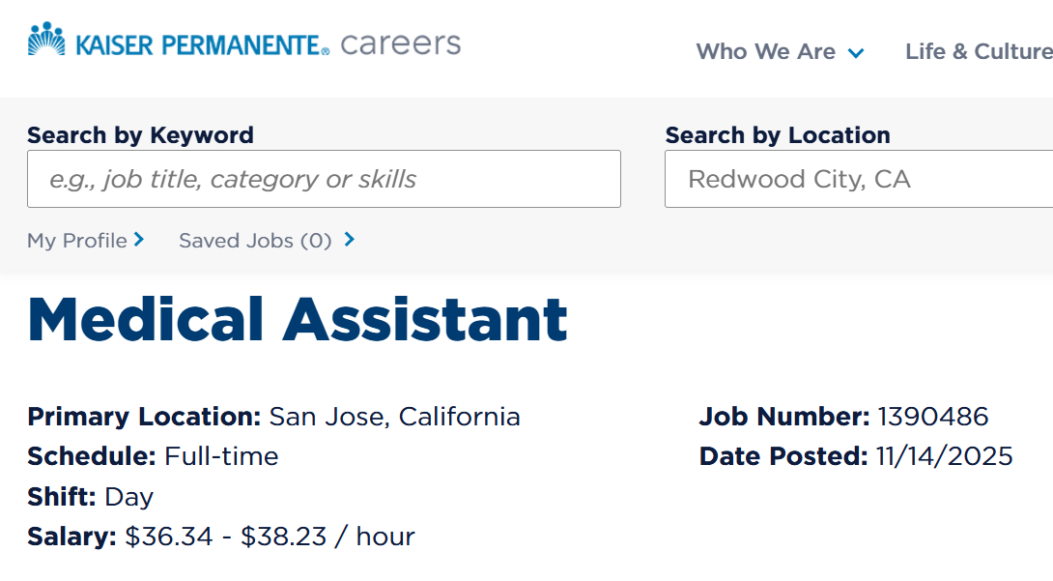
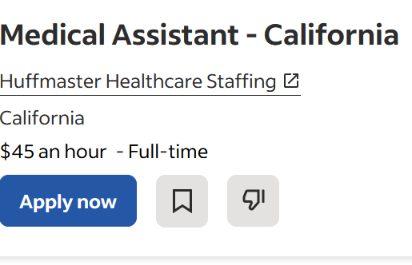
Medical Assistant Pay Exceeds County Living Wage
Competitive Entry-Level Pay: Graduates earn $28–$45/hour, exceeding the county’s $30 living wage benchmark.
Economic Impact: Provides students with immediate financial stability and a clear path to long-term career growth.
Mission Alignment: Directly supports the college’s goals for student success, completion, and upward mobility.

Slide 4
Success of Program in Meeting Community Demand
Our Mission We empower students to become skilled healthcare professionals — transforming lives and advancing community well-being.
Who We Serve Diverse learners including first-generation students, working adults, single parents, and ESL learners — ages 20 to 60.
Career Pathways Graduates enter stable, long-term healthcare careers with opportunities for advancement in nursing and allied health.
Impact Students achieve financial independence, support their families, and contribute to a stronger regional healthcare workforce.

Slide 5
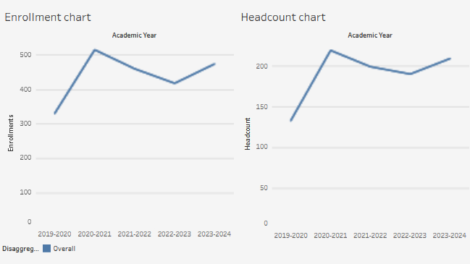
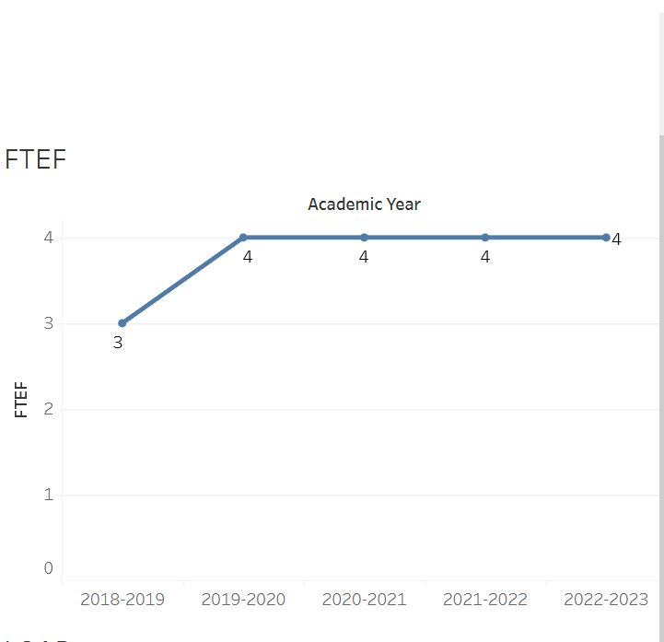
Enrollment, Headcount, and Success Trends (2019–2024)
Enrollment Growth: Program enrollment has increased by 43% since 2019, reflecting sustained student demand.
Headcount Expansion: Overall participation has grown by 57%, marking one of the fastest-growing programs in the division.
Student Success: Maintains a consistent success rate above 85%, exceeding institutional benchmarks.

Slide 6

Program Success & Achievements
Flexible Learning Options: Online, hybrid, accelerated, and accessible course formats
Expanded Partnerships: Strong employer collaborations and externship opportunities
High Placement Rates: Graduates consistently hired in diverse healthcare settings
Steady Enrollment Growth: 43% increase since 2019 with >85% student success rate
Outstanding Student Experience: High satisfaction and soft skill development
Simulation-Based Training: Hands-on labs that prepare students for real-world clinical practice

Slide 7
Current Challenges
High Faculty Turnover: Ongoing difficulty recruiting and retaining qualified instructors.
Course Coverage Gaps: Limited staffing creates scheduling and continuity challenges.
Workload Imbalance: One full-time faculty managing 300–360 hours of semester tasks.
Operational Pressure: Increased enrollment without proportional instructional support.
Risk of Burnout: Sustained overload affecting faculty well-being and program stability.

Slide 8
Why an Instructional Aide Is Essential
Maintains quality and compliance in labs and clinical instruction.
Provides continuous support and operational stability each semester.
Preserves program knowledge and reduces retraining of short-term staff.
Enhances student learning through consistent hands-on skills support.
Expands mentoring capacity and boosts student success.
Frees faculty time for teaching, assessment, and program growth.

Slide 9
Impact on Program Quality & Community Demand
Supports program growth and expanded lab capacity to meet rising enrollment.
Boosts student success through stronger retention, completion, and outcomes.
Improves workforce readiness and aligns training with community healthcare needs.
Strengthens program reputation and ensures long-term stability and growth.
Delivers cost-effective continuity versus retraining short-term assistants.

Slide 10
Thank You for Supporting Student Success

