Slide 1

Program Review
New Position Request Presentation
2 Positions: Chemistry Faculty Tenure Track
Requested by: Chemistry Department/STEM Division
Notes:
SOL

Slide 2

Cañada's Chemistry Department
With 2 FT Instructors and 8 PT Instructors as of Fall 2025:
NINE unique courses with at least 3 sections of per year of core series (*)
Day, evening and Saturday offerings
Online, Hybrid and in-person modalities
75% ZTC/OER/LTC adoption rate
Cohesive department curriculum in core series
11.5% increase in Success Rates from
AY 2022-2023 to AY 2023-2024 to AY 2024-2025
Cañada College Chemistry Club
CHEM 114: Survey of Chemistry and Physics
CHEM 192: Elementary Chemistry
**CHEM 120: Chemical Safety and Risk Managment
CHEM 410: Chemistry for Health Science (ZTC/OER)
CHEM 695: Independent Study (ZTC/OER)
----------------------------------------------------------------
*CHEM 210: General Chemistry I (ZTC/OER)
*CHEM 220: General Chemistry II (ZTC/OER)
*CHEM 231: Organic Chemistry I (ZTC/OER)
*CHEM 232: Organic Chemistry II (ZTC/OER)
Notes:
CAMILLE:
Who we have & what we teach
Chem in alignment with District's Strategic Initiatives and Goals:
Engage in innovative course scheduling that provides more student options for course completion. (Equity, Social Justice, and Completion)
Continually explore and implement interventions that benefit all students, with particular emphasis on students with high potential and limited resources.
Create an active campus environment that creates a sense of belonging and engagement for students.

Slide 3
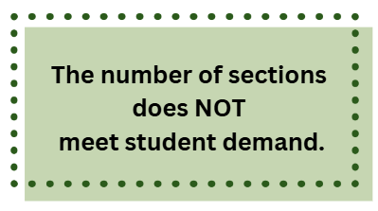





Current Observations & Expected Outcomes
100.7% fill at census
in Fall 2025
No Saturday offering
in AY 2025-2026
Insufficient faculty affect overall student retention, directly affecting the institution's mission to support student success, retention, and career readiness, especially in key fields like healthcare and STEM.​
Notes:
SOL:
Faculty shortage impacts timely degree completion, successful transfer opportunities, and retention
The department will have to face a reduction of offering; be unable to offer enough sections of critical courses.
Adjunct hiring to accommodate will not fix the underlying issue of LARGE DEPT WROKLOAD

Slide 4
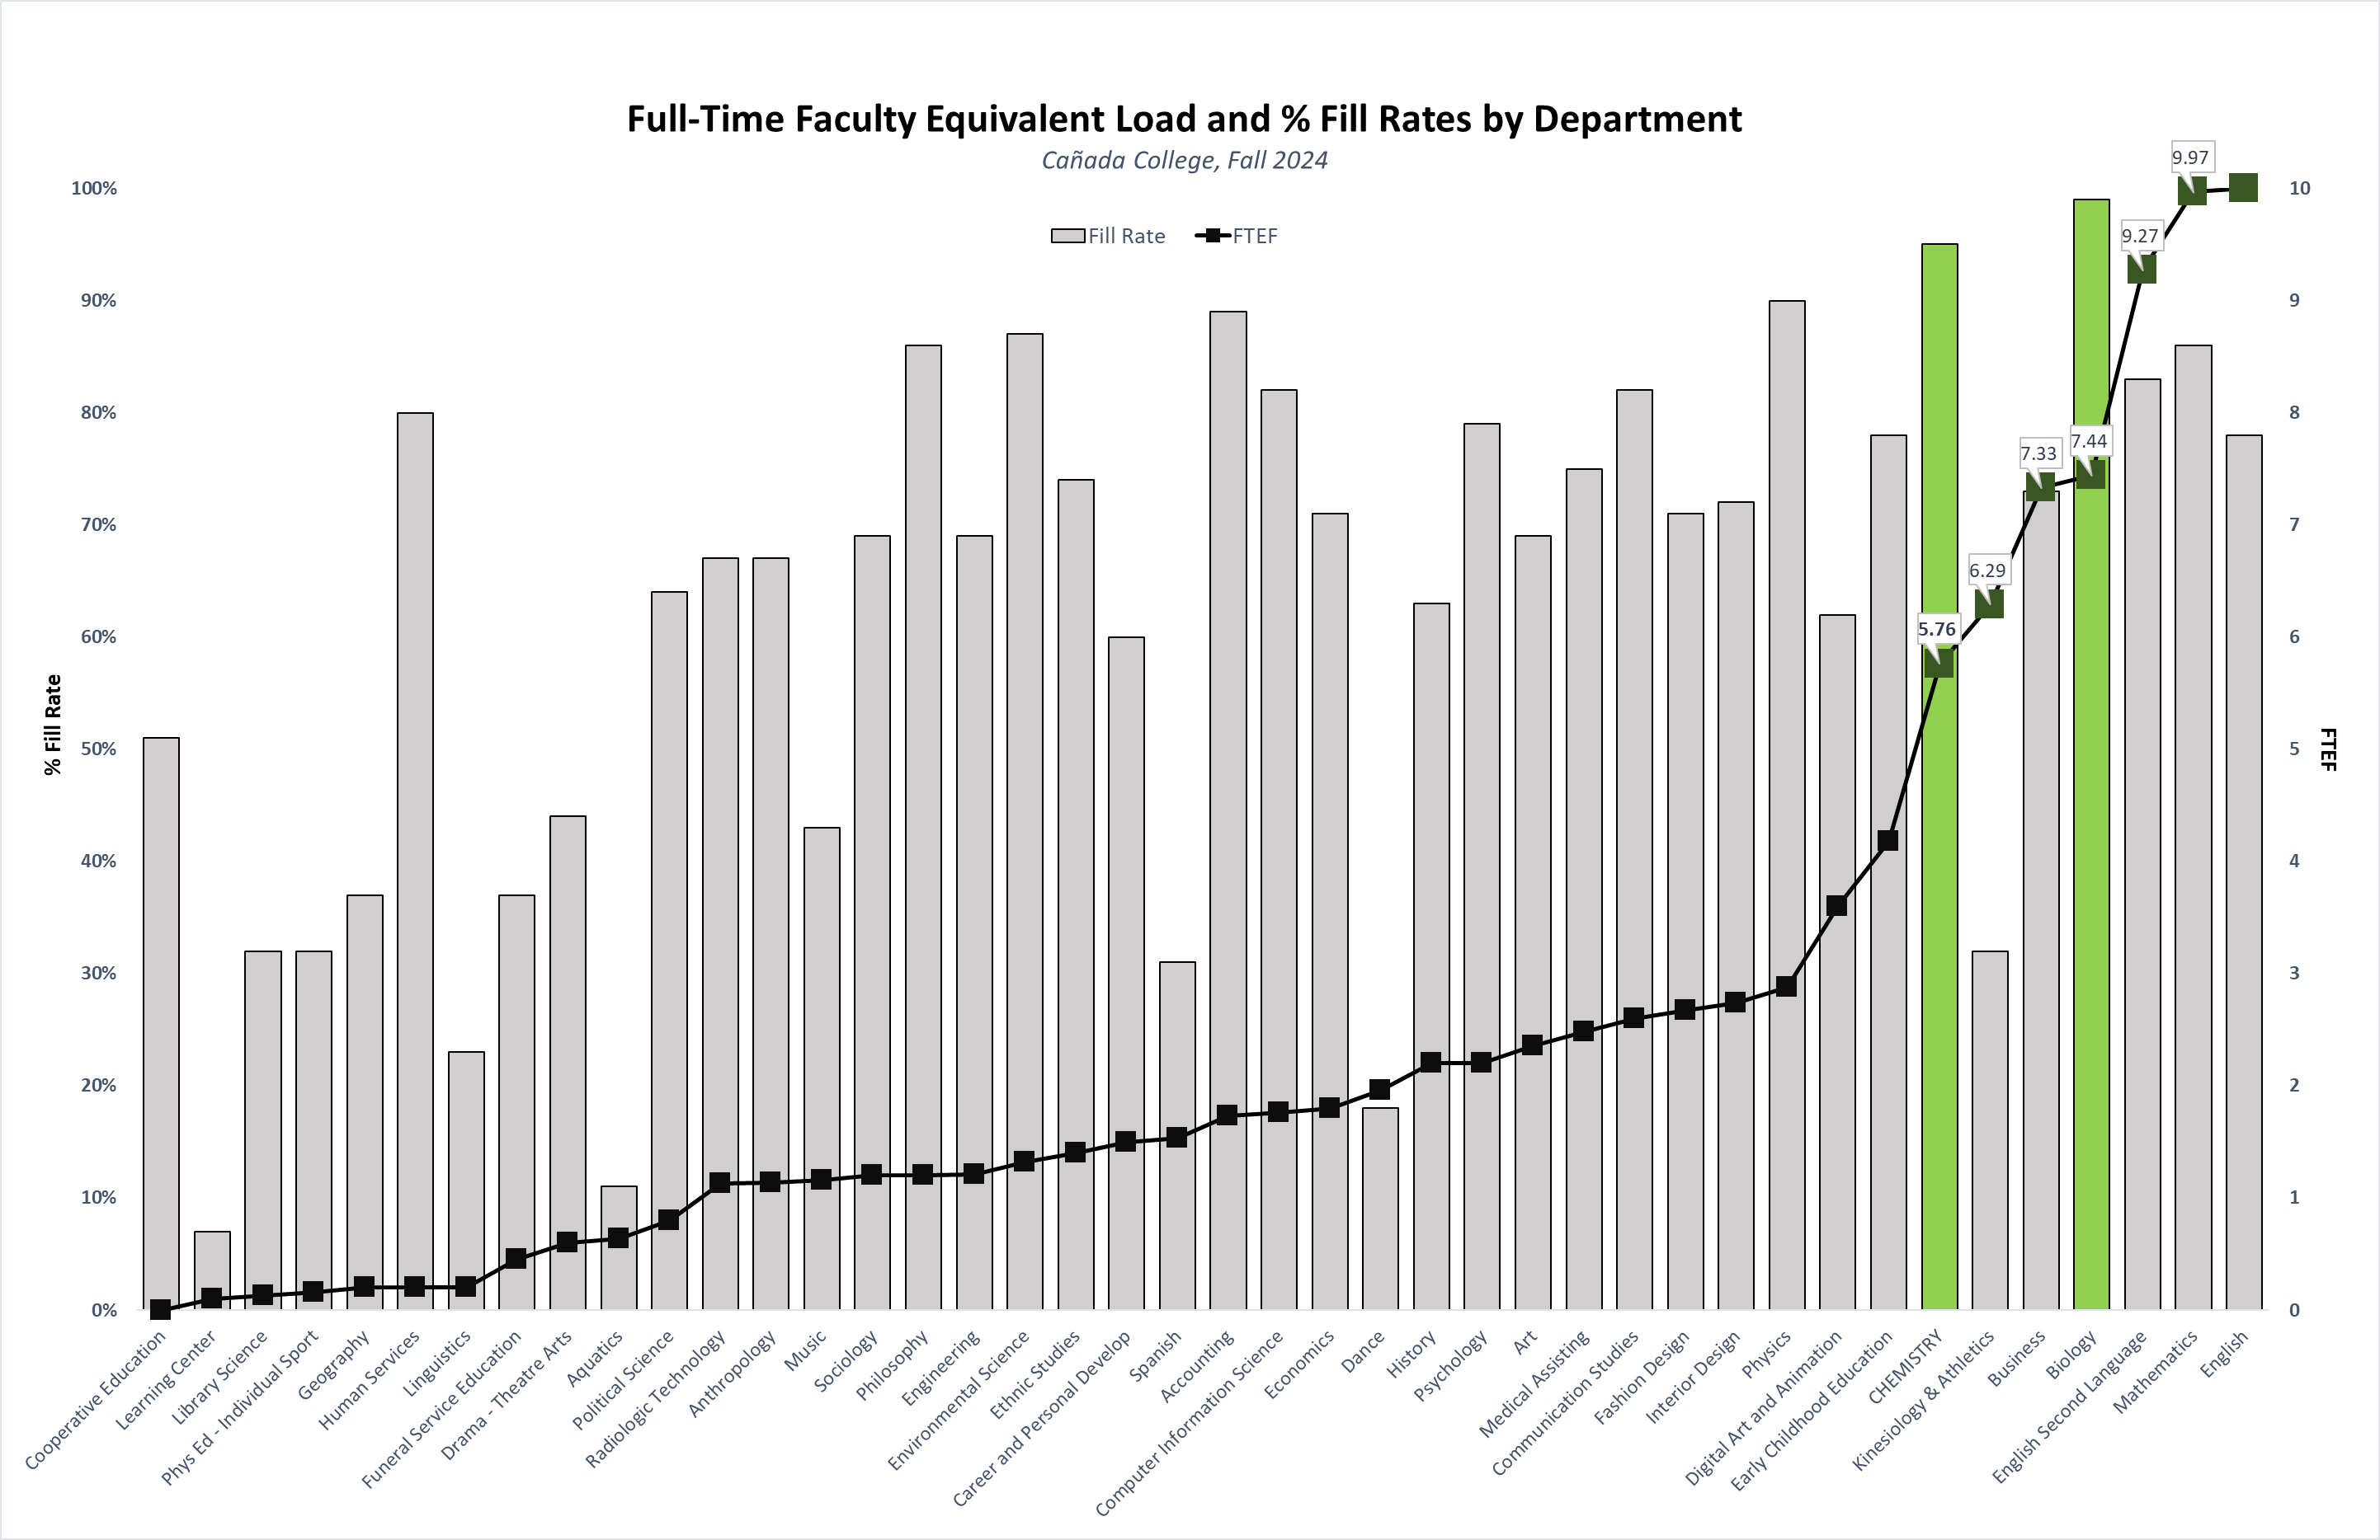
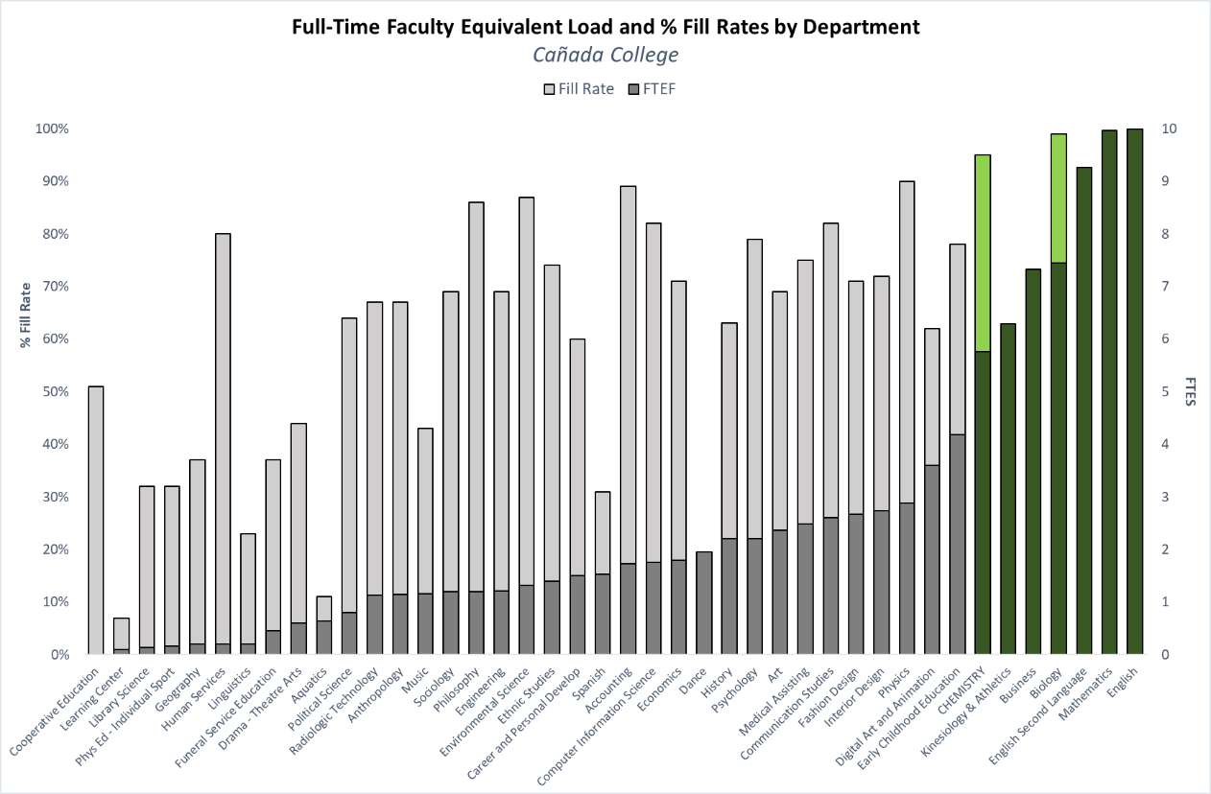
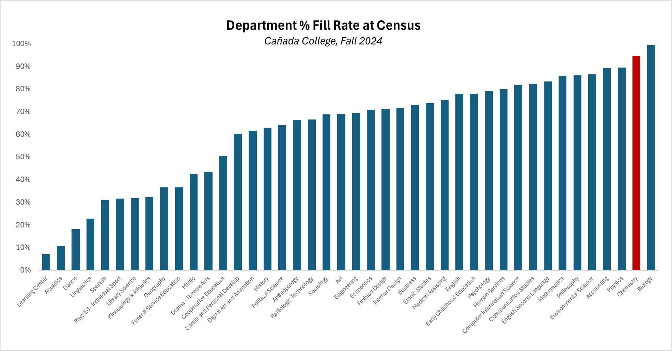
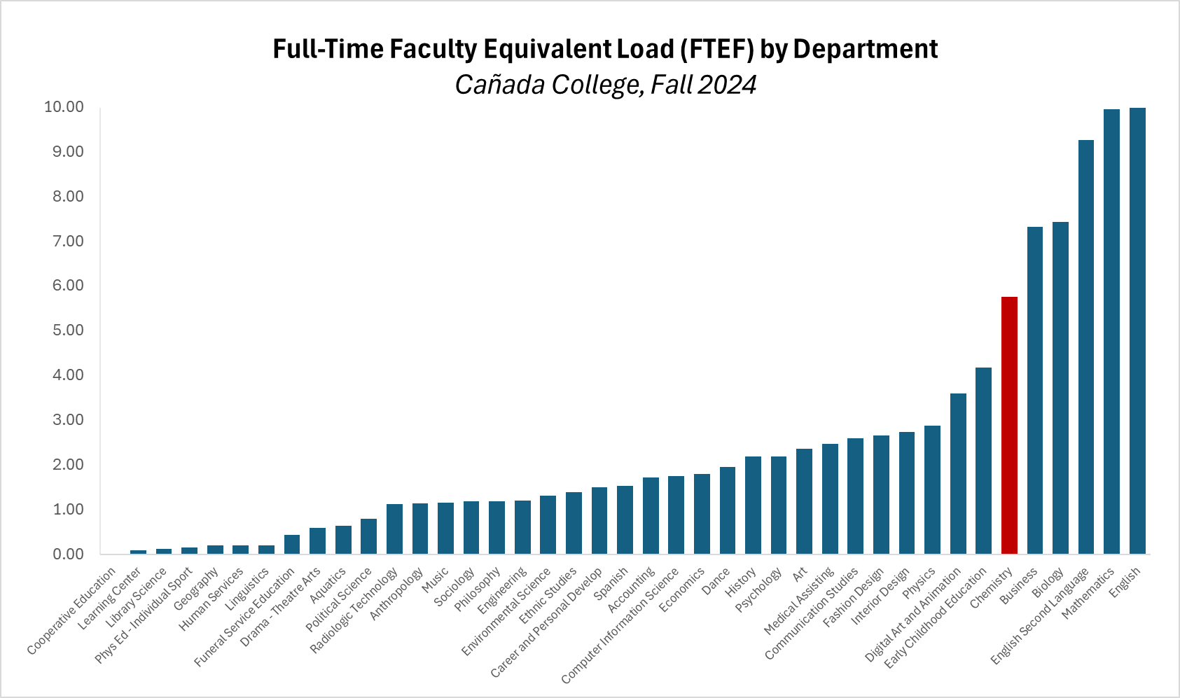
Institutional Impact of Our Department
As of Fall 2024:
Chemistry is the 7th largest department at Cañada (by FTEF)
Chemistry has the 2nd highest fill rate of 95%
Biology at 99%
Biology
Chemistry
Notes:
Chemistry offers 7th highest courseload by FTEF in the college
Attracts the second-highest number of students at the college with a 95% fill rate, playing a crucial role in the college's overall enrollment.
Dept. Is critical achieving the institution's academic and enrollment objectives.

Slide 5
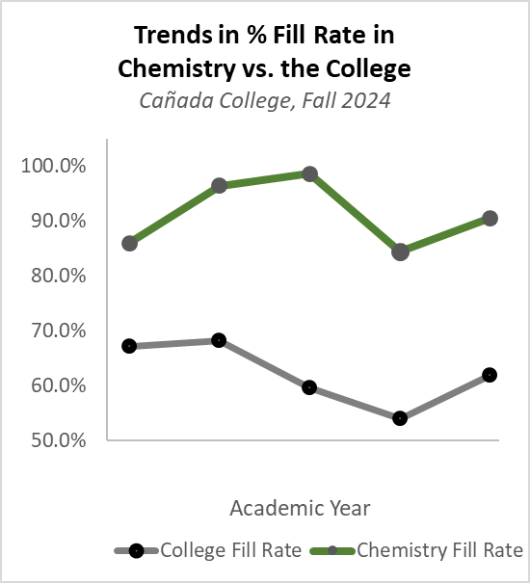
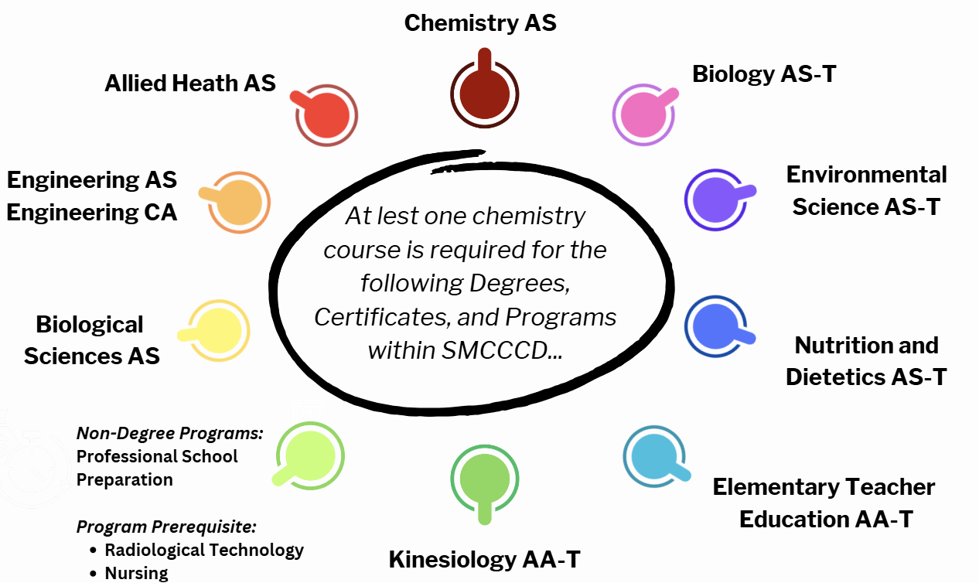
Students' Demand for Chemistry
Students have and will continue to take chemistry at Cañada College as long as sections are available.
4 Associates in Science (AS) Degrees:
Allied Health AS
Biological Sciences AS
Chemistry AS
Engineering AS / CA
5 Associates in Science for Transfer (AS-T) Degrees
Biology AS-T
Environmental Science AS-T
Elementary Teacher Education (AA-T)
Kinesiology AA-T
Nutrition and Dietetics AS-T
To apply to two specialized certificates:
Radiological Tech AS (CC)
Nursing (SMC)
Professional School Preparation: Pre-Dental, Pre-Medicine, Pre-Pharmacy, Pre-Veterinary, Pre-Optometry Preparation/Specialization Information
19-20 20-21 21-22 22-23 23-24
Notes:
SOL:
Department has resilient enrollment compared to the college.
CAMILLE:
10 Canada College programs require at least ONE chemistry course.
@ SMCCCD-level, demand is larger

Slide 6
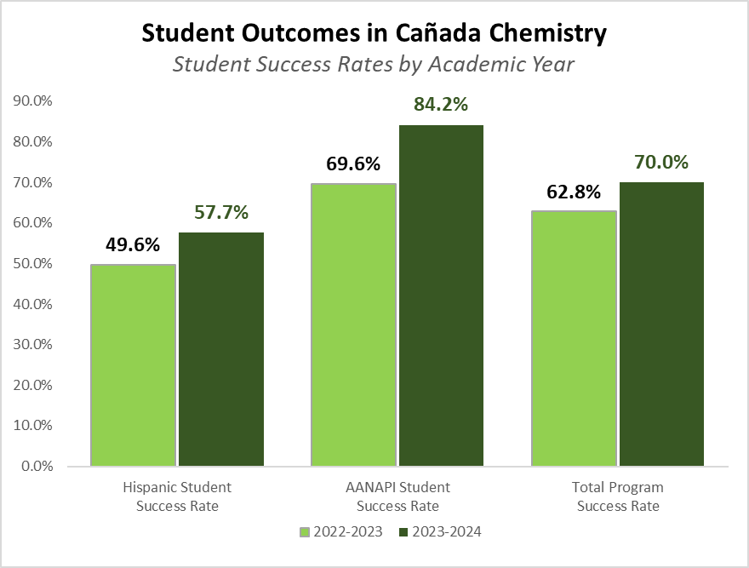
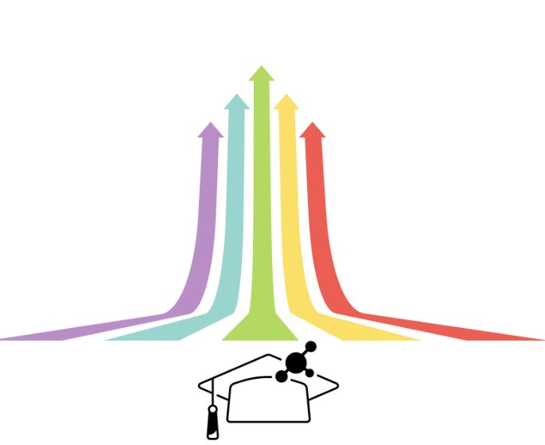

Step 2: Increasing Student Success
FTF provide tailored academic support for underserved students:
Mentorship and guidance
Personalized Interventions
Community and Belonging
College Service Collaboration
Representation
Improved Student Success
73.9%
AY 24-25
Notes:
Full-time faculty members are uniquely positioned to support student success by offering sustained, individualized attention, improving the inclusivity of course materials, and advocating for equity-driven changes within the department.
This investment in faculty will help close the achievement gaps, particularly for students of color and low-income students.

Slide 7
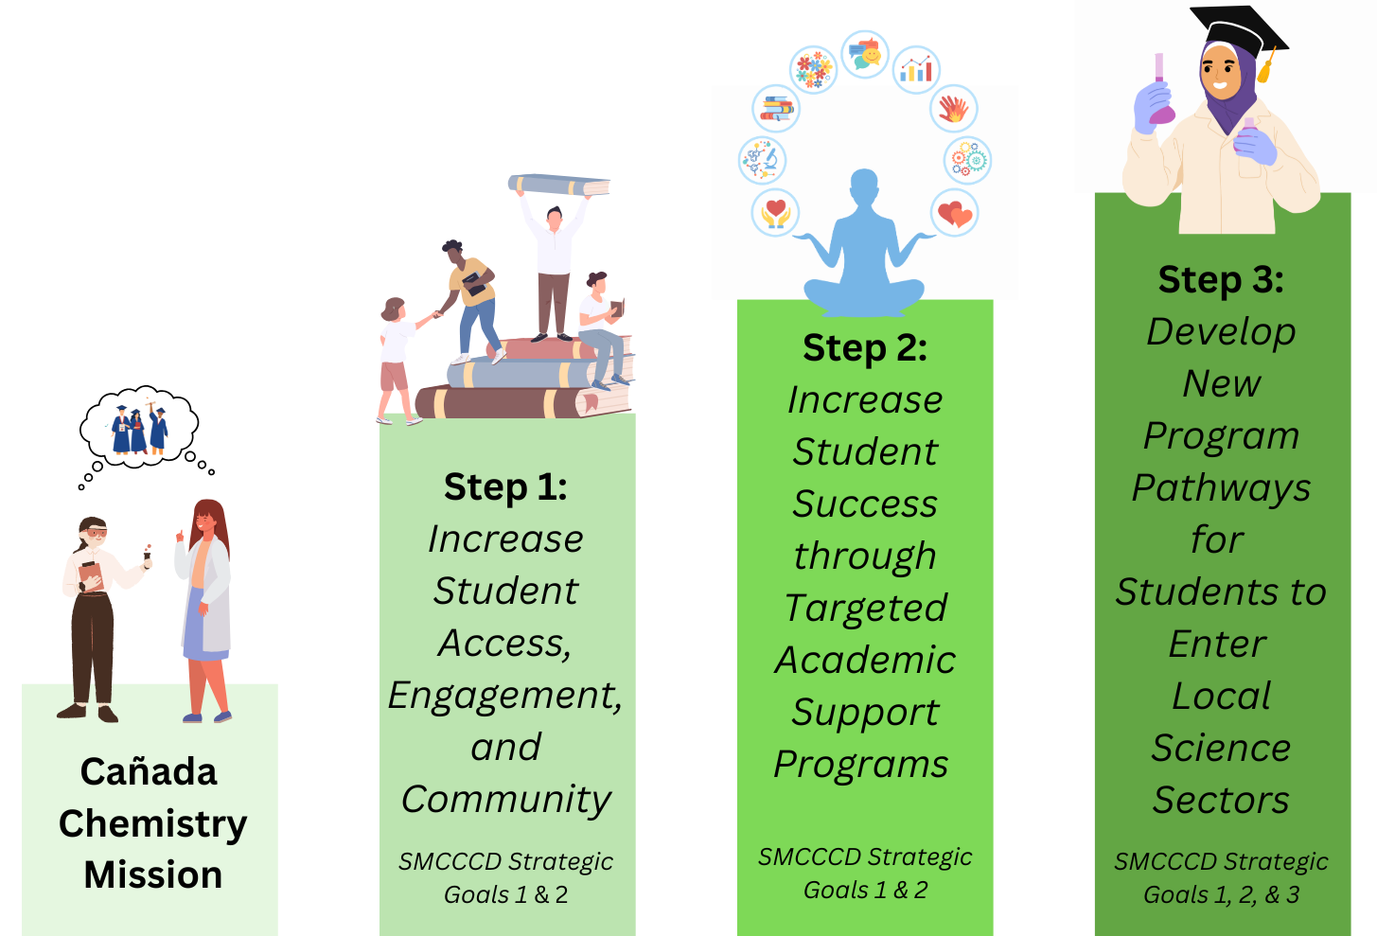
The Future of Chemistry at Cañada
To align with the Department's Mission Statement, we have planned a series of actions for the near future...
Step 1
Continue to increase the offering of courses and course modalities.
Form collaborations and learning cohorts with MESA, UMOJA, and other college-wide academic support services for disproportionately impacted students in chemistry.
Step 2
Reinstate the "Chem Jam" programs to prepare students for the skills and technology required for use in their chemistry courses.
Create a series “Just in Time” co-requisite support courses to provide structured support each semester.
Step 3
Develop the Chemistry Associate in Science Degree for Transfer (AS-T).
Develop an Associate in Science Chemical Technician Certificate Program.
Goal: four-year vocational baccalaureate degree.

Slide 8
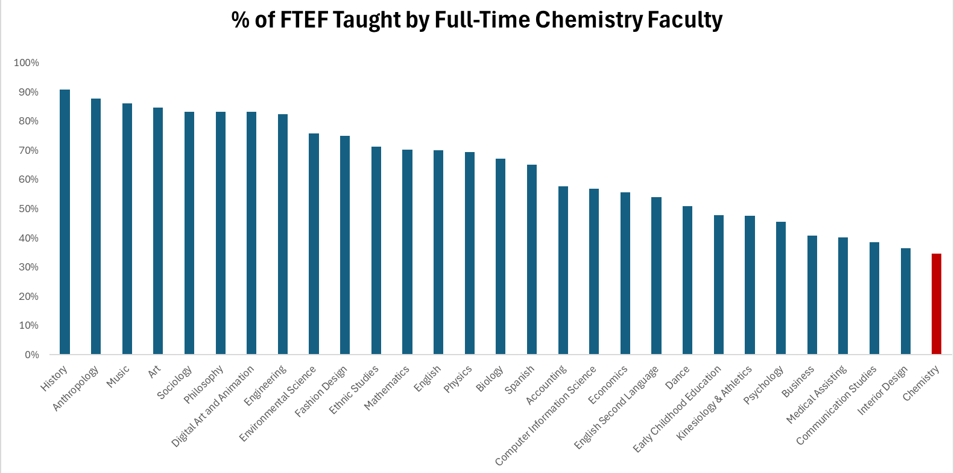
Chemistry: The Lowest % FT:FTEF at
Lowest Ratio in the College of 35%
Deficiency halts Program Development
Notes:
CA EC Section 87482.6 (AB1725) requires that at least 75% of credit instruction hours at California Community Colleges be taught by full-time instructors.
The chem department is under HALF of that limit.

Slide 9
Why Two Full-Time Faculty?
Projected Course Offerings and %FT:FTEF
Year | Fall-Spring FTE (%FT-FTEF)
22 - 23 | 8.56 (24%)
23 - 24 | 9.08 (41%)
24 – 25 | 11.5 (35%)
25 – 26 Urgent Expansion (was minimal) | 11.88 (27% During fall 2 FT – 43% during spring 3 FT) Lab Support (1 FT and 1 PT)
26-27 Student Demand Expansion to Guarantee Access | 16.44 - 5 FT (61%) and Lab Support (1 FT and 2 PT) Saturday offerings for both general chemistry courses
100.7% fill at census in Fall 2025
Notes:
SOL
Annual Expansion: Urgent / Student Demand
CHEM 192: 1 / 2
CHEM 210: 1 / 3
CHEM 220: 1 / 2
CHEM 231: 0 / 1
CHEM 232: 0 / 0
CHEM 410: 2 / 3

Slide 10


Investing in 2 Chemistry Faculty Improves...
ACCESS AND SUCCESS
ENROLLMENT
EQUITY IN STEM
Thank you!

