Slide 1

Program Review
New Position Request Presentation
TEMPLATE
Positions: 3 CDC Teaching Positions
Requested by: Kristina Brower- ECE Faculty Coordinator

Slide 2
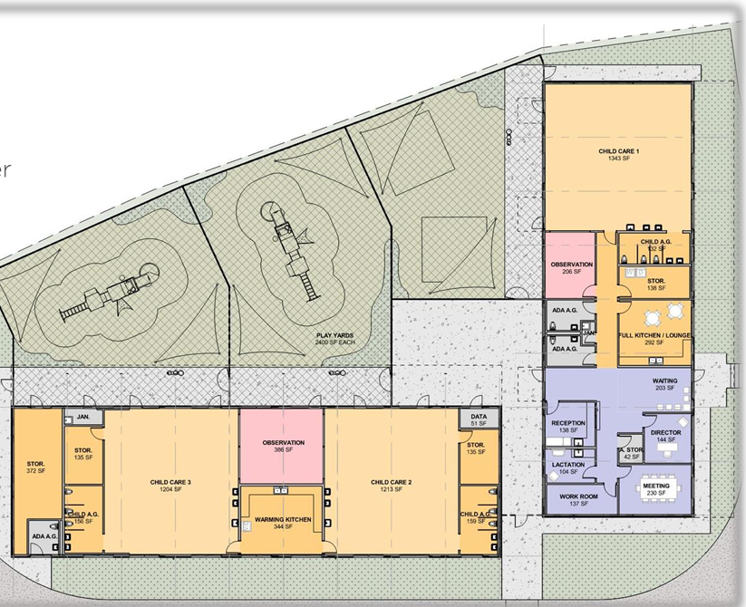
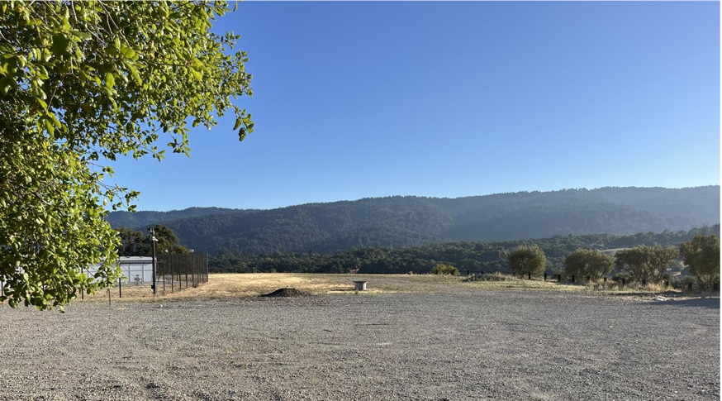
This process is for new position requests only
The Child Development Center at Cañada College is scheduled to be built and ready by spring 2027.

Slide 3
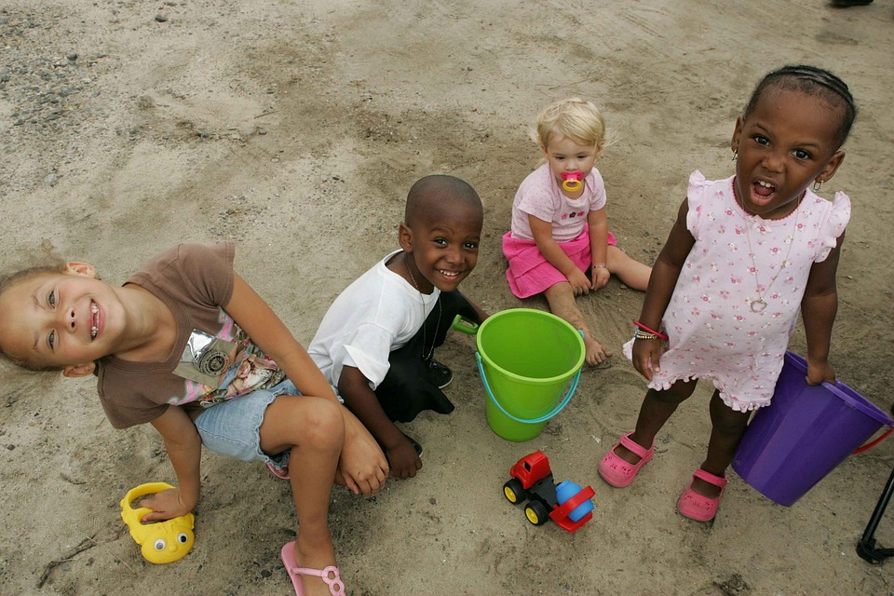
The Child Development Center is being built as a space to care for children and train future teachers.

Slide 4


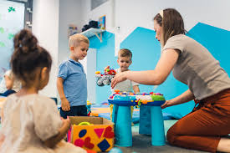
Children and students need qualified early educators
We will have 3 classrooms.
Each classroom will need 3 early educators.
We are currently requesting only 3. Enough to staff 1 classroom.

Slide 5
Educational Master Plan 2022-2027 COLLEGE GOAL #4 Accessible Infrastructure and Innovation
4.2 Build student housing on campus, as well as a Childcare Center to serve students with families.
While 4.2 only addresses building the childcare center, once built, it will need to become a fully functioning lab school for children and future teachers.

Slide 6

Position Titles and Salary
Master Teacher - $35.93 - $46.10
Teacher - $31.09 - $39.78
Associate Teacher -$25.86 - $32.63
As we prepare to operate child development centers across all three campuses, we are aiming to ensure alignment and consistency among them. To that end, we intend to maintain the existing staffing structures, which have been established in accordance with California Licensing regulations governing staff-to-child ratios.

Slide 7
Please be sure to submit your presentation before your presentation time so it can be posted to the PBC position request website:
Please email it to:
Karen Engel (engelk@smccd.edu) or Alessandra Zanassi (zanassia@smccd.edu)
Thank you!

