Slide 1

Program Review
New Position Request Presentation
Position: Full-Time Athletic Trainer
Requested by: KAD Division

Slide 2
Role of the Athletic Trainer
Athletic Trainer Duties
  Emergency Response – injury evaluation and treatment, infection control, practice and game medical coverage.
  Preventative Care – baseline concussion testing, pre-participation physicals, athlete education.
  Rehabilitation Services – physical therapy
  Administrative Responsibilities – creating emergency action plans and standing operating procedures, injury documentation, insurance claims, physician referrals, supply orders and budget management.
Cañada College is a member of the California Community College Athletic Association (CCCAA)
  Per the constitution, an Athletic Trainer is mandated at all hosted intercollegiate events
  Bylaw 9 – Medical Policies
  Bylaw 3 – Contests and Seasons of Sport

Slide 3
Why the Request?
Currently 1 full-time Athletic Trainer on staff
  Serving approximately 140-160 student-athletes each year
  Previously we had an additional part-time Athletic Trainer, but that position has remained vacant since Summer 2024, with very limited applicants
Why do we need another one?
  Addition of women’s badminton - increases number of athletes and opportunities for conflict with hosted events
    ATC is required to be onsite
    Spring - 3 in-season sports that play Tuesdays, Thursdays, and Friday afternoons
  No available substitutes and limited options for hiring outside help in case of emergency and game conflicts
  Out-of-season teams have limited medical support
  Already understaffed per the Appropriate Medical Coverage for Intercollegiate Athletics

Slide 4
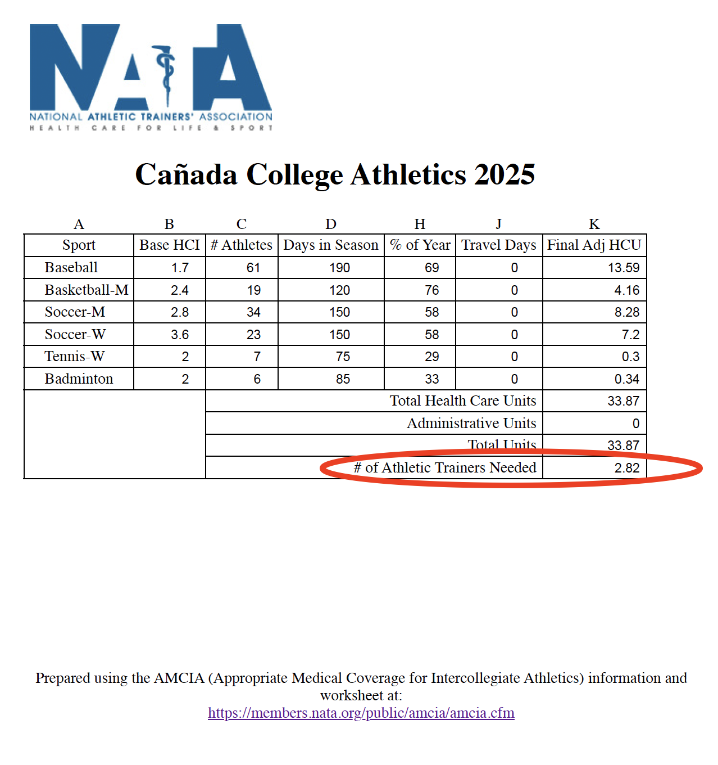

Slide 5
Supporting the District and College
Educational Master Plan Goal #1 (Student Access, Success, and Completion) – The student-athlete population continues to one that has higher graduation and transfer rates as compared to the general student population. Providing adequate medical coverage is key to the success of their participation.
Educational Master Plan Goal #3 (Community Connections) – Having appropriate medical coverage encourages potential student-athletes and their parents to consider Cañada College as a landing spot during recruiting
SMCCCD Strategic Initiative #3 (Not So Basic Needs) – The Athletic Training Facility provides access to medical resources that the student-athletes may not otherwise have. Many athletic injuries are treated by in-house staff and reduce the cost of insurance premiums for athletic accident insurance.

