Slide 1
Planning and Budgeting Council EMP Updates: 1.15 & 3.11
Ron Andrade, Director of Student Support
March 5, 2025

Slide 2
Educational Master Plan 1.15
Create and scale the First Year Experience program for all incoming students, including default course schedules for some first-time cohorts.

Slide 3
CREW activities and timeline
Take inventory of current activities – Fall 2024
Outline desired FYE elements – Fall 2024
Identify gaps and opportunities to further FYE outcomes – Spring 2025
Complete Gap analysis and develop FYE expansion plans – Spring 2025

Slide 4
Regular and Recurring Activities
Super Registration events recruitment into programs
First semester Counseling and SEP by major (program maps)
Pre-semester orientations, classes, and workshops
Welcome Week

Slide 5
Pre-semester orientations, classes, and workshops
Project Change/Foster Youth/ Next Up - Case manager collaboration, intake meeting, share resource information, individual introductions, Welcome Day
NextUp CRER 401 summer before first semester, Welcome/Open House
Promise – Multi-day orientation (Fall and Spring), Kickoff in Spring for continuing students,
Dual - On-board, college connection form, orientation, CRER 137 pre-semester course
Middle College - Parent Orientation, Multi-day orientation for new students
TRIO – Re-Orientation
EOPS – Orientation where students see counselor, service form, meet EOPS staff, school supplies & SWAG, pre-advisement evaluation, Welcome/Open House
International - Orientation, counselor meeting, verify following SEVIS guidelines
Athletics – Eligibility meetings, COLTs
Counseling - Connections and introductions to programs and services, CRER 137 and 401
Interest Areas - IA Kickoff, welcome message, early outreach and appointments, Welcome Week presence
Concurrent - Needs h.s. Counselor clearance, online orientation (services, access, social connection and that they are college students), include parents in Orientation
CWA - Orientation/Information session

Slide 6
Identified Gaps
Opportunities for collaboration and growth, be strategic about resource requests limited by the scope of our own programs
Summer Bridge and/or First Year Experience collaborations to form community of learners
Reaching students earlier about technology information & resources that can be accessed through bookstore
Broader pre-semester CRER 401 offerings for new students
Interest Areas introduction before semester begins (Colts-Connect)
Digital/Print handbooks w/ QR codes to direct students to information

Slide 7
Plans for AY 25-26
Promise CRER 401 the first week of August that ends with a day of resources
Interest Areas resource request for budget augmentation to expand welcome activities
First year milestone print/digital material

Slide 8
Questions Comments Thoughts

Slide 9
Educational Master Plan 3.11
Create and expand career exploration experiences (such as work-based learning, internships, and job shadow opportunities) for students during their time at Cañada, particularly during their First Year (in each Interest Area), as they choose a program of study and refine their education goals. Close racial equity gaps in access to career development and job placement opportunities.

Slide 10
Reimagining Career Workgroup (23-24)
Made recommendations to PBC in December of 2023
Interest Areas are the focal point for career exploration and work-based learning

Slide 11
Students have experienced several forms of work-based learning
Speakers who are knowledgeable about working in the field(s) in which students have interest
Employer site visits/industry tours
Field-based research experience
Service learning and/or volunteer opportunities
Job shadows
Internships (paid and unpaid)
Summer jobs (paid and unpaid)
Paid on-campus work related to their field of study (perhaps via the Learning Aligned Employment Program (LAEP)
Cooperative Education (Co-op Ed)
Pre-apprenticeship and apprenticeship
Job placement assistance (Career Fairs as well as other opportunities to connect to employers)

Slide 12
Employer site visits/industry tours & Job shadows
SJSU Conference for Engineering Diversity
Various workshops with industry members discussing how to break into industry.
Discussions on how industry is changing, LinkedIn presentation, career development.
Brunch w/Biotech - Mission College (7 Students)
Industry members did a round robin at the tables and talked with the students about professional development, personal experience and internships
Genetech Tour (12 Students)
General presentation about Genentech, site/lab tours

Slide 13
Career Fairs as well as other opportunities to connect to employers
Number of students served by Career Center per year ~ 290
Fall Job Fair Participation:
Employers 60
Students 170
Recruitment Weekday (Hiring & Info Sessions)
Fall 2024 Employers: 28
Students 60+
Spring 2025 Employers 35 so far

Slide 14
Speakers who are knowledgeable about working in the field(s) in which students have interest

Slide 15
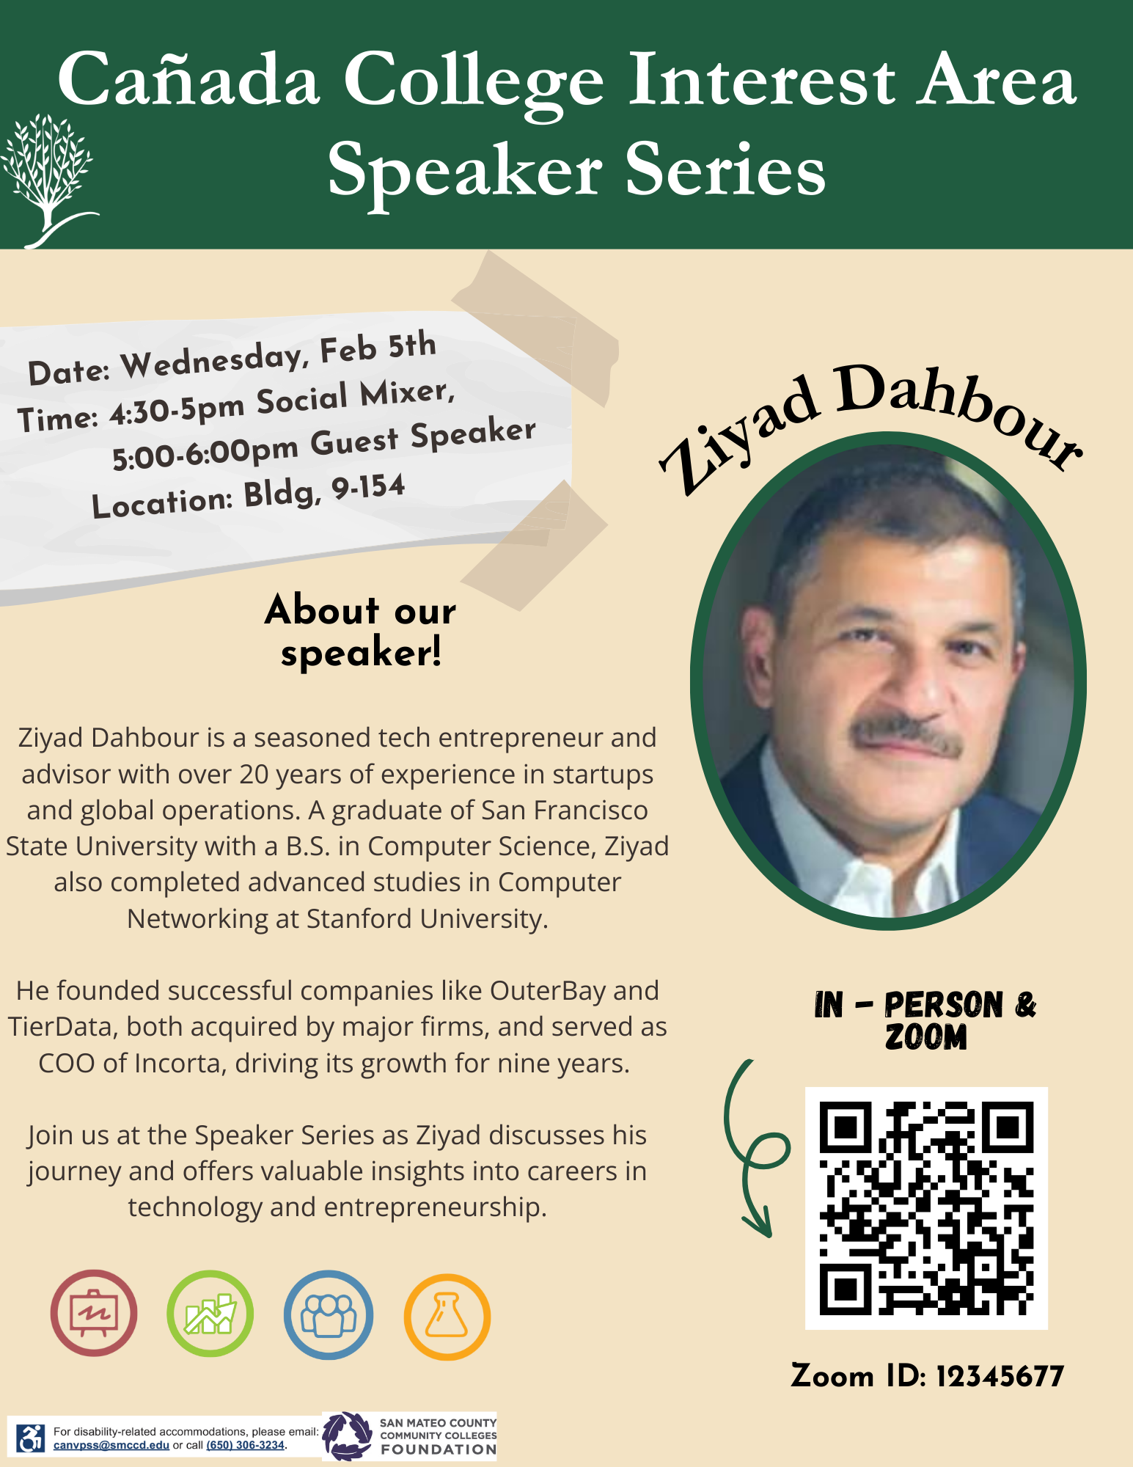
Speakers who are knowledgeable about working in the field(s) in which students have interest

Slide 16
Challenges Remain
Data tracking, monitoring, and sharing
Ensure that college career “on-ramp” services are accessible, comprehensive, and coordinated and there is a nexus of information sharing.
Develop database tools to facilitate information sharing and employer relationship management between College’s Career On-Ramp programs and services.
Scaling Work Based Learning
Cancellation of Learning Aligned Employment Program

Slide 17
Questions Comments Thoughts

