Slide 1
New Position Proposal
Position: Program Service Coordinator
Requested by: Mary Ho

Slide 2
Position Request
Program Service Coordinator:
Colts-U Transfer Station/ARC (Access, Relevance & Community) Project
$75,636.00 (+52.82% Fringe & adjust for 3% COLA each year)
Year 1: 80%
Years 2-5: 60%
Year 1: 20%
Years 2-5: 40%

Slide 3
Position Responsibilities
Colts-U Transfer Station “One stop station for university information & transfer resources) | ARC Project (Title 3 - Asian American and Native American Pacific Islander Serving Institution grant project)
Coordinate support for the Colts-U Transfer Station. Direct & coordinate Colts-U Transfer Ambassadors. Support planning and implementation of marketing, outreach efforts and programs with partner universities (i.e. NDNU, SFSU etc.) Coordinate support for transfer activities, special events, University rep visits and other events | Develop and implement culturally responsive activities and intervention to support the academic, emotional and social needs of AAPI students (first-year to completion). Direct & coordinate ARC peer mentors Develop and implement transfer related workshops and activities to support students in their educational plan to transfer. Develop and implement culturally responsive events (i.e. speakers, discussions, panels etc.) to help build institutional capacity.

Slide 4
Cañada College Plans
EMP College Goal #3: increase 35% of the number of Cañada College transfer-seeking students to achieve transfer readiness and the number of students who apply to a 4-year University between 2022-2027 and to reduce the transfer equity gap for low-income, first generation, and Black, Indigenous, and People of Color (BIPOC) students.
College Transfer Plan (2021-2024): centers our AANAPISI, HSI status, BIPOC students and embeds antiracism and equity in the strategies.

Slide 5
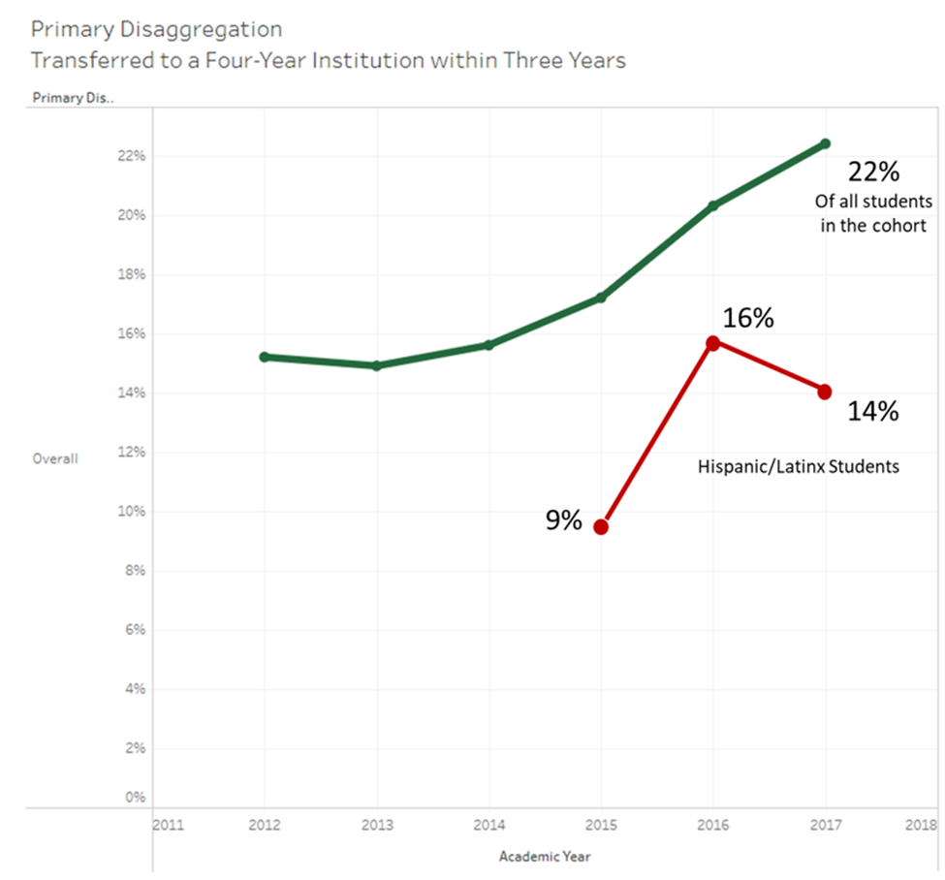
Student Equity and Achievement Program Plan (2022-2025)
Year 1 (2022- 23) | Increase by 4 percentage points from 14% in 2020-21 (the 2017-18 cohort) to 17% in 2022-23 (the 2019-20 cohort).
Year 2 (2023- 24) | Increase by 4 percentage points from 17% in 2022-23 (the 2019-20 cohort) to 21% in 2023-24 (the 2020-21 cohort).
Year 3 (2024- 25) | Increase by 4 percentage points from 21% in 2023-24 (the 2020-21 cohort) to 25% in 2024-25 (the 2021-22 cohort).

Slide 6
Cañada College
Asian American and Native American Pacific Islander Serving Institution (AANAPISI)
23% identify as Asian, Filipino or Pacific Islander
PRIE Data Dashboard

Slide 7
Career Ladders Focus Group (2020): Findings and Student Voice
An expectation that the Asian Americans and Pacific islanders have to live up to the model minority myth [has led to] instances of stereotyping or micro aggression behaviors.
Students also noted that they felt the image of the model minority led to hurtful microaggressions and unattainable expectations in their classes.
“Asian Americans are so diverse and [we] get clump[ed] under one group, right, and then we have Pacific Islanders.” They expressed a desire for a place to celebrate, discuss, and recognize the rich diversity of the cultures within the AANAPI community”
They also reported a need to better understand all Asian American cultures.

Slide 8
Addressing antiracism
Since 2017 (perhaps prior): Cañada College has AANAPISI designation
No interventions, programs or services specifically for AAPI students
Áse Recommendations # 2: Prioritize affinity spaces
The research: lack of targeted support for AAPI students have led to isolation, mental health issues and belongingness thus impacting educational outcomes for AAPI (Museus, 2014).
Disaggregate! Disaggregate! Asians are diverse.
Addressing equity
Filipino: DI in persistence first primary term to subsequent primary term: 29% compared to 58% for all students (2020)
Asian, Filipino and Pacific Islander: Successful Enrollment in the first-year: 14%, 19% and 8% compared to 33% for all students
Data on Asian students do not tell the full story

Slide 9
Question?

