Slide 1
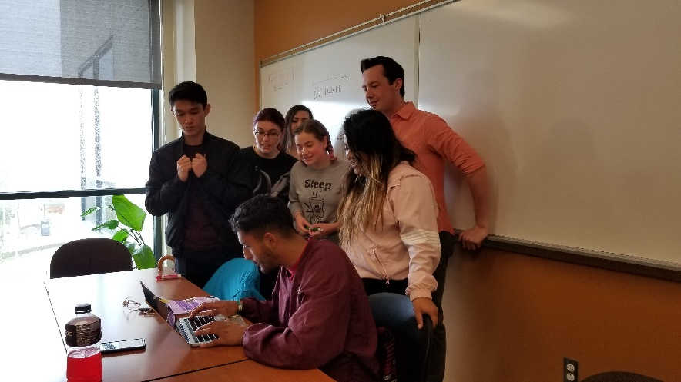
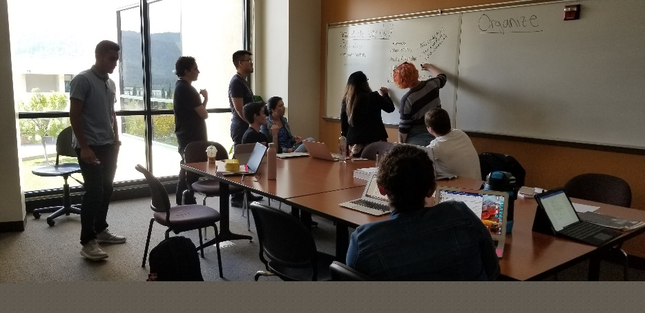
New Position
Proposal:
Transfer Success Coordinator
December 3, 2020

Slide 2
What is the need?
In order to graduate from Canada and to transfer to a four-year institution, students, particularly first-generation, minoritized students, need:
Exposure to STEM professionals and opportunities to explore STEM professions in order to formulate academic and career goals
Exposure, guidance and encouragement to explore and apply to numerous four-year university options and find the best fit for their lives and goals
Consistent, intrusive mentoring to guide students through the transfer application process
A warm hand-off to a four-year university as well as follow-up to ensure successful transition from Canada to the four-year university

Slide 3
STEM Transfer Success Coordinator Duties
Major duties of this position include:
Organizing and leading STEM-focused university visits
Identifying transferring students and intrusively guiding them through the application process
Providing transferring students with a “warm handoff” at the four-year university
Coordinating a speaker series each semester which brings local STEM professionals onto campus.

Slide 4
STEM Transfer Success Specialist – Transfer Cohort
Year | 2018 | 2019 | 2020
Number of Students Applying in Fall | 94 | 98 | 67
Number of Confirmed Transfers for the following fall admission | 66 | 82

Slide 5
STEM Speaker Series Works
The average values of student survey responses indicated that students were motivated by these speakers.
Survey Statement | Average response Spring 2019
This speaker has inspired me to devote the time and energy necessary to succeed in my classes. | 3.60
Listening to this speaker made it easier for me to envision myself as a professional in my chosen field | 3.60
The speaker’s presentation provided me with concrete tips and/or study skills that I feel I can apply to my coursework. | 3.60
Likert scale with 1=disagree strongly, up to 4=agree strongly).

Slide 6
Speaker Series Works

Slide 7
Transfer Success Coordinator guides cohorts of transfer-bound students from first-year to transfer
COLTS-CON
Speaker Series
College Visits
Speaker Series
College Visits
SEPS
2nd Year
Final Year
Grad!
New Student
First Year
Transfer Celebration
Warm Hand-Off
Summer Follow Up
Transfer Prep
Workshop (June)
Transfer
Success
Selects interest Area
Enrolls
Application Workshops
Cohort Reminders
Recent Grad Panel
College Visits

Slide 8
Future Applications of the Transfer Success Coordinator Position
Career Exploration is a central component of the Interest Area Success Team work in Guided Pathways
STEM Speaker Series can be expanded to include speakers from all interest areas
An all-college Speaker Series effort can help to build the alumni network as well as strengthen relationships with local companies
The Transfer Success Coordinator’s Boots-on-the-Ground Approach can:
Identify transferring students across the college and intrusively connect them to Transfer Center resources
Ensure that all students with a goal to transfer are able to explore and consider multiple transfer universities to find the best fit for their academic and career goals

Slide 9
What Happens if the Transfer Success Coordinator position is not funded?
Transfer Center Provides High-Quality Services to Students, but lacks the ability to be intrusive
Many students are at risk of not connecting with the Transfer Center and applying to transfer without expert guidance and support
Students may successfully be accepted to schools, but not actually attend in the fall
Students May Choose Majors without Knowing the Career Options the Major Presents:
Students risk following an academic track that may not lead to a fulfilling career

Slide 10
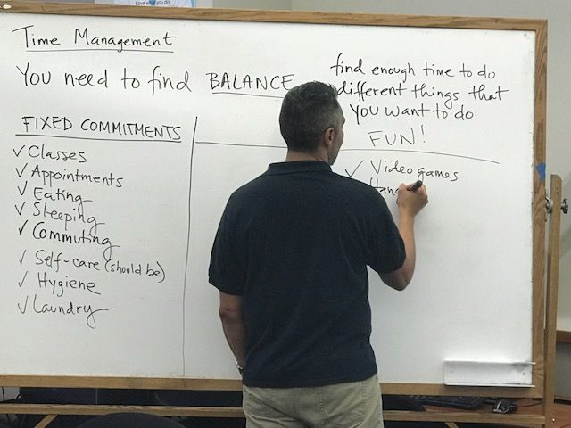
Thank you!
What are your questions?

