Slide 1
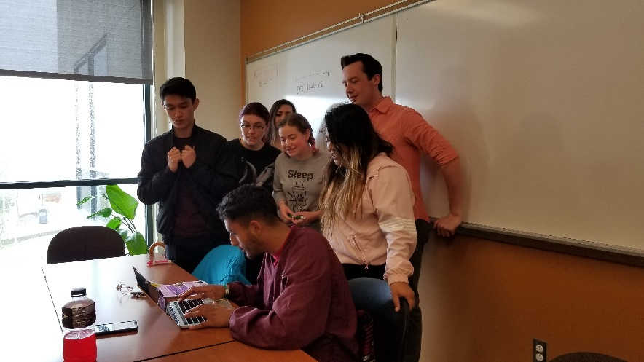
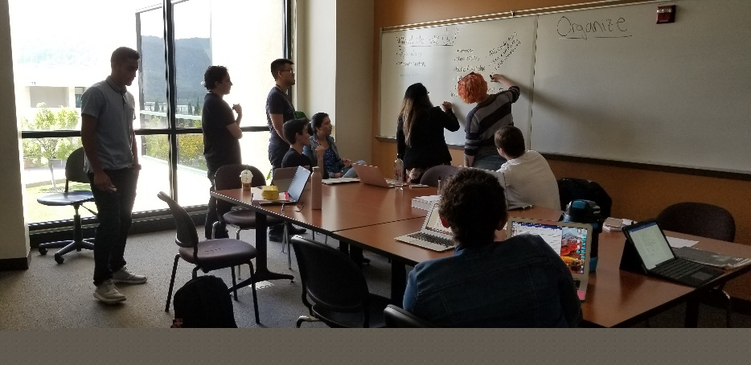
New Position
Proposal:
STEM Project Director
December 3, 2020

Slide 2
What is the need?
The STEM Assistant Project Director (currently grant-funded) provides behind-the-scenes supervisory and coordination support for STEM Center staff and activities. The STEM Center Project Director is also responsible for aligning the STEM Center activities to ensure that they support the college’s strategic plans and priorities.

Slide 3
Project Director Duties
Exchanges information with project and College management staff, other educational institutions, government, community, and business representatives regarding needs assessments, project services design, delivery and required outcomes, compliance regulations, funding resources, short- and long- range plans, public relations, and reporting requirements
Plans and implements meetings, receptions, orientation programs, and other special events and outreach activities
Gathers, maintains and analyzes STEM Center program data; Tracks project outcomes for use in planning and reporting activities as well as broader dissemination
Composes and prepares correspondence, report and grant narratives, and presentations for both internal college audiences and external community audiences.
Uses a variety of computer software to enter, format, and retrieve data for a variety of reports, grant applications, presentations, and documentation
Confers with other College departments in order to provide coordinated services to students
Coordinate with division faculty and campus administrators to ensure that STEM Center services are aligned with and support division and campus teaching and learning.

Slide 4
What Happens if the Assistant Project Director position is not funded?
Currently, all leadership for the STEM Center is grant-funded.
Without this position, leadership and supervision would fall on the Science & Technology Dean
Not having a STEM Center with a designated director would place Canada College at a disadvantage in attracting students as our sister colleges, as well as most local colleges have STEM Centers and STEM professionals are in high demand in our local communities.

Slide 5
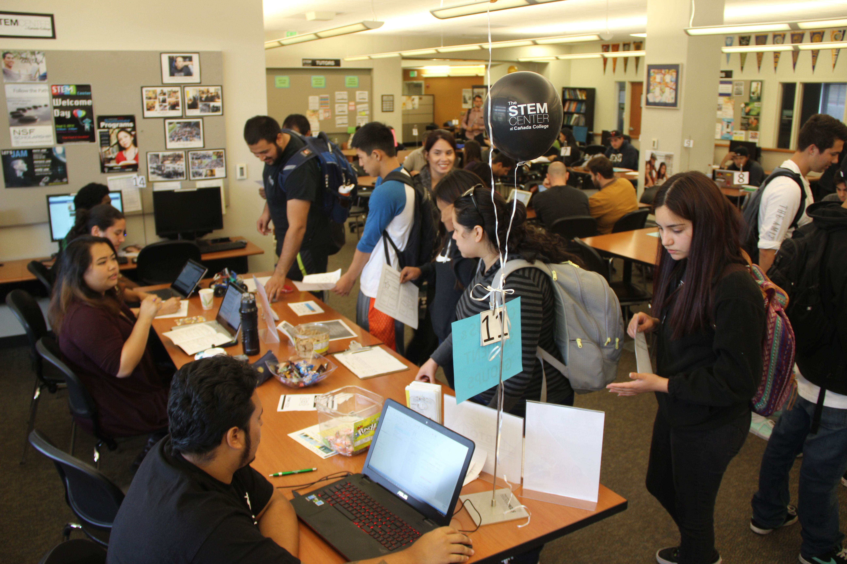
Thank you!
What are your questions?

