Slide 1
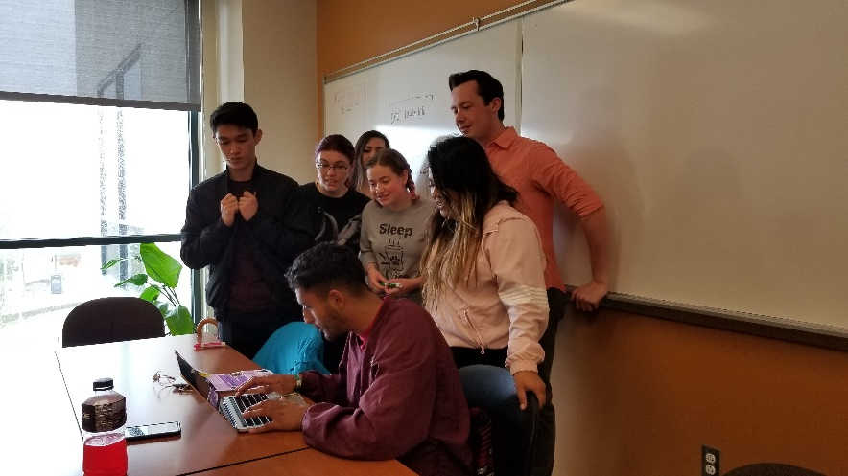
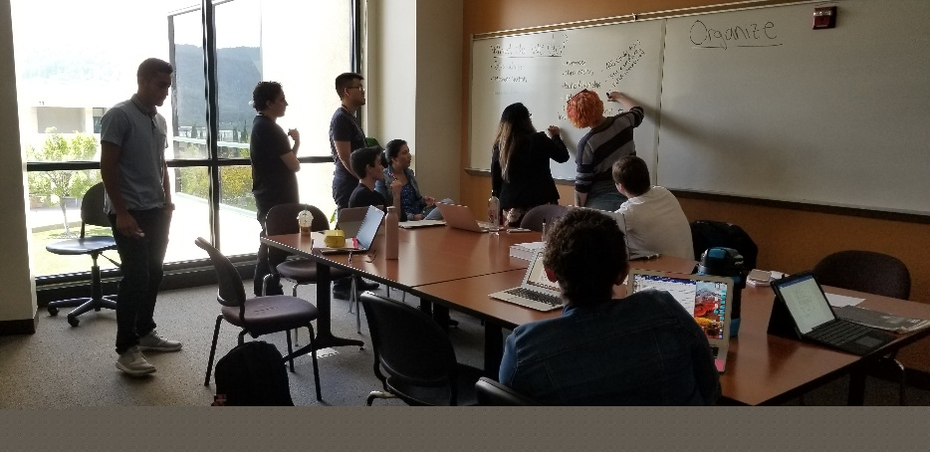
New Position
Proposal:
Peer Mentor Coordinator
December 3, 2020

Slide 2
What is the need?
Peer mentors will play a pivotal role in the Interest Areas/Success Teams to :
Connect students to resources:
“If I myself had not been peer mentored, I would not have known where to go and which resources to use.”
Support the work of the counselors and retention specialists:
“…I’m like the motivational friend who checks in with them and asks how they are doing, if they need anything.”
“I also have accompanied mentees to an event or experience. It helps if somebody there who has been here longer can take you [the mentee] physically from point a to point b.”

Slide 3
Peer Mentor Coordinator Duties
Major duties of this position include:
Recruiting peer mentors (approximately 15 per semester)
Screening and interviewing applicants
Leading training sessions
Providing leadership and mentorship for the peer mentors
Supervising and evaluating peer mentors
Coordinating with faculty and staff to match students
Collecting and analyzing data for program improvement
Coordinating with other programs on campus
Administrative duties

Slide 4
Peer Mentor Training is Crucial to their Effectiveness
Online trainings
Not Anymore – Title IX training - (certified)
Growth Mindset
Kognito – “At-Risk” and “Veterans”
In-person trainings
Workshop facilitation
FERPA & Title IX (via district)
SafeZone
Communication and Customer Service
Recruitment and Outreach

Slide 5
What Happens if the Peer Mentor Coordinator position is not funded?
The Interest Areas/Success Teams may not have the capacity to adequately recruit, screen, hire, train, supervise and support their respective peer mentors
The work of the retention specialists/counselors to reach out to students who need support may be restricted
Peer mentors in the interest areas may not have the training and focus to fully address student needs, risking students needs falling through the cracks
Administrative tasks associated with hiring and supervising peer mentors will fall to someone else:
Division Assistants in the Interest Areas
Staff in the Business Office

Slide 6
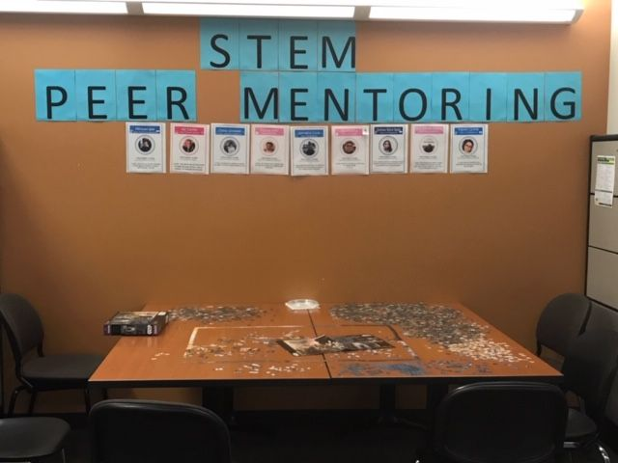
Thank you!
What are your questions?

