Slide 1


EOPS
FULL-TIME TENURE TRACK COUNSELOR

Slide 2

Funding Request*
EOPS – 20%
SEAP – 55%
Fund 1 – 25%
*Was approved for 2020-21 but was pulled due to COVID

Slide 3
EOPS was the first social justice program at the community college level to address the issues of access, equity, and completion at the state level; acting as a gateway for financial and social mobility.
Mission
Notes:
EOPS just had their 50th Anniversary last year and although we celebrate our students successes, we acknowledge that there is still so some much that needs to be done in order to address the inequities in higher education that effect our students. Students must be

Slide 4
Background

Slide 5

Faculty Assignments
1 - 50% EOPS Counseling, 50% EOPS & CARE Coordination
Since 2016 we have been approved for additional adjunct EOPS counseling hours. These hours fluctuate from year to year, depending on funding and availability. Since it is not consistent year to year, it becomes challenging to do program development.
For 2020-21:
1 - reassigned time 8 – 14 hours a week
1 - reassigned time 9 hours a week
1 - adjunct 6 hours a week
Notes:
This semester we were booked out 2-3 weeks out and needed to increase our counseling appointment availability for the last month and half of the semester.

Slide 6
Program Goals

Slide 7
Increase
EOPS Enrollment
Notes:
BOGW eligible and are required to take a minimum of 12 units (unless in DRC)

Slide 8
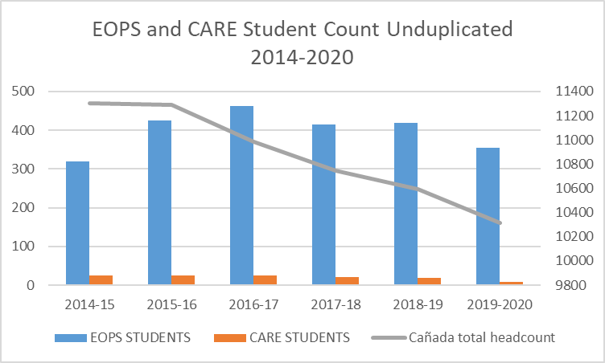

Notes:
Last year we had 355 nonduplicated count

Slide 9
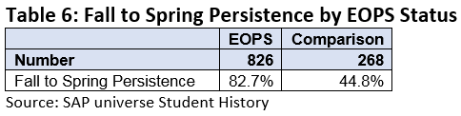
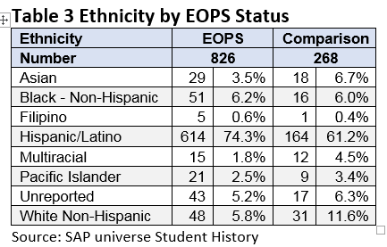
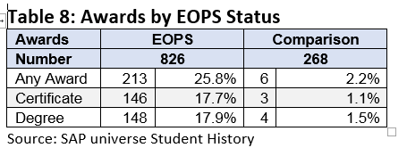
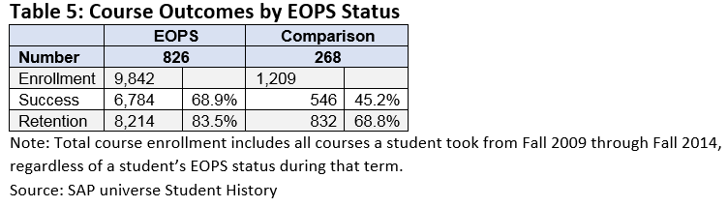
Key Findings:
EOPS students tend to be slightly older than the comparison group
EOPS students perform better academically with higher course success, course retention, Fall to Spring persistence, and Dean’s List attainment
EOPS students are far more likely to attain a degree or certificate than the comparison group
Notes:
In addition, students completed our program SAO this last spring semester (Exit Survey and End of the Semester Survey) which ranked meeting with a counselor and other counseling related supports were rank as the most critical service EOPS offers.

Slide 10
Expand programming

Slide 11
Comprehensive Counseling

Slide 12
Crisis intervention
Follow up
Academic
Financial
EOPS COUNSELOR
Career
Foster Youth
Dreamers
Personal
Goal setting
Notes:
Students are required to meet with an EOPS counselor 3 times a semester. Due to that counselor are doing much more than just advising students on what classes to take……They build a repore with students that extends from their academics.

Slide 13
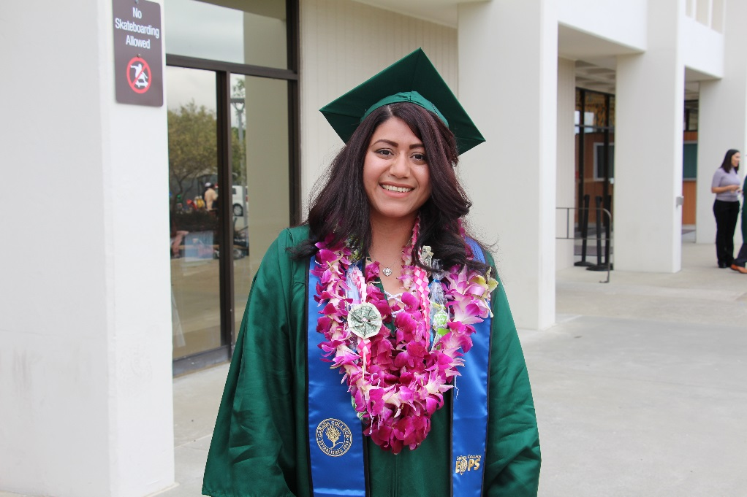
Provide more stability to the program and students
Notes:
Counselors work with students not just on academic and career goals but on various challenges they face that effect their success in their course completion and retention (i.e. homelessness, working 2 jobs, etc.) it’s common for students to come back and ask us letters of recommendations for employment and grad school. Currently reaching out to students for our EOPS video project and all the students we are contacting are so overwhelming supportive to help us out with this project that will allow us to increase our outreach efforts. We have also have seen an increase of students moving out of the area but still take classes online to finish their goals. Therefore, we need to look more at how we will expand on our online counseling and supportive services.

Slide 14
EOPS Budget & Funding Request

Slide 15
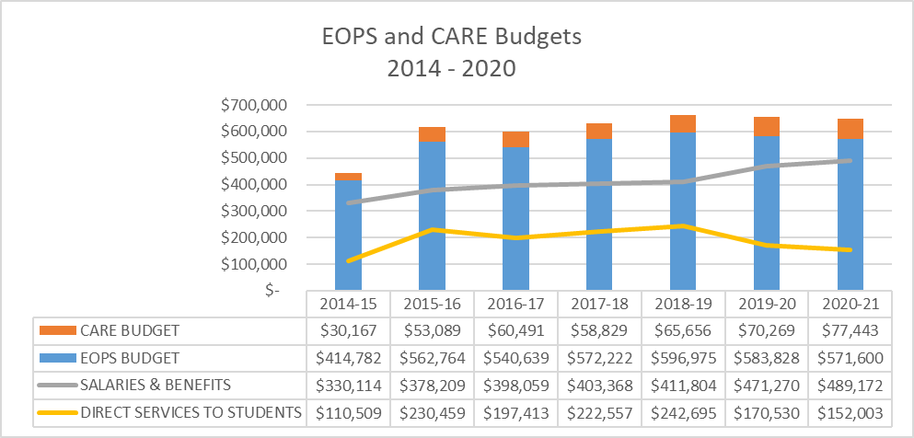

Slide 16
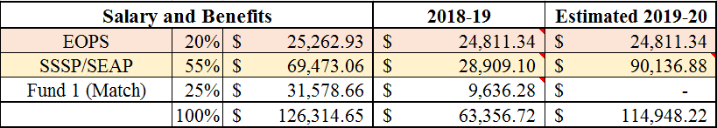
Funding Request
EOPS – 20%
SSSP – 55%
Fund 1 – 25%

Slide 17
