Slide 1
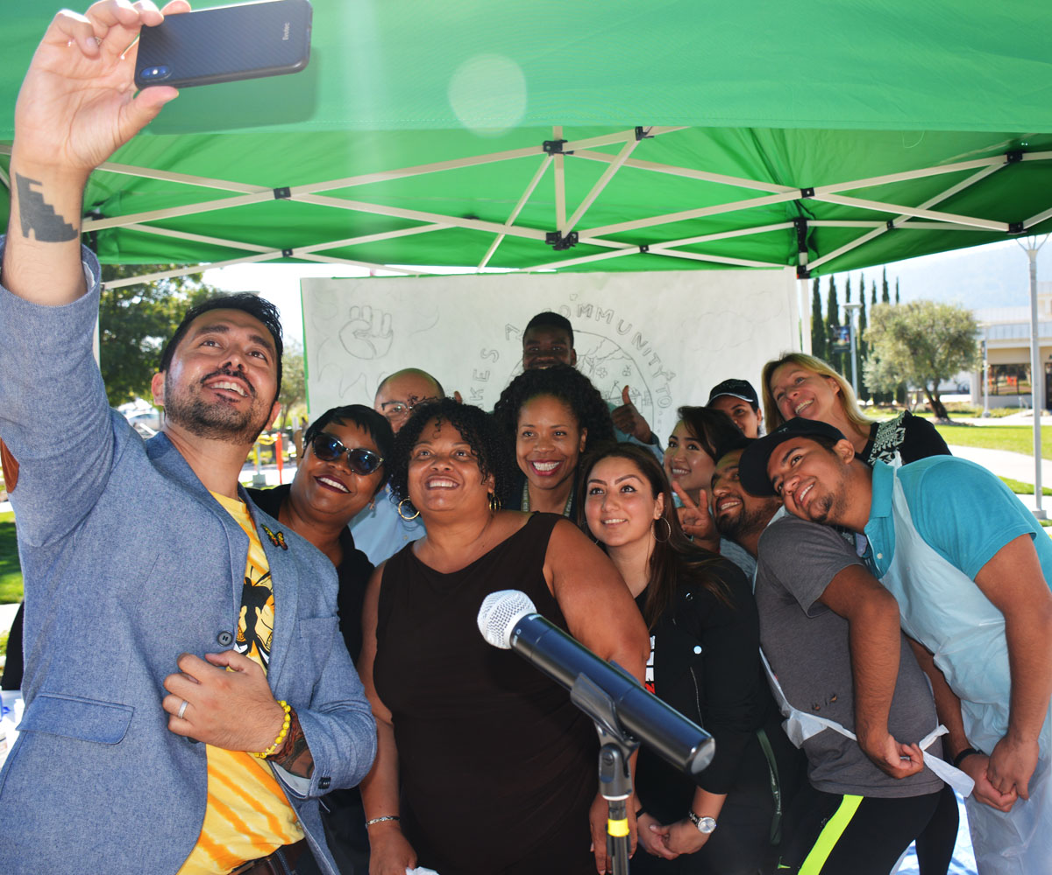
Mission
Dream Center Program Services Coordinator
2020 - 2021 New Position Proposals
Presentations and Discussions
December 4, 2020

Slide 2
About the Cañada College Dream Center
The Cañada College DREAM Center is a resource center & safe space for undocumented students, community members & allies.
Services include:
Assistance with AB 540, DREAM Act, DACA & scholarship applications
Free Legal Clinic – Pre-Covid 19, nearly 85% capacity – 75% of which requested translations
Informational and community building events for students and staff – Undocumented Student Week of Action
Computer access and Hotspot internet access
Fighting for Immigration Rights and Equity (FIRE) – Weekly District-wide Student Meeting
Notes:
Resources: Financial Aid, SparkPoint, Food Pantry, Legal assistance, PCC
Legal: we served 38 clients served 50 times (decreased by 52% in volume since Spring 2020)
Events: USWofA, Know Your rights, Policy Briefs, professional development

Slide 3
Cañada College’s Equity Goals
1. ACCESS: Increase full-time enrollments of new and continuing students from low-socio-economic backgrounds, in particular students coming to the college from North Fair Oaks and East Palo Alto
2. PERSISTENCE: Over the next two years, increase fall-to-spring persistence rates for disproportionately impacted students with a particular focus on African American and Latino/Hispanic students
5. COMPLETION RATE: Increase percentage of students who complete their educational goal (certificate, degree, and/or transfer) from 47.6% to 52.6%, with a focus on goal completion by underprepared students
Notes:
Increasing ACCESS to full time enrollments for new and continuing students from low socio-economic backgrounds
Increasing PERSISTENCE particularly for Latino / Hispanic students
Increasing COMPLETION RATES with a focus on goal completion by underrepresented students

Slide 4
Dream Center Duties
Educate our students and community with updated and correct information about changing policies that impact Dreamer students
Provide an opportunity for dialogue and expression about the Dreamer experience
Connect Dreamers to appropriate resources and services during COVID-19 SparkPoint, Financial Aid Office, EOPS, Promise, Fair Oaks Community Center, Catholic Charities
Provide professional development including information workshops for students and staff to understand challenges and resources.
Increase enrollment of AB540 students
Notes:
Provide Dreamers and allies with updated and correct information
Increase enrollment of AB540 students through partnerships with High Schools and Adult Schools
Establish strong campus and district-wide collaborations through the campus and District Dream Centers Task Forces
Maintain a network of undocumented community support
Connect students to student supports including SparkPoint (financial coaching, food pantry and free Legal Clinic - 154 appointments met, 134 unduplicated)

Slide 5
Who Is Served 2017/18 AB540 Student Characteristics - data packet
There has been a downward trend in the Annual Unique Headcount of registered AB540 students since 2015/16
2015/16 ➔ 422
2016/17 → 399
2017/18 → 387
Not all AB540 students are undocumented but almost all are.
Not all undocumented students register as AB540
74% are Hispanic, 75% intend to transfer, 58% are between 18-22 years old

Slide 6
CA Dream Act Applications – 5 year Trend
Academic Year | Number of CADAA
2015-2016 | 200
2016-2017 | 222
2017-2018 | 181
2018-2019 | 198
2019-2020 | 228
2020-2021 (YTD) | 181
Courtesy of the Cañada College FAO

Slide 7
AB540/DACA Students- 5 year Trend
Chart data courtesy of the PRIE
Not all AB540 students are undocumented but almost all are.
Not all undocumented students register as AB540
74% are Hispanic, 75% intend to transfer, 58% are between 18-22 years old (2019 data)

Slide 8
Why do we need a Permanent 1.0FTE PSC
We are a Hispanic Serving Institution (HSI)
AB1645 – CCCCO’s mandates Dream Center Liaisons (DRL)
SB74 – Funds to support Dreamer Resource Liaison (DRL) *
Alignment with our sister colleges’ Dream Center staffing (SKY = 1.0 FTE Fund 1 PSC) (CSM = 1.0 FTE Innov. Fund Retention Specialist + support by Multi-cultural Ctr. Fund 1 PSC)
Staff Turnover - With a short-term .48 FTE position, staff will leave for other permanent opportunities
Notes:
We are a HSI
AB1645 now mandates that Community Colleges have Dream Center Liaisons
SB 74:
Budget Act of 2020 that includes $5.8 million in local assistance funds to support Dreamer Resource Liaisons and student support services for immigrant and undocumented students in community colleges.
Address disparities and advance economic justice
Dream Resource Liaison --- $ 34,061
Alignment with our sister colleges
Staff Turnover

Slide 9
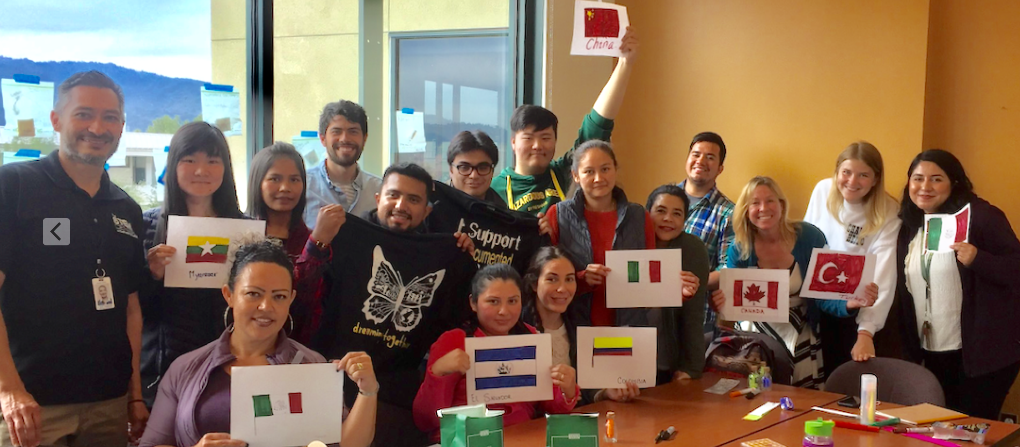
College, District and Chancellor’s Office Support
Support at Every Level
Students
DREAMers Club
College
ACES
District
Contemporary Conversation Regarding Race, Class, Gender, Privilege, and Equity: Undocumented Student Week of Action Presentation
CCCCO
AB1645 – CCCCO mandates CC’s to have Dream Center Liaisons to expand resources for undocumented immigrant students.

Slide 10
Supports Mission Statement & Strategic Goals
Alignment with College Mission Statement
The Dream Center ensures that all students have equitable opportunities to achieve their transfer, career education, and lifelong learning educational goals, regardless of their immigration status
Alignment with College Strategic Goals
The Dream Center provides student services programs that highlight inclusivity, diversity, and equity in their mission to help students meet their unique educational goals.

Slide 11
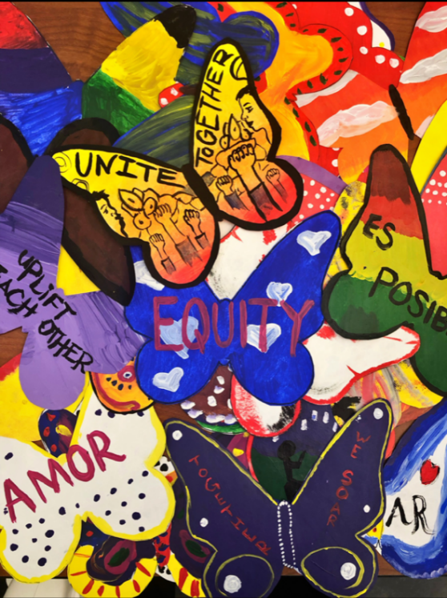
If This Position is Not Funded…
Cañada College will be out of compliance with AB1645 – State mandate
Who will serve as the Resource Liaison on CCCCO Regional Calls?
Limited (and insufficient) resources would be available for our DREAMers and allies. (workshops, presentations, resources, guest speakers)
We may be prevented from re-hiring a short-term staff (repeatability)
As an HSI, Cañada has a responsibility to support DREAMers with success, retention and transfer rates
Notes:
Staff turnover will negatively impact student success
This marginalized population will once again not receive needed services

Slide 12
If This Position is Not Funded… Who Will Do This Work?
Immigration changes are constant even with different administrations and require specialized knowledge
Who will attend Regional Calls?
What do I do if my family member has been deported?
Where do I find information about DACA, TPS, or Public Charge rules?
My boss does not pay me. What can I do?
Who can I ask about DACA, CA Dream Act, and FAFSA?
I’m finding it difficult to find work. What can I do?
The Dream Center provides supports to all our students!
Notes:
Staff turnover will negatively impact student success
This marginalized population will once again not receive needed services

Slide 13
And…who Will Meet the Growing Demand of Dream Center Needs?
The Dream Center receives requests from faculty and staff regarding:
Requests to hold community events
Flex Day Presentations
Undocumented Student Week of Action
Know Your Rights, Student Workshops
Confidential Conversations
District-wide Migration Celebration
Support for students (and their families) who have been detained by ICE
Assistance for student questions about ICE & Immigration
Notes:
Close to 200 students, faculty and staff attended a variety of supportive events including a collaborative art project, story sharing, and a know your rights event with community organization Immigration Institute of the Bay Area. The DREAMers Club student leaders were central to the planning and executing of the week. The Club designed and gave away t-shirts, facilitated a story sharing event, and spoke messages of support and inspiration throughout the week. Their leadership is to be commended. Attendance at opening day by Cañada College President Jamilla Moore and all campus Vice Presidents solidified that supporting all students regardless of immigration status is not just something we say at Cañada, but something we do. All of the work for this week could not have been possible without the support of the California Community Colleges Chancellor’s Office, the Community College League of California, the Foundation for California Community Colleges, Immigrants Rising, and the Student Senate for California Community Colleges. Together we can create a system that truly serves all students, regardless of immigration status.

Slide 14
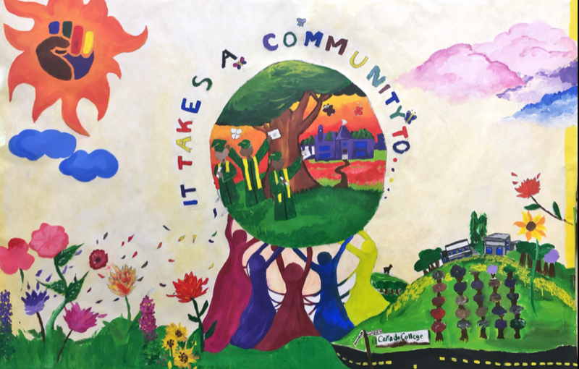
Questions?
Key Takeaways
Pending AB1645, mandating Community Colleges to identify a Dream Center Liaison, the Dream Center PSC position would be offset thereby reducing the expense for this position
FY21 = $35K
We anticipate an increase in Dreamer enrollment with the new administration taking office. We will need staffing to meet the success, persistence and retention needs of these students.

