Slide 1
Guided Pathways Student Voices
Focus Group Findings

Slide 2
Introduction
Student Voices sub-committee co-leads:
Hyla Lacefield
Marisol Quevedo
Partnership with Career Ladders Project:
Sia Smith-Miyazaki
Additional members include: Daryan Chan, Manny Delgado, Karen Engel, Yesenia Haro, Michiko Kealoha, Sarita Lopez, Kiran Malavade, Ada Ocampo, Ariela Villalpando.

Slide 3
Self- Reflection
What is your understanding of students’ experience at Cañada College?
How do you contribute to their success on campus?

Slide 4
Our Approach
39 real student experiences
5 Focus Groups
2 day time, 3 evening
2 sessions happened during a hybrid Career Course
Survey of Student Engagement (CCSSE) will be administered in classrooms Spring 19

Slide 5
Research Question
What are the barriers to student entry, persistence, and completion at Cañada College?

Slide 6
Interview Protocol Topics
Motivation to attend college
Choosing a major
Choosing classes
Obstacles students face in completion
Student recommendations

Slide 7
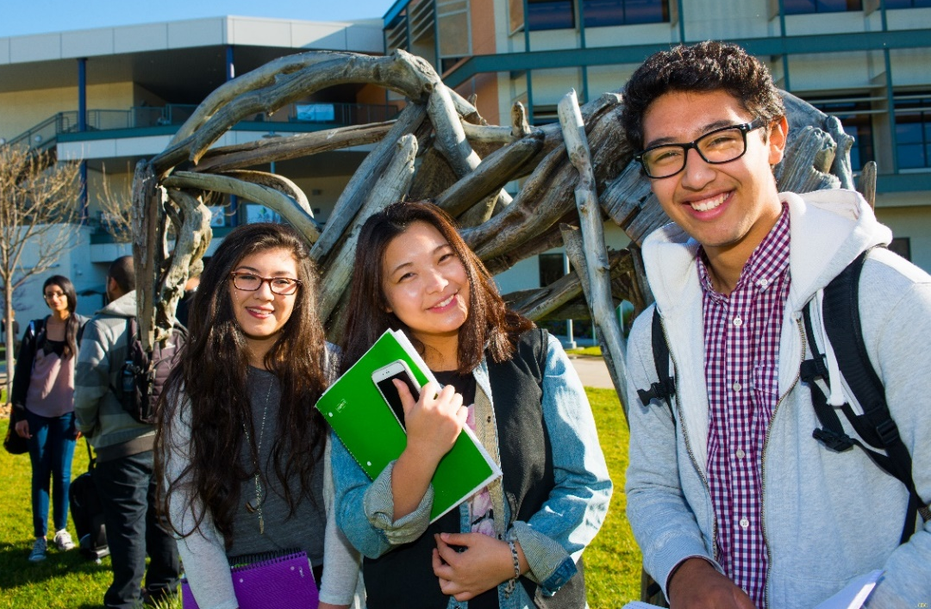
Our Students
We compared our Focus Group participants to our general student population

Slide 8
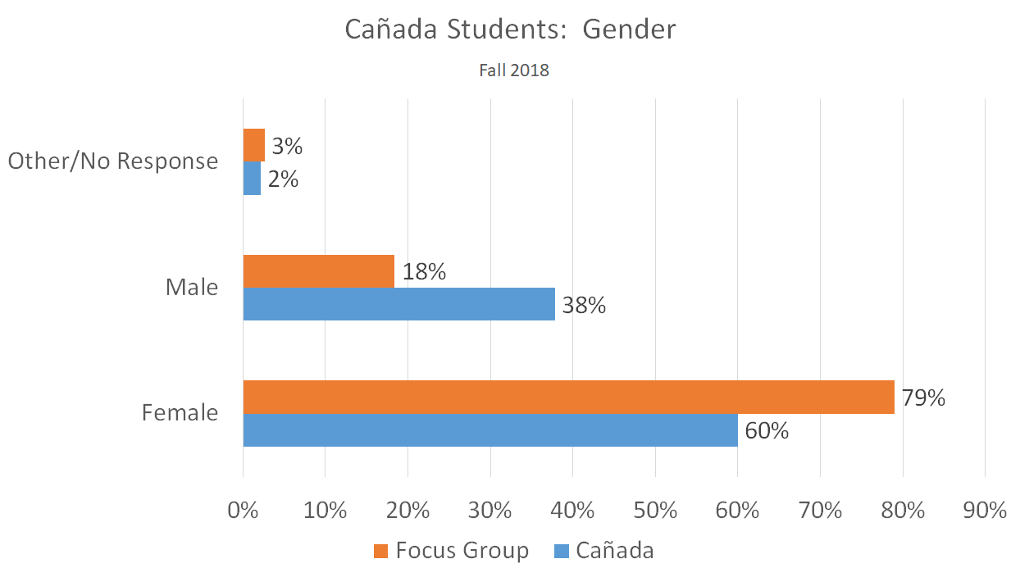

Slide 9
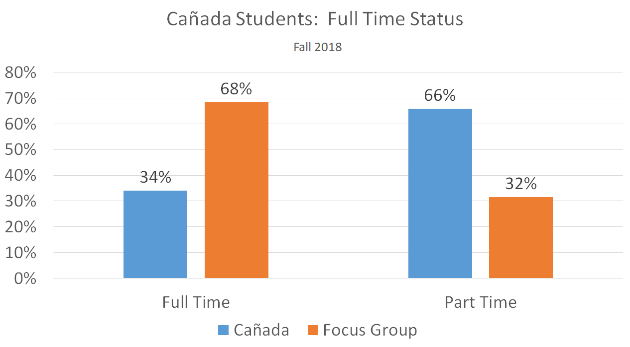

Slide 10
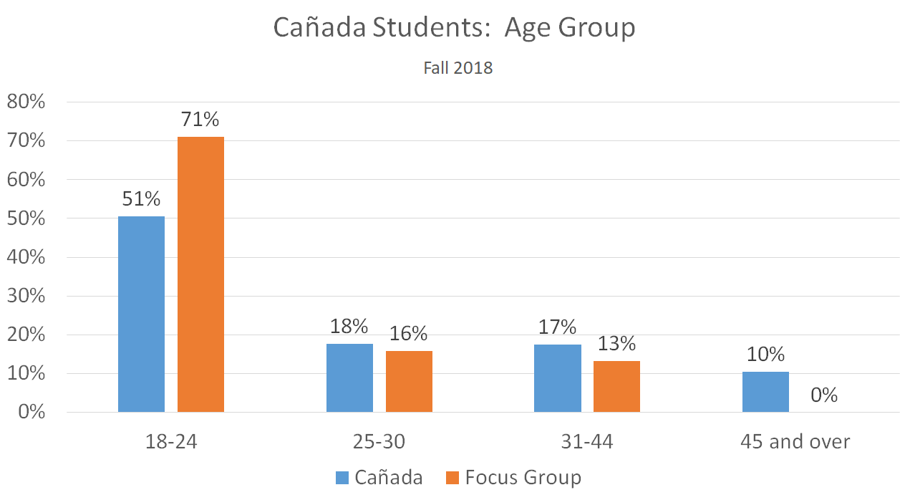

Slide 11
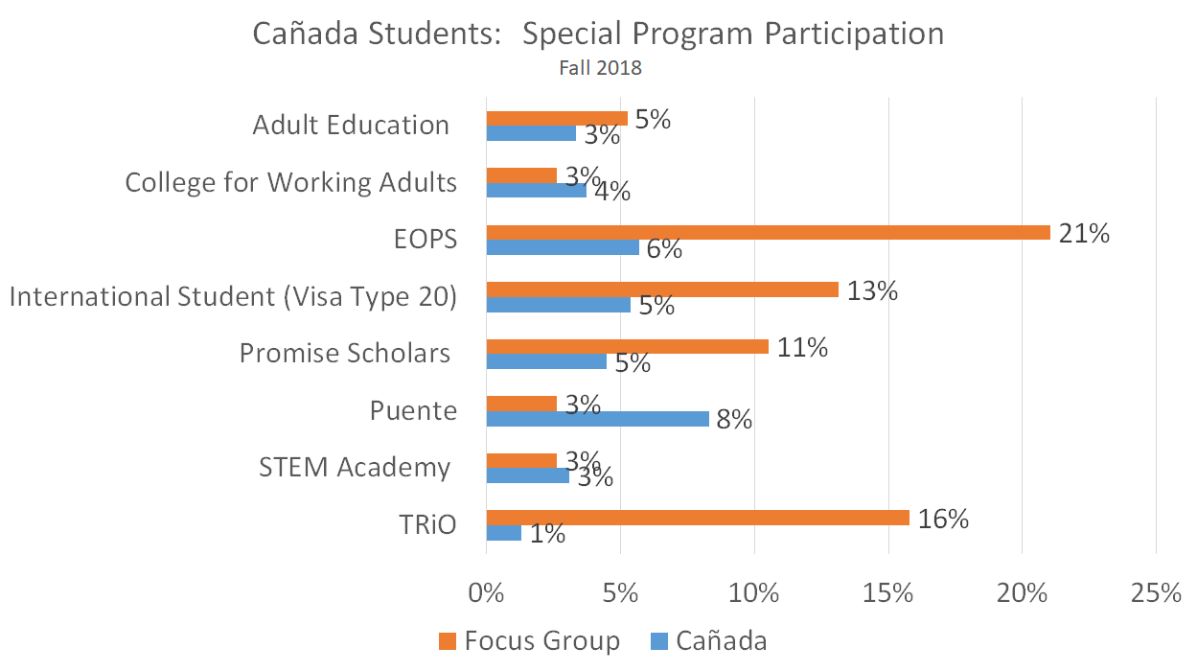

Slide 12
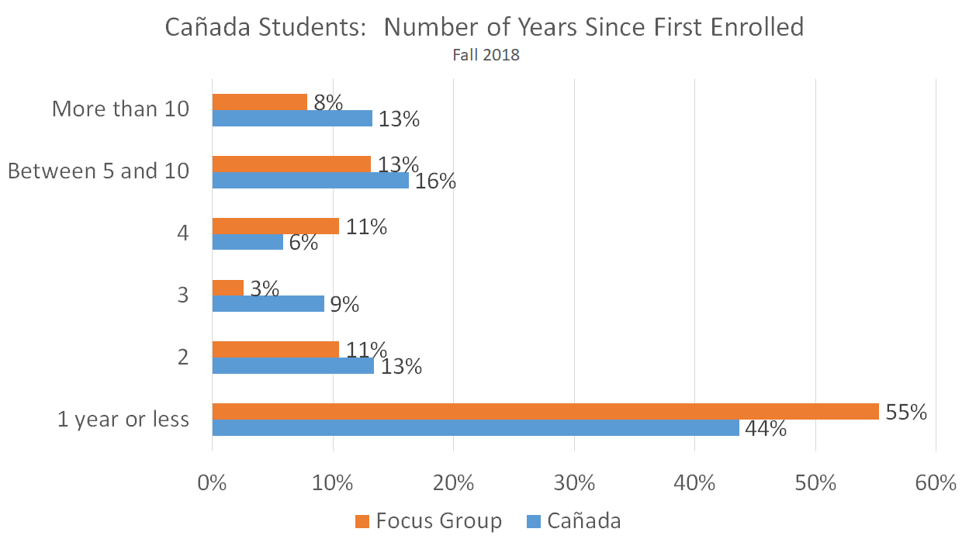

Slide 13
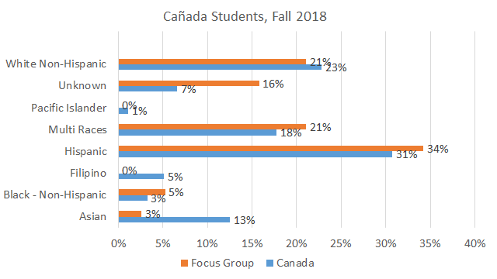

Slide 14
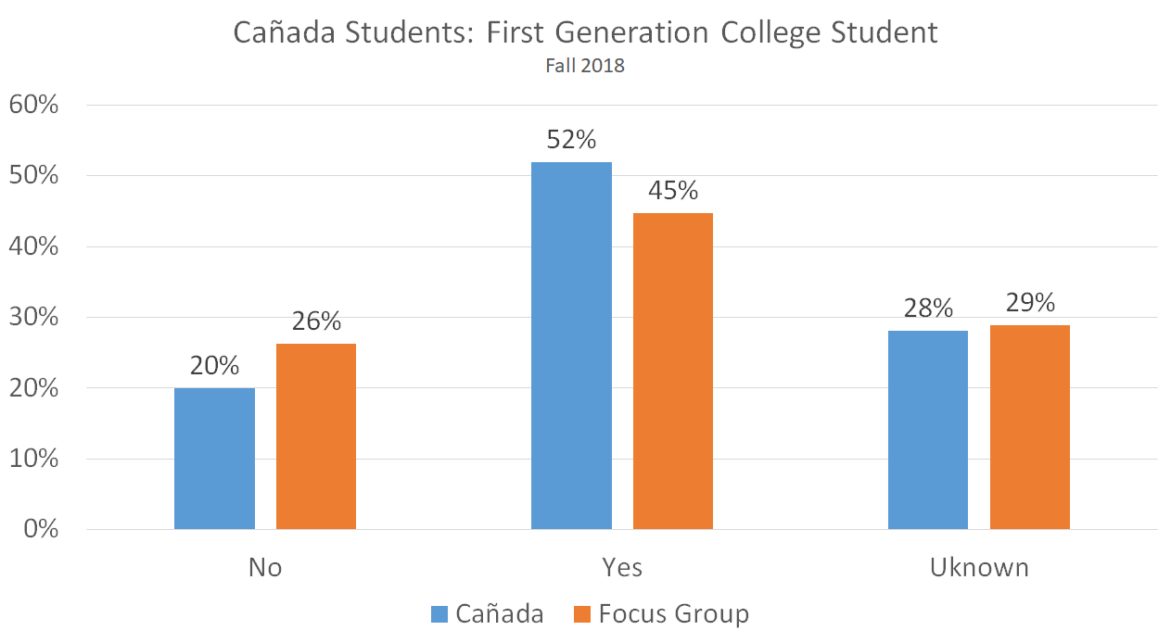

Slide 15
While listening, jot down...
What are you hearing from students?
What are some things that you hear that confirm or challenge your understanding of Cañada students?

Slide 16
Focus Group Preliminary Findings
Finding the right career & major is a journey where students negotiate personal fulfillment and financial/familial pressures
Experiential learning is key for major & career exploration & decision making
Support services & resources are important & students stressed the need for early & improved awareness of available resources
Personal and specialized support is important in the exploration & decision making process. Students who did not receive clear & consistent information from college staff, faculty, & counselors experienced negative effects.
Students who are connected to a student services program or campus community feel more supported & successful. Students not involved expressed desire for a sense of community & peer connection

Slide 17
Finding 1
Finding the right career & major is a journey where students negotiate personal fulfillment and financial & familial pressures
Career goals determined by:
Personal passion and happiness
Desire to support others & making an impact
Financial security
Familial expectations and pressure
Major determined by career interest/goal

Slide 18
I'm a nursing major after a long, long road of changing like five or six different times. Hopefully, I stick to this one and it's not a major of the month, but right now is nursing... if you want to have a stable home life and eventually I want to be able to support my own family I'm going to need to have a degree to like take care of rent and taxes…then hopefully, it can be something that you enjoy doing…

Slide 19
I want to be a part of a change where kids that are being abused...there's a community around this child that isn't seeing it. It's being ignored... So my goal is to be a part of a change that makes sure that that doesn't happen. Either a change, a new curriculum, just something. Either create it or be a part of it.

Slide 20
Finding 2
Experiential learning is key for major and career exploration & decision making
Life, work, internship, and class experience
Career Courses and Non-academic support programs

Slide 21
I went to bio to go pre-med. But after taking the entire general chem series, and knowing that I would have to take o-chem, I was kind of, I cried, I kid you not. I cried every single day taking general chemistry, the second one. Just because I was so unhappy doing it, and then I thought to myself, I'm not going to-- I know myself enough that I can't do med school.

Slide 22
I'm a computer science major and I was working at a software company in tech support. The way I came around to my major is, my life was really hard when the engineers made really bad decisions and didn't talk to us, the people that talk to our customers. I had some of the worst days of my life to this day working at that company, and I thought, "I know I can do a better job than they can do it, and so I'm going to do that."

Slide 23
I feel that the first semester, I took the Career 137. So that really helped me to make sure that I wanted to decide that interior design was going to be my major. But maybe it could be ...mandatory if you want to get an associates...to take in maybe in the first semester.
And STEM Explorers helped me see the computer science of it. Gave me a little taste. And I realized that that wasn't for me.

Slide 24
Finding 3
Support services & resources are important
Students stressed the need for early & improved awareness of available resources

Slide 25
So I just feel they really need to encourage students at the beginning of the semester to really be involved on the campus...and take advantage of all their resources. Because I just feel, now that I'm a part of this ESO Adelante program, and I'm working on campus, that's how I knew more about their resources. And I wish I knew all of that when I was an ESL student. Because for me, it would be way easier to figure out everything. So I just feel it's more about sharing that information right when the students arrive at Cañada.

Slide 26
A lot of the students don’t know about all the clubs that are in campus and that is a great resource for us. For me, the interior design club, we have to pay a membership which is $10. And I'm okay with that because I have benefited so much from that.

Slide 27
I think be more transparent about the way things work. I feel there's a lot of students, especially first time-- first-generation college students who don't have a parent who's been through these-- doesn't have somebody who can't give them guidance to show them the ropes. And I feel like the orientation does what it does, it orients you to the first minute, but there's so much more that you have to learn how to navigate. How do I get tutoring? How do I do this? How do I do that? So I think that if the college is more transparent about that and it's not such a maze on the website to find that information and communicating better.

Slide 28
Finding 4
Personal & specialized support is important in the exploration and decision-making process.
Students who do not receive clear & consistent information from staff, faculty, & counselors experienced negative effects.
Students relied heavily on peers for guidance/support
Students desire assigned and specialized counseling
Supportive & culturally aware counseling & instructional faculty members made a significant impact

Slide 29
I get a lot of advice from other students who have been through the class. It's like, "Hey, could you do these three classes in the same semester? Yes or no." And sometimes it's no, sometimes it's yes, so I think that getting a student's opinion I value more.

Slide 30
So confused, my first semester here because my counselor did not get me or maybe it was too fast because it was like a short meeting. So that's why I never trusted counselors again...I think a year and a half, I was alone... So I think that made it a longer process for me.

Slide 31
And then [the counselor said], "What do you want to do?" We looked into everything pretty much. And I've always liked children….So within a month, I changed my major to Mathematics for Middle Schoolers because …[the counselor] made the connection that I could use my theater experience to get middle schoolers more engaged in doing math and to be excited about it...So that's how I'm connecting my passion to something that can help children.

Slide 32
I think something that might help with the counselors is that if they specialized in a certain degree or a degree pathway. Like if you know you want to go into business, you should meet with these counselors because this is what they specialize in. They [will] know all the different pathways, the different programs.

Slide 33
Finding 5
Students who are connected to a student services program or campus community feel more supported and successful
Students not involved expressed desire for a sense of community and peer connection

Slide 34
What really helped me feel comfortable enough to change my major was the fact that I was part of a community that I felt wouldn't judge me if I changed my major….I didn't feel like I'd be disappointing anyone if I decided to go after my dream so being part of a community here at school that I was comfortable with was a really big deal for me.

Slide 35
But getting the word out ...that there are these people who care about you and who want you to succeed, who want to be there next to you and help...open the opportunities to you, just make it more aware that these people are looking out for you.

Slide 36
Recommendations from Students
Peer mentorship & alumni panels
Learning more about courses/ professors beforehand (course evaluation, syllabus, sit-in on classes)
FYE/Sampler course
Community building in courses

Slide 37
STUDENT PANEL

Slide 38
Guiding Questions
If you could summarize your experience at Cañada College thus far, what would you say?
Can you tell us about a barrier that you are being faced with or have overcome while at Cañada College?
What do you think is important for staff, faculty & administrators to know about your experience here at Cañada College ?

Slide 39
Meet our Students
Azucena Medrano
Major: Business Administration and Psychology
Student Type: Continuing Student
Ed Goal: AA and Transfer
Career Interest: Human Resources Manager
Biggest Barrier to Success: More student assistant opportunities & more financial support to place daughter in enrichment classes

Slide 40
Meet our Students
Matthew Nuez
Major: Mechanical Engineering
Student Type: Continuing Student
Ed Goal: Become successful, Be a voice of leadership, & Graduate
Career Interest: Build/Design for a car manufacturer like Nissan or Ford OR work for Google, Apple or Microsoft
Biggest Barrier to success: Challenging myself more to get out of my comfort zone and being confident in my abilities

Slide 41
Meet our Students
Fernanda Reyes
Major: Undecided
Student Type: First-Time Student (Fall 18)
Career Interest: Probably a Social Worker

Slide 42
Meet our Students
Jade Shonette
Major: Mathematics (considering double major in Fashion Design)
Student Type: First-Time, International Student
Ed Goal: Transfer-UCLA for Mathematics or FIDM-Fashion Design
Career Interest: Create Formal Wear clothing line, Customer Design for Film and Red Carpet events
Biggest Barrier to success: Lack of a support system, self-doubt, finances

Slide 43
THANK YOU

