Slide 1

Presentation to EAPC
Student Equity and Achievement Program
Metric Check In and Discussion
Metric 3: Persistence: First Primary Term to Second Primary Term
Presented By: Max Hartman, Dean of Counseling
Ron Andrade, Dir. of Student Support
Date: April 28, 2026

Slide 2
The SEAP Metric and Action
Metric 3: Persistence: First Primary Term to Second Primary Term
  ASSESS & STRENGTHEN EARLY ALERT SYSTEM: Assess Early Alerts and identify options and opportunities to improve its effectiveness.
Who is the DI population this metric focuses on?
  Asian male, female, Filipino, White, male

Slide 3
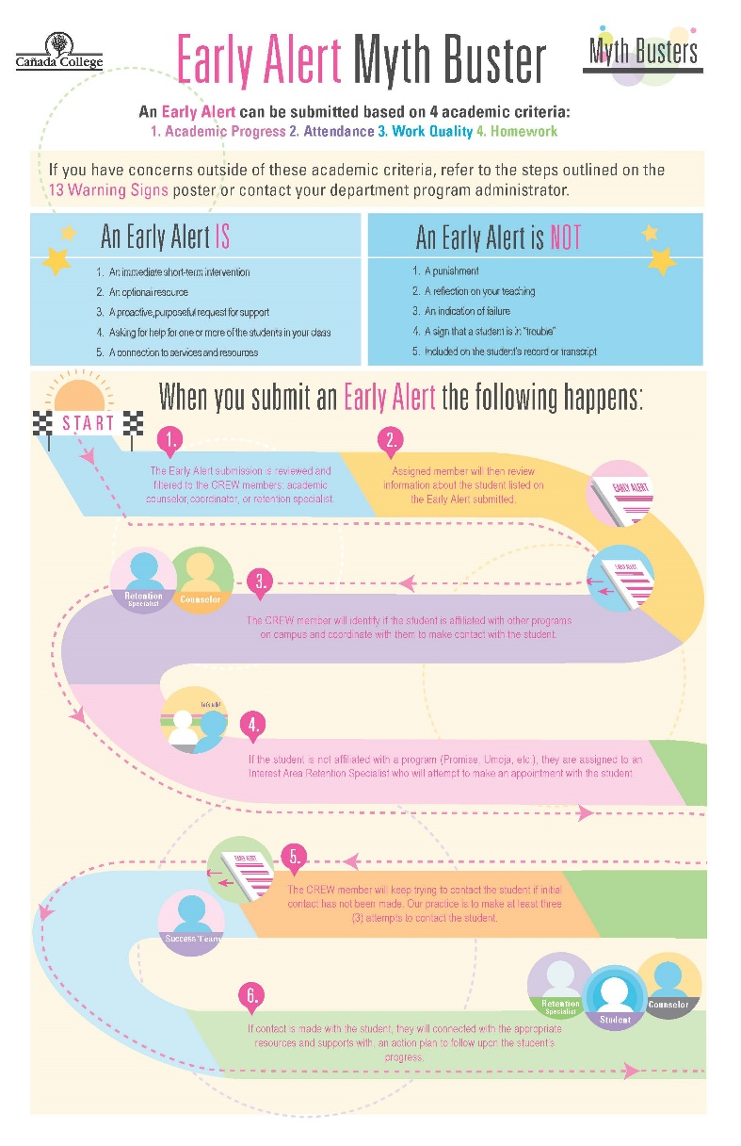
How Early Alerts Work at Cañada College Now
Faculty submit an Early Alert through CANVAS
Early Alerts are collected in the Student Success Link (CRM)
Members of the College Retention & Engagement Workgroup (CREW) review the Early Alert regularly, and follow up on submitted Early Alerts in their caseload
Sample Text in Franklin Gothic Book
Border is in Yellow. Copy picture and right-click -> replace picture

Slide 4
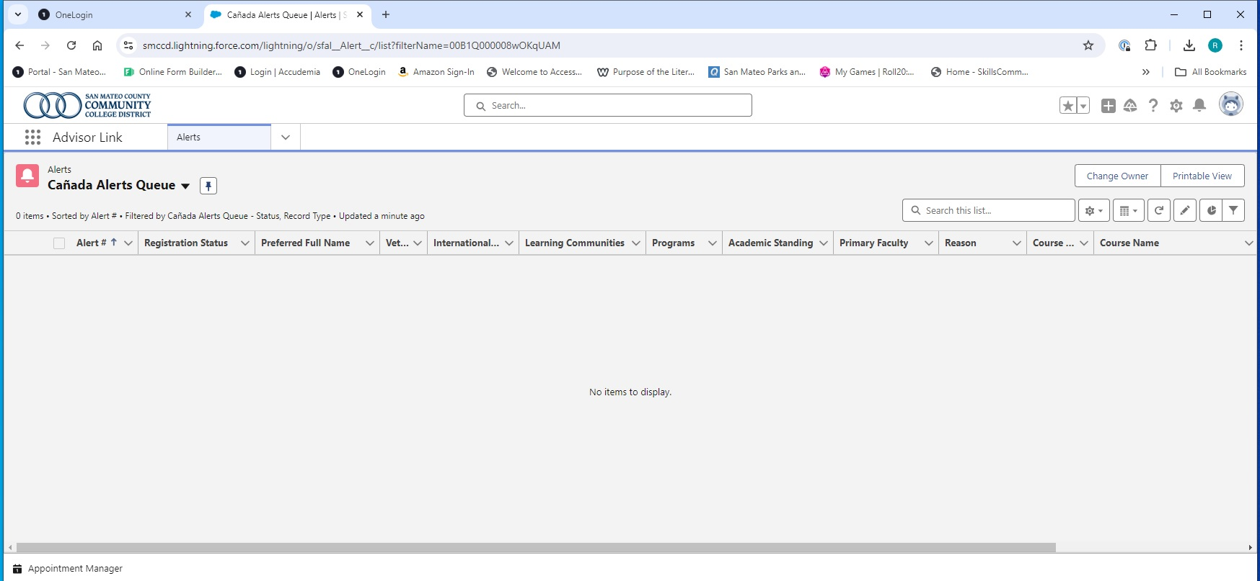
How Early Alerts Work at Cañada College Now
Sample Text in Franklin Gothic Book
Border is in Yellow. Copy picture and right-click -> replace picture

Slide 5
2024-25 Summary
52 faculty submitted 328 Early Alerts across 59 different courses
45% of Early Alerts (duplicated) came from two departments:
  24% from ESL, primarily ESL-923 and ESL-400
  21% from English, primarily English 105
Sample Text in Franklin Gothic Book
Border is in Yellow. Copy picture and right-click -> replace picture

Slide 6
Results from Early Alerts in 2024-25
Action Update
328 Early Alerts filed in 2024-25:
  53 of these were for the same students in the same courses by the same faculty
  275 unique student enrollments were subject to one or more Alerts
    152 in Fall 2024
    123 in Spring 2025
The persistence rate of Early Alert students was 50%, compared with 70% for all home campus students.
Student re-enrolled in the subsequent primary term | Student Count | %
Yes | 137 | 50%
No | 138 | 50%

Slide 7
Results from Early Alerts in 2024-25
Action Update
 | % of Early Alert Students
Male | 46%
Female | 53%
Nonbinary | 1%
 | Duplicated % of Early Alert Students (multiracial students are counted in more than one category)
American Indian/Alaskan Native | 4%
Asian | 4%
Black - Non-Hispanic | 4%
Filipino | 4%
Hispanic | 72%
Pacific Islander | 2%
White Non-Hispanic | 28%

Slide 8
Action Update
Completed survey of Retention Specialists
  Overall, the findings suggest that while the Early Alert system has foundational value, its impact on persistence may be limited by variability in implementation, gaps in coordination, and inconsistent engagement across stakeholders. Addressing these areas represents a key opportunity to strengthen the system’s effectiveness, particularly for disproportionately impacted student groups.

Slide 9
Action Update: Next Steps
  Identify which students acknowledge/respond to Early Alert outreach to identify any trends in that data
  Encourage broader use of Early Alerts by faculty

