Slide 1
Livescribe Echo Smartpen
Module II: Using the Smartpen
1. Smartpen Status and Settings 3. Audio Playback
2. Record Audio and Take Notes 4. Smartpen Notetaking Tips

Slide 2
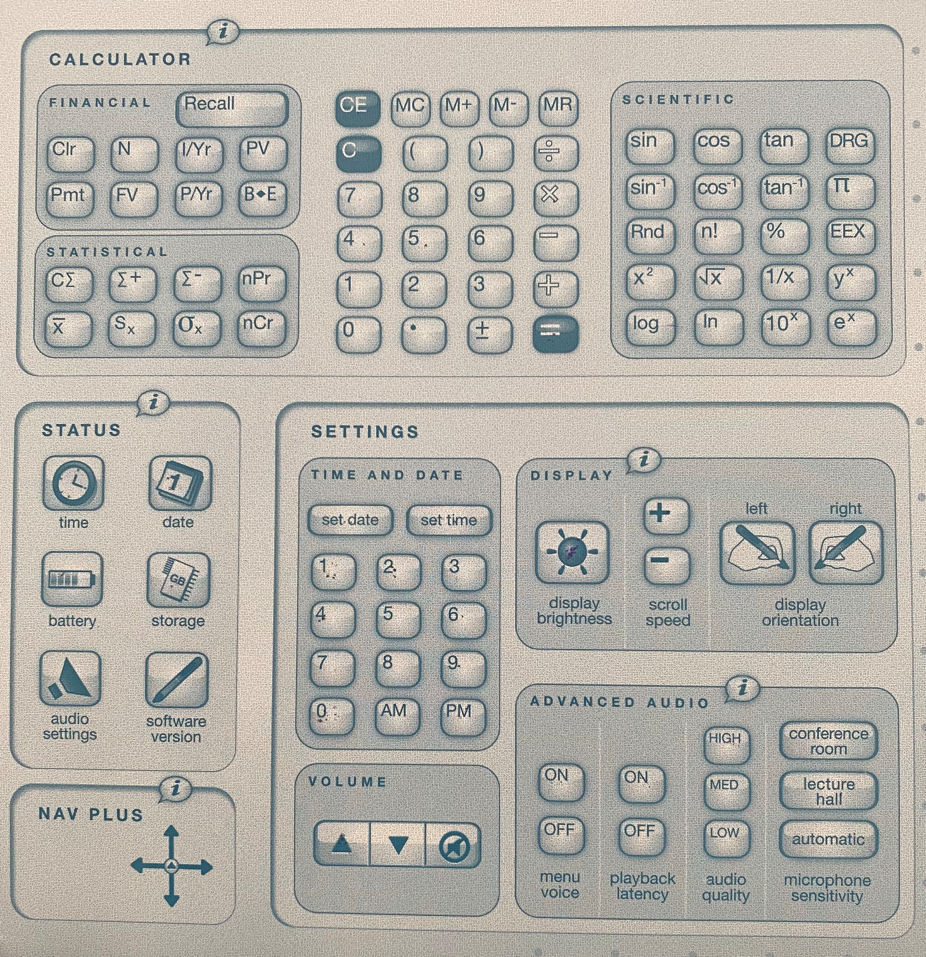
Smartpen Status and Settings
Take some time to familiarize yourself with the tools on the inside cover of the Livescribe Notebook
With your pen powered on, simply tap on the icons to perform these functions:
Manage the time and date
Check the battery level
Check the remaining storage capacity
Calculate mathematic expressions

Slide 3
Record Audio and Take Notes
To get started taking notes, turn on your pen, and tap on the Record icon at the bottom of the page you’re on
Begin taking lecture notes
At the end of the lecture, tap on the Stop icon at the bottom of the page you’re on
If you use the Pause icon, you must remember to tap the Record icon when you are ready to resume recording

Slide 4
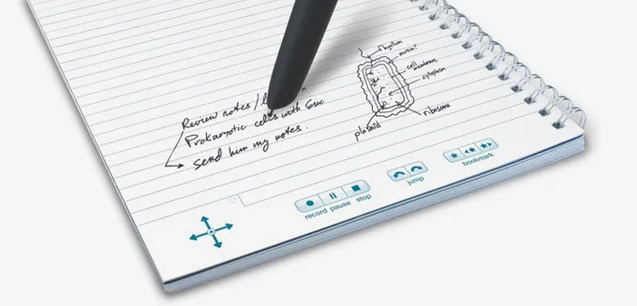
Audio Playback
To playback Audio, simply tap on your handwritten notes with the tip of your pen
You can tap on a specific section of your notes, to listen to a specific section of the audio recording
Icons at the bottom of the page allow rewinding and fast-forwarding of the audio
You can also adjust the playback speed (useful for adding more details to your notes while listening)

Slide 5
Smartpen Notetaking Tips
Some practices to adopt while taking notes with the Smartpen include:
Outline or Cornell Notes
Write down main topics and key words
Leave space in between topics, so you can fill in more detail later
Circle and/or underline important topics and announcements

