Slide 1


Institutional Learning Outcomes (ILO) Assessment
Graduation Survey Results
2024-2025
Presented to the Instructional Planning Council
October 3, 2025
Office of Planning, Research & Institutional Effectiveness (PRIE)

Slide 2
Cañada’s Existing Institutional Learning Outcomes (ILOs)
Critical Thinking
Select, evaluate, and use information to investigate a point of view, support a conclusion, or engage in problem solving.
Creativity
Produce, combine, or synthesize ideas in creative ways within or across disciplines.
Communication
Use language to effectively convey an idea or a set of facts, including the accurate use of source material and evidence according to institutional and discipline standards.
Community
Understand and interpret various points of view that emerge from a diverse world of people and cultures.
Quantitative Reasoning
Represent complex data in various mathematical forms (e.g., equations, graphs, diagrams, tables, and words) and analyze these data to draw appropriate conclusions
Note: In spring 2025 the Academic Senate updated the College ILO statements. These new statements will be assessed in future cycles. For this cycle, the ILOs approved from 2012-25 were evaluated.

Slide 3
ILO Assessment
Cañada College regularly assesses its Institutional Learning Outcomes (ILOs) in order to assure institutional effectiveness and promote continuous improvement.
The college uses multiple methods of assessment:
A survey of students petitioning to graduate with a degree or certificate every year.
The Community College Survey of Student Engagement (CCSSE).
Program Learning Outcomes Assessments aligned with ILOs.
The results of these assessments are discussed by our participatory governance bodies, including the Planning and Budgeting Council, and appropriate action plans are developed.

Slide 4
Survey details
Field date: April 24 - June 18, 2025
201 out of 514 graduates responded
  39% response rate
  + 9% point improvement from 2024
Respondents were generally representative of the graduating student population, except:
  Slightly older (6% pts fewer students ages 18-22 and 4% pts more students over age 40)
  Slightly more female (69% of respondents vs. 63% of all graduates)
  Slightly more Latine (57% of respondents vs. 52% of graduates)
  Fewer certificate completers (24% of respondents vs. 35% of graduates)
Notes:
Highlighted in 2024: (completers), except:
• Female completers slightly more likely to respond than male completers
• Degree completers were more likely to respond than those earning a Certificate and no Degree
• Older completers more likely to respond than younger completers

Slide 5
Survey Findings

Slide 6
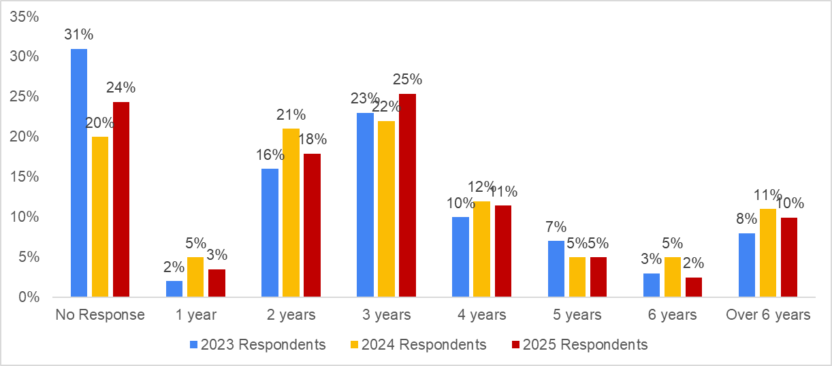
A majority of students who graduate complete their programs within 3 years, but 38% take more time
Survey Question: Including this year, how many years have you attended Cañada College?

Slide 7

Quantitative Reasoning
Community
Communication
Creativity
Critical Thinking
Median responses reported on a 1 to 100 scale where 100 is “strongly agree”

Slide 8
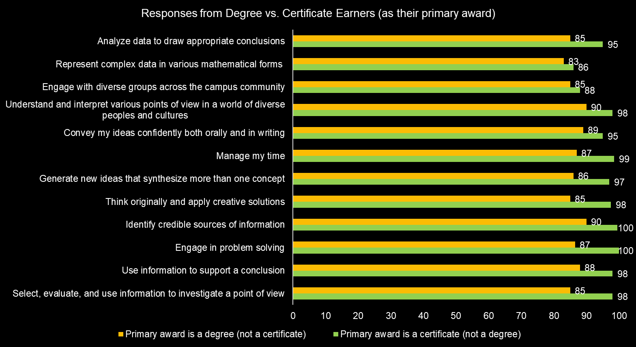
2024-25 Respondent Median Responses on a scale of 1 to 100 where 100 = strongly agree

Slide 9
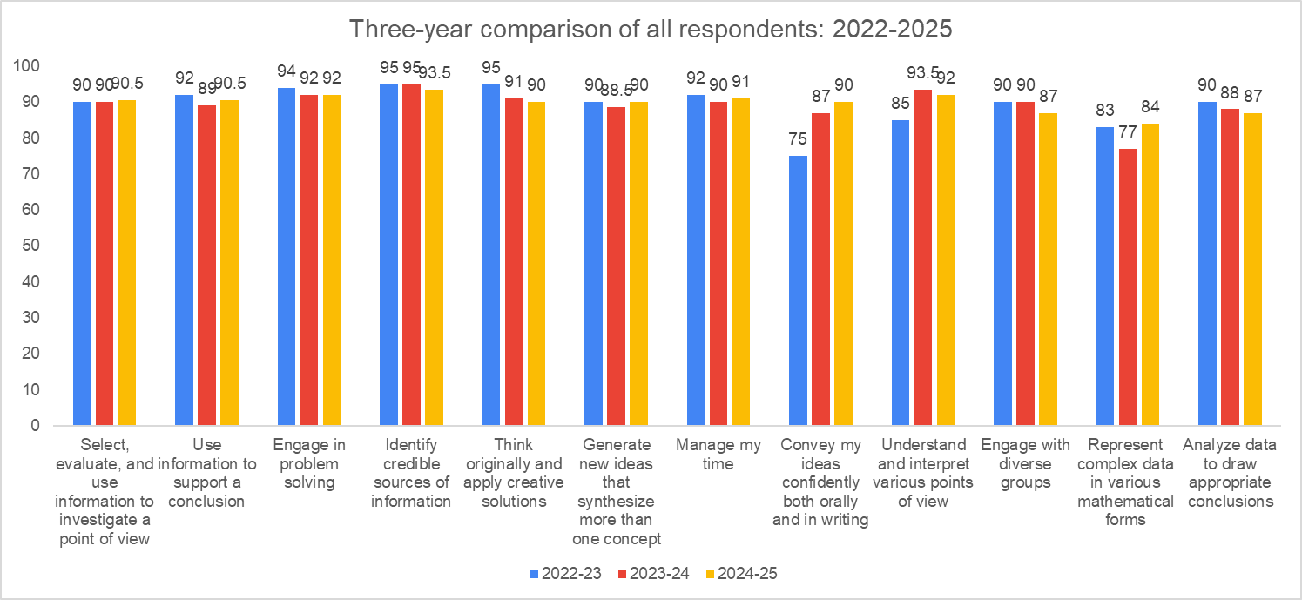

Slide 10
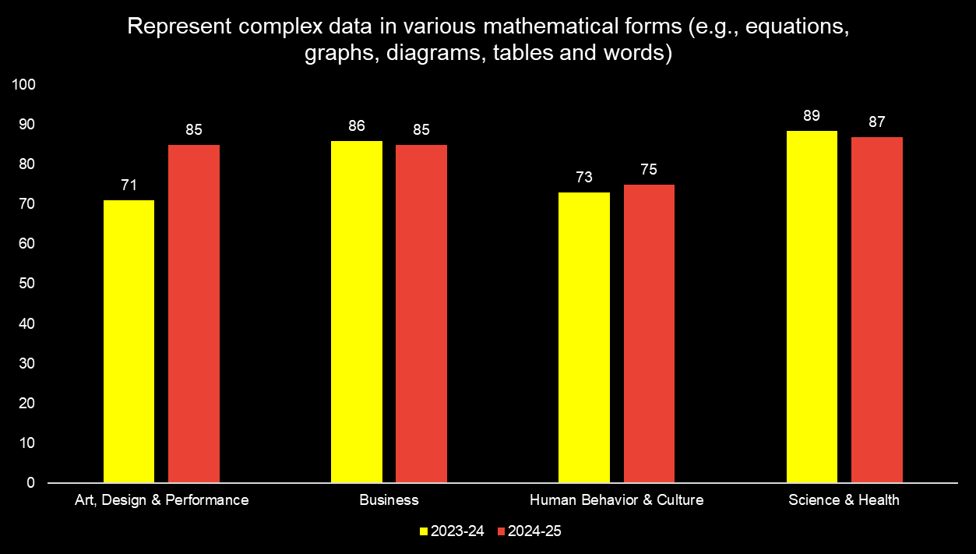
Median responses reported by Interest Area

Slide 11
Comparing our home campus students with our graduating students

Slide 12
Home Campus vs. Completers
Home Campus Students
Students seeking to earn a degree or certificate from Cañada in an academic year (excluding undecided students)
Degree & Certificate Completers
Students verified by A&R as earning a degree or certificate in an academic year
Notes:
Highlighted in 2024: (completers), except:
• Female completers slightly more likely to respond than male completers
• Degree completers were more likely to respond than those earning a Certificate and no Degree
• Older completers more likely to respond than younger completers

Slide 13
Male students continue to make up ground, but Latino male students are under-represented in the students who complete their program of study
 | 2024-2025 |  |  | 2023-2024 | 2022-2023
 | % of all Home Campus students (HC) | % Degree and Certificate earners (Completers) | difference between HC and Completers | difference between HC and Completers | difference between HC and Completers
Male students | 34% | 35% | +1% pts | -7% pts | -11% pts
Latino male students | 22% | 16% | - 6% pts | -3% pts | -9% pts
First-generation students | 56% | 54% | - 2% pts | -2% pts | -1% pts
Notes:
Highlighted in 2024: (completers), except:
• Female completers slightly more likely to respond than male completers
• Degree completers were more likely to respond than those earning a Certificate and no Degree
• Older completers more likely to respond than younger completers

Slide 14
Disaggregating Survey Results

Slide 15
Percentage of 2025 respondents by disaggregated population of interest:
ILO’s most likely to score lower overall
27% Male
13% Latino male
54% First Generation college student
Represent complex data in various mathematical forms (e.g., equations, graphs, diagrams, tables and words)
Convey my ideas confidently both orally and in writing

Slide 16
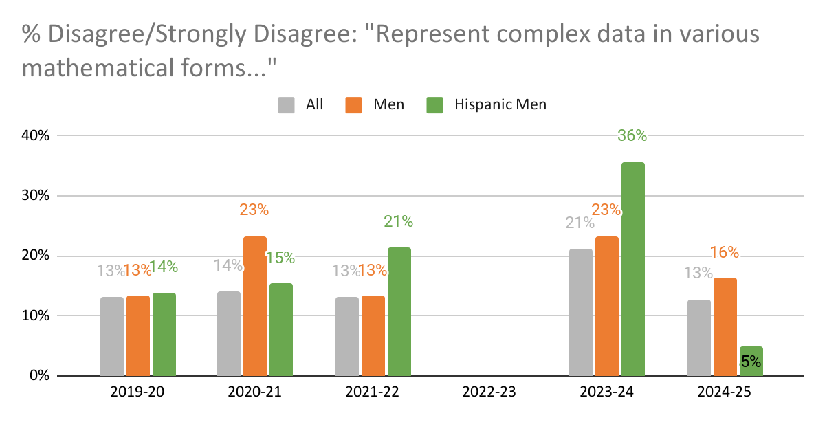
Male and Latino male students are more likely to disagree that they are able to represent complex data in various mathematical forms
ND

Slide 17
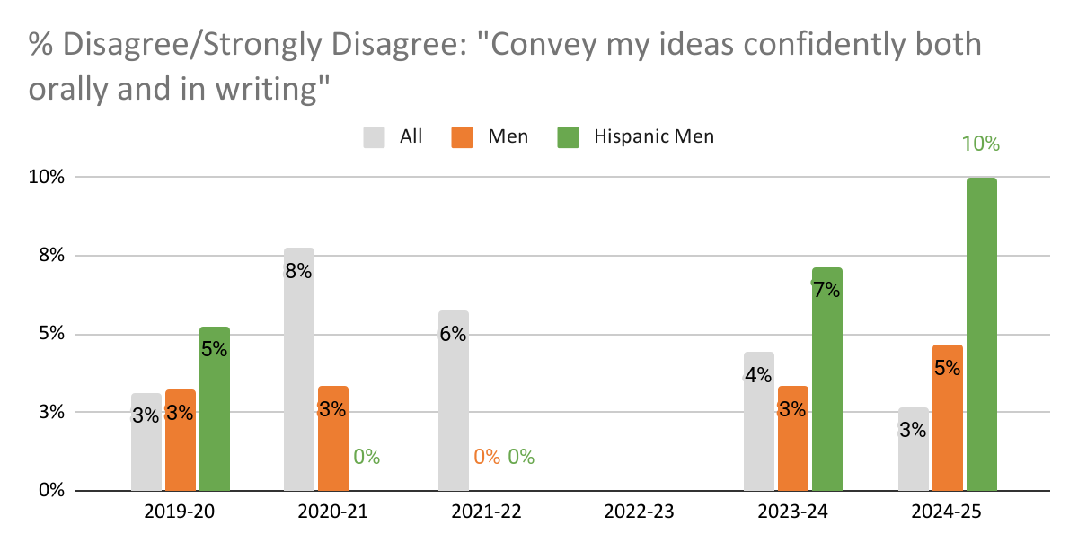
Male as well as Latino male students are more likely to disagree that they can convey their ideas confidently
ND
2022-2023 Smaller sample sizes: All n=52; Men n=9; Hispanic men n=5

Slide 18
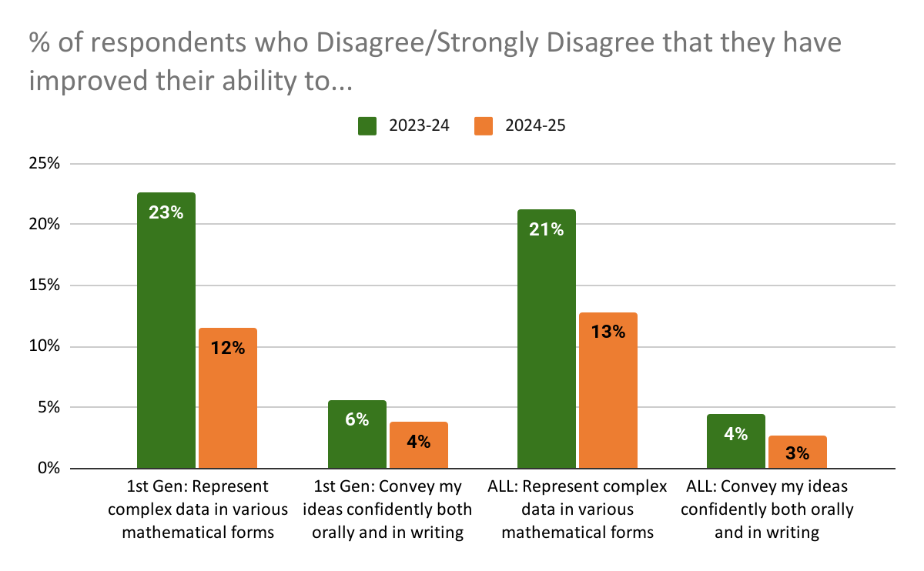
Key ILOs improved amongst First Generation students
since last year

Slide 19
All Graduating Students: Trends

Slide 20
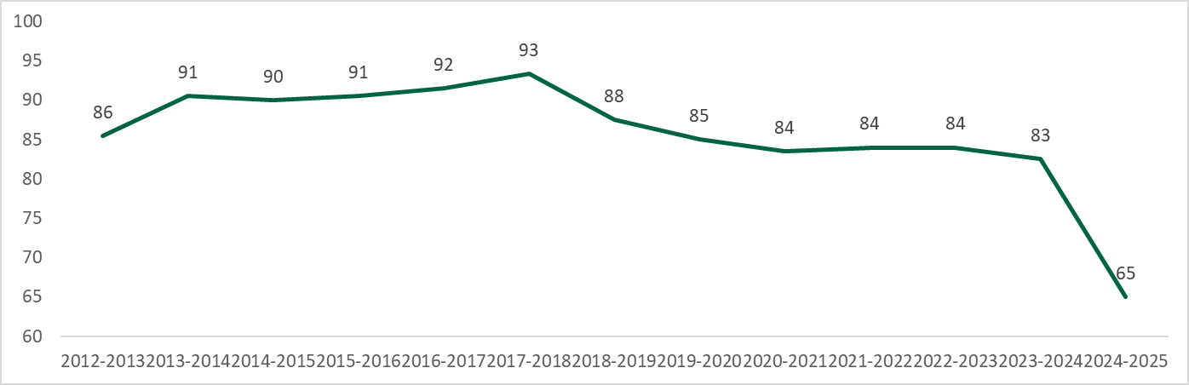
Median units earned by Cañada degree completers have been dropping since we launched Guided Pathways initiatives.
And dropped significantly last year!

Slide 21
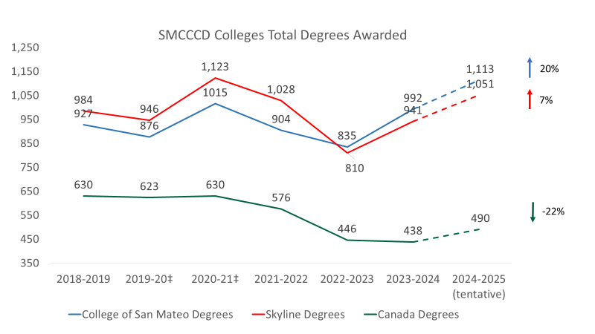
Canada’s total degree awards have not recovered from the pandemic

Slide 22
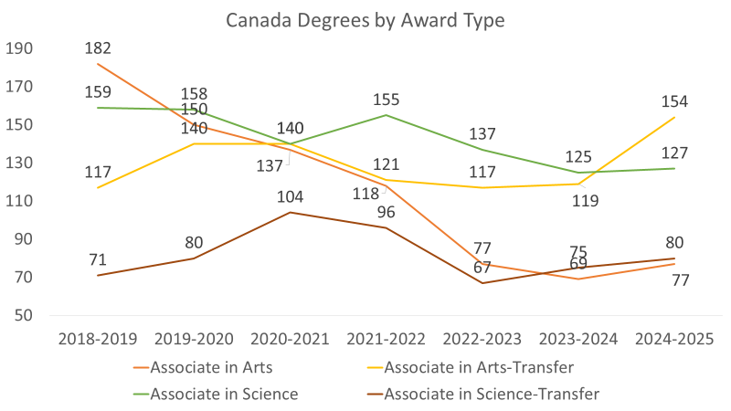
AS-T Degrees are not growing to make up for the drop in AS degrees

Slide 23
Key Take-Aways
Most graduates complete within 3 years, but 38% take more time
Within the full set of ILOs, students struggle more with the quantitative skills
  Certificate earners rate their ILOs higher than degree earners
  Most ratings have been stable over the last 3 years
Amongst “completers” and populations of interest:
  Male students completion rates have improved and equity gap closed last year
  Latino male students continue to be under-represented among completers
  Male and Latino male students are more likely to disagree that they are able to represent complex data in various mathematical forms
  Key ILOs improved amongst First Generation students since last year
Median units by degree completers have been dropping since we launched Guided Pathways
The number of degrees Cañada awards has been declining for more than 5 years and not recovering at the same rate as degree awards at Skyline or CSM

Slide 24
Open-ended responses

Slide 25
Open-response themes | Challenges
Balancing Work, Family, and Time Management (~30%)
Struggles with competing demands—full-time jobs, parenting, caregiving, and finding time for coursework
Language and Communication Barriers (~15%)
English as a second language, academic communication, or difficulty expressing themselves clearly
Institutional and Academic Challenges (~20%)
Issues with professors, counseling/advising, coursework load, and program structure

Slide 26
Q: Please describe any obstacles you experienced while working towards your educational goals at Cañada College.
Yes, I faced several obstacles because I'm a mother and I work. Sometimes I would go to bed too late to do my homework. But every time I finished a semester, I saw my goals being met every day.
Working full time.
Working full time while taking classes
When I arrived in [redacted], I came from a community college where I didn't feel very comfortable. Here, I was welcomed and advised on how and when to study.
Well I had some obstáculos as the English not is my First lengua
Transportation to school.
Transcript Evaluations took so long to be evaluated.
Too much home work from one unit class and me reading slowly
Time management, Rude professors
Time management
There was no obstacles. [redacted] staff and professors were the best at communicating and educating to help me thrive in every class and in my degree process.
The principal obstacles were language, math proficiency, and time management.

Slide 27
Q: Please describe any obstacles you experienced while working towards your educational goals at Cañada College.
The pandemic
The only obstacle I can think of was getting a consensus on if colleges cared about a student completing a series of courses at one school. I ended up playing it safe and completing series at the same school but I believe getting clarification on this would help future students.
The language. My first language is Spanish, which was a little challenge for me to do all the homework.
The free classes helped so much and free parking as well.
The difference in information from various counselors. I was put into a calculus series that limited my ability to apply to many colleges. I feel like many of the general counselors need to be on the same page as those in the transfer center with the articulation of courses for transfer.
The ability to reach the goal of finishing College in a speedier way and still getting good grades. I have had to take only one class at a time in order to make sure that my grades stay at a good level because I had to get good grades in order to have a chance to get accepted to the program I wanted to transfer to. For many years I was only able to take a couple of classes or even just one class semester to stay at a decent grade level. However, the College system has now ventured into late-start classes, which I am really grateful for, this way you can finish certain classes quickly and it gives the ability to take more classes at the same time during one semester, instead of only taking the 18 week long courses. I am also grateful for the 6 week long classes during the summer. The combination of the two options is terrific.
Sometimes it felt like I wasn’t really learning anything from my classes and we were just doing assignments
Some professors that did not care for my learning and made it hard to understand the class, forcing me to find other alternatives such as studying at another College just because of the professor.
Some obstacles that I experienced was the purchasing of literature for my classes. Some books were unaffordable. What helped was being part of the promise scholars program, which helped with some funds.
Some challenging classes, but overall passed
Recordéd video by zoom.
Raising a family as a single mom.
"Online course professors lacked proper communication with students consistently over the last 1.5 years.
I also informed my professor this semester that a student in a group project was attempting to submit plagiarized work, but was told that I needed to figure out how to handle on my own."

Slide 28
Q: Please describe any obstacles you experienced while working towards your educational goals at Cañada College.
One of the obstacles I have was how to be managed time between work, school and socialize.
One of the main obstacles I experienced while studying Business Administration at Cañada College was the language barrier. As an international student from Peru, adjusting to academic English, especially in subjects like law, marketing, and communication, was challenging at first. I often had to spend extra time reviewing class materials, participating in discussions, and completing assignments to ensure I fully understood the concepts. Another challenge was adapting to a new educational system and learning how to navigate college resources. Despite these difficulties, I remained focused on my goals and continued improving my English and academic skills with each semester.
One of the biggest obstacles I faced while working toward my educational goals at [the] College was balancing full-time work, personal responsibilities, and emotional challenges. I work as a service advisor in the automotive industry and often had to manage long hours while supporting my family—especially after the passing of my mother. [redacted]. Despite these hardships, I remained committed to my education and used these experiences to build resilience and self-awareness. They motivated me to grow, stay focused, and pursue something better for myself.
One of my obstacles is the time, is been a hard and difficult to make time for my physical condition, Unfortunately I have an car accident last year and been a little stressed and painful, but I have to study’s and able to make time to complete my classes!
One obstacle I experienced while working towards my educational goals at Cañada College was balancing my coursework with personal and family responsibilities. It was challenging at times to manage everything, but it taught me the importance of time management and perseverance.
"On my end, I experience a lack of direction when comes to narrowing what I wanted to work toawrds with Business."
Not enough asynchronous online classes
None!
None that I am aware.
None
None
none
NONE

Slide 29
Q: Please describe any obstacles you experienced while working towards your educational goals at Cañada College.
No real obstacles here at Cañada, just took a break because I wasn’t motivated in the beginning.
My time at Cañada College was fairly straightforward, but I did have multiple issues with councilors regarding my schedule such as not mentioning that a course had a co-requisite when planning out my schedules for the semester.
My past education I messed up after high school and didnt really care for school so when I went back it affected me GPA wise. Also getting Un expectingly pregnant made it worse because my GPA went down
My obstacles were more internal and towards my mentality towards my workload, but I would feel that way on any campus.
my main obstacle was always myself, getting work done, Turing it in on time that kind of stuff, but overall that, Also sometimes techers were not always super helpful with what they wanted us to do for work.
My chronic illness
My biggest obstacle was technology because Covid hits right after l started my first semester and we were forced to move to 100% online classes.
Many times the obstacle could have been concentration or not knowing what career to study, but over time I learned how to handle it.
Managing time is not too easy. Some of the classes have a heavy workload.
Managing my time more effectively.
Managing jobs and school
Mainly the obstacles I faced was how do I deal with my time here and what I want to do while at Cañada before Transfer
Life- taking care of my father who now has dementia
life
Language barrier
language barrier
Just the pandemic, when resources were limited.

Slide 30
Q: Please describe any obstacles you experienced while working towards your educational goals at Cañada College.
It’s tough being a full time student and also working multiple full time jobs as an adult. Some of the professors are unwilling to consider that, and seem unable to be reached or unable to be flexible.
It's not esay to efficient to contact with a professor who working at evening classes，particular，who works as a part-time role.
It was my communication skills since English is my second language
I'm getting transportation over here because I don't live in road City, and also just managing my time
I was working full time while I was a student. Some classes were only available during the day and not in the evening.
I was academically disqualified several times, but I never gave up. I recollected myself and made it happen despite the number of times I failed. Thanks to Cañada College for giving me countless opportunities to redeem myself.
I was a part-time student because I needed to work. Management my time was a obstacle that I had.
I struggle with ADHD and unfortunately wasn't aware of the wonderful DRC department and its valuable resource until towards the end of my studies. I think it should be better advertised. I feel much is received in "printed" info on syllabus but maybe representatives of the department should talk in class so students are more aware. It has helped me tremendously and I want others to have this so valuable support!
I started the program and was lacking confidence in every aspect of my life. I was a returning student and was terrified about entering the learning environment and learning new/current technologies. The environment supported me in so many ways. I'm forever grateful. I'm interviewing for positions that I never thought I'd be qualified for. They are entry level, but it's a start and that's all I need. I've built my confidence over this program. Thank you.
I recently moved so I used to had a long commute
I only took online classes so that was limiting to only online learning, but I loved the flexibility of taking online classes being a mom and working full-time. It wouldn't have been possible for me to attend in-person classes.
I loved my experience at Cañada College, always good to help the students, I have a few obstacles like the price and some biology concepts and Cañada was always prepare to help all students.
I legitimately cannot remember my second semester at Canãda. Besides that, one of my professors didn't hand back the first lab report until half way through the semester.

Slide 31
Q: Please describe any obstacles you experienced while working towards your educational goals at Cañada College.
"I haven't had any major obstacles while working my educational goals at Cañada College. I've had helpful instructors and resources, and my family has been a great support, which has made my journey easier."
I have experienced carpal tunnel while studying.
I have disabilities and I am homeless but all the resources helped me to get to this step and to get two degrees. I'm leaving with sociology and psychology and even though I'm homeless I used all the resources on the campus from the pantry to counseling to tutoring different programs. That would help me financially be able to get there and help with books help with everything that does contribute to my success and without those it wouldn't have happened without you guys. Yes I had to be blunt and let people into my life and let them know how I'm struggling what I'm going through but I got over it and you guys were able to assist me in every way possible. Even in the transferring process, I'm linking over to similar programs at San Francisco State University by using the help from the programs you guys offer that I qualified for that are assisting me on to the next campus and it's awesome and I love you guys for that.
I had to take 2 breaks during my time at Cañada College to maintain demanding work schedule to survive, and to take care of my Grandpa after my grandma passed away and he was diagnosed with dementia shortly thereafter. My father was diagnosed with stage IV cancer at the same time so i stepped up to take care of my loved ones that took such good care of me.
I had to change my degree from Theatre Arts to Interdisciplinary Studies in the Arts & Humanities because Cañada did not offer the last two classes needed for the Theatre Arts degree. Rather disappointing. However, school counselors assisted me quite well in moving forward to attain a degree towards which I started over 40 years ago. Woohoo!!
I had a few obstacles with classes not lining up with what I needed for certain requirements. Counseling was helpful but sometimes the information would change.
I had a few obstacles outside of school. I had family deaths and other responsibilities at home.
I first started at Cañada college in January of 2020. Then the pandemic happened and possibly like many other people. I lost my motivation finish my degree. I changed my major many times then finally found what I love which is psychology and now when transfer until be studying Social Work. Last year I had a very tragic loss. I thought about giving up but I never did and I’m so proud of myself.

Slide 32
Q: Please describe any obstacles you experienced while working towards your educational goals at Cañada College.
I first attended back in 2002 and again in 2013, the obstacles I experienced while working towards my educational goals were all personal in nature. I did not feel ready or prepared at those times and ultimately I did not succeed. When I decided to return in 2023, I had clear goals and also the option for online only courses really helped me.
I experienced personal obstacles everyone at Cañada has been great!
I did not experienced any obstacles, It was smooth overall.
I did not experience any obstacles as it was very flexible and supportive.
Health
Having to withdraw classes because there was too much coursework and it didn’t align with my work schedule.
Having a lack of guidance/ information
Getting to school easily since the Lyft program which I originally needed to use to get to school was cancelled. 🙄
Financial obstacle, time management between family, commute, daily activities, doing homework, sleeping, and other school events. Dealing with various aspects related to School Clubs, requesting finance for club events. Finding energy to study, exercise, and be present for my family and church events.
finances
finacially: tuition for international students cost too much
Express myself in another language.
During the pandemic I dropped out for two years because of mental health problems.
Doing all classes in person at once
Covid, Confidence, Finance, Food, Mental health
Counseling appointments. In my 3 Experiences with counselors, the three were rude. 2 of them (same person) told me to transfer to a college in irvine upon seeing that my phone number was from there, to which I had to explain that I don’t like there anymore. What shocked me is that I believe she was a head or a superior in the counseling team. I have other memories of her being extremely rude to me, and pointlessly intrusive. Those 2 experiences made me decide not to transfer to [redacted] (coming from [redacted]), and only graduate from there (as my units have mainly been from [redacted] classes).

Slide 33
Q: Please describe any obstacles you experienced while working towards your educational goals at Cañada College.
Childcare
Being a single mom and moving to a new home
Balancing mom life with homework.
An obstacle I experienced was maintaining my school work while also working. At first it was difficult, but as time went on it became easier. This obstacle made me put more effort into my time management skills.
All of the geography courses I took were virtual, and that is no good. There should be a disclosure for degrees that do not have in-person offerings for all of the classes. The METE 100 (Weather and Climate) class was also only offered in the summer. Honestly, I think the degree should be taken off of the list since none of the geography classes are actually offered in person.
No obstacles

Slide 34
Open-response themes | Positive learning experiences
Personal Growth, Confidence, & Resilience (~25%)
discipline, time management, belief in self, overcoming setbacks, motivation
Supportive Faculty, Counselors, & Mentors (~20%)
Including professors’ encouragement, counselors’ guidance, mentors in specific programs
Programs, Clubs, & Resources (~20%)
Specific mentions: Umoja, EOPS, Promise, Fashion, CWA, Architecture club, Cultural Center, Tutoring, Learning Center

Slide 35
Q: Please describe one learning experience you had at Cañada College that has helped shape who you are.
Working with the Umoja program has been amazing.
Working as a team taught me a lot, such as being patient and helping others, and that helped me grow as a person since I applied it daily at school.
Working as a peer mentor at Cañada College which allowed me to work with students from different backgrounds and attend eye-opening events.
Well, I learned to live with various cultures and I have great friends with whom I studied during some semesters. I learned study habits and how to ask for help when I needed it in the different services that Cañada offers for students.
Using my critical thinking and fact research abilities in a much different way on a daily basis. I believe the STEM classes have helped me develop this a lot, through hands on Labs and methods.
Tutoring was a best experience that I had at Cañada
To take my time but also take my school work seriously
To improvement Spanish grammar.
To believe in myself and that I can and will accomplish my educational goals to live the life I deserve and to be the first in my family to graduate from college. Cañada reaffirmed my confidence in know that yes I can.
Time management is very important
There have been so many experiences at Cañada that have given me many learning experiences that have shaped who I am. The one that comes to mind first is my Ethnic Studies class. It was my first time taking this type of class and I learned so much. I learned to be open minded, to learn more about myself… my identity. That class gave me a reason to research, analyze, and speak out.
The support of my CWA program
The mentorship of Mrs. Ronda Chaney with her incredible skills and dedication along with her team of wonderful professors have not only opened doors for me in the Fashion industry but also prepared me well for what is coming next. I will continue to further my education and further develop my sustainable art to wear business.
The community

Slide 36
Q: Please describe one learning experience you had at Cañada College that has helped shape who you are.
The clinical rotations at the hospitals which I am assigned to during my time in the Radiology Technology program at Cañada College helped me to deal with patients from all types of backgrounds who are facing various challenges to achieve an optimal quality of life. I am now able to identify specific challenges presented by the patients, provide a listening ear, perform my necessary duties as a Radiology technology, while still maintaining patient safety and doing all of it in a safe learning environment.
The classes I took on learning about diversity and different cultures has helped me to expand my world and build on my empathy for others.
The classes are so engaging, not only do I learn, but it enriches my life.
The academic consultant，Jinmei，is so professional and helpful，who leads me find a better path to acknowledge my strengths，and figure out how to exploit my career experience in different culture.
The ability to seek the help I need from counselors.
Team work, work with people from different cultures.
Teachers. I think teachers played a significant role in this journey. They valued my strengths and helped me shape my weaknesses.
Taking my first computer science course with professor [redacted], while the class was very difficult, and many students failed, I excelled at the course, finding passion in the material. If she had not asked me to be her TA the next semester, I would have never had the confidence to become a tutor here at Cañada, something that a prize dearly, as it has made me realize how much I enjoy teaching.
Taking Child Development allow me to know myself better and to understand why I was the way I was and that I had the power make changes to become a better version of myself.
Taking all the psychology classes really helped me figure out what I wanted to do with my education and career.
Taking a physical education class, which is indoor soccer, several times did help me shape who I am by having more confidence in myself and understanding the importance of pushing my limits to succeed.
Statistics & Probability Professor Amira Alkeswani's positive and encouraging style of teaching
Some professors are really helpful and caring and want you to succeed, as well as counselors. Alot of helpful resources at Cañada
remember your why on why you are getting the degree and what you want your outcome to be. Also for who are you doing it for aswell

Slide 37
Q: Please describe one learning experience you had at Cañada College that has helped shape who you are.
Reinstating the Architecture (AIAS) club at College of San Mateo helped shape who I am becoming and what type of impact I will be leaving behind and continuing into for my future endeavors in my new career that I have decided on pursuing. I am grateful for all the support I received while I attended these last 2 years, from free food on campus, gas cards each month, a stipend for the book store and an electronic credit, it really lessened the burden that I have faced throughout the last two years. Everyone is going through so much and to have some help makes the biggest difference. I will surely be supporting Cañada College as an alumni. Thank you for everything.
Professors are very talented and helped me towards achieving my educational goals. International Conselour Jinmei Lun was extraordinarily well prepared and helpful with my education plan.
Professors are very helpful.
Playing on the women’s soccer team had made my experience so amazing. I’m so grateful to have participated in it
Opportunity to complete an internship and implement a design for a community service recipient.
Opportunity comes to those who leave themselves open for it, even if things don't work out it's best to look for alternate solutions and learn from your mistakes.
One thing I learned was that was dedication and the right educators anything is possible.
One learning experience was when I was struggling in my classes and went to get help from tutoring. This taught me that it's okay to not know everything and that Cañada provided me many resources to help with my academic success.
One learning experience that I had was when I was getting ready to transfer. You have to make sure that even though they do guide you that you stay on it and that you make sure you turn in your final transcripts and make sure all of your petitions are put in. Yes it's not 100% your problem or your issue but you need to make sure that things are in line as you're moving across in your educational goal. I also one learning experience I learned was that because I was in the hospital a lot that as long as I communicate and I had sufficient documents to back up my truth even though they didn't require them. I was able to get assistance or extensions through different programs and it was awesome because I was over there in the hospital stressing and sick and having surgeries and not able to walk or not able to do things and the programs and the professors all work together to help me continue my straight A streak and it was amazing and I love you guys.

Slide 38
Q: Please describe one learning experience you had at Cañada College that has helped shape who you are.
One learning experience that I had at Cañada college that has helped shape who am I now was in my first ESL class. … I put all my effort in the class and pass with an A-. I strived all through english classes and my resilience helped me to accomplish my goals. Now, I'm transferring to a four-year university pursuing a bachelor's degree in business administration.
"One learning experience that helped shape who I am was participating in group projects at Cañada College. Working with classmates from different backgrounds taught me how to communicate better, appreciate different perspectives, and grow as both a student and a person."
One learning experience that has shaped who I am at Cañada College is having great professors who helped me whenever I needed it. Their support made a big difference in my education.
One important learning experience I had at Cañada College was developing the discipline and mindset needed to succeed in a professional environment. …
none
NONE
Never stop critically thinking, it is an important rule for education.
N/A
N/A
N/A
N/A
N/A
"My experiences were that I learned a lot in every class I took. Today, it's reflected in my work because I'm in the position I always imagined. Thank you Cañada College for providing us with this support."
My experience in ESL overall has helped me to be who I am now.
Meeting all the experienced teacher that helped me understand the field that I accomplished my degree in.
learning to ask for help and about more resources
Learning in groups and working hands on

Slide 39
Q: Please describe one learning experience you had at Cañada College that has helped shape who you are.
Learning how to work from afar and use tech for online classes helped me complete the degree and become a much better user of technology.
Learning calculus
Learn how to cope with learning difficulties
it helped immensely by introducing me to very nice professors and counselor. In addituion the college provdided me with a myraid of different programs, clubs and students with similar interest.
Ironically my to total failure a year or so ago i had a 1.5 GDP and through hard work and getting my act together I'm currently at a 2.8 and hopefully going to graduate and transfer.
In my economics class, it has transformed the way I think critically and reinforced my learning style that I have carried on and will carry to university.
If you work hard you can accomplish your goals
I've had the pleasure to work with amazing peers/talent and learn from passionate and insightful professor. I've had great opportunities to gain more experience through the Menlo Studio Internship in the Marketing Department.
I would say that being at Cañada College helped me to be able to not procrastinate with my assignment or any schoolwork that I had. Furthermore, it helped me to prioritize what task are pressing.
I was new to Country and Cañada college helped me to understand US market in more depth
I was handling more than I could at home, work, and school. My mental health was declining. I had to withdrawal from classes. …
I think the instructors are incredibly supportive. The environment was such a nurturing one. Students are given opportunities to excel and to get support as needed. I cannot express enough my thanks for this program.
I learning be kind and take time studying, with the excellent professors I improve my English and my health skills.
I learned to work in a group.
I learned to better understand arguments in my ethics class
I learned to better manage my time between work, school, and my hobbies.
I learned the importance of pitting myself out there and making friends in class to create study groups. …

Slide 40
Q: Please describe one learning experience you had at Cañada College that has helped shape who you are.
I learned that many people have different point of views but that does not mean we can’t get along.
I learned ESL, and Childhood education.
I learn that in order to do better in school I would have to stop socialize and focus on what is more important. …
I learn how to be more creative and help my community
I have really enjoyed being part of the Fashion Program! …
I have learned to communicate effectively with professors and my peers in order to create a better school and learning experience for myself.
I have learned different skills from different instructors.
I had many beautiful experiencia as to know many people.
I forgot how much I love researching things (for classes or otherwise). The Learning center was very helpful the few times I went there to study as well.
I feel more confident in my education.
I enjoyed the discussion posts for online learning as I am more of an introverted person …
I can’t think of anything at the moment.
I believe being in community with the different programs on campus helped me learn how to become a better leader …
"I attended the Middle College Program back in 2020-2022, and it really helped me overcome the social challenges I experienced at the public high school … Working at the Cultural Center was really meaningful for me. It helped me find community and feel fulfilled."
How to think more for myself and how to rely more on myself for certain things.
How to better manage time.
Having an opened mind. And networking, you never know who you are going to meet and who they will connect you with.
Forming study groups with people who have become lifelong friends.
Everything has been a learning experience during my time at Cañada College l started with many fears about if l could be able to finish college and to learn new things.
Everyone is so supportive. This is the kind of community I want to surround myself with.

Slide 41
Q: Please describe one learning experience you had at Cañada College that has helped shape who you are.
Ethnic studies class requirement. Best graduation requirement I never asked for! :)
Discipline, I’ve learned that with discipline I can go a long way.
Consistent support with EOPS throughout the last year and a half
Being part of programs such as promise and eop that helped me stay on track and prioratizing my education.
Being able to take numerous classes that have allowed me to understand my interests.
Balancing mom life and homework.
At Christ Flow club I learned more about God and Jesus.
Associated students of Cañada college
An oceanography class that I took made me have a great appreciation of the sciences despite it not having anything to do with my career.
All of my [redacted] classes were taken online, but definitely, I have learned to be very thorough with assignment rules as one of my teachers would take down half the points of assignments for one little part of it not understood correctly.
Accused of sexual harassment and multiple injuries sustained while playing baseball.
A defining learning experience at [redacted] College was taking Managerial Accounting. …
[redacted] College help me to my dream and help me to be a better person, and the person I am now!
"[redacted] College for me It’s a home because I learn, grow in my knowledge and all time field save and happy. All programs, Staff and Professors are so Professional. Thanks for help me to make my dream come true."

