Slide 1
Preparing for fall
What are you reading, watching, or listening to this semester, and how will it keep you inspired this fall?
Scroll down, add your name to slide and tell us your plans
Fall Equinox

Slide 2



Anniqua

Slide 3
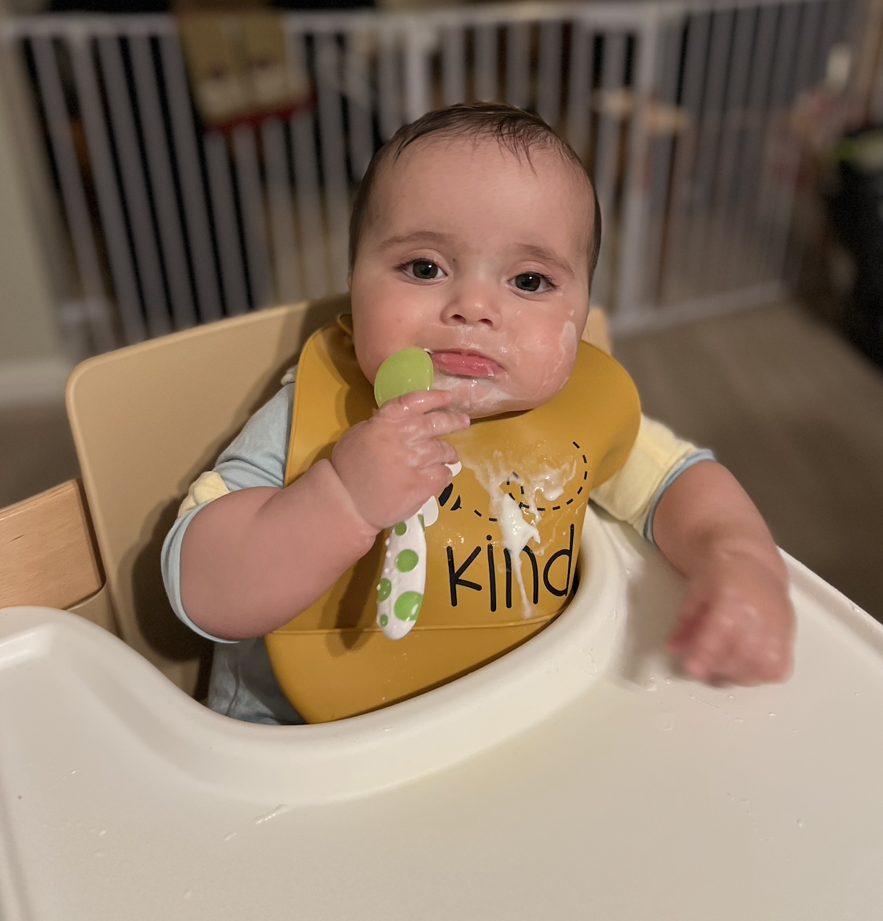
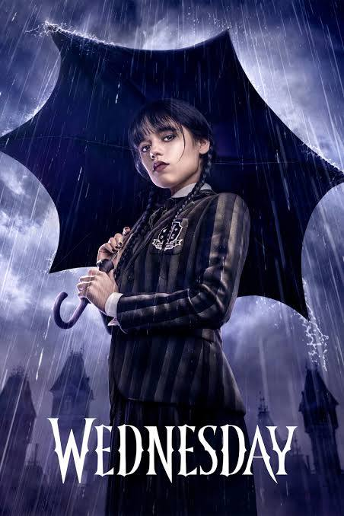


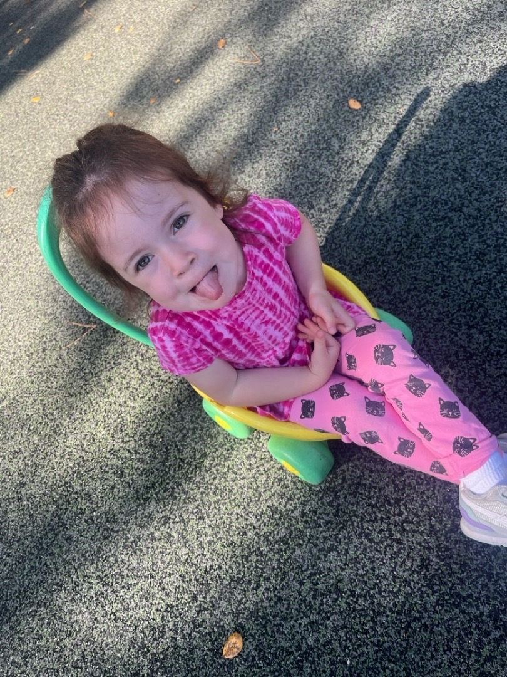
Allison
Looking forward to slowing down during the Fall and finding more peace.

Slide 4




Sarah Harmon
On my various lists this semester:
…and making more biscotti…

Slide 5



Diego Payán
Culturally relevant practices, sustainable efforts with our mother nature and minds, and lastly keep dancing to the rhythm of life with some soul

Slide 6





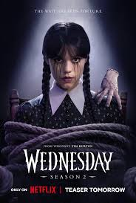

Tania Isidra
Currently watching
Currently reading or want to read
This fall I want to read more books written by Latino authors to be able to support people within my ethnic community.
Listening To : Lofi, RnB, Salsa

Slide 7

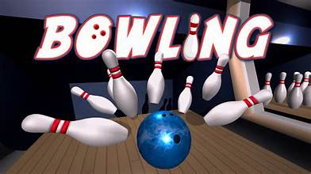

Ron Andrade

Slide 8


Adriana Lugo
A Yosemite Park special agent investigates murders while trying to survive. Like him, I’m trying to survive this semester.
Trying to balance the thrill of life leads me to Mentiras, la serie. One where I can sing along to Mexican pop ballads from the 80s at full volume, so long as no one is around.
Books? None, just audiobooks.

Slide 9
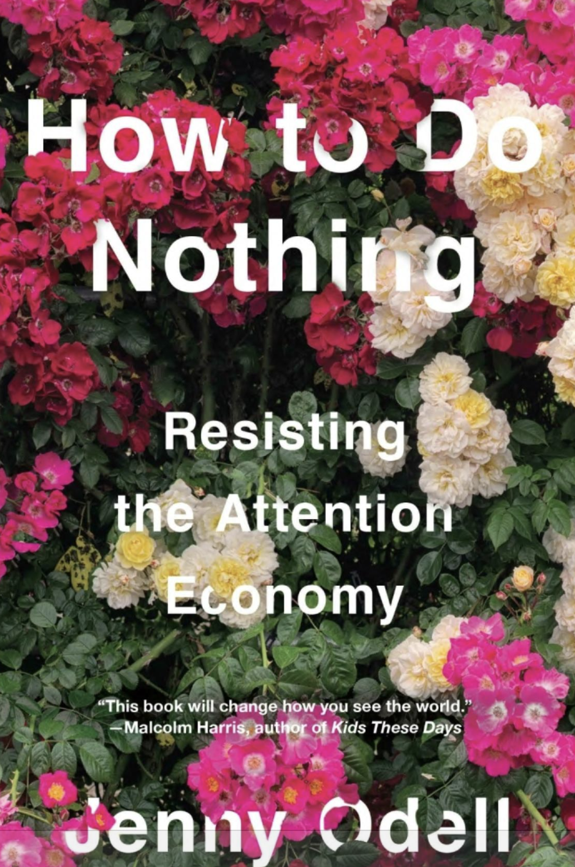

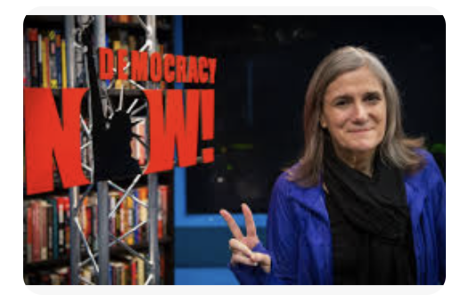
Jessica Silver-Sharp
Thinking hard about what’s most important and learning how to say “no”
watching…and listening
reading…

Slide 10



Maureen Wiley

