Slide 1

REDWOOD CITY, CA
CARES Presentation to
Academic Senate
Nadya Sigona and Marcos Chacon

Slide 2
What Is CARES
Definition: Cañada Assessment, Response, and Evaluation of Students.
Mission: To provide a centralized, coordinated approach to supporting students in distress.
Who Can Report? Staff, faculty, administrators, and students are all encouraged to submit referrals.

Slide 3
Who is CARES
Marcos Chacon Counselor, Personal Counseling Center
Nadya Sigona Counselor, Academic/Early Alert
Dr. Devon Scott Director, DRC and PCC
Max Hartman Dean of Counseling and TIX Coordinator
Zorie Gomez and Jason Wendt Public Safety Representatives
Dr. Jackie Flores VPSS Executive Assistant
Lizette Bricker VPSS

Slide 4
How to Report
Submit the online CARES form: https://smccd-advocate.symplicity.com/care_report/index.php/pid238479?
What Happens Next: The team reviews the referral to strategize a follow-up. Urgent concerns may involve immediate checks; less urgent cases are discussed in weekly meetings.
Confidentiality: Reports are private. Reporters can request anonymity, though safety concerns may require disclosure to intervene effectively.

Slide 5
Reminders
Mandated Reporters: All non-confidential district employees must report abuse (child/elder) and sexual misconduct.
Title IX incidents should use the separate Title IX Reporting Form:
https://smccd-advocate.symplicity.com/titleix_report/index.php/pid862025?
Academic Concerns should be submitted through Early Alert in CANVAS
Q: What if you don’t know if it is a CARES, TIX, or Early Alert?
A: Report where you know how to report, our CARES, TIX, and Early Alert teams are braided, we will rout your report to the right place!

Slide 6
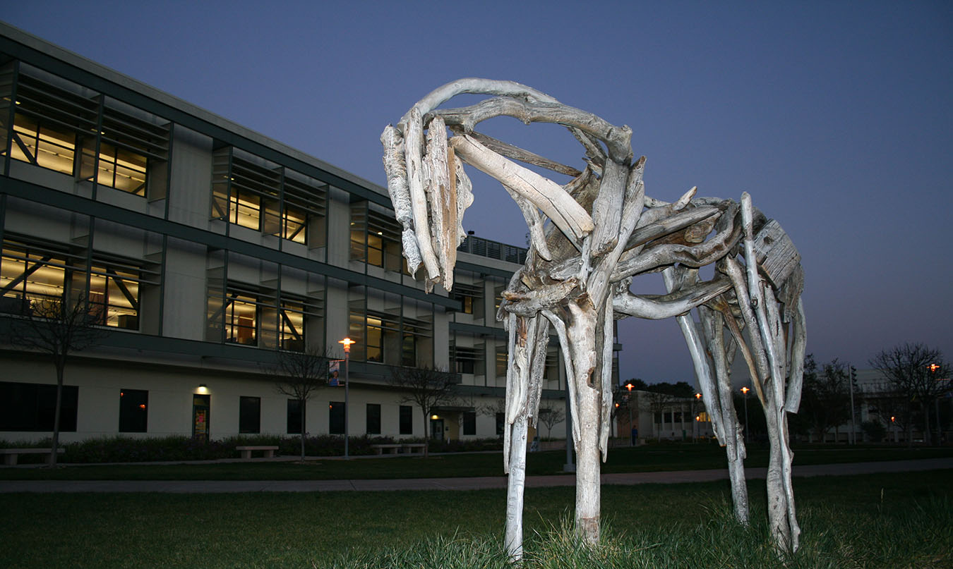
Thank you!

