Slide 1
Evening Students: Fall 2023
Analysis of Fall 2023 Enrollment Data
Prepared by PRIE on June 20, 2023

Slide 2
Summary
A class is considered an evening class if the start time of the course is 4:30 or later and it is Face to Face or Hybrid.
Students
Enrollments
443 students out of 3174 registered for F23 (14%) are registered for an evening class
269 (61% of evening students) are exclusively enrolled in evening sections
364 (82% of evening students) are continuing students
148 (33% of evening students) are low income
16 are in the College for Working Adults Cohort*
519 Enrollments
292 (56%) of Enrollments are in Hybrid classes (especially in Building 13) – unclear how often they will meet in person
115 (22%) of Enrollments are in ESL (M=42; T=36; W=52; Th=48) in Building 13
*Most of the 50 CWA students registered for Fall 2023 are enrolling in Online Courses

Slide 3
Building | Monday | Tuesday | Wednesday | Thursday | Friday | TOTAL
1 | 10 | 35 | 10 | 35 | 11 | 101
3 |  | 58 |  | 47 |  | 105
5 | 3 | 3 | 3 | 3 | 3 | 15
9 |  |  | 16 |  |  | 16
13 | 52 | 60 | 62 | 72 |  | 246
18 |  | 17 |  | 17 |  | 34
22 |  | 5 | 14 | 7 |  | 26
23 | 4 | 30 |  | 40 |  | 74
Fall 2023 Enrollments as of June 20, 2023 in Face to Face and Hybrid Classes by Building

Slide 4
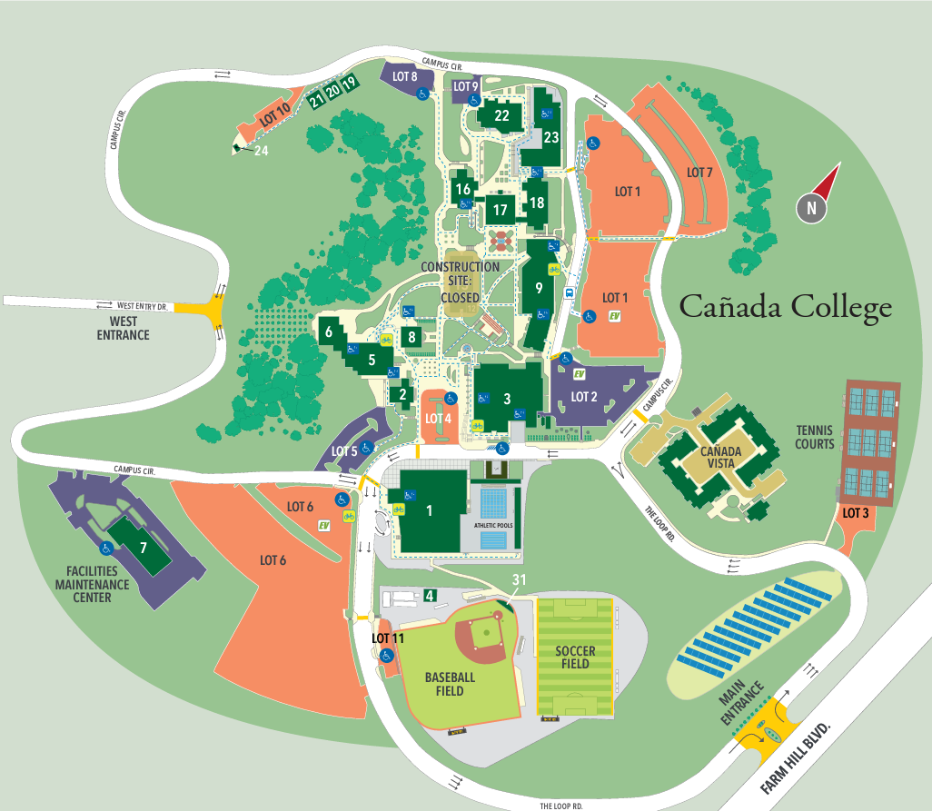
Monday

Slide 5
Building 3 Classes | Enrollments
Beg. Clothing Construction | 21
Soc. Science Research Methods | 12
Advanced Elementary Spanish | 12
Advanced Illustration | 10
Film Study and Appreciation | 7
Compos., Lit. & Crit. Thinking | 6
Creative Writing I | 6
Piano I | 6
Intermediate Spanish I | 5
Guitar I | 4
World Music | 4
Guitar II | 3
Intermediate Spanish II | 3
Advanced Intermediate Spanish | 2
Piano III | 2
Creative Writing II | 1
Piano II | 1
Grand Total | 105
Hybrid | 51
Building 13 Classes | Enrollments
Reading & Listening-Speakng II (ESL) | 26
Grammar and Writing II (ESL) | 22
Grammar and Writing III (ESL) | 19
Financial Accounting | 17
Introduction to Business | 13
Accounting Procedures | 11
Reading & Listening-Speakg III (ESL) | 11
Reading & Listening-Speakin IV (ESL) | 11
Comp. Multilingual Students (ESL 400) | 10
Grammar and Writing IV (ESL) | 10
Quickbooks | 9
Introduction to Sociology | 8
Managerial Accounting | 8
Reading and Composition (ENGL 100) | 8
Intensive Composition &Reading (ENGL 105) | 7
English Pronunciation (ESL) | 6
Introduction to Philosophy | 4
Interpersonal Communication | 3
Principles of Macro Economics | 3
Business Law | 2
Small Business Management | 2
U.S. History through 1877 | 2
Grand Total | 212
Hybrid | 175

Slide 6
Low Income Students
Building | Monday | Tuesday | Wednesday | Thursday | Friday | TOTAL
1 | 1 | 8 | 1 | 8 | 1 | 19
3 |  | 4 |  | 16 |  | 20
5 | 1 | 1 | 1 | 1 | 1 | 5
9 |  |  | 3 |  |  | 3
13 | 21 | 14 | 22 | 22 |  | 79
18 |  | 11 |  | 11 |  | 22
22 |  | 1 | 7 | 1 |  | 9
23 |  | 8 |  | 10 |  | 18
Fall 2023 Enrollments as of June 20, 2023 in Face to Face and Hybrid Classes by Building

Slide 7
Enrollment Status | Evening Students | % of all Evening Students
Continuing Student | 364 | 82%
First-Time Student | 34 | 8%
First-Time Transfer Student | 17 | 4%
Not Applicable, Currently K-12 | 19 | 4%
Returning Student | 4 | 1%
Returning Transfer Student | 5 | 1%
Grand Total | 443 | 100%

Slide 8
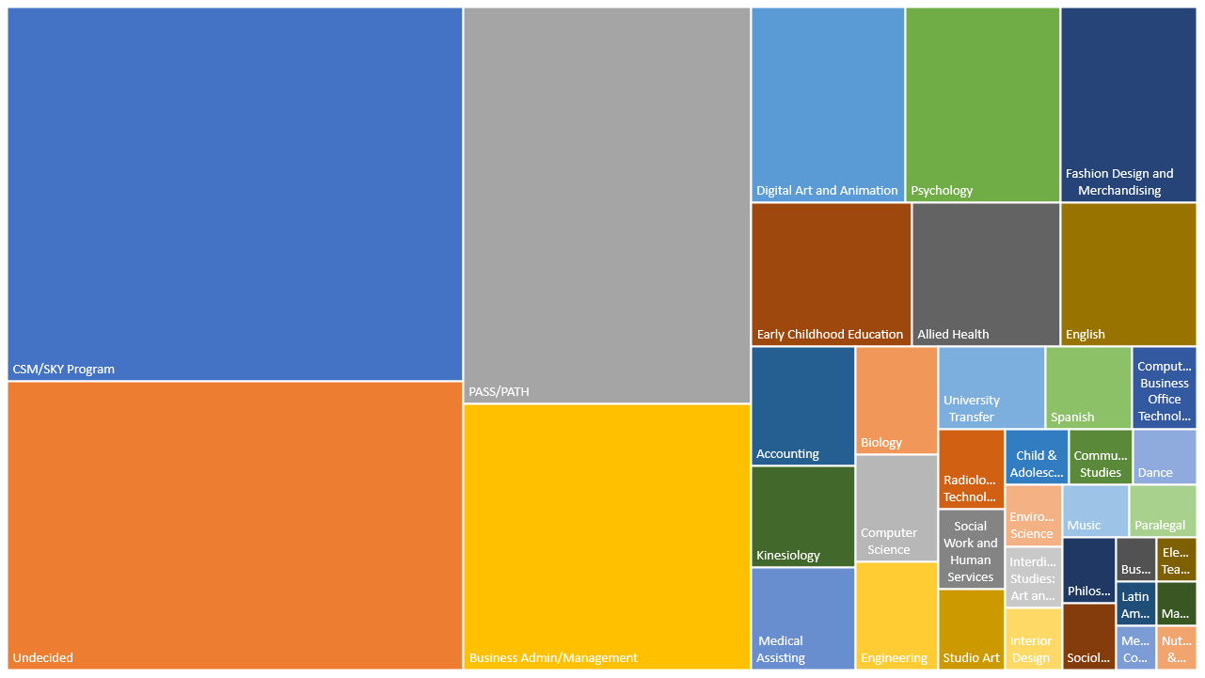
Notes:
Evening Students by Major (F23) – unique headcounts
Major # of students CSM/SKY Program 96 Undecided 74 PASS/PATH 64 Business Admin/Management 44 Digital Art and Animation 17 Psychology 17 Fashion Design and Merchandising 15 Early Childhood Education 13 Allied Health 12 English 11 Accounting 7 Kinesiology 6 Medical Assisting 6 Biology 5 Computer Science 5 Engineering 5 University Transfer 5 Spanish 4 Computer Business Office Technology 3 Radiologic Technology 3 Social Work and Human Services 3 Studio Art 3 Child & Adolescent Development 2 Communication Studies 2 Dance 2 Environmental Science 2 Interdisciplinary Studies: Art and Humanities 2 Interior Design 2 Music 2 Paralegal 2 Philosophy 2 Sociology 2 Elementary Teacher Education 1 Latin American and Latino/a Studies 1 Mathematics 1 Medical Coding Specialist 1 Nutrition & Dietetics 1

Slide 9
Major | Blg 1 | Bldg 3 | Bldg5 | Bldg 9 | Bldg 13 | Bldg 18 | Bldg 22 | Bldg 23 | Total
CSM/SKY Program | 17 | 28 |  | 1 | 18 | 6 | 4 | 25 | 99
Undecided | 17 | 29 |  | 2 | 17 |  | 8 | 8 | 81
Business Admin/Management |  | 3 | 1 | 3 | 42 | 1 | 2 | 3 | 55
PASS/PATH | 2 |  |  | 3 | 48 |  |  |  | 53
Digital Art and Animation | 1 | 4 | 1 | 2 | 4 |  | 7 |  | 19
Fashion Design and Merchandising | 2 | 14 |  | 1 | 1 |  |  |  | 18
Psychology | 1 | 9 |  |  | 4 |  | 1 | 2 | 17
Early Childhood Education |  | 1 |  |  | 11 |  | 2 | 2 | 16
Allied Health |  | 1 |  |  | 5 | 5 |  | 2 | 13
English |  | 2 |  |  | 11 |  |  |  | 13
Accounting |  |  |  |  | 10 |  |  |  | 10
Medical Assisting |  |  | 1 | 1 | 7 |  |  |  | 9
University Transfer |  | 1 |  |  | 5 |  |  | 1 | 7
Biology | 1 |  |  | 1 | 3 |  |  | 1 | 6
Engineering | 4 |  |  |  | 2 |  |  |  | 6
Kinesiology | 2 |  |  | 1 |  | 3 |  |  | 6
Computer Science |  | 4 |  |  | 1 |  |  |  | 5
Social Work and Human Services |  | 1 |  |  | 3 |  |  |  | 4
Spanish | 1 | 2 |  |  | 1 |  |  |  | 4
Studio Art | 2 |  |  |  | 2 |  |  |  | 4
Computer Business Office Technology |  |  |  |  | 3 |  |  |  | 3
Interdisciplinary Studies: Art and Humanities |  | 1 |  |  | 2 |  |  |  | 3
Interior Design |  |  |  |  | 3 |  |  |  | 3
Radiologic Technology | 1 |  |  |  |  | 2 |  |  | 3
Child & Adolescent Development |  | 1 |  |  |  |  | 1 |  | 2
Communication Studies | 1 |  |  |  |  |  | 1 |  | 2
Dance | 2 |  |  |  |  |  |  |  | 2
Environmental Science |  |  |  |  | 2 |  |  |  | 2
Music |  | 2 |  |  |  |  |  |  | 2
Paralegal |  |  |  |  | 2 |  |  |  | 2
Philosophy |  |  |  |  | 2 |  |  |  | 2
Sociology |  | 1 |  |  | 1 |  |  |  | 2
Business |  |  |  | 1 |  |  |  |  | 1
Elementary Teacher Education |  |  |  |  | 1 |  |  |  | 1
Latin American and Latino/a Studies |  | 1 |  |  |  |  |  |  | 1
Mathematics | 1 |  |  |  |  |  |  |  | 1
Medical Coding Specialist |  |  |  |  | 1 |  |  |  | 1
Nutrition & Dietetics | 1 |  |  |  |  |  |  |  | 1
Grand Total | 56 | 105 | 3 | 16 | 212 | 17 | 26 | 44
Evening Students by Major by Building

Slide 10
Cohort | Building 1 | Building 3 | Building 5 | Building 9 | Building 13 | Building 18 | Building 22 | Building 23 | Grand Total
(blank) | 41 | 73 |  | 14 | 162 | 10 | 21 | 33 | 354
A2B Transfer Pathway Students |  |  |  |  |  | 1 |  |  | 1
ADULT EDUCATION - CAN | 1 |  |  |  | 3 | 1 |  |  | 5
ADULT EDUCATION - CSM | 2 |  |  |  | 2 |  |  |  | 4
ADULT EDUCATION - SKY |  |  |  |  | 2 |  |  |  | 2
Automotive |  | 1 |  |  |  |  |  |  | 1
Basic Skills English - SKY |  |  |  |  |  |  | 2 |  | 2
Brother's Empowering Broth-CSM |  | 1 |  |  | 2 |  |  |  | 3
CIPHER |  |  |  |  |  |  |  | 1 | 1
College for Working Adults-CAN | 1 | 6 |  |  | 8 |  |  | 1 | 16
Comm. Learning thru Sport- CAN | 1 |  |  |  | 1 |  |  |  | 2
Cosmetology |  |  |  |  | 1 |  |  | 1 | 2
CSM International Students |  |  |  |  | 5 |  |  | 1 | 6
Dual Enrollment - CAN |  | 2 |  |  |  |  |  |  | 2
Dual Enrollment - CSM | 1 |  |  | 1 |  |  |  |  | 2
Dual Enrollment - SKY |  | 3 |  |  | 3 |  | 1 | 1 | 8
EOPS - CAN | 3 |  |  |  | 10 | 2 | 2 | 2 | 19
EOPS - CSM |  | 1 |  |  | 2 |  | 1 |  | 4
ESO Adelante - Canada |  |  |  |  |  |  |  | 1 | 1
GOAL - Canada |  |  |  |  | 1 |  |  |  | 1
Kababayan |  |  |  |  | 1 |  |  |  | 1
Massage Therapy |  |  |  |  |  |  |  | 1 | 1
MIDDLE COLLEGE - CAN |  | 12 |  |  | 1 |  |  |  | 13
Part-Time Promise Scholars-CAN |  | 1 | 1 |  | 5 |  |  |  | 7
Promise Scholars - CAN | 6 | 12 | 3 | 1 | 17 | 1 | 2 | 4 | 46
Promise Scholars - CSM | 2 | 2 |  |  | 1 | 2 | 1 | 1 | 9
Promise Scholars - SKY | 1 | 1 |  |  | 1 |  |  |  | 3
Puente - CAN | 1 | 3 |  |  | 2 | 1 |  | 1 | 8
Puente - CSM |  | 1 |  |  |  |  |  | 1 | 2
San Mateo Adult School - CAN |  |  |  |  |  |  |  |  | 0
San Mateo Adult School - CSM | 2 |  |  |  | 1 |  |  |  | 3
Sequoia Adult School - CAN |  |  |  |  | 2 | 2 |  |  | 4
STEM Academy - CAN |  |  |  |  |  |  |  | 1 | 1
Student Athlete - CSM |  |  |  |  |  | 1 |  | 1 | 2
Study Abroad | 3 | 2 |  |  | 1 |  | 1 |  | 7
Umoja |  |  |  |  | 3 |  |  |  | 3
Umoja - CAN | 1 |  |  |  | 4 |  |  | 2 | 7
Women's Voices in Action - CSM |  |  |  |  |  |  |  | 1 | 1
Grand Total | 66 | 121 | 4 | 16 | 241 | 21 | 31 | 54 | 554

