Slide 1
Making Informed Choices
By Reading Food Labels

Slide 2
Objectives
At the completion of this session, the student will be able to:
Access MyPLate.gov and customize a diet plan.
List the calorie content for each gram of Fat, Carb, or Protein.
List the major sections on a Nutrition Label.
Calculate the percentage of fat calories in each serving.
Identify the amount of added sugar in a product.
Identify hidden sugars in the list of ingredients.

Slide 3
We will be covering:
THE BASIC COMPONENTS OF A HEALTHY DIET
CONFUSING FOOD LABELS
NUTRITION LABELS
INGREDIENTS LIST

Slide 4
WHAT IS A HEALTHY DIET?
This Photo by Unknown Author is licensed under CC BY-NC

Slide 5
A HEALTHY DIET INCLUDES: Fats: 20-30% of Calories Carbohydrates: 45-65% of Calories Protein: 15-30% of Calories

Slide 6
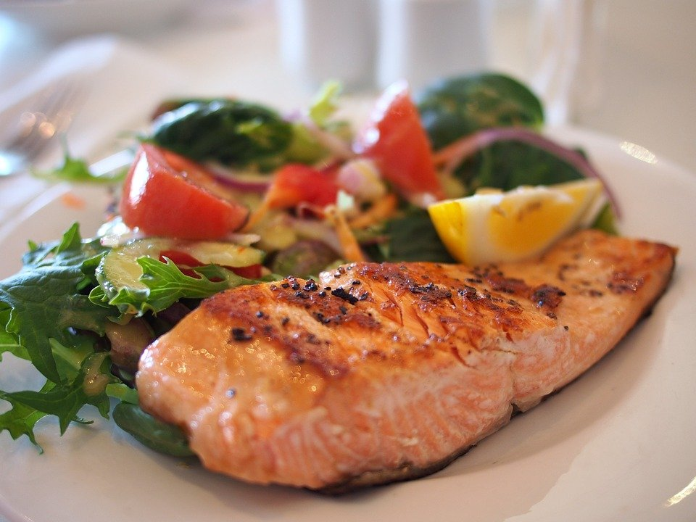
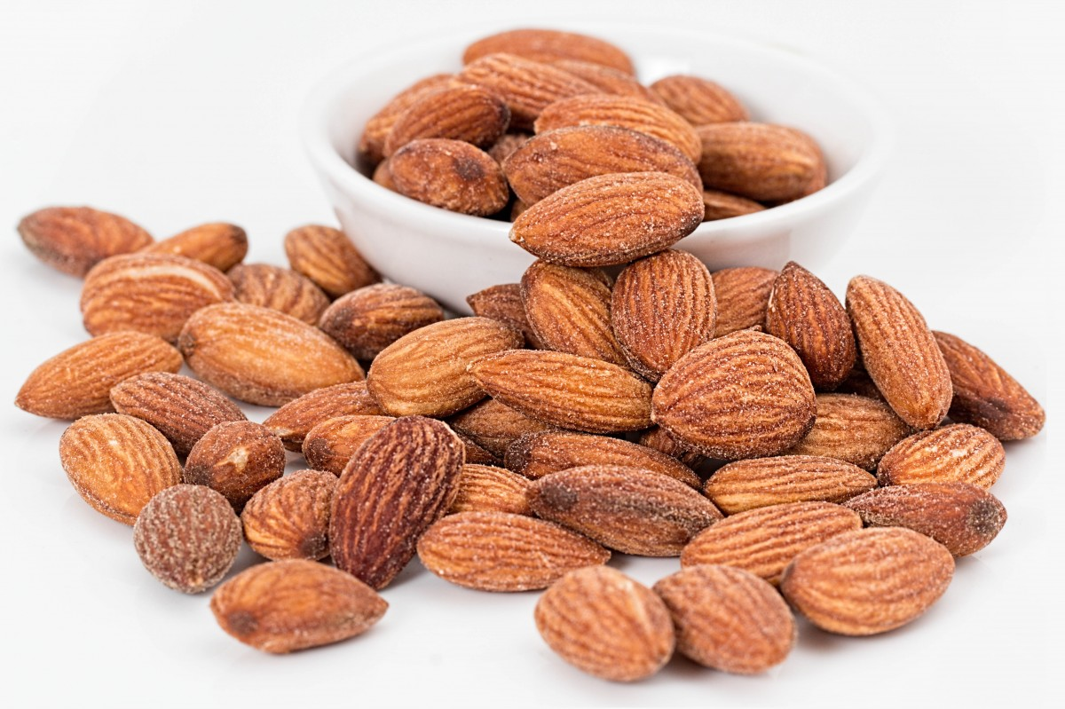
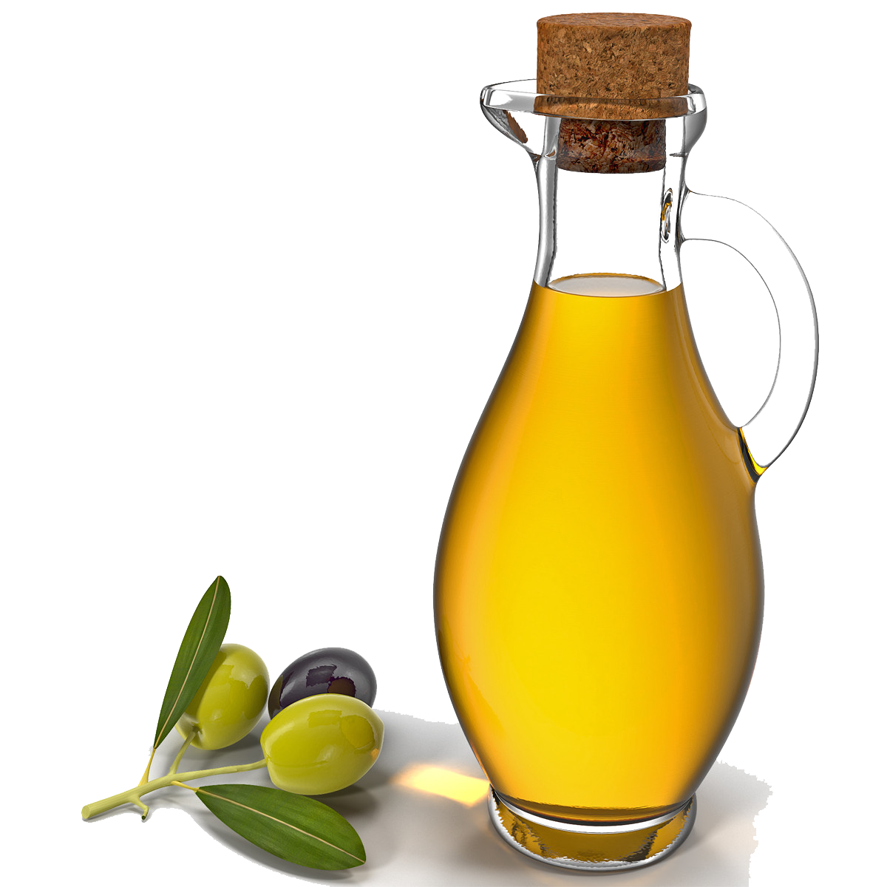
FATS
GOOD FATS:
UNSATURATED FATS: Polyunsaturated or Monounsaturated
SOURCES:
NUTS, VEGETABLE OILS, FATTY FISHES
This Photo by Unknown Author is licensed under CC BY-NC

Slide 7
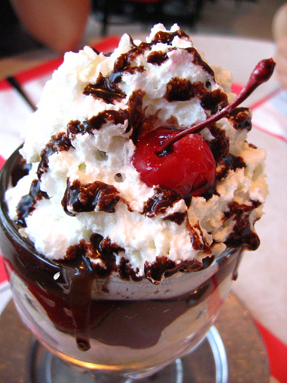
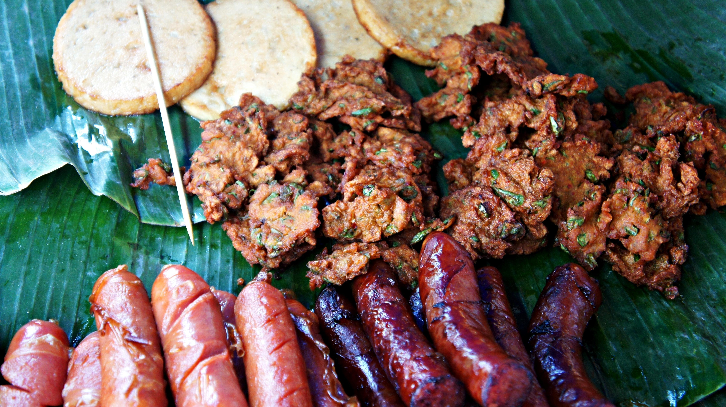
BAD FATS (limit to 10%)
SATURATED FATS
TRANS FATS
This Photo by Unknown Author is licensed under CC BY-NC-ND

Slide 8
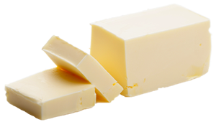
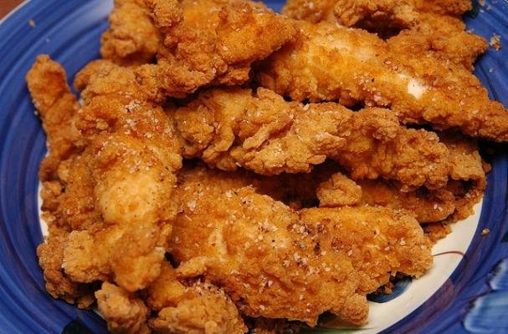
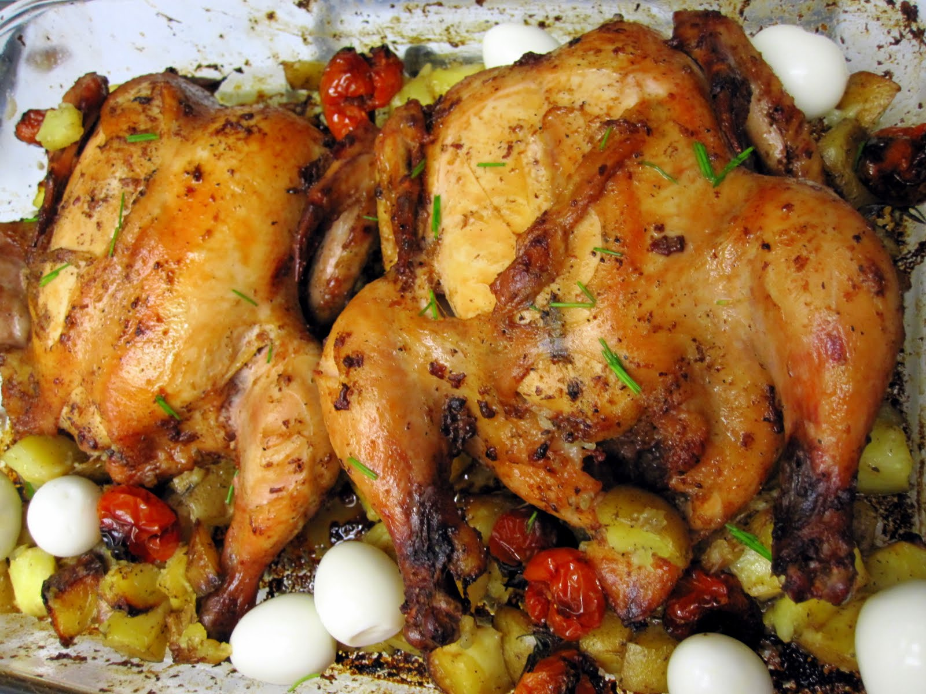
HEALTHY CHOICES
INSTEAD OF: CHOOSE:
This Photo by Unknown Author is licensed under CC BY-NC
This Photo by Unknown Author is licensed under CC BY-NC
This Photo by Unknown Author is licensed under CC BY
This Photo by Unknown Author is licensed under CC BY-SA-NC

Slide 9
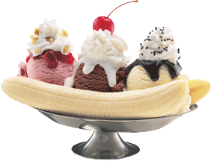
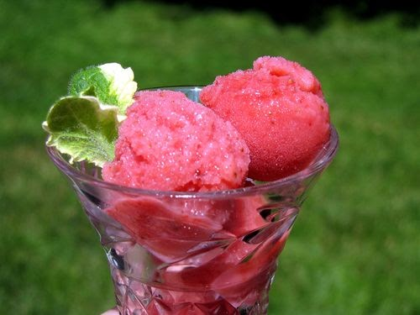
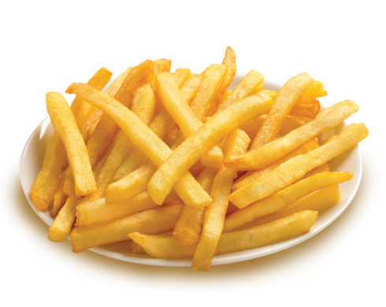
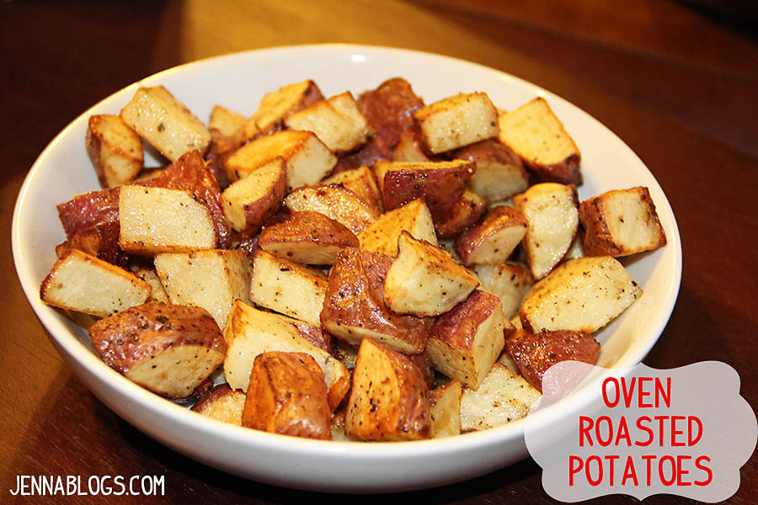
HEALTHY CHOICES
INSTEAD OF: CHOOSE:
This Photo by Unknown Author is licensed under CC BY-NC
This Photo by Unknown Author is licensed under CC BY
This Photo by Unknown Author is licensed under CC BY-NC-ND
This Photo by Unknown Author is licensed under CC BY-SA

Slide 10
CARBOHYDRATES
MAIN SOURCE OF ENERGY
45-65% of Calories
Provides needed fiber
Most Carbs are broken down into Glucose and used as energy. Excess carbs are stored as fat.

Slide 11
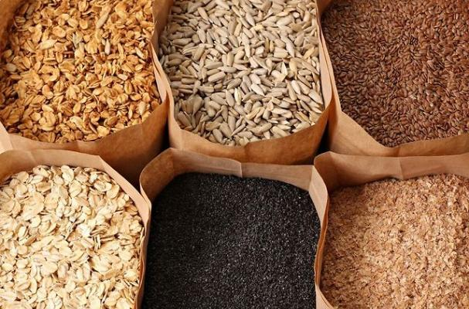
Three Main Types of Carbs:
Starches
Sugars
Fiber
Good Carbs:
Are naturally found in whole foods.
Are unprocessed
These provide needed fiber, stabilize blood sugar
And provide greater satiety.
Examples:
Vegetables
Quinoa
Barley
Legumes
Potatoes
Whole grain
This Photo by Unknown Author is licensed under CC BY

Slide 12
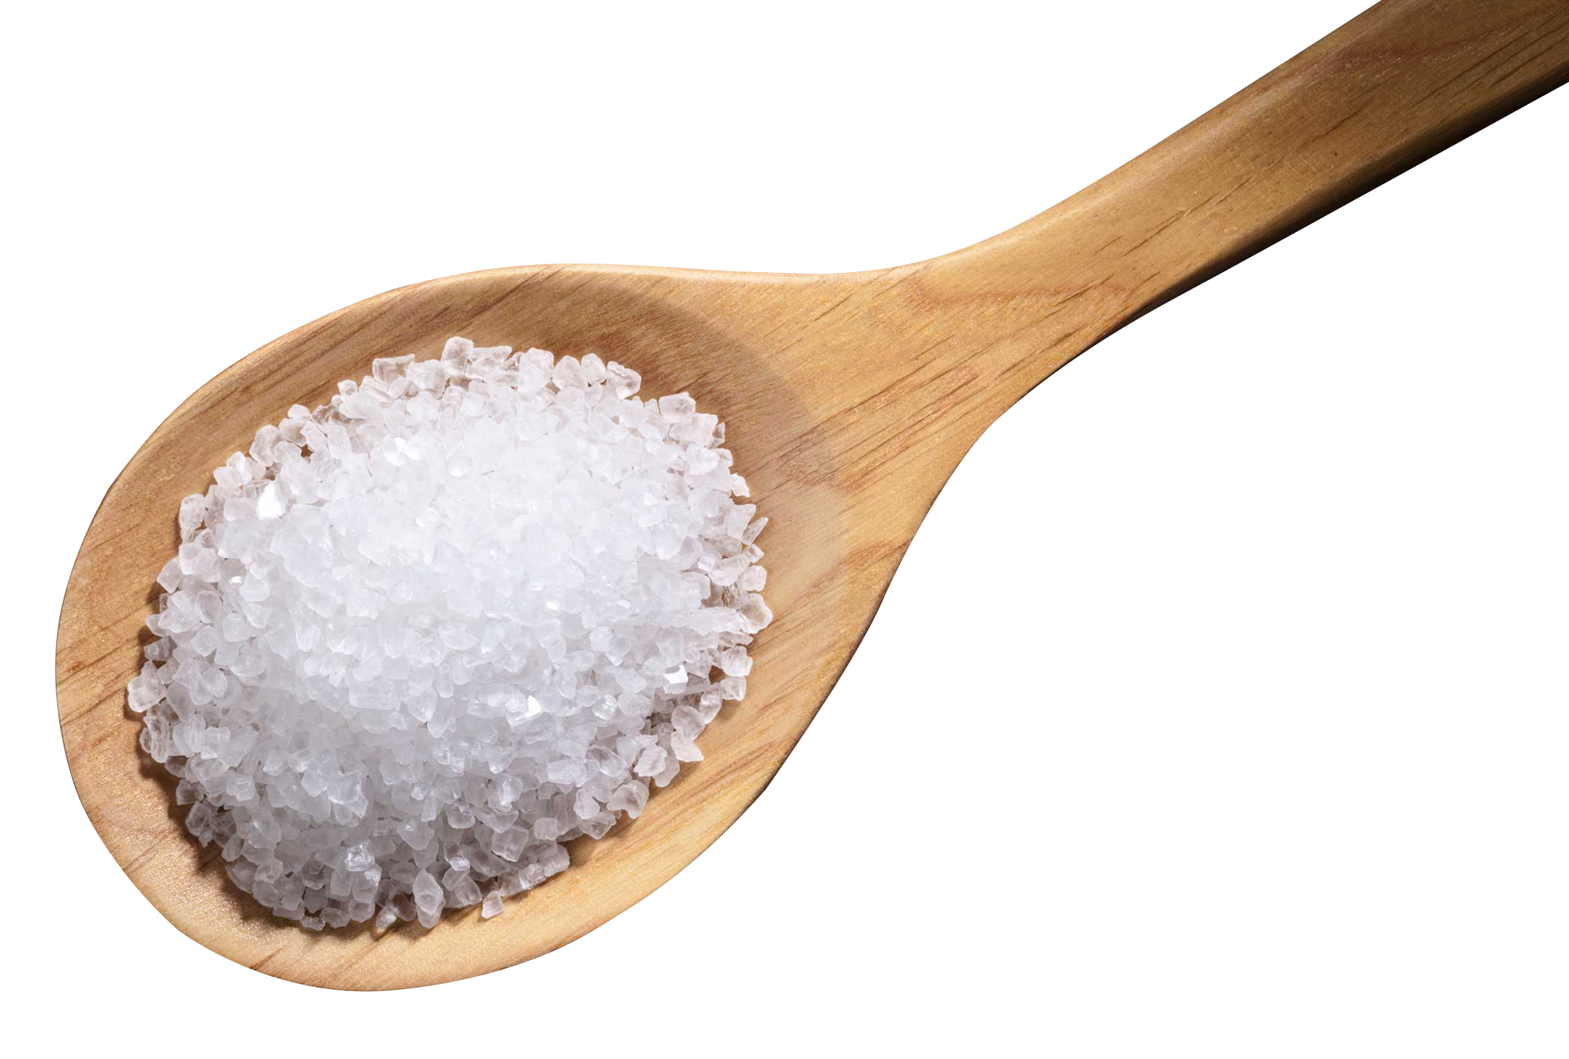
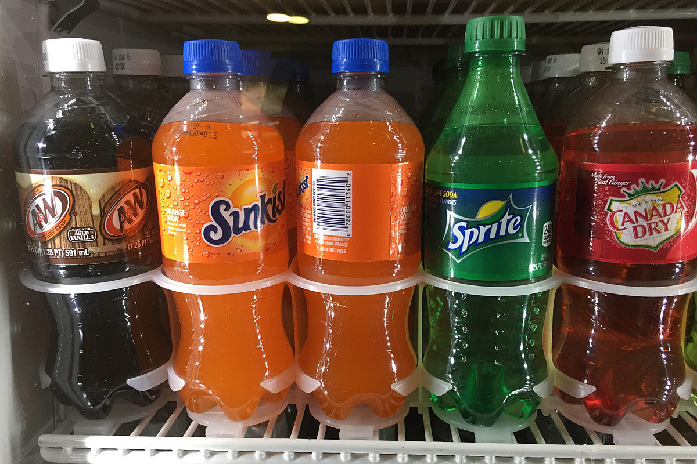
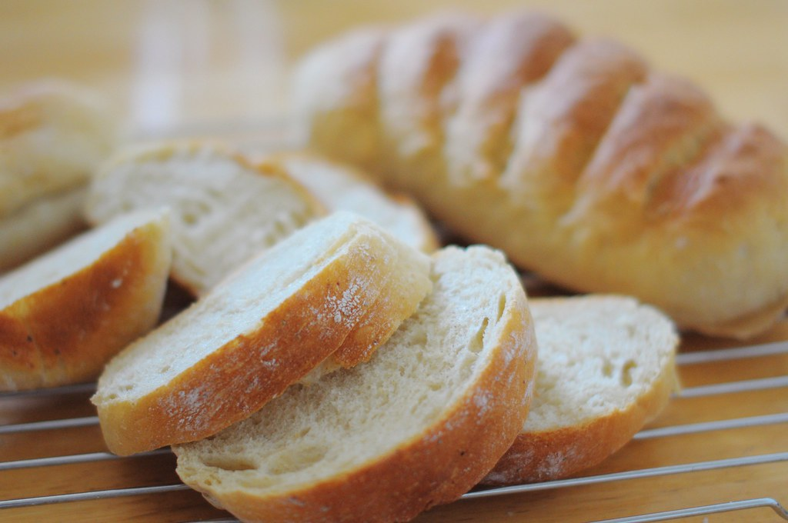
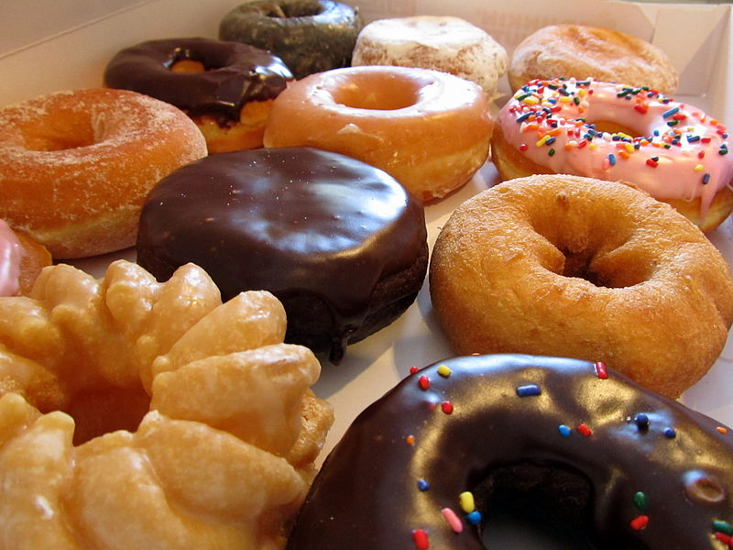
“Bad” or Empty Carbs:
Highly processed
Have much of the fiber removed
Are added sugars
Examples:
White bread or white rice
Doughnuts, cakes, pies
Sweetened drinks
Alcohol
This Photo by Unknown Author is licensed under CC BY-NC-ND
This Photo by Unknown Author is licensed under CC BY-NC
This Photo by Unknown Author is licensed under CC BY-SA
This Photo by Unknown Author is licensed under CC BY-ND

Slide 13
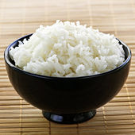
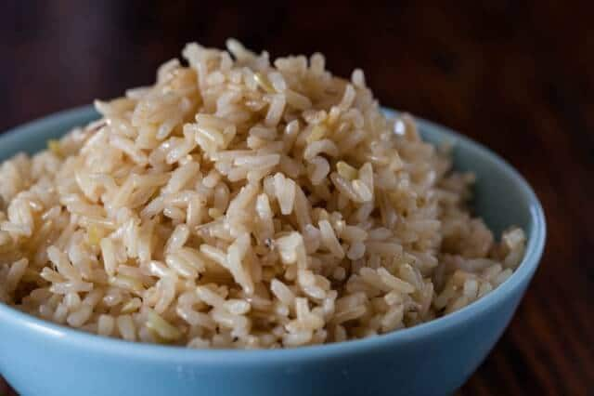
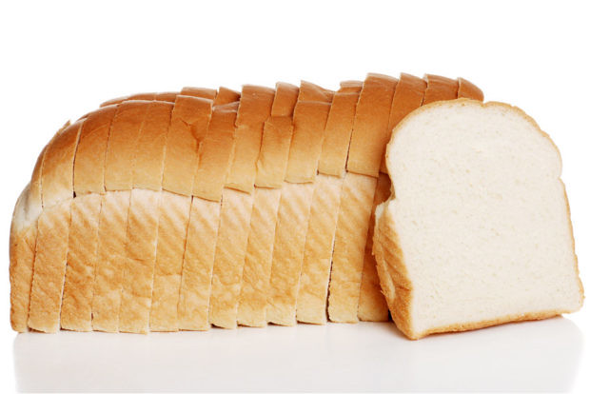
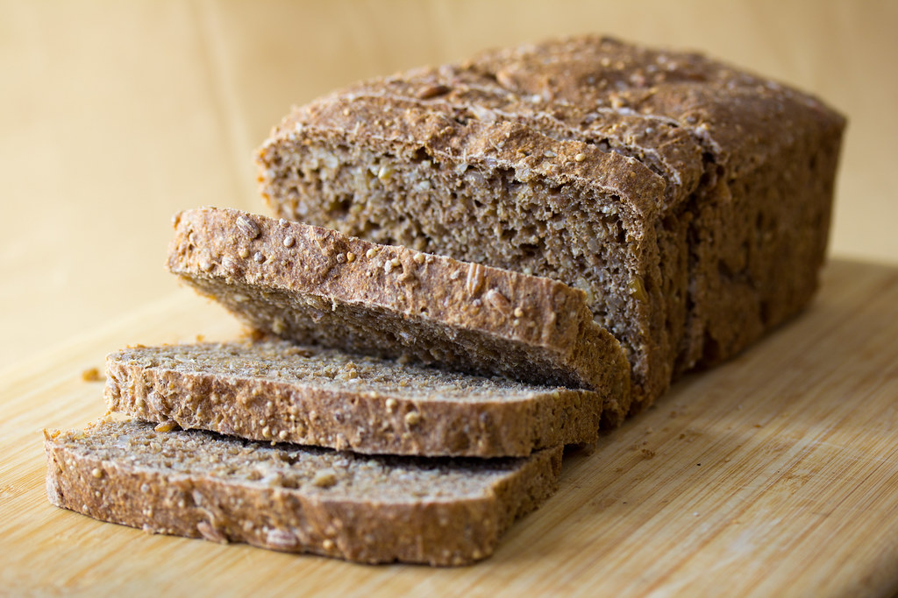
HEALTHY CHOICES
WHITE PRODUCTS BROWN/WHOLE GRAIN PRODUCTS
This Photo by Unknown Author is licensed under CC BY
This Photo by Unknown Author is licensed under CC BY-SA-NC
This Photo by Unknown Author is licensed under CC BY-SA
This Photo by Unknown Author is licensed under CC BY-SA

Slide 14
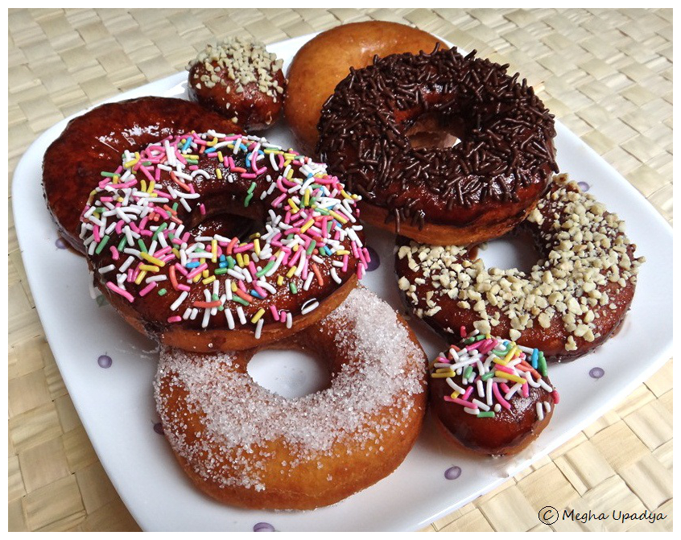
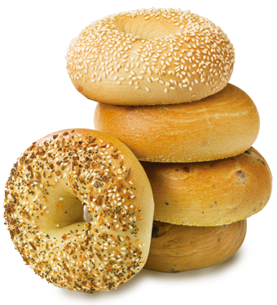
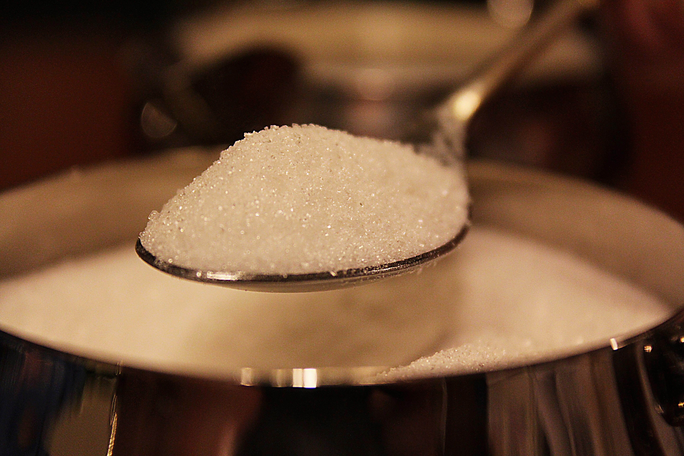
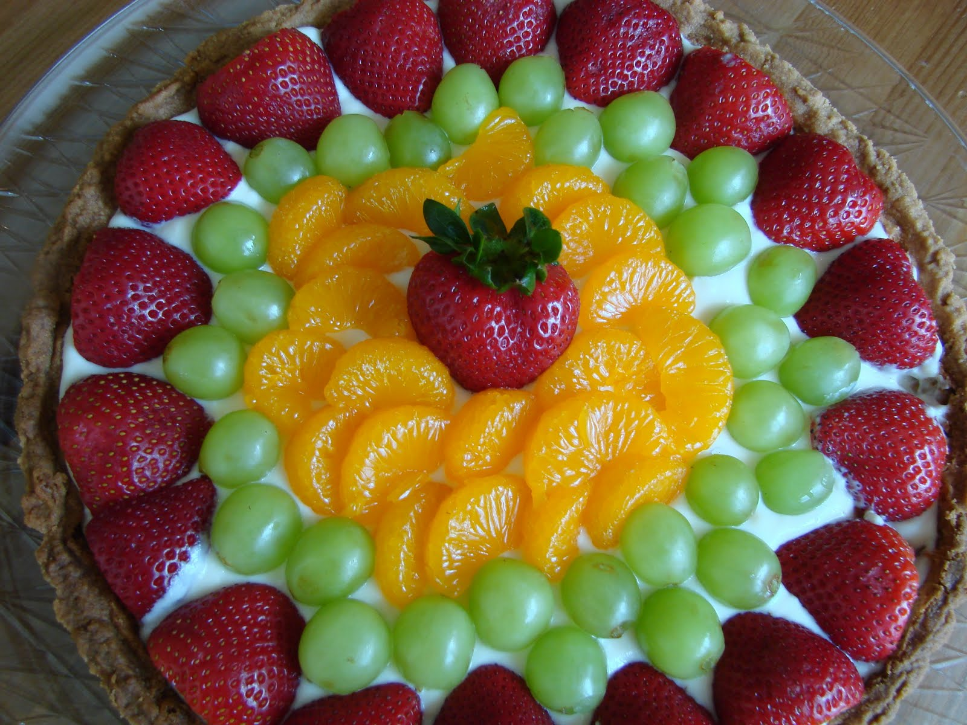
HIGH FAT
HEALTHY CHOICES
LOW FAT
NATURAL SUGARS
ADDED SUGARS
This Photo by Unknown Author is licensed under CC BY-NC
This Photo by Unknown Author is licensed under CC BY-NC-ND
This Photo by Unknown Author is licensed under CC BY-NC-ND

Slide 15
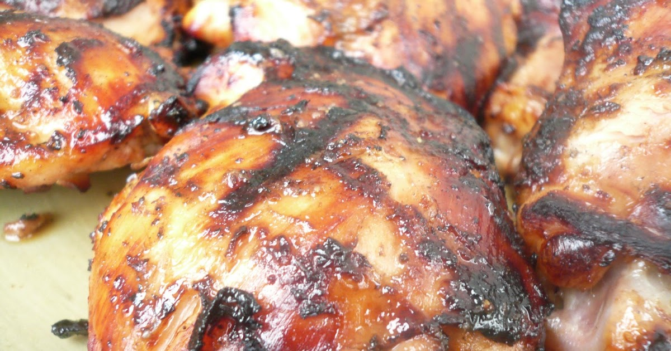
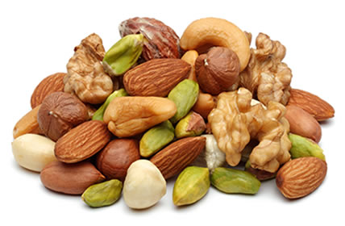
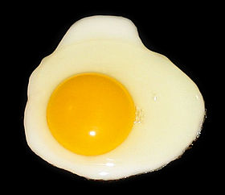
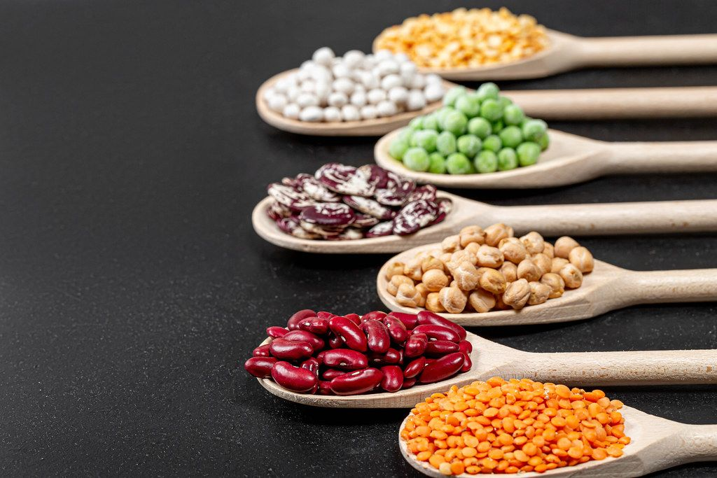
PROTEINS
BUILD MUSCLE AND COLLAGEN
MININUM OF 10% TOTAL CALORIES
This Photo by Unknown Author is licensed under CC BY-SA
This Photo by Unknown Author is licensed under CC BY
This Photo by Unknown Author is licensed under CC BY
This Photo by Unknown Author is licensed under CC BY-SA

Slide 16
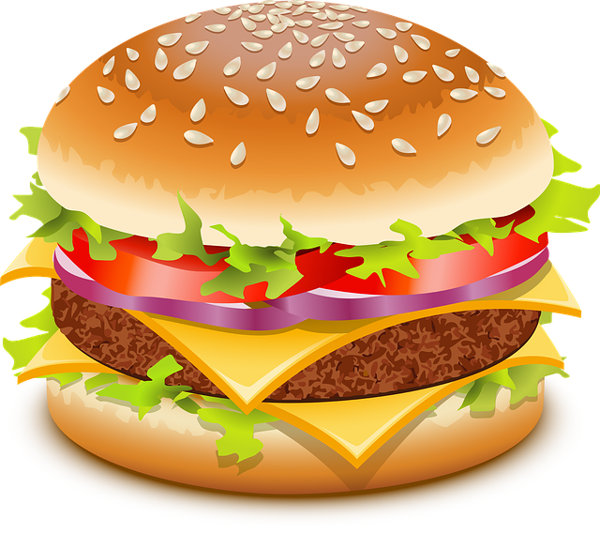
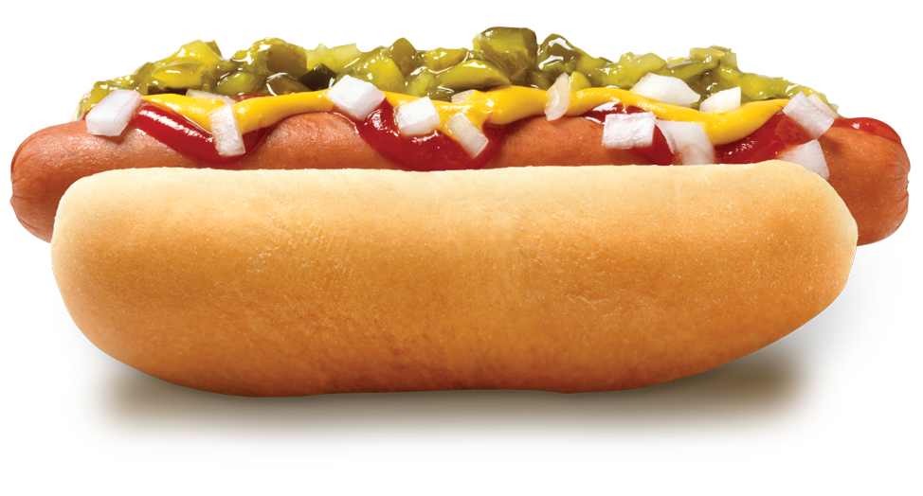
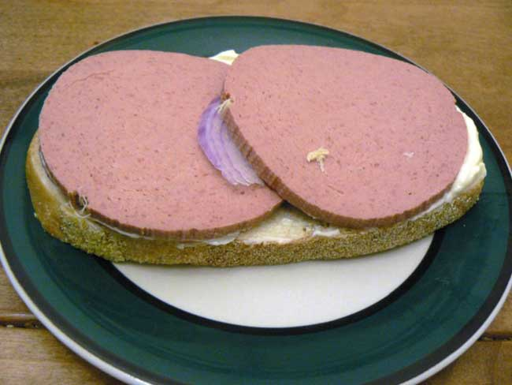
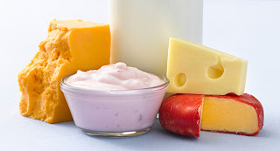
HIGHLY PROCESSED AND HIGH FAT PROTEINS
TO LIMIT
This Photo by Unknown Author is licensed under CC BY-NC
This Photo by Unknown Author is licensed under CC BY-SA
This Photo by Unknown Author is licensed under CC BY-NC-ND

Slide 17
Important Points:
EAT FOODS LOW IN FAT
EAT WHOLE GRAIN CARBS
CHOOSE LEAN PROTEINS
CHOOSE LOW FAT DAIRY PRODUCTS
EAT A VARIETY OF FRESH FRUITS AND VEGETABLES
AVOID PROCESSED FOODS

Slide 18
MISLEADING LABELS
WHAT DO THEY MEAN?
FAT FREE
LOW FAT
ZERO TRANS FAT
LIGHT
MULTIGRAIN
NO SUGAR ADDED
SUGAR FREE
REDUCED FAT
UNSWEETENED

Slide 19
LABELING OF FAT CONTENT
FAT FREE: Contains less than 0.5 grams of fat/serving
LOOK FOR HIDDEN SUGARS
REDUCED FAT: Contains 25% less fat than the regular version
LOW FAT: Contain 3 grams of fat or less/serving
LIGHT: Must have 1/3 fewer Calories OR 50% less fat/serving
WHEN FAT IS REMOVED, FLAVOR IS REDUCED. THEREFORE MOST OF THESE PRODUCTS CONTAIN ADDED SUGARS.

Slide 20
SUGARS
Natural Sugars:
Found in fruit and some vegetables: Fructose, Glucose, Sucrose
Found in milk: Lactose
Found in germinating grains: Maltose
ADDED SUGARS:
Honey,
Molasses,
Corn Syrup,
Rice Syrup,
Barley Malt,
Cane Juice
AND OTHERS
Sugar Alcohols: Man made sweeteners
Erythritol
Maltitol
Mannitol
Sorbitol
Xylitol
Isomalt
Hydrogenated Starch Hydrolysates

Slide 21
MEANING OF SUGAR LABELS
MISLEADING
SUGAR FREE: Contains less than 0.5 gm sugar/serving
Not completely sugar free
and
It can still contain artificial sweeteners and/or sugar alcohols
NO SUGAR ADDED: Contains natural sugars, or sugar alcohols.
BEST CHOICE
UNSWEETENED: There are no added sugars, no artificial sweeteners, no sugar alcohols.

Slide 22
NUTRITION LABELS

Slide 23
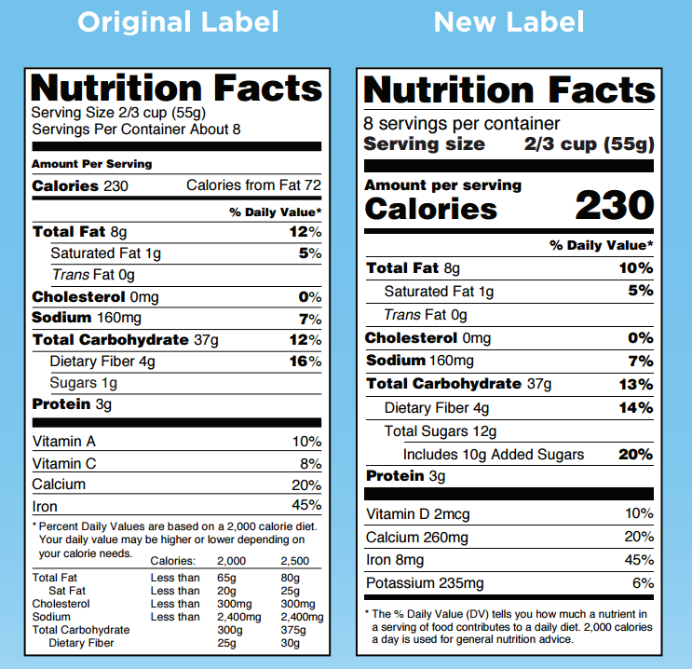
This Photo by Unknown Author is licensed under CC BY-NC-ND

Slide 25
SERVING SIZE

Slide 26
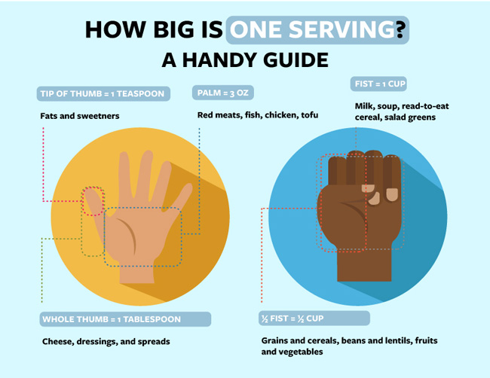

Slide 27
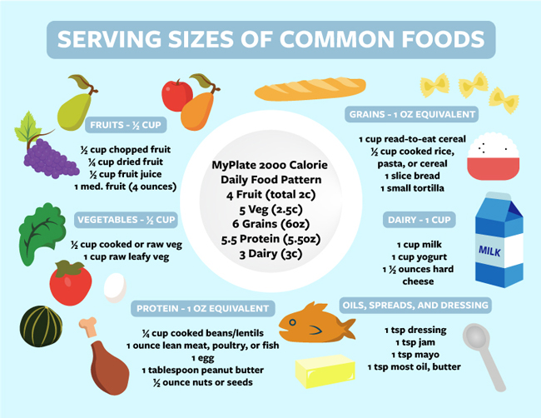

Slide 28
CALORIES
FATS: 9 Cal/gm
CARBS: 4 Cal/gm
PROTEIN: 4 Cal/gm

Slide 29
CALORIES
Serving size is 2/3 cup.
This box has 8 servings or 5.28 cups
Each serving has 230 Cal
1840 Cal in entire box

Slide 30
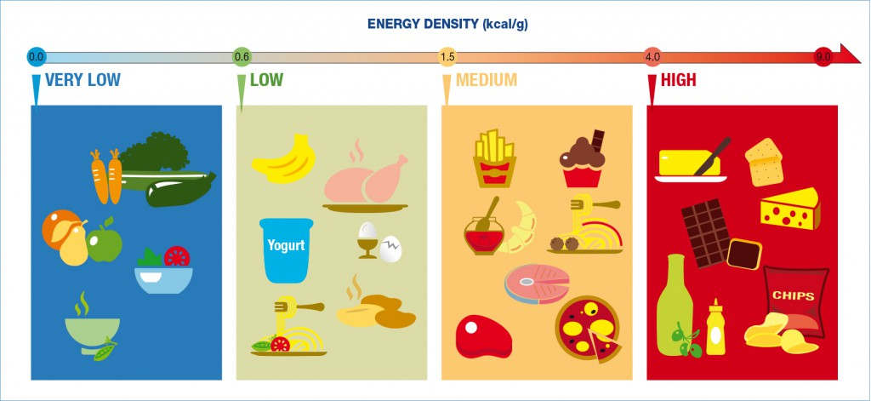

Slide 31
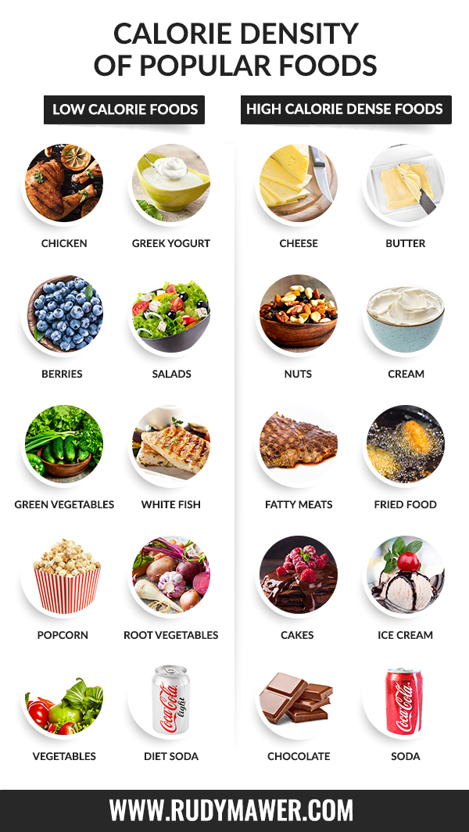

Slide 32
NUTRIENTS
1 gram of sugar =1/4 teaspoons
10 grams = 2.4 teaspoons/serving

Slide 33
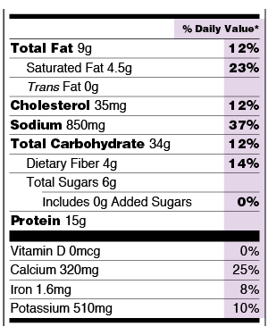
PERCENT OF DAILY VALUE
Based on 2,000 Calories/day
This Photo by Unknown Author is licensed under CC BY-SA-NC

Slide 34
% OF DAILY VALUE
Based on 2000 Calorie/day diet
General rules:
5% or less is considered LOW. Look for 5% or less of saturated fat, trans fat, cholesterol and sodium
20% or more is considered HIGH. Aim for high in vitamins, minerals and fiber

Slide 35
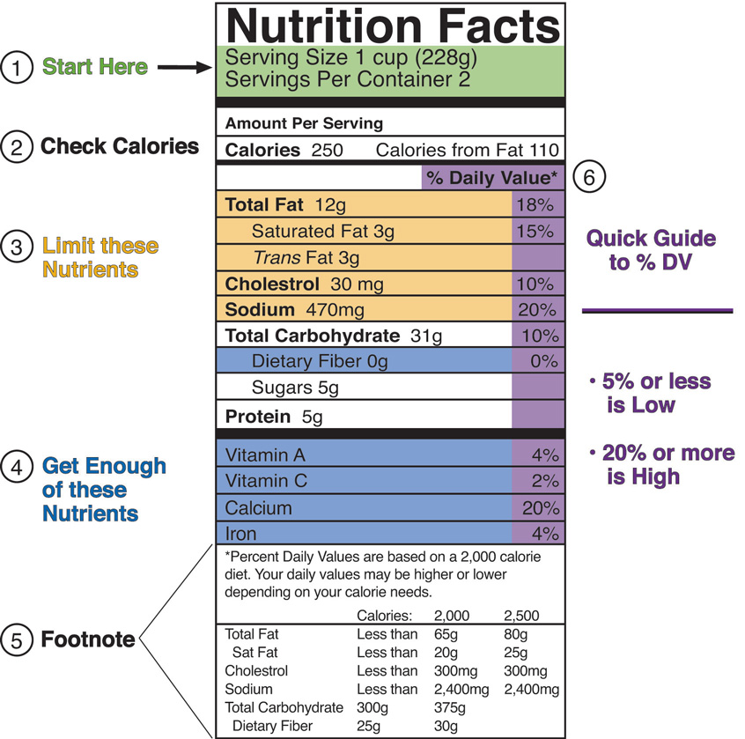
This Photo by Unknown Author is licensed under CC BY-SA-NC

Slide 36
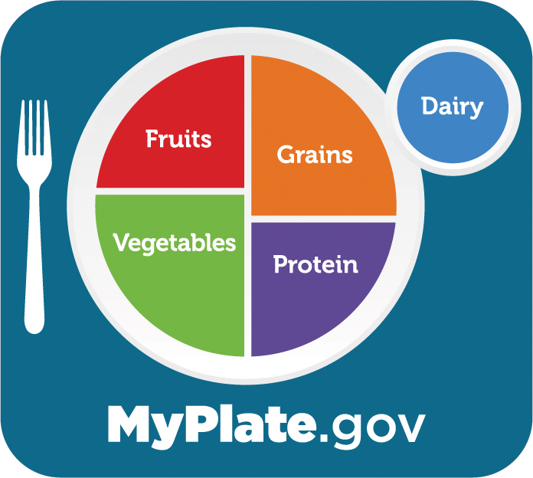
RECOMMENDED DAILY ALLOWANCE
www.MyPlate.gov

Slide 37
INGREDIENT LIST

Slide 38
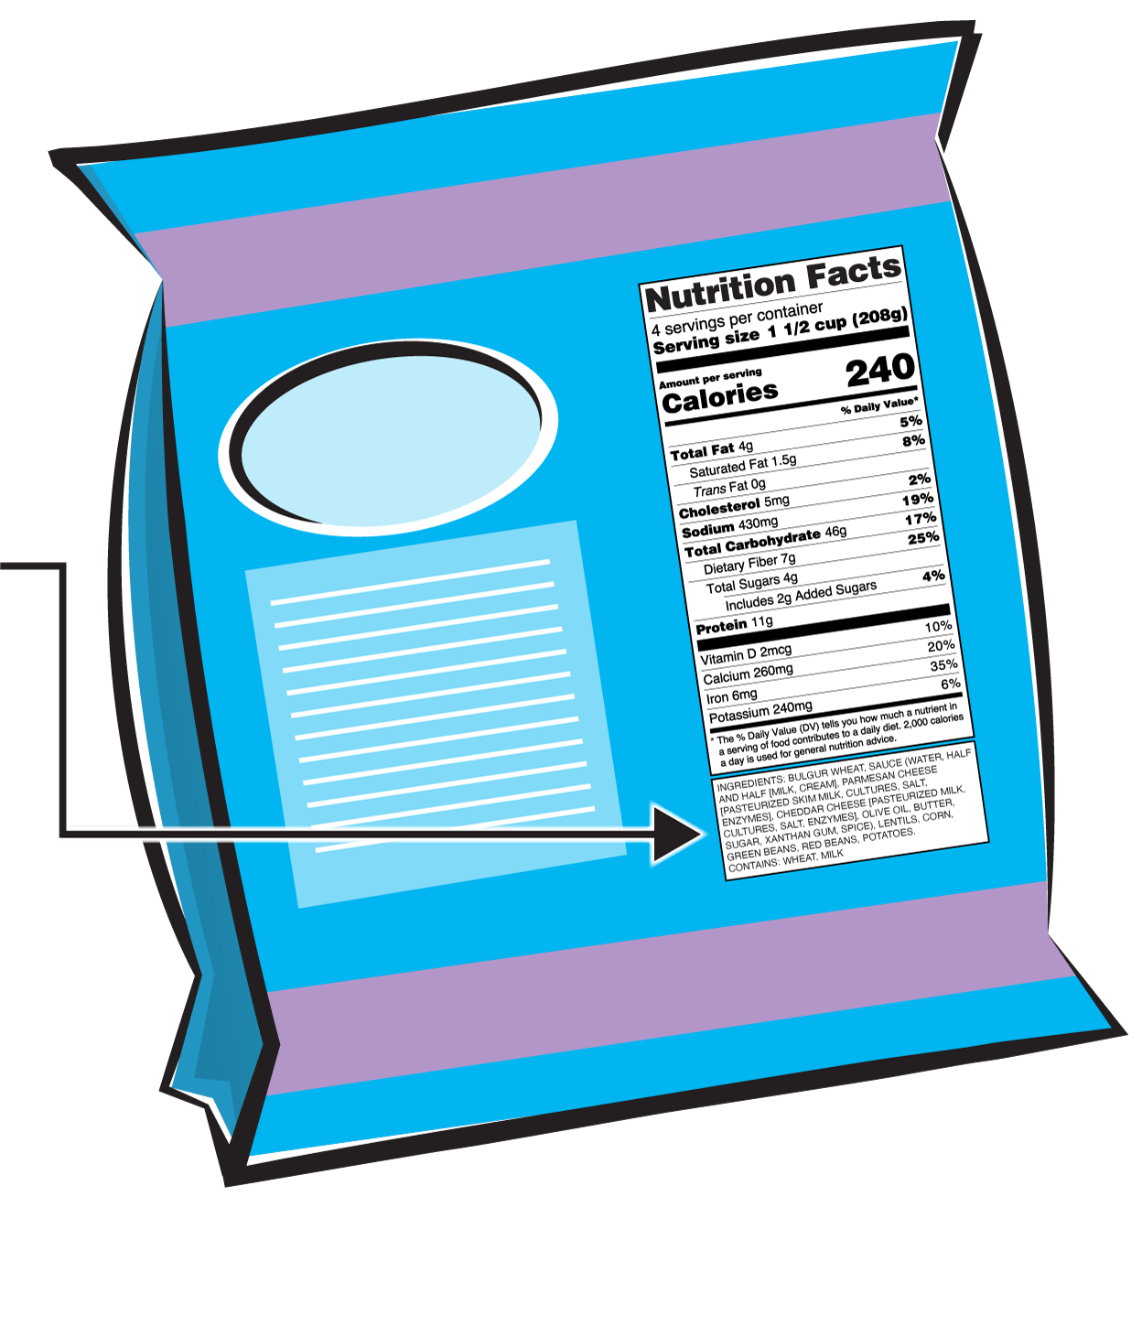
LIST OF INGREDIENTS
INGREDIENTS ARE LISTED BY WEIGHT.
THE FIRST INGREDIENT IS THE HIGHEST AMOUNT IN THE FOOD.
LOOK FOR HIDDEN SUGARS!

Slide 39
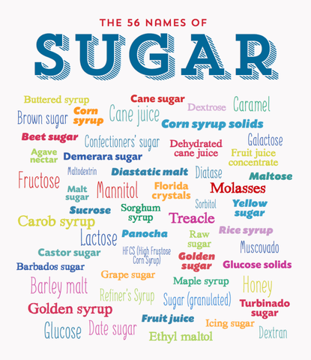

Slide 40
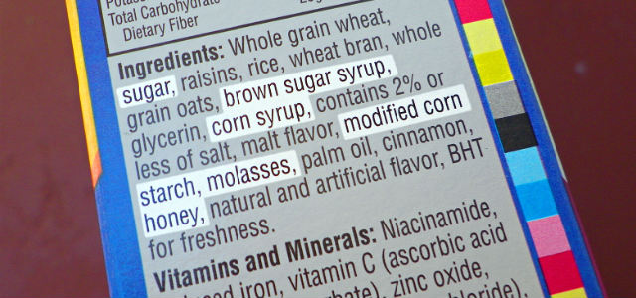
LIST OF INGREDIENTS
TAKEN FROM ANOTHER CEREAL BOX:
This Photo by Unknown Author is licensed under CC BY
wholegrain wheat, rolled oats, sultanas, sugar, triticale, dried apricots, wheat flour, fructose, palm oil, humectant [glycerol], dextrose, wheat fibre, food acid (citric acid), natural flavour, barley malt extract, salt, honey, mineral (iron), vitamins (niacin, riboflavin, folate, thiamin).

Slide 41
APPLICATION

Slide 42
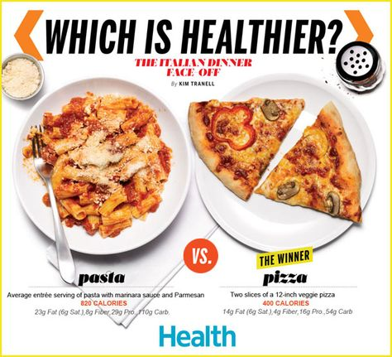

Slide 43
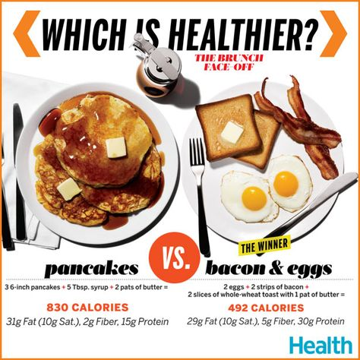

Slide 44
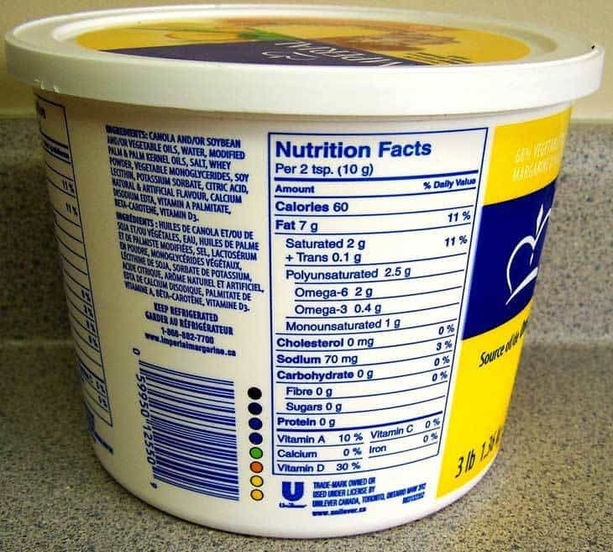
This Photo by Unknown Author is licensed under CC BY-SA

Slide 45
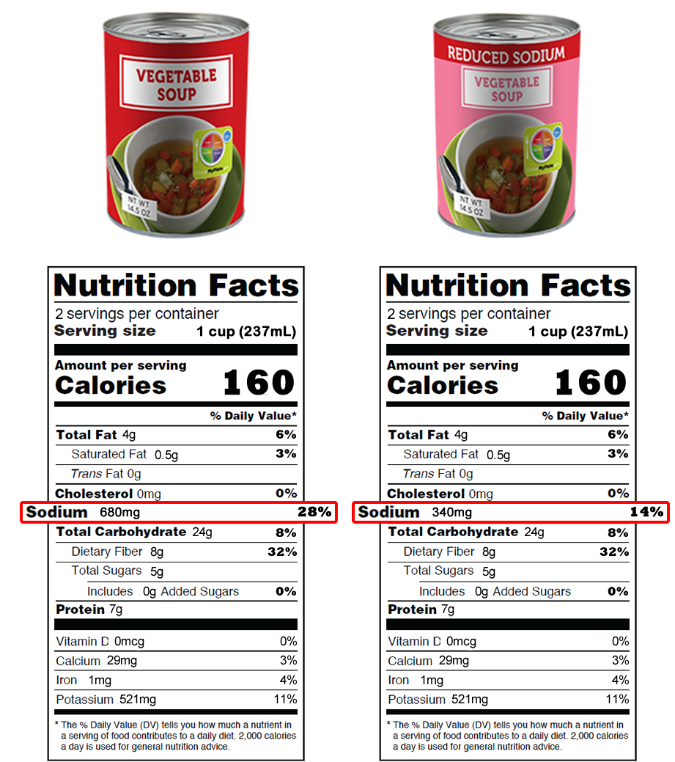
This Photo by Unknown Author is licensed under CC BY-SA-NC

Slide 46
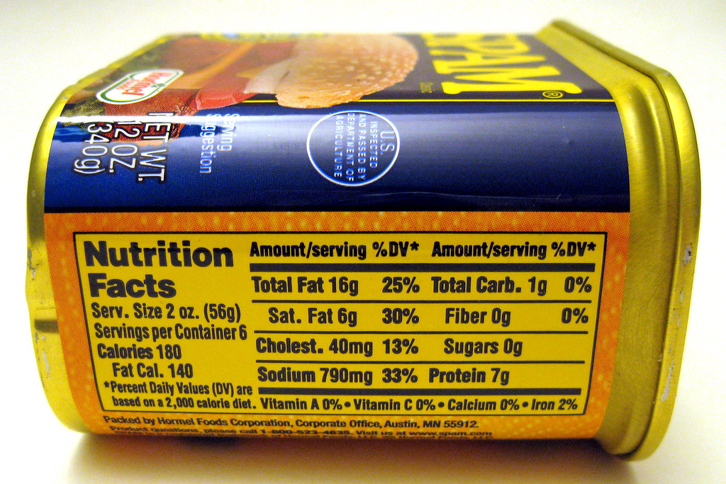
This Photo by Unknown Author is licensed under CC BY-SA

Slide 47
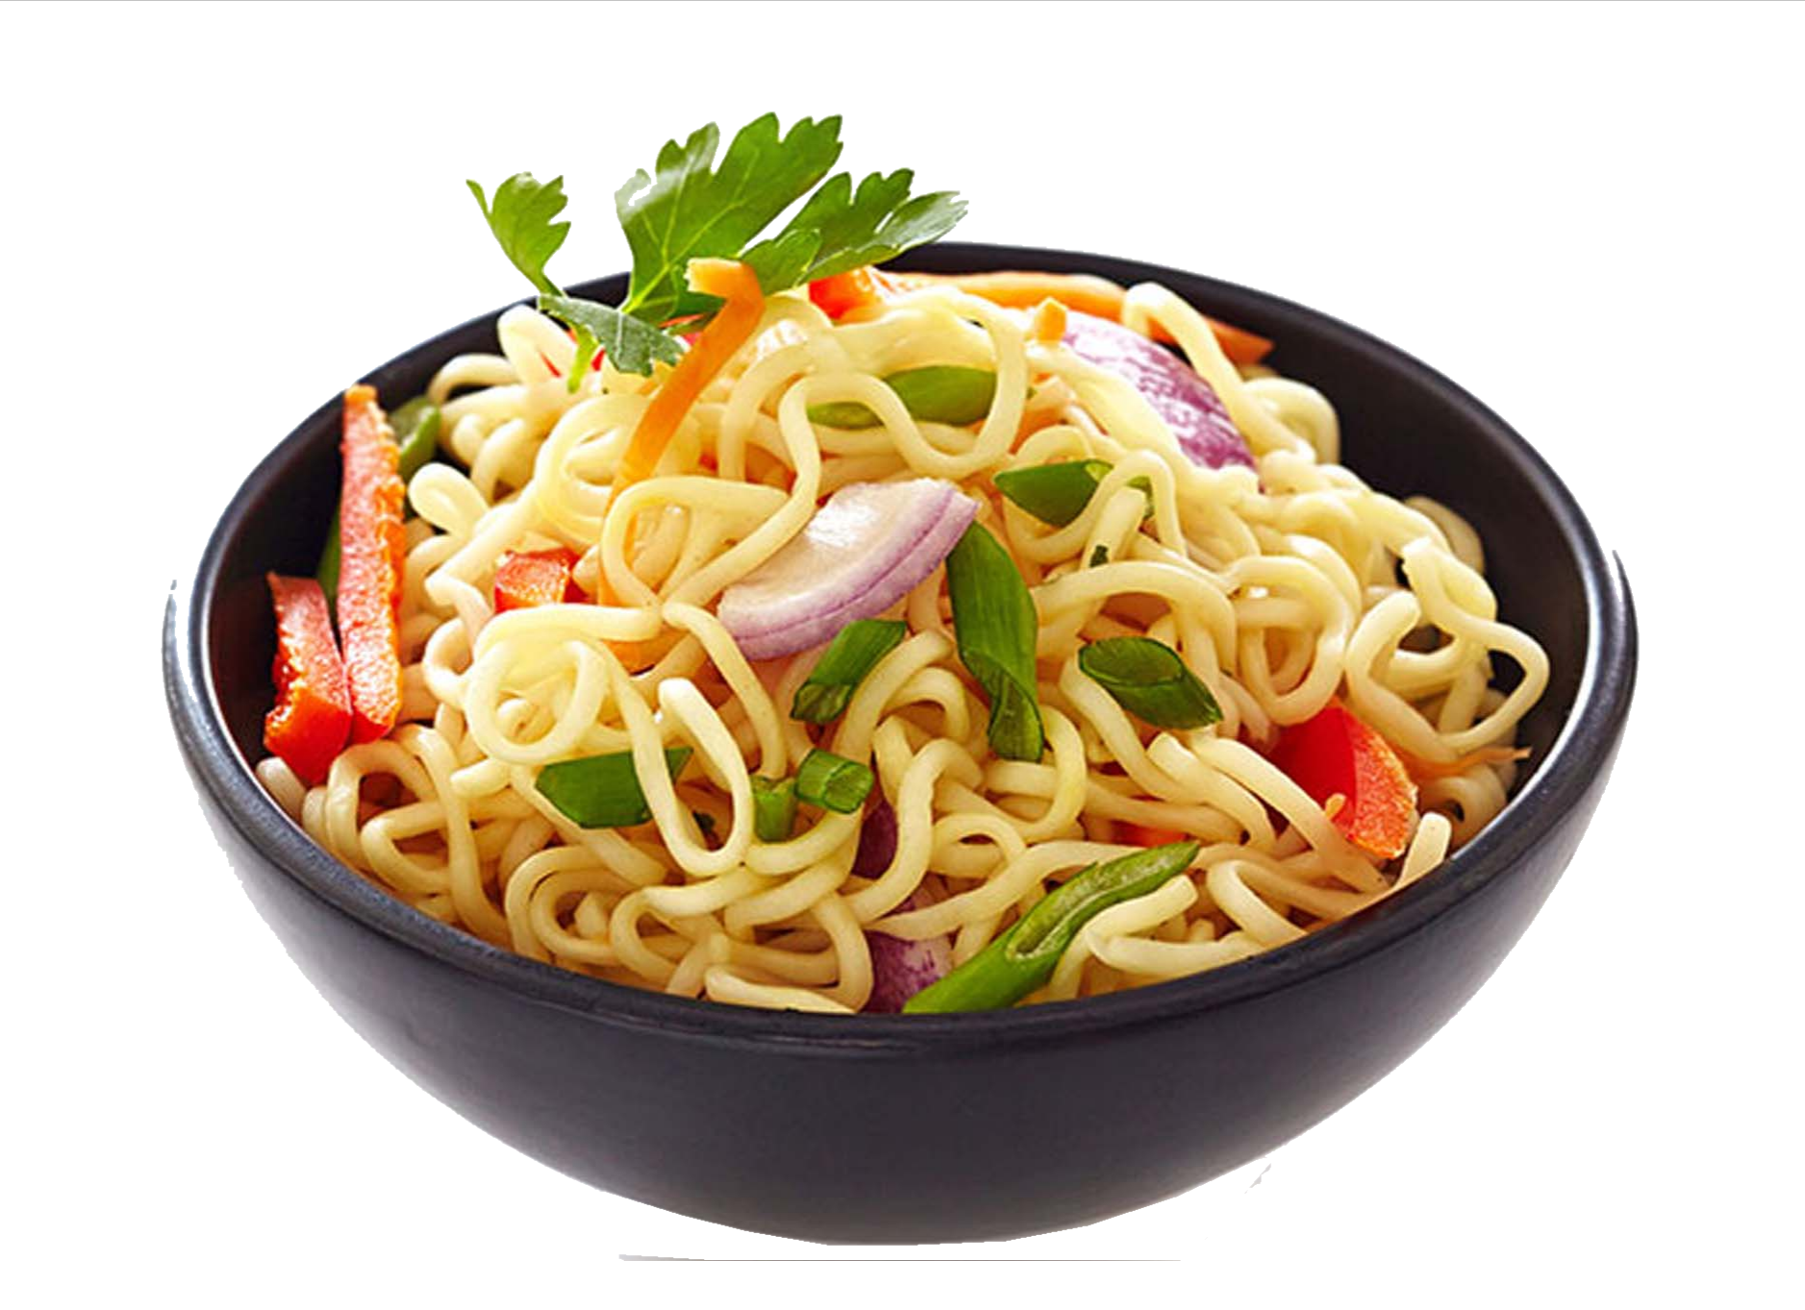
This Photo by Unknown Author is licensed under CC BY-SA
This Photo by Unknown Author is licensed under CC BY-NC

Slide 48
This Photo by Unknown Author is licensed under CC BY-SA-NC

Slide 49
This Photo by Unknown Author is licensed under CC BY

Slide 50
This Photo by Unknown Author is licensed under CC BY-SA
This Photo by Unknown Author is licensed under CC BY-SA-NC
This Photo by Unknown Author is licensed under CC BY
This Photo by Unknown Author is licensed under CC BY-NC-ND

Slide 51
EAT FRESH, UNPROCESSED FOODS
(NO LABELS NEEDED)
This Photo by Unknown Author is licensed under CC BY

