Slide 1

Mission
Supporting Undocumented Students
Dream Center Resources and Services
Conference for Immigrants and Allies
Sequoia High School – February 28, 2020

Slide 2
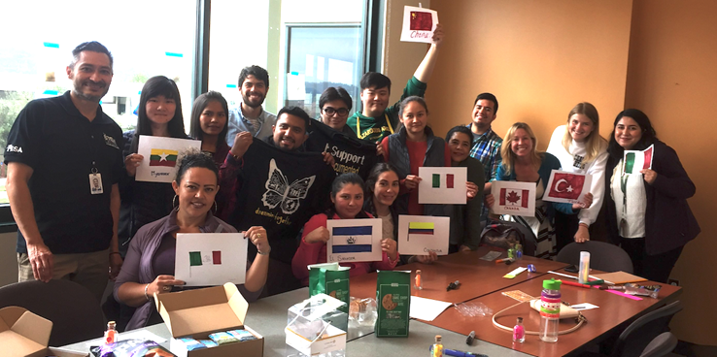
Why Are We Here?

Slide 3
Do You Know?
Can I Renew my DACA Application?
How does AB540 form support Undocumented Students?
What is the CA DREAM Act application and when is it due?
Are there scholarship available for Undocumented Students?
What is the process for undocumented students to apply for college?

Slide 4
The Cañada College Dream Center
  The DREAM Center is a resource center & safe space for
  undocumented students, community members & allies.
    Location: Building 9, Room 219B
    Hours: 8:30 am – 4:30 pm, Monday - Friday
  Services include:
  resources and services– SparkPoint, Financial Aid, Personal & Academic Counseling
  Confidential conversations
  Free legal clinic

Slide 5
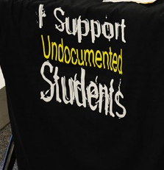
Dreamers Club
Events
On Campus Activites
Latinx Celebration
Undocumented Student Week of Action
Migration Celebration
Information Workshops

Slide 6
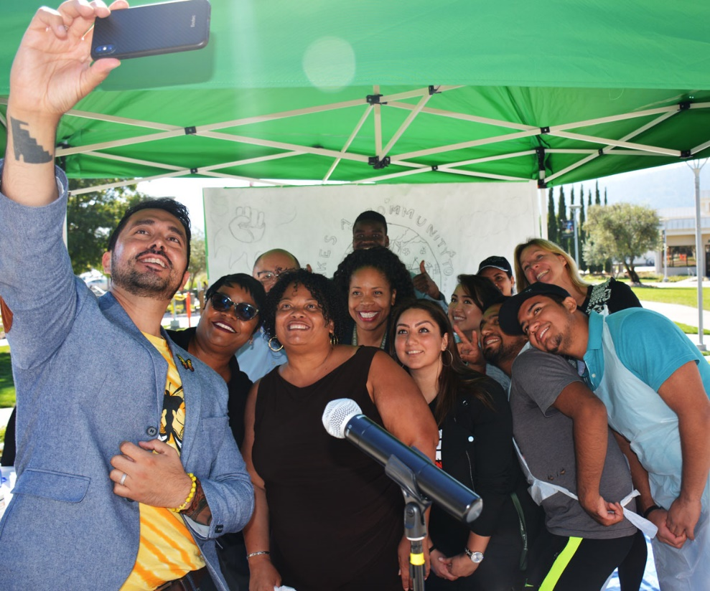
Cañada College Welcomes You
Undocumented Students have the Right to pursue higher education.
Cañada College is a Safe Haven.
We are here to help you succeed.
Your information is protected

Slide 7
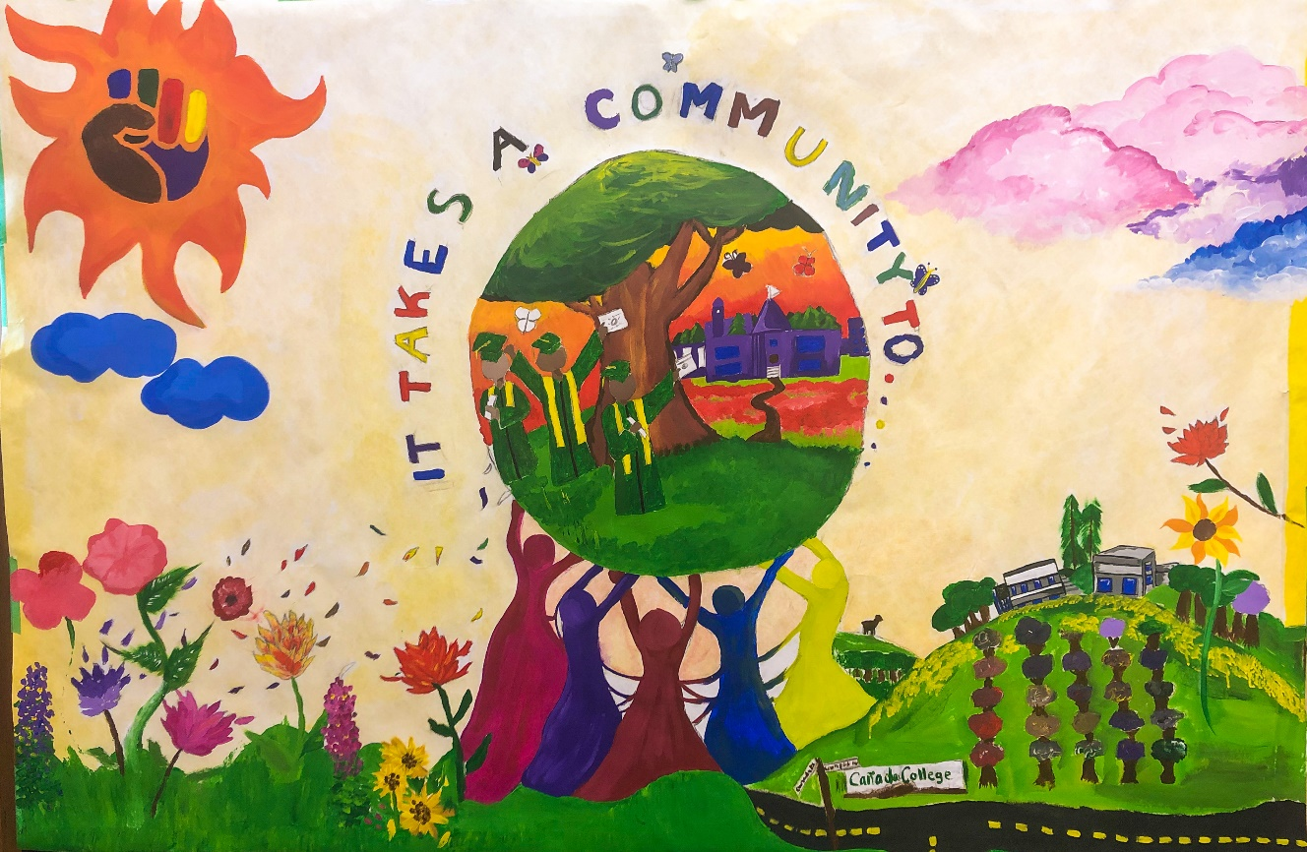
Deferred Action for Childhood Arrivals (DACA)
What is DACA?
Why was DACA in the news
on November 12, 2019?
Can I Apply or Renew?
What do I do if I have questions?

Slide 8
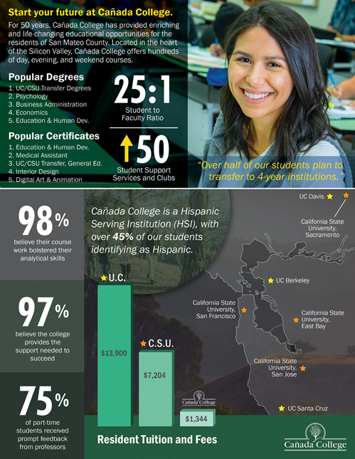
Cost- In State Tuition
$13,900 UC
$7,204 CSU
$1,344 CC

Slide 9


Paying for College
For US Citizens and Residents
http://fafsa.ed.gov
FAFSA: Free Application for Federal Student Aid
For DACA, AB 540 and undocumented students
https://dream.csac.ca.gov/
CADAA: California Dream Act Application
Waives Tuition Fees
Discounted Parking
Apply via WebSmart
Promise Grant

Slide 10


We’ve got your back and your Books
… and your college degree is FREE!
Eligibility
First-time college student with a high school diploma / equivalent
Complete the FAFSA or CA Dream Act Application
Be a full-time student (12+ units)

Slide 11
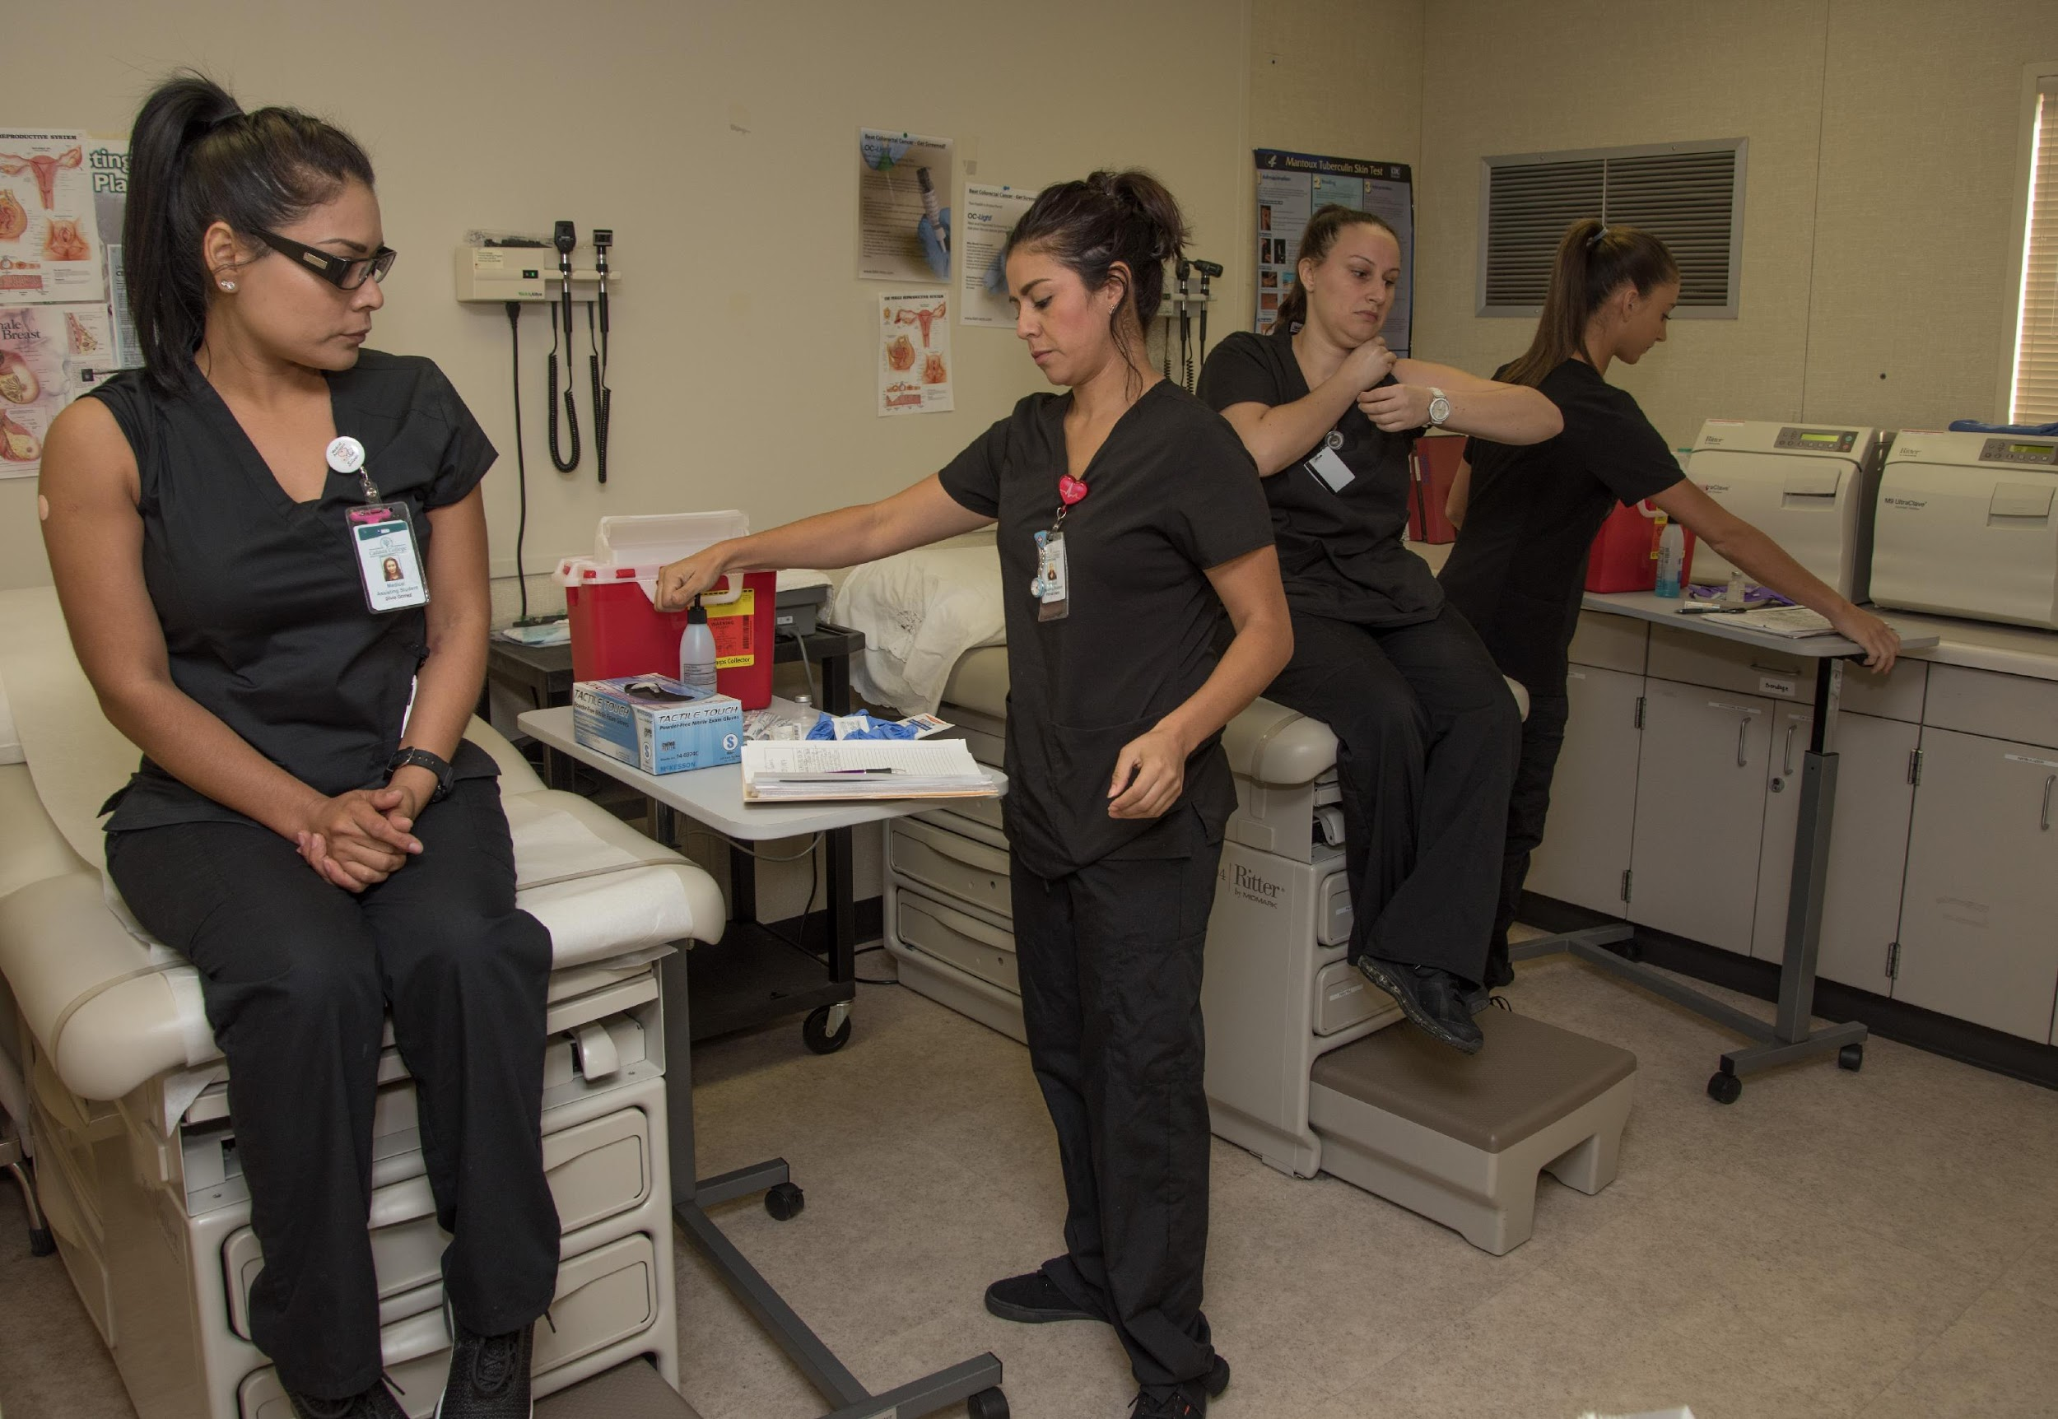
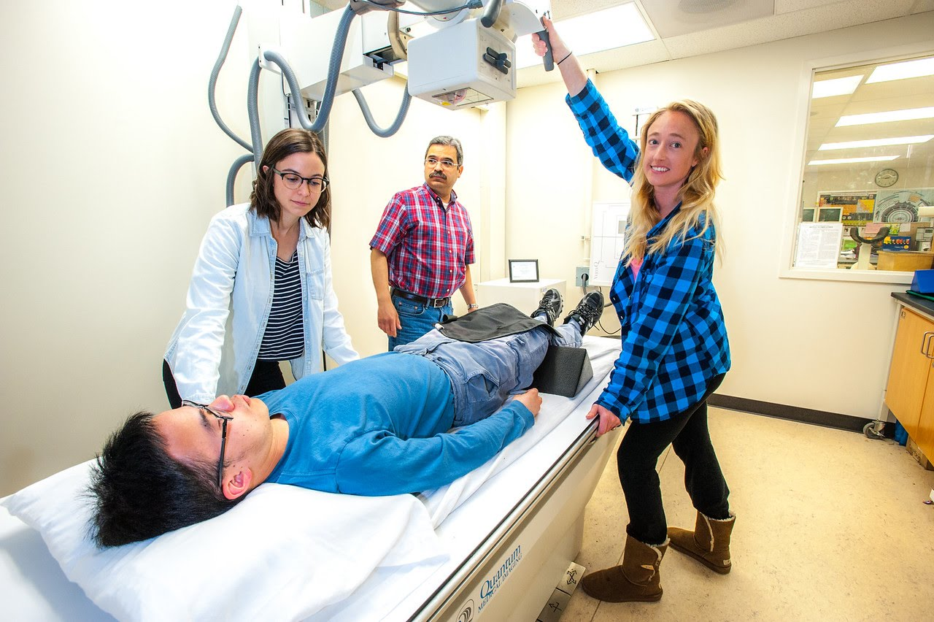
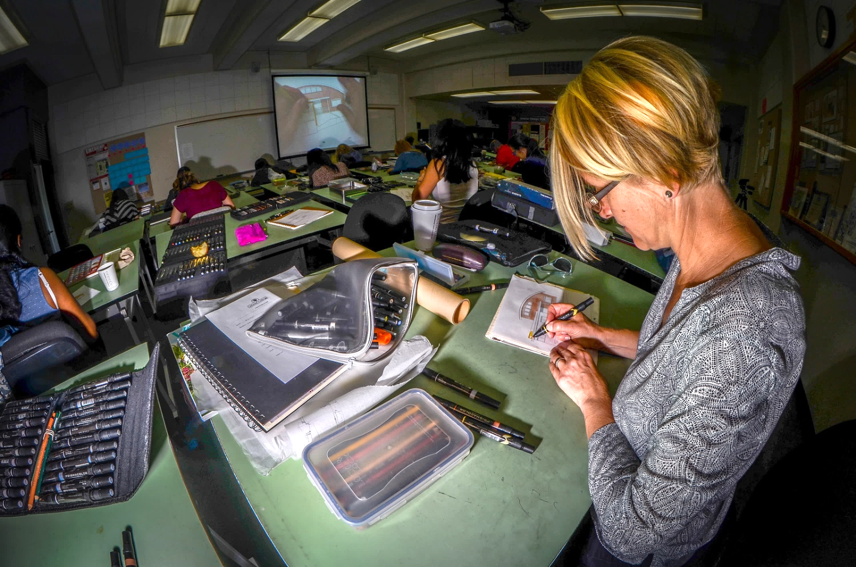
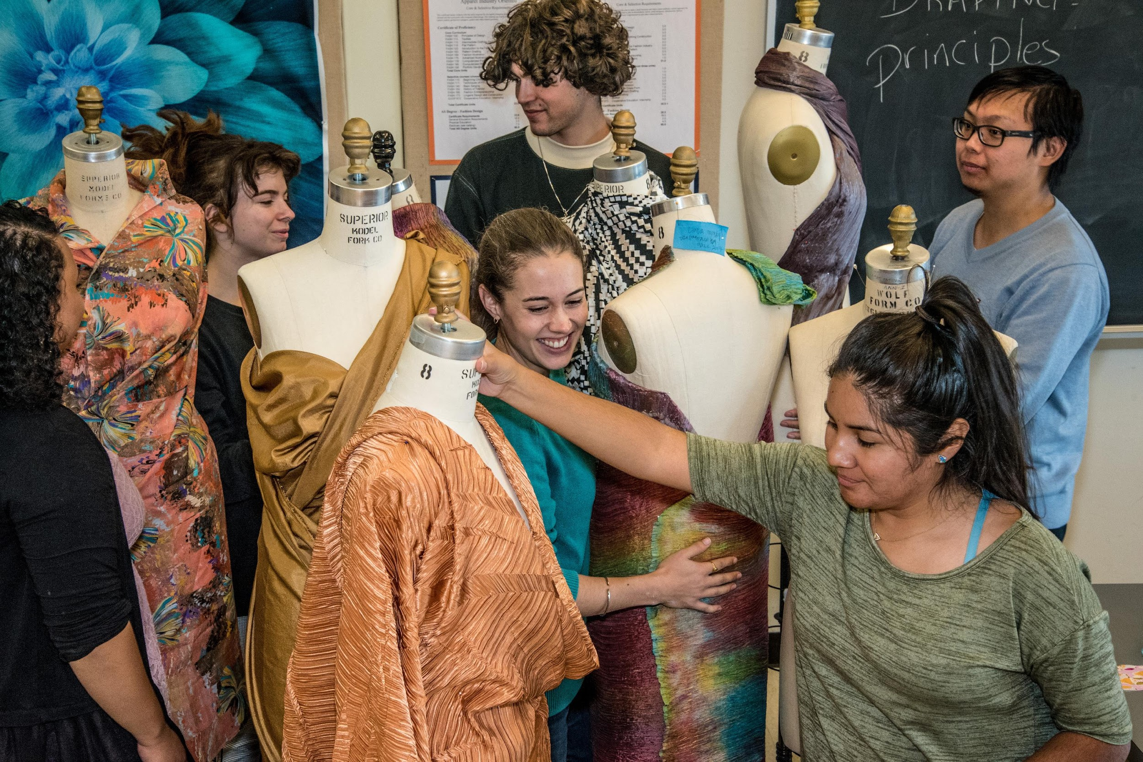
Career Educational Program
Radiology Tech
Business Administration
Digital Arts & Animation
Education & Human Development
Engineering
Fashion
Interior Design
Medical Assisting
Nursing

Slide 12
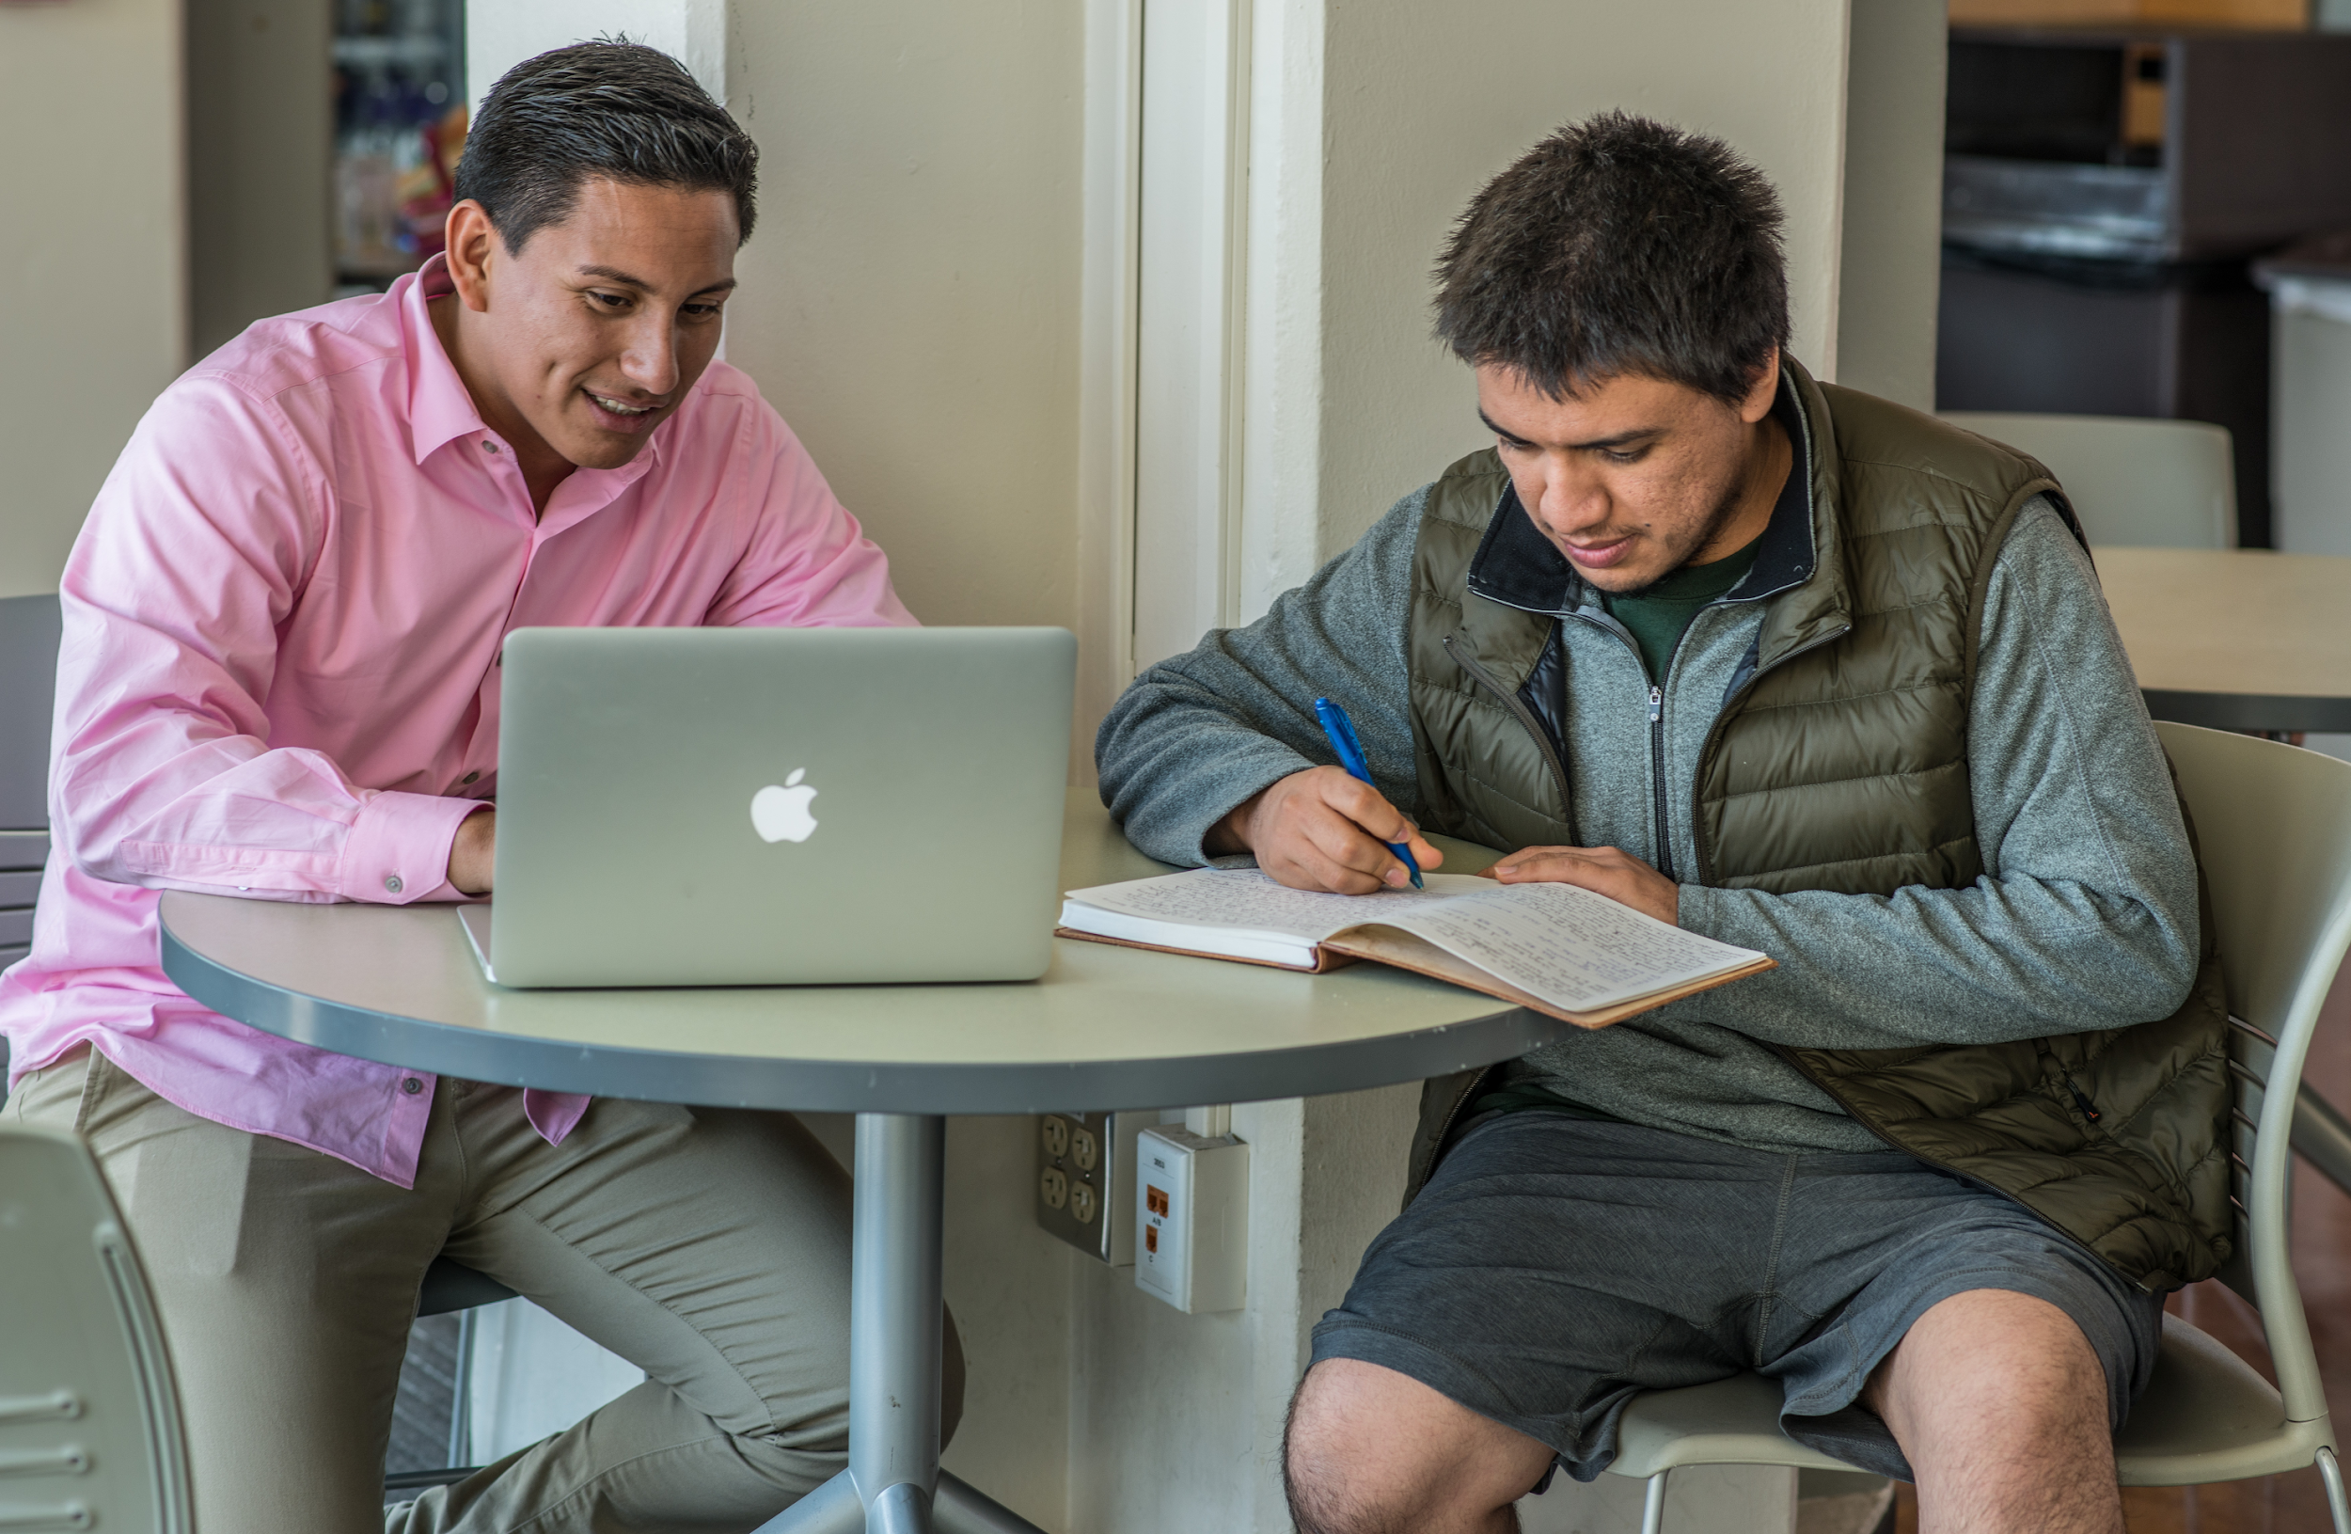
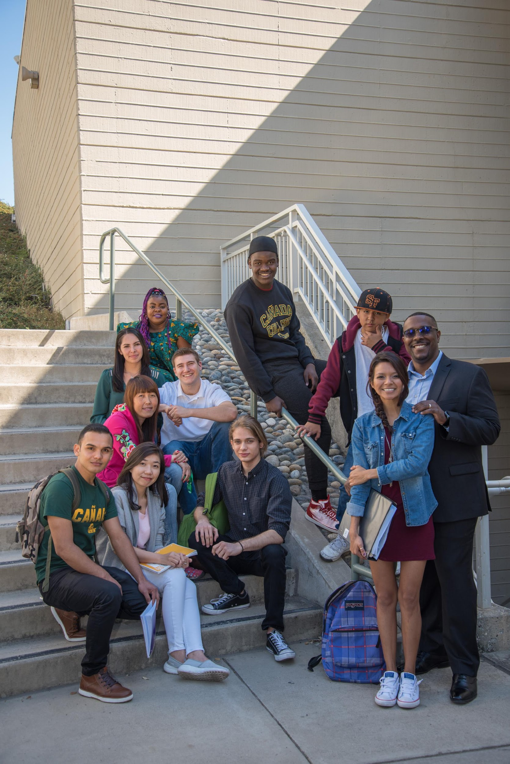

Student Support Programs
Disabled Students Programs &
Services (DSPS) / Disability Resource Center (DRC)
Extended Opportunity Programs &
Services (EOPS)
Transfer Admission Guarantee (TAG)
ESO Adelante
Learning Centers and Labs
Financial Aid/Scholarships
Health Services
Career Services
Admissions
Veterans
SparkPoint

Slide 13

How do I get started?
Online Application
Financial Aid- CA Dream Application
Submit “California Nonresident
Tuition Exemption form
Orientation
Counseling
Register

Slide 14
Thank you!
Saúl Miranda
Dream Center Program Services Coordinator
650-306-3466
mirandas@smccd.edu
Mayra Arrellano
College Recruiter
650-306-3166
arellanom@smccd.edu
canadacollege.edu/dreamers

