Slide 1
Adult-Education College and Career Educational Leadership
From the Coast to the Bay
Presenters:
Jenny Castello and Anniqua Rana
Cañada College
Lionel de Maine
Sequoia Adult School
October 5, 2016
Notes:
Anniqua

Slide 2
Overview
AEBG Context
CATs: Collaborative Action Teams
Cañada College & Sequoia Adult School
Cañada College & La Costa Adult School
Data
Concluding Activity
Notes:
Anniqua

Slide 3
AB 86 & AEBG
The 2015-2016 State Budget appropriated $500 million to the California Community College Chancellor’s Office (CCCCO) and the California Department of Education to allocate funding for adult education.
The funds will be provided to eligible consortia for the purpose of implementing regional plans for adult education.
The intent of the Adult Education Block Grant was to expand and improve the provision of adult education via these consortia.
Source: http://aebg.cccco.edu
Notes:
Anniqua

Slide 4
CATs: Collaborative Action Teams
Based on geography, ALLIES experience, and student transitions
Initiated by college administration and faculty visits to adult school
Strengthened professional relationships
Co-located classes to serve students
Scheduled student field trips to college
Notes:
Anniqua

Slide 5
CATs: Collaborative Action Teams
Steering Committee
Executive
Committee
Regional Vision and Coordination
Collaborative Action Teams - CATS
Coastside
North County
Central County
South County
Adult School and Community College Staff
Adult School and Community College Staff
Adult School and Community College Staff
Adult School and Community College Staff
Meet local needs
Notes:
Anniqua

Slide 6
Our Partners
Workforce Investment Board
Supportive Services
Employers
Jefferson Adult School
Skyline College
County Office of Education
Human Services Agency
Foundations
Cabrillo School District
Adult Learner Success
South San Francisco Adult
Faith-Based Orgs
Jail Education Services
Cañada College
San Mateo Adult School
Sequoia Adult School
College of San Mateo
Economic Development
Community Based Orgs

Slide 7
Sequoia Adult School: Overview
Founded 1921 to serve seven cities
2000 students a year take classes
Long history of collaborating with Cañada
Co-located ESL classes
ESL Transition Advisor since 2010
About 130 students a year transition
Notes:
Lionel

Slide 8
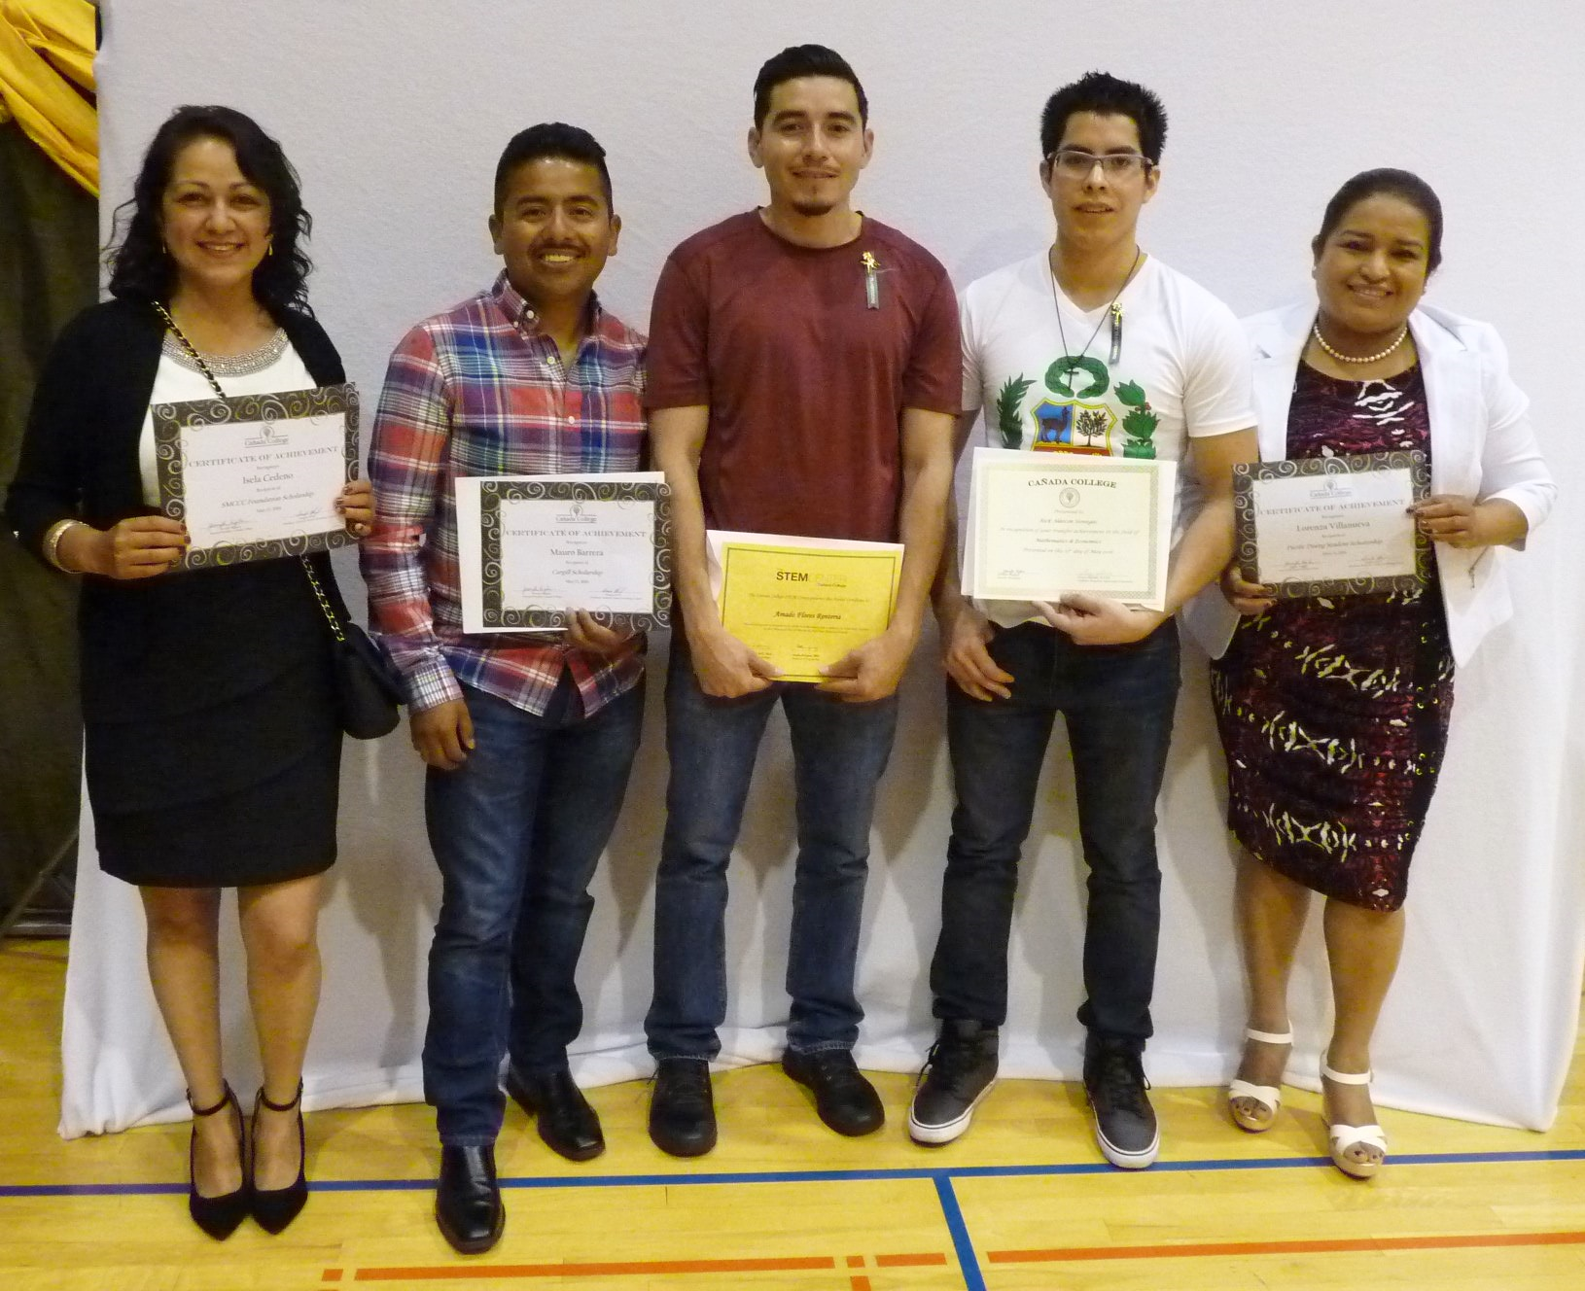
Sequoia Adult School: Outcome of Collaboration
Eleven Sequoia alumnae received scholarships at the 2016 CañadaCollege Awards Ceremony
Notes:
Lionel
Two of the students honored received National Science Foundation Scholarships, an award given for academically talented students in the STEM program transferring to 4-year colleges
One received the Hamilton Award for Excellence in STEM, a $1000 scholarship given to an outstanding student transferring to a 4-year college
Mauro Barrera, awarded the Cargill Scholarship for students who demonstrate a sincere desire to attend college, to Brenda Canchola, awarded the Dale & Helen Mersereau Scholarship for academic merit, to Silvia Gurrola, winner of the Atkinson Foundation Scholarship, to Erika Velazquez for receiving the Gus Pagels Scholarship for a student in the English Institute who has demonstrated academic merit and to Lorenza Villanueva, awarded the Pacific Dining Scholarship for students interested in majoring in business and who have a GPA of 3.0 or above. Katherine Ramirez received the Kruttschnitt Aspire Scholarship Program award, given to academically promising students planning to continue to a 4-year college. Jose Quinteros and Isela Cadeno won San Mateo Community Colleges Foundation Scholarships, given to students who have demonstrated a strong desire to attend college.

Slide 9
Sequoia Adult School: Mission
Provide quality programs in which students develop the skills needed to enter college, job training and careers, succeed in school and support their children’s education, and contribute to vibrant and healthy communities.
Congruent with AEBG intent and direction
Notes:
Lionel

Slide 10
Coding/Web Developer Pathway
BA/BS Degree
Computer Science
Employment
Associate Degree for Transfer:
Computer Science
Employment
Cañada College
Computer Science Certificates
Java Certificate
C++ Certificate
Swift Certificate
Employment
Job Train Certificate
ICT/Coding
Introduction to Computer Science
Employment
Sequoia Adult School Pre-coding
Career Exploration, Introduction to coding
Employment
Sequoia Adult School Foundation Skills
Assessment, Basic Skills, Computers
GED/High School Diploma
Employment

Slide 11
Data: GED Pilot
Notes:
Lionel

Slide 12
La Costa Adult School: Overview
Established by Cabrillo & La Honda / Pescadero Unified School Districts, Cañada College, & Puente de la Costa Sur
Serves adult learners on the South San Mateo County Coast
Notes:
Jenny

Slide 13
La Costa Adult School: Mission
Our mission is to support the education of students through all stages of adult life, to facilitate transition to college, to enhance workplace success, and encourage students to contribute to the community.
Congruent with AEBG intent and direction
Notes:
Jenny

Slide 14
La Costa Adult School: ESL Pathway
CTE PROGRAMS
SMCCCD
Connections to CTE, including short-term
Alignment of classes
Integration of ESL with math, computer literacy, and career exploration
COLLEGE ESL
Cañada College
ENTRY LEVELS ESL
Cabrillo District Adult School
Puente de la Costa Sur
SPANISH LANGUAGE LITERACY
Cabrillo District Adult School
Puente de la Costa Sur
Notes:
Jenny Initiating programs

Slide 15
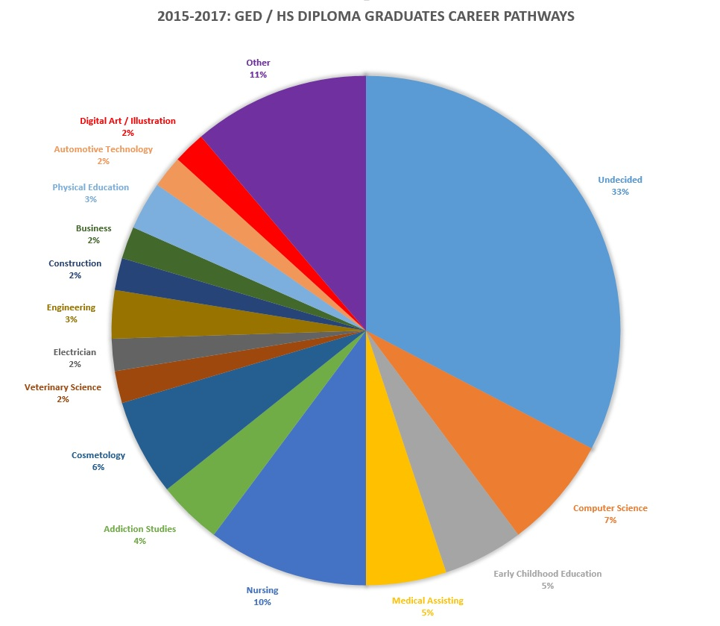
Data: Adult HSE/HSD Transitions
Notes:
Audience input

Slide 16
Data: ESL Transitions to Cañada College Spring 2016
Notes:
Audience:
Former and current Adult Ed students – as well as ESL

Slide 17
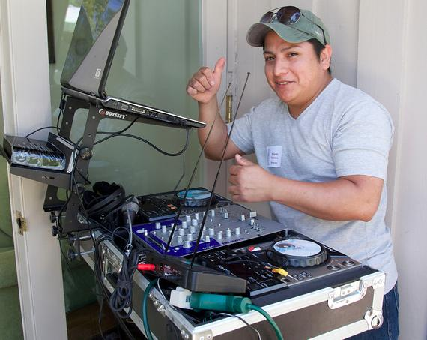
Miguel Ventura
-------------------------------------------------------------------------------------------------------------------- Miguel Ventura first learned the DJ business when he was 14 and looking for a job in San Salvador, where he lived. A friend suggested he park cars at a local club. One thing led to another and Miguel soon was helping the resident DJ run the show. Now, more than 20 years later, Miguel has his own DJ business. After arriving in the US, Miguel borrowed money from friends to purchase sound equipment. He also enrolled in ESL classes, first at Sequoia Adult School and then at Cañada College. In addition to paying for his books, SASS provided Miguel with a computer, freeing him from having to go to the library to complete homework assignments. Up until recently, most customers for Miguel's DJ services were Latinos. But that's changing. "Now I know English and I can work with the American people," Miguel says.
Miguel Ventura
Notes:
Jenny: Miguel Ventura first learned the DJ business when he was 14 and looking for a job in San Salvador, where he lived. A friend suggested he park cars at a local club. One thing led to another and Miguel soon was helping the resident DJ run the show. Now, more than 20 years later, Miguel has his own DJ business.
After arriving in the US, Miguel borrowed money from friends to purchase sound equipment. He also enrolled in ESL classes, first at Sequoia Adult School and then at Cañada College. In addition to paying for his books, SASS provided Miguel with a computer, freeing him from having to go to the library to complete homework assignments.
Up until recently, most customers for Miguel's DJ services were Latinos. But that's changing. "Now I know English and I can work with the American people," Miguel says.

Slide 18
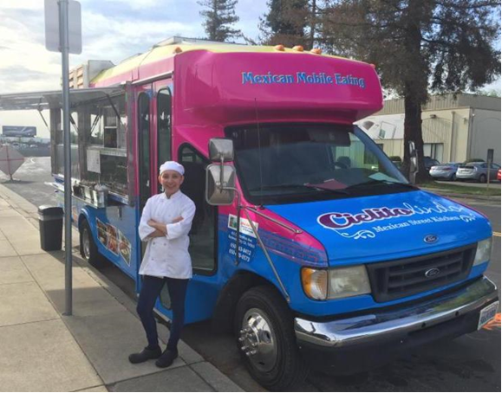
Carmina Ortuño
Notes:
Lionel
Confronted with skyrocketing rents and stagnant wages -- and emboldened by their ability to communicate in English -- SASS recipients are starting their own businesses, while still staying in college.
Before coming to the United States, SASS recipient Carmina Ortuño owned a small restaurant in Acapulco. Wanting to capitalize on her passion for cooking, she has opened a food truck in San Jose specializing in traditional Mexican fare like chili verde, chicken tinga, and barbacoa. A company called FoodTruckEmpire provided her with the know-how she needed to get started. Thanks to her SASS scholarship, Carmina could afford to attend Cañada College to gain the English skills she needed to embark on this endeavor.
In addition to working 12-hour days preparing and selling food for her truck, Carmina now has a catering business, a result of satisfied food truck customers asking her to prepare food for private parties. Carmina's goal is to get an Associate degree in business from Cañada College and help other people open their own food trucks.

Slide 19
Key Takeaways
Initiate purposeful meetings.
Discuss data to identify implications.
Align and coordinate pathways based on students’ needs and goals.
Be flexible.
Notes:
Lionel

Slide 20
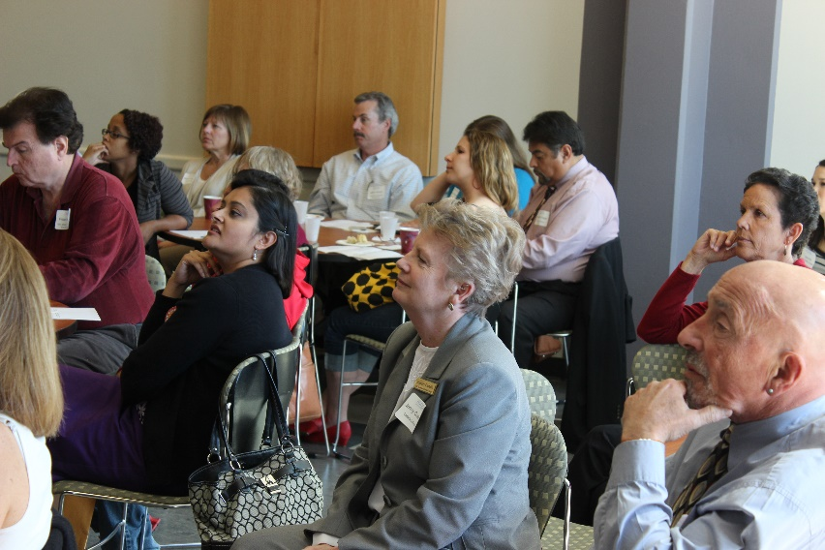
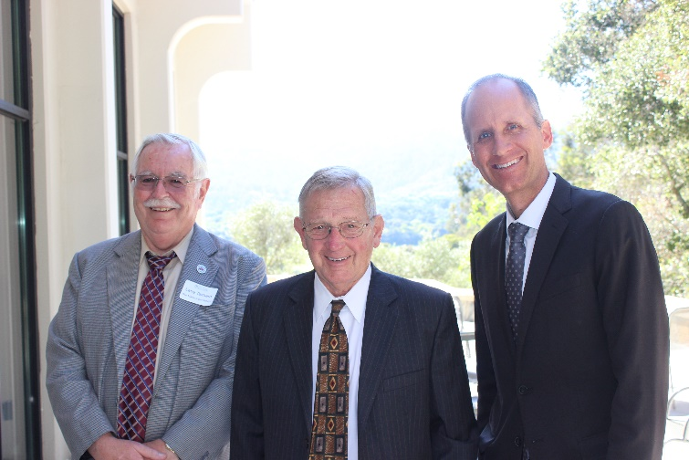
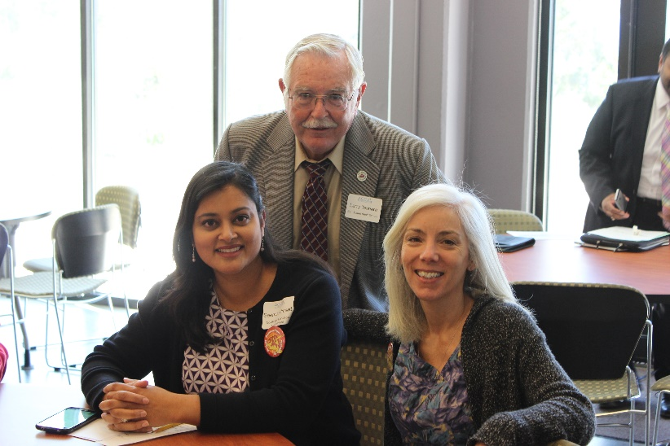
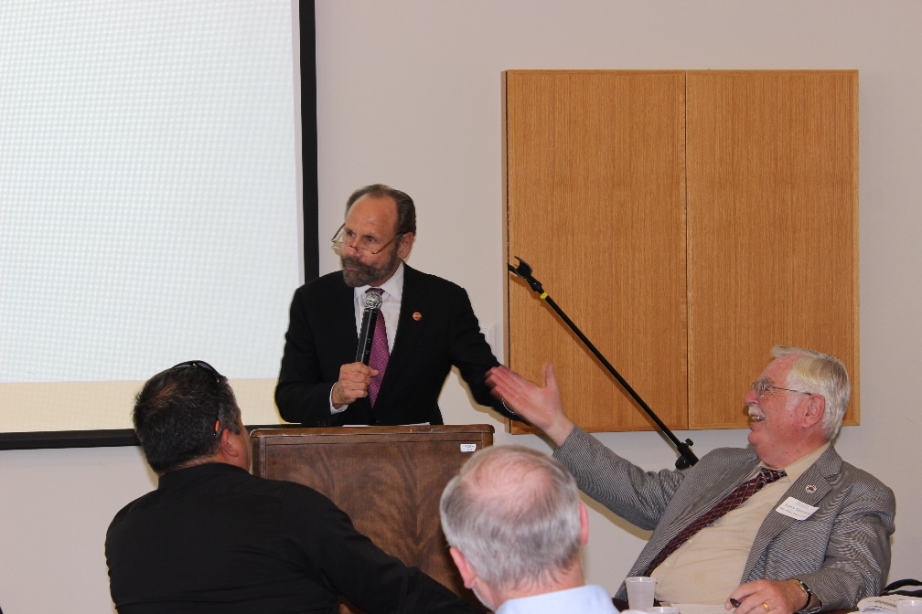
Questions?
Notes:
GREGORY

Slide 21
Thank You
Jenny Castello: castello@smccd.edu
ESL Coordinator & Faculty, Cañada College
Anniqua Rana: rana@smccd.edu
Dean of Athletics, Library & Learning Resources, Cañada College
Lionel de Maine: ldemaine@seq.org
Director, Sequoia Adult School

