Slide 1
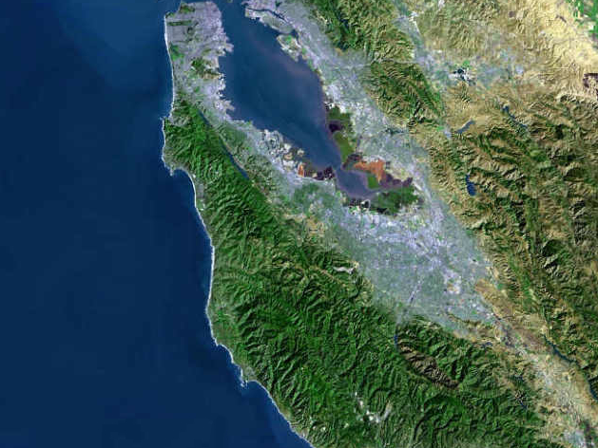

Adult College and Career Education Leadership
Creating Pathways to Success for Adult Learners
ACCEL Retreat
August 26 2016

Slide 2
Overview
Our outcomes today will be:
Snapshot of 2016-17 organization and plan
Getting to know each other
Clarifying team roles
Reviewing initial landscaping data

Slide 3
Agenda Review
9:00 I. Welcome and Introduction
9:20 II. Getting to Know the ACCEL Team: Staff and Steering Committee
10:30 Break
10:45 III. Roles and Landscaping Presentation
11:55 IV. Summary and Next Steps
12:00 Lunch

Slide 4
ACCEL’s Draft Vision
ACCEL supports San Mateo County’s adult learners achieving educational success, attaining economic self-sufficiency and contributing to communities.
Notes:
GREGORY

Slide 5
2016-17 Implementation Strategy
Strategy | ACCEL Implementation Strategy | Team Coordination
Bridge Prep | Implement shared TIF framework locally Reflect and evaluate at end of fall term Develop a plan for Spring 2017 | Adult School Directors
Bridge 1 | CAT navigators meet with their local team to understand roles and current Bridge 1 efforts Meet with navigators to review background landscaping and 16-17 plan Formalize Bridge I Framework and resource list Workshop (September): Refined framework and 16-17 plan. Develop local CAT implementation plan Meet periodically for information exchange and updates | Navigators
Bridge 2 | Identify pathways for development during 2016-17 Identify CTE faculty, potential community or agency partners (request commitment to participate) Review pathway and bridge models and resources Participate in Leading from the Middle process | Coordinators and Navigators

Slide 6

ACCEL Organization
Steering Committee
Collaborative Action Teams (CATS)
Coastside
North County
Central County
South County
Adult School and Community College Staff
Adult School and Community College Staff
Adult School and Community College Staff
Adult School and Community College Staff
ACCEL Staff Coordination Team
Navigators
Executive Director
Coordinators
Notes:
GREGORY

Slide 7

CATS Organization
Students
Navigator Role
Student goal setting
Support transitions
Address barriers
Connect to services
Monitor student progress
Outreach
CAT Collaboration Team
Co-Facilitator Role
Content expertise
Liaison to adult school and community college faculty
Participate in pilots
“Represent ACCEL
Navigator
Adult School
Co-Facilitator
Community College
Co-Facilitator
Coordinator
Coordinator Role
Program development
Team coordination
Stakeholder engagement
Student Data
Schedule Coordination
CATS Administrator Support Team
Adult School
Director
Community College Dean
ACCEL Leadership
Executive Director, Project Directors, Project Coordination Team, Steering Committee

Slide 8
Meeting Schedule

Slide 9
Questions and Discussion

Slide 10
Getting to Know the ACCEL Team

