Slide 1
Academic Senate Study Session 11/12/15

Slide 2
Outcomes of Today’s Session
See a broad overview of enrollment management
Revisit the steps in enrollment management at our college
Revisit the college’s documentation of enrollment decision-making
Examine pertinent information regarding enrollment trends
Explore connection between resource allocation and enrollment
Engage in a discussion around how to improve processes going forward

Slide 3
What is Enrollment Management?
It is not…
Just a quick fix to your current enrollment problems
Just an enhanced admission or marketing operation
Just an explanation for enrollment-related decisions (class cancellations, etc.)
Just a planning document that “sits on a shelf”

Slide 4
What is Enrollment Management?
It is…
An institutional commitment and an integral part of strategic planning
A clear articulation of institutional enrollment goals (well beyond sheer numbers)
A plan that aligns services and resources under the umbrella of a larger vision
A data-driven strategy
A living plan that is constantly changing as institutional needs change

Slide 5
A Glance at Declining Enrollment
 |  |  |  | SECTIONS
Row Labels | WSCH | FTEF | FTES | CENSUS ENR. | ACTIVE ENR. |  | LOAD |  | HEADCOUNT | TOTAL UNITS
FALL 2010 | 67,265.30 | 106.12 | 2,242.176 | 17,234 | 589 |  | 634 |  | 7,380 | 48,726
FALL 2011 | 64,210.93 | 116.32 | 2,140.365 | 17,573 | 643 |  | 552 |  | 7,248 | 48,513
FALL 2012 | 59,838.94 | 118.14 | 1,994.631 | 16,924 | 645 |  | 507 |  | 6,926 | 47,628
FALL 2013 | 57,037.48 | 115.73 | 1,901.249 | 16,071 | 637 |  | 493 |  | 6,826 | 46,035
FALL 2014 | 54,183.59 | 109.48 | 1,806.119 | 15,673 | 583 |  | 495 |  | 6,999 | 45,854
FALL 2015 | 54,368.54 | 113.24 | 1,812.285 | 14,886 | 605 |  | 480 |  | 6,990 | 46,718
Fall 2015 Data as of 11/5/15

Slide 6
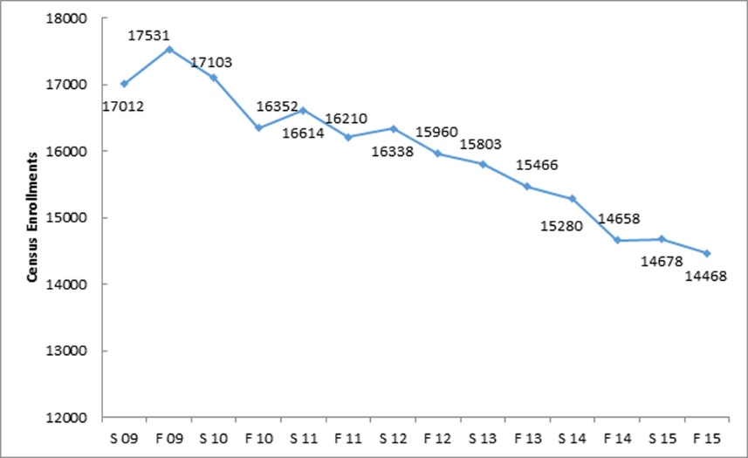
A Glance at Declining Enrollment
*Fall 2015 Data as of 11/5/15

Slide 7
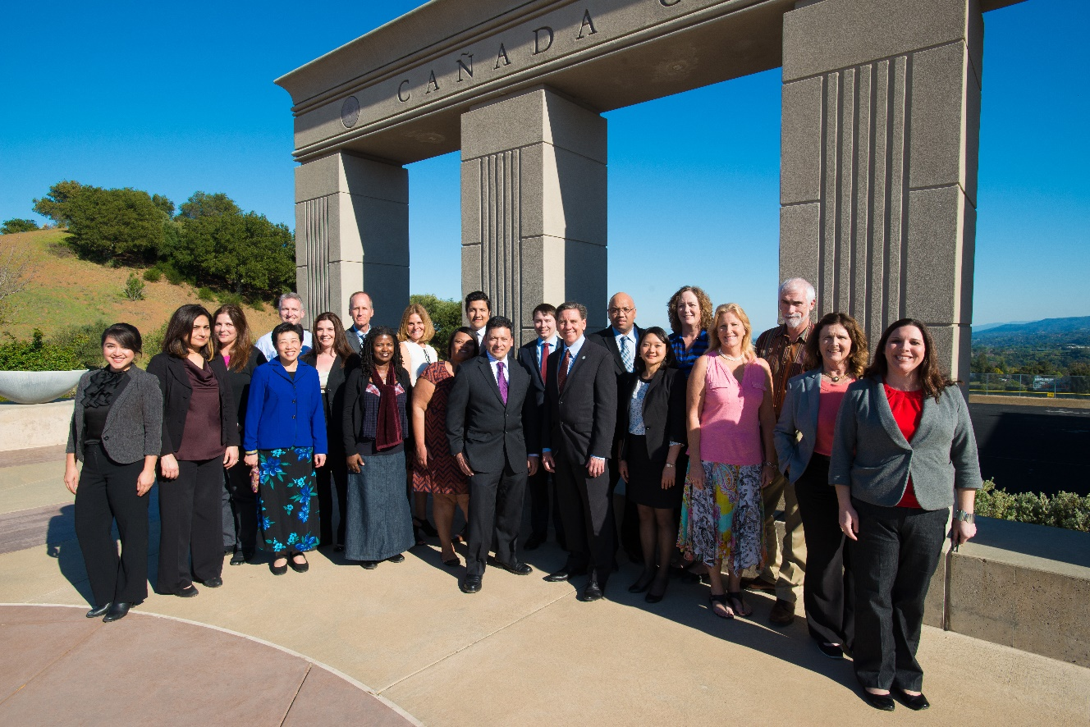
Everyone Should be Involved
At the operational planning level—Key Administrators and their Management Teams:
Chief Instructional Officer
Chief Student Services Officer
Chief Business Officer
Faculty Leaders
Office of Instruction Classified Staff
Dean of PRIE
Marketing/Public Information Office

Slide 8
Empowering Faculty, Providing Voice
CCR Title 5 (Division 6)
§ 53200. The Academic Senate is an organization “whose primary function is, as the representative of the faculty, to make recommendations to the administration of a college and the governing board of a district with respect to academic and professional matters.”

Slide 9
Information Needed…
Reliable historical enrollment, course offering, and budget data
Useful “what if” projection tools based upon these historical data
Ability to actively monitor progress so that timely adjustments can be made
Identification of key performance indicators
Identification of benchmarks

Slide 10
Schedule Planning: Meeting Student Need
Importance of good historical information regarding student demand patterns, such as:
History of course offering size and distribution
History of individual course offering experience/trends:
Courses with Largest Enrollments
High Enrollment/Demand Courses
Low Enrollment/Demand Courses
Course cancellations/additions during previous registration periods
Course Fill Rates

Slide 11
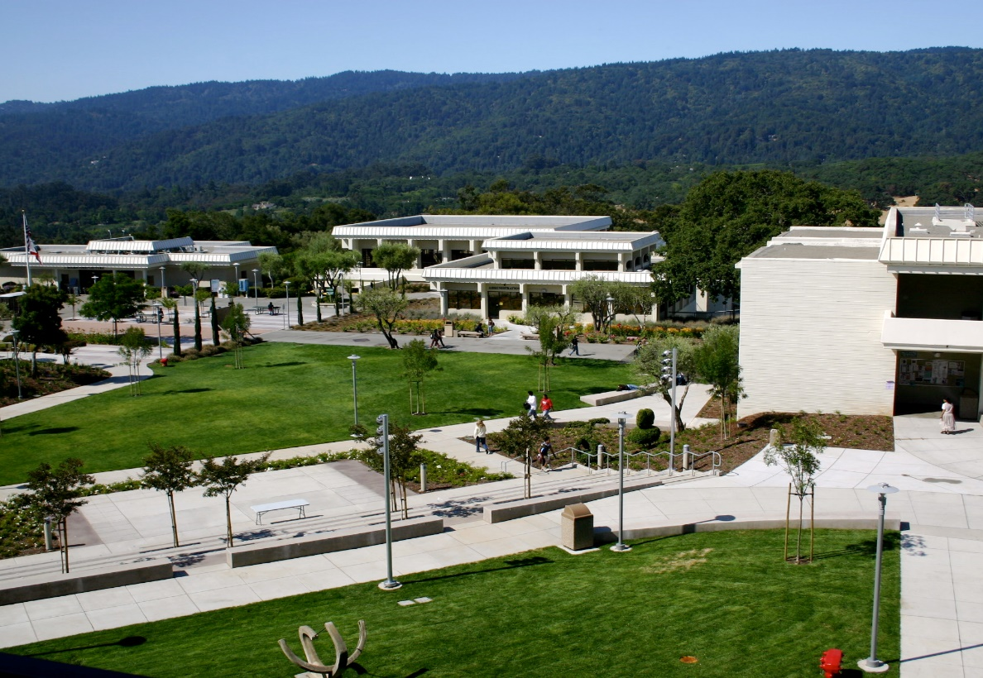
Schedule Planning: Meeting Student Need
Faculty Assignment and Load—Legal and Contractual issues
Full-Time Faculty:
Contract Load
Overload
Assignment Preference Provisions
Banking of Contract Load

Slide 12
Steps Involved in Scheduling & Monitoring
Pre-scheduling – long term community / student / industry / transfer demands
Scheduling – shared processes
Assigning – shared processes
Enrollment – real-time monitoring, communicating, modifying
Documentation

Slide 13
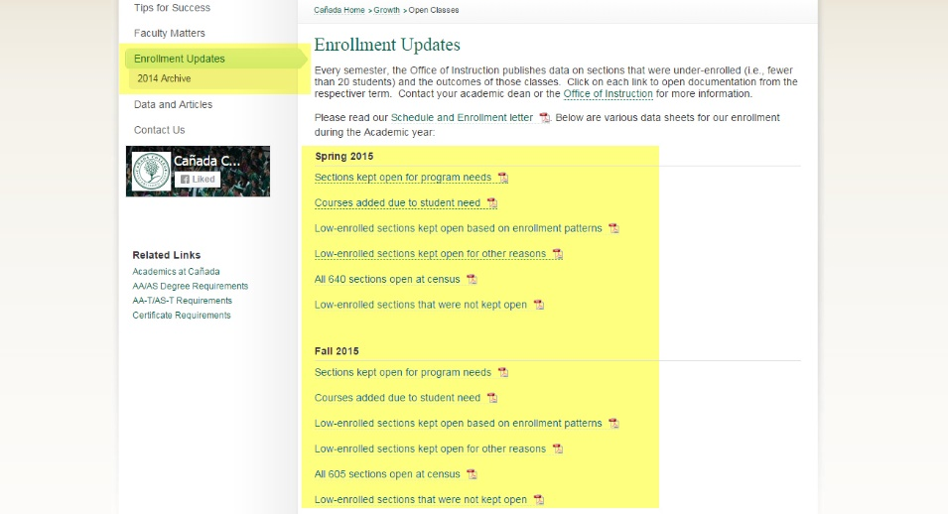
Transparency Documents

Slide 14
Growth and Engagement

Slide 15
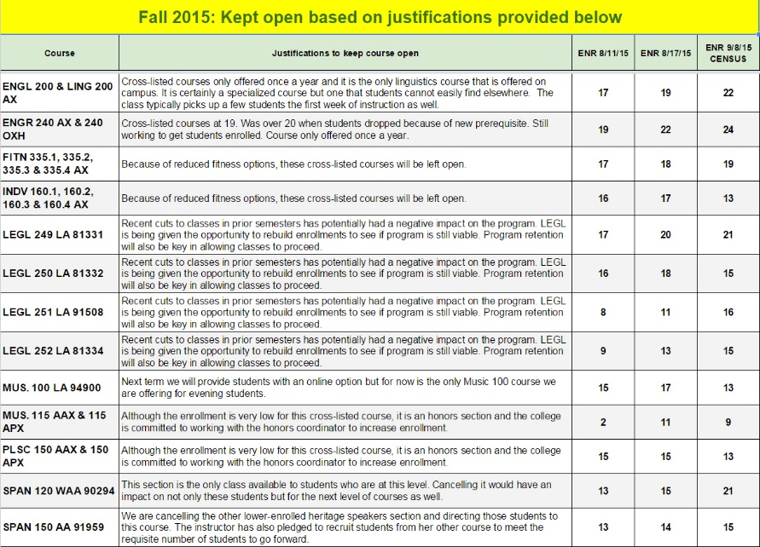
Under 20 Sections Kept Open: Spring 2015

Slide 16
How Does Load Impact Budget?
Load, productivity, and efficiency are often used interchangeably
Higher productivity means more students served per FTE
Lower productivity means fewer students are served per FTE
Type of class has to be considered in evaluating productivity
The state “standard” productivity level is 525
This number represents the break-even point for a course

Slide 17
Budget Based on Load
Load | Amount | Financial Impact
525 | $ 3,513,885 | $341,371
520 | $ 3,579,533 | $275,723
515 | $ 3,646,456 | $208,800
510 | $ 3,714,691 | $140,565
500 | $ 3,855,256 | -
490 | $ 4,001,558 | $146,302
480 | $ 4,153,956 | $298,700
475 | $ 4,232,561 | $377,305
470 | $ 4,312,838 | $457,582
465 | $ 4,394,842 | $539,586
State Standard
FY 2015/2016 Goal
Where we are Fall semester 2015

Slide 18
Being Community Supported is a Public Trust
Cost to Taxpayer
35 students/class
Load 525
$285/student
30 students/class
Load 500
$300/student
20 students/class
Load 300
$500/student
Notes:
Assume average cost of FTEF is $50,000/semester; serve 167 students/1.0 FTEF/semester (Load 500)

Slide 19
How is Productivity Improved?
Ways to improve:
Offering fewer sections (tightening the core schedule)
Get a strong sense of enrollment patterns, rates of return, and develop a base schedule that is specific to each discipline (and monitor every semester)
Increase the number of students in sections
Restructure of scheduling (curriculum/program offerings, times that sections are offered)
Working across departments to identify load targets that are appropriate and pedagogically sound
Things to avoid:
Rolling schedules and hoping course enrollment targets are met
Setting enrollment targets that are unrealistic for the type of course or discipline
Assuming things should be done across the board (ie, 5% less courses,
5% more enrollment)

Slide 20
Weekly Census Courses
GROWTH CALCULATOR
COURSE | Census Enr. |  | Lec. | Lab | TBAs |  | FTEF | WSCH | Load | FTES
ENGL 100 | 26 |  | 3.0 |  |  |  | 0.20 | 78 | 390 | 2.60
ENGL 100 | 26 |  | 3.0 |  | 1.0 |  | 0.20 | 104 | 520 | 3.47
ENGL 100 | 20 |  | 3.0 |  |  |  | 0.20 | 60 | 300 | 2.00
ENGL 100 | 20 |  | 3.0 |  | 1.0 |  | 0.20 | 80 | 400 | 2.67
HIST 100 | 45 |  | 3.0 |  |  |  | 0.20 | 135 | 675 | 4.50
HIST 100 | 35 |  | 3.0 |  |  |  | 0.20 | 105 | 525 | 3.50
HIST 100 | 30 |  | 3.0 |  |  |  | 0.20 | 90 | 450 | 3.00
HIST 100 | 20 |  | 3.0 |  |  |  | 0.20 | 60 | 300 | 2.00
1 FTES is 1 student taking 30 units Load = WSCH / FTEF

Slide 21
Discussion and Questions

